Slide 1
R Stats Bootcamp
Ed Harris

Slide 2


Slide 3
R Stats Bootcamp 01
“Setup & Intro”
https://rstats-bootcamp.github.io/website

Slide 4
Objectives
How the R Stats Bootcamp works
R motivation
Install R and RStudio or set up RStudio Cloud
RStudio components and setup
Workflow for scripts in R
Practice exercises

Slide 5
How the R Stats Bootcamp works
Practical, open instructional materials for learning R
Simple statistics in R
Reproducible research and collaboration tools
Self-guided learning and self-assessment
Friendly community

Slide 6
R motivation: why R?
R is objectively the best statistical software available
R is designed for people with no programming experience to perform sophisticated statistical analysis with minimum effort
In wide use at universities, companies: job demand
Very large community of users
Free and open source
Works well on all computers and OSes, old and new
R is easy to learn (as you will see)

Slide 7
Option for using R
Install R and R Studio locally
Help for Windows
Help for Macs
Other options
Posit Cloud
(limited free account)
Google colab

Slide 8
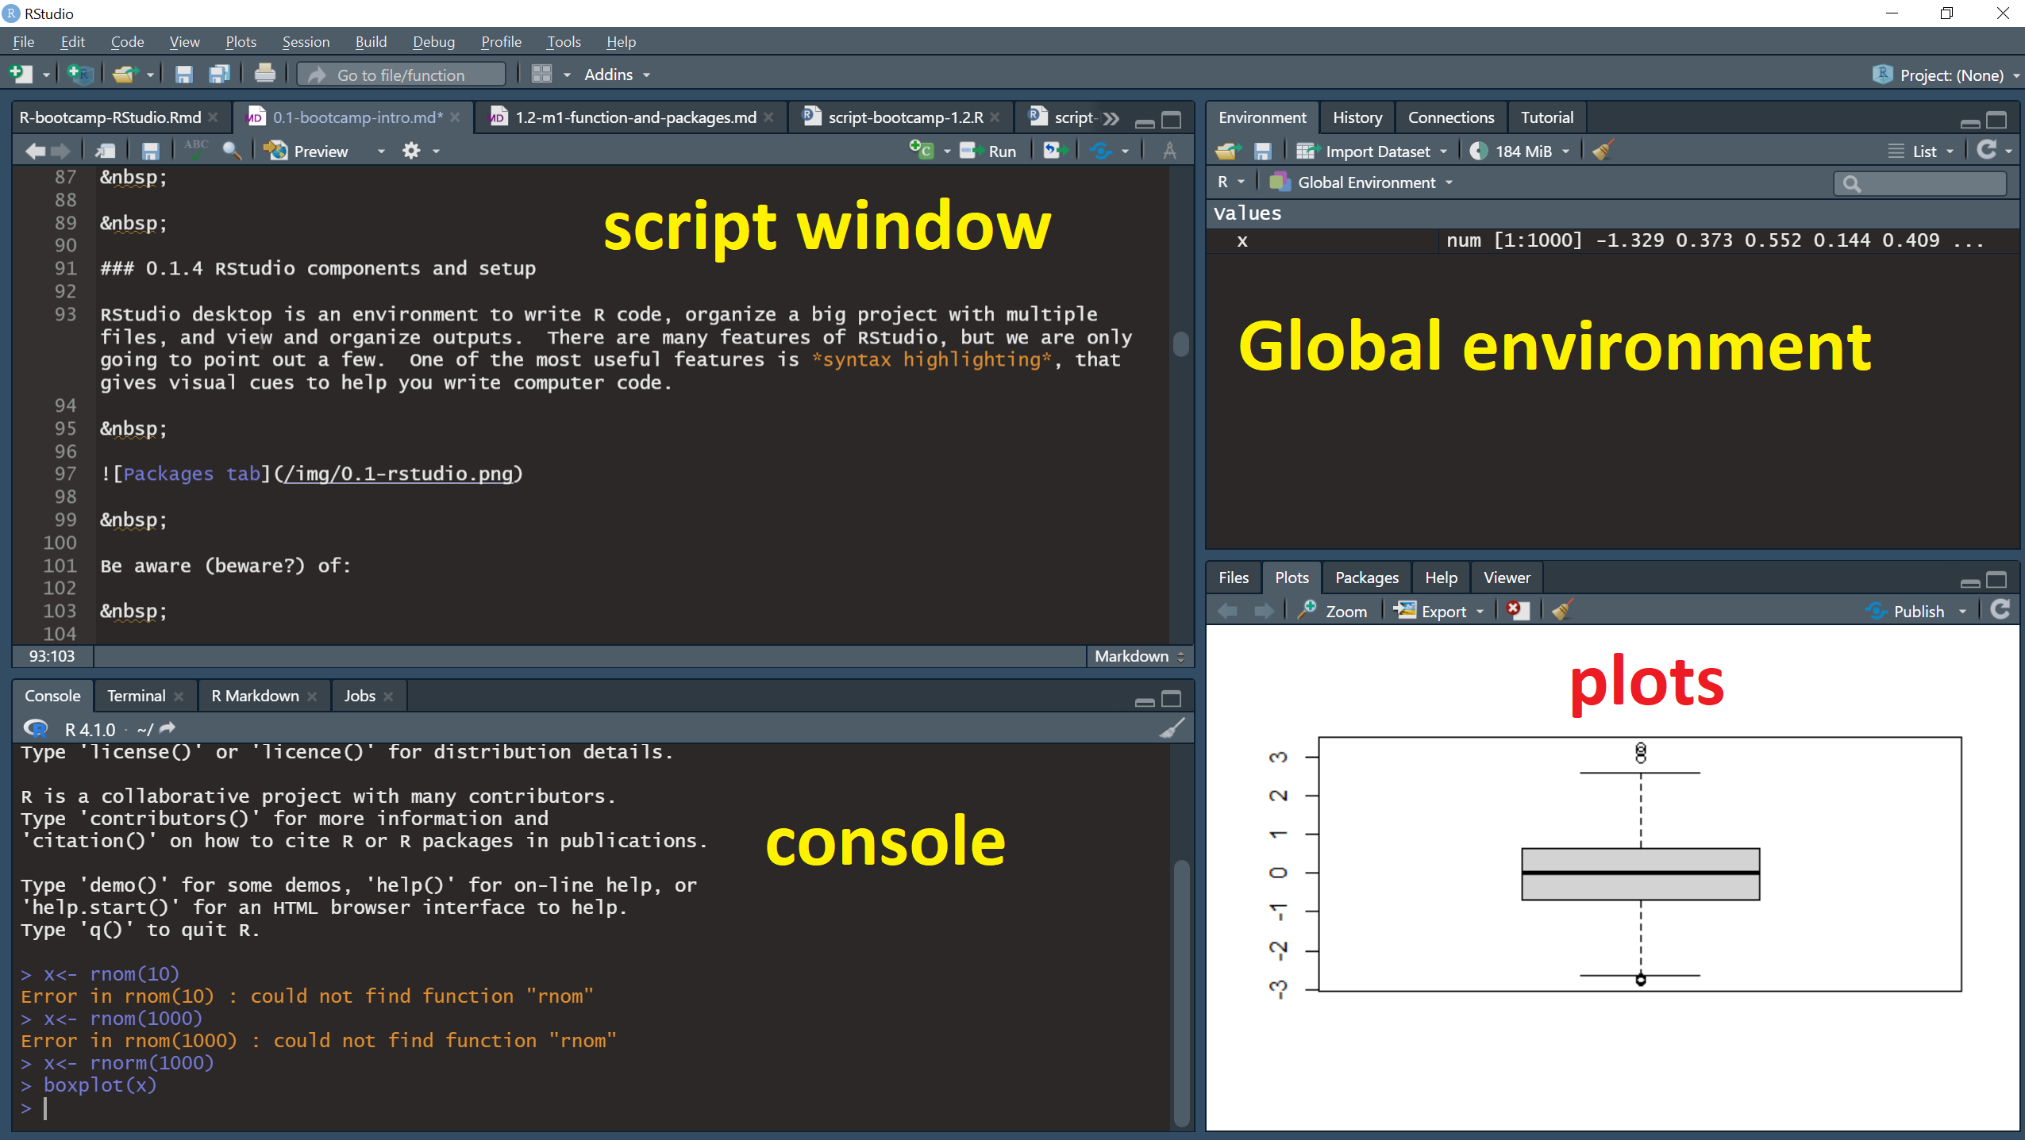
RStudio components and setup

Slide 9
Workflow for R scripts
An R script is a plain text file
Ends in “dot R” (.R) by default
Interface between your commands and R software
Documents your analysis
Interface between your commands and R software
Organized and logical, has meaning for other people

Slide 10
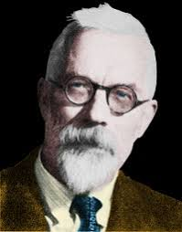
Workflow for R scripts
Your R script should be good enough to show a friend (like a supervisor, or even your future self), a friend you respect.

Slide 11
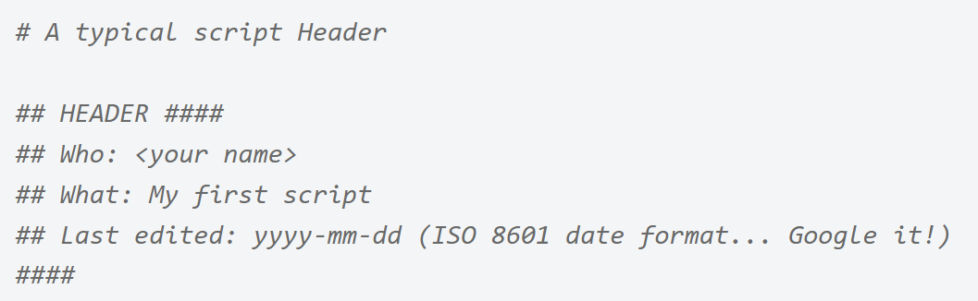
R script organisation

Slide 12
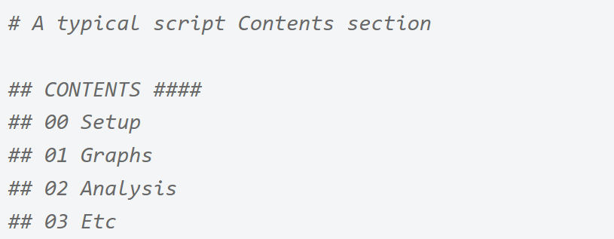
R script organisation

Slide 13
R script organisation
# 01 First line of a CODE CHUNK ####
Code chunks start with a hash sign #
Title descriptive of contents
End with (at least) four hash signs ####
Numbered titles optional
Visual + navigation function

Slide 14
R script comments
# Vector of numbers << a comment my_variable <- c(2,5,3,6,3,4,7) # Calculate the mean << another comment mean(my_variable)
Comments explain your code

Slide 15
R script “submitting” commands
Run whole line of code your cursor rests on Ctrl+Enter (Cmd+Return in Macs)
Run code you have selected Ctrl+Enter (Cmd+Return in Macs)
Use the “Run” menu above the Script window
Use the Code > Run dropdown menu

Slide 16

Practice Exercises

