Slide 1

{mlr3} package in R
HARUG! 2022-10-20
Ed Harris

Slide 2
Efficient, object-oriented programming
-Building blocks of machine learning.
-'R6' objects for tasks, learners, resamplings, and measures
-Geared towards scalability and larger datasets by supporting parallelization and out-of-memory data-backends like databases.
-Ecosystem of add-on packages provide additional functionality.

Slide 3

Data analysis workflow we want

Slide 4
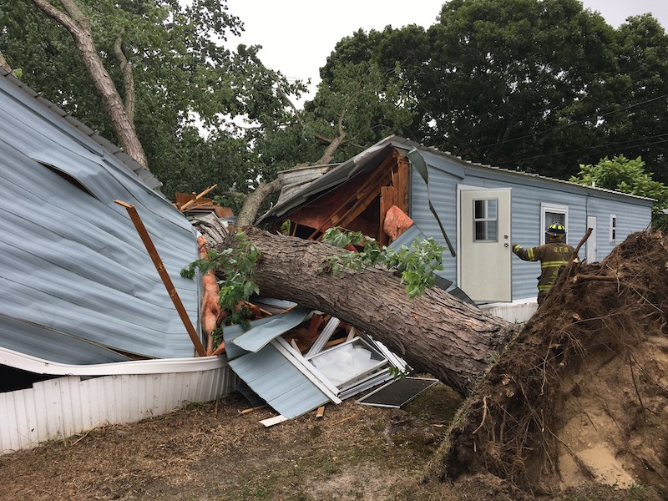
Data analysis workflow we have

Slide 5


EDA and potential models, analyses
Data
Best model
Analysis
Results
This can take a lot of time
Requires experience

Slide 6
EDA and potential models, analyses
Data
Best model
Analysis
Results
This can take a lot of time
Requires (less) experience

Slide 7
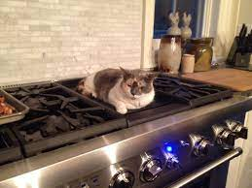
Analysis
Results
Requires (less) experience

Slide 8
{mlr3} - est 2013
3rd major version just out
New book…
Decent manual and resources
https://mlr3book.mlr-org.com/
https://mlr3.mlr-org.com/

