Slide 1
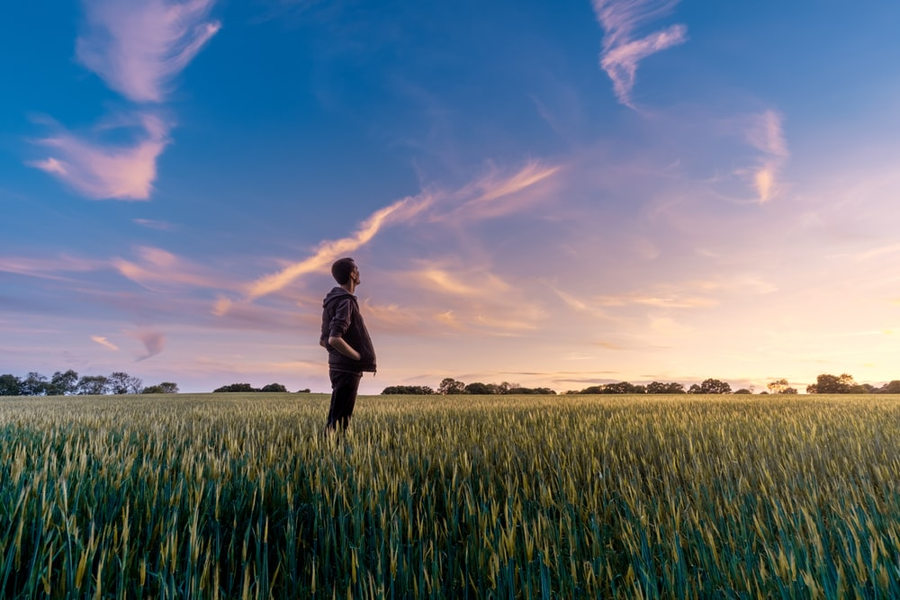
"...need for carbon footprint data within the harper farm... available data is dispersed"
"...data on calf growth rate, feed intake, temperature for fertility data animals and livestock"
..." Animals and livestock, weather data, milk yields, milk recording, milking order..."
"livestock and arable crops and yield"
"soil organic carbon benchmarking, GIS Data, maps"
Specialized genetic sequence data: "...Biobank, generating samples to go into the bio bank"
weather station data, crop rotation data, field trial data… Some data is confidential, no contingency if I were to leave Harper.

Slide 2
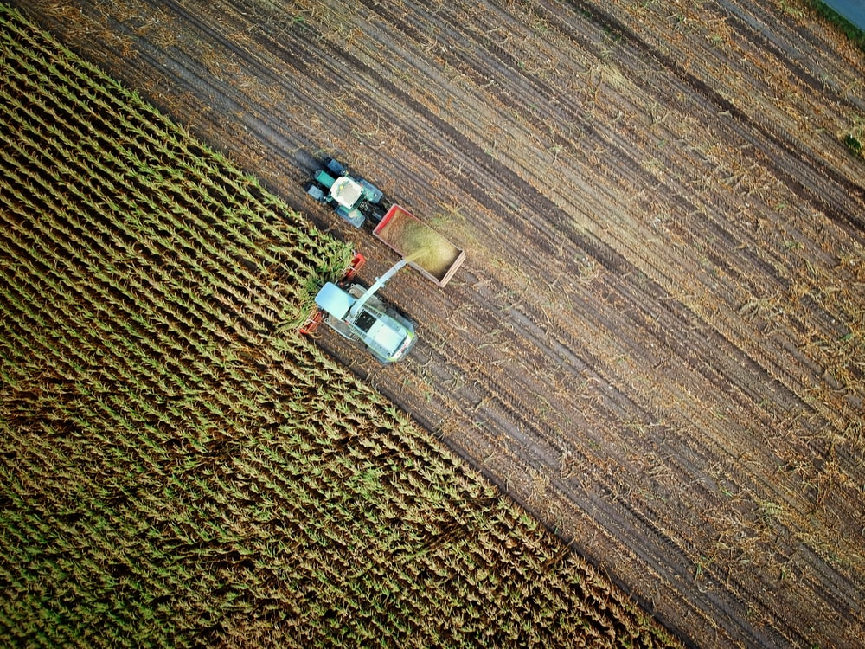
"communication between farm and academics, ... accessibility"
"maps, knowing what [data] is available, training"
"Easy access to farm data"
"yields and machinary costings"
"needs to be centralised- data management, health record digitalised per animal"
"...robust, centralised data store that is managed"
"field maps"
"[farm] performance data... transparency"
"Someone responsible soley for data curation/management"
"...searchable database, meta data, raw data, meta analysis"
"One programme/software that could do everything ... database "
"farm animal data including health that is accesible..."

Slide 3
