Slide 1
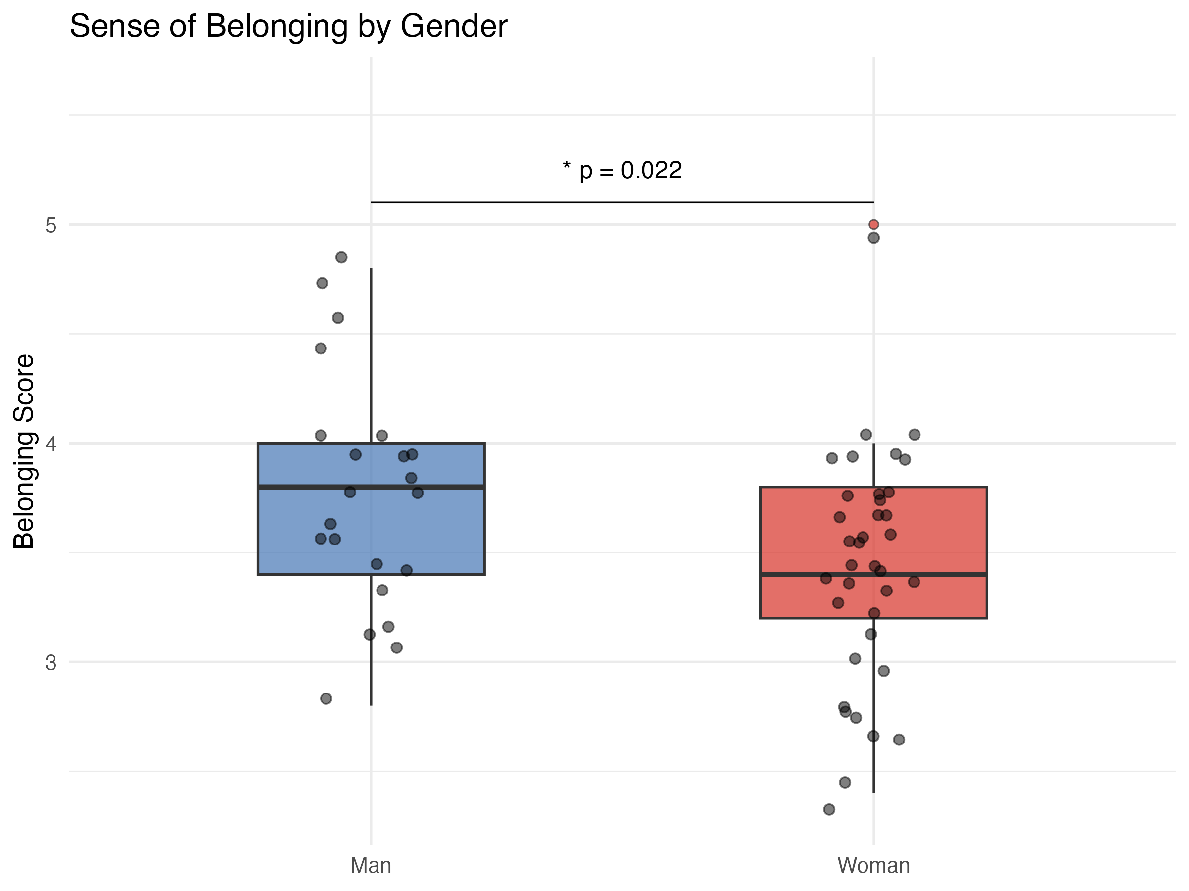
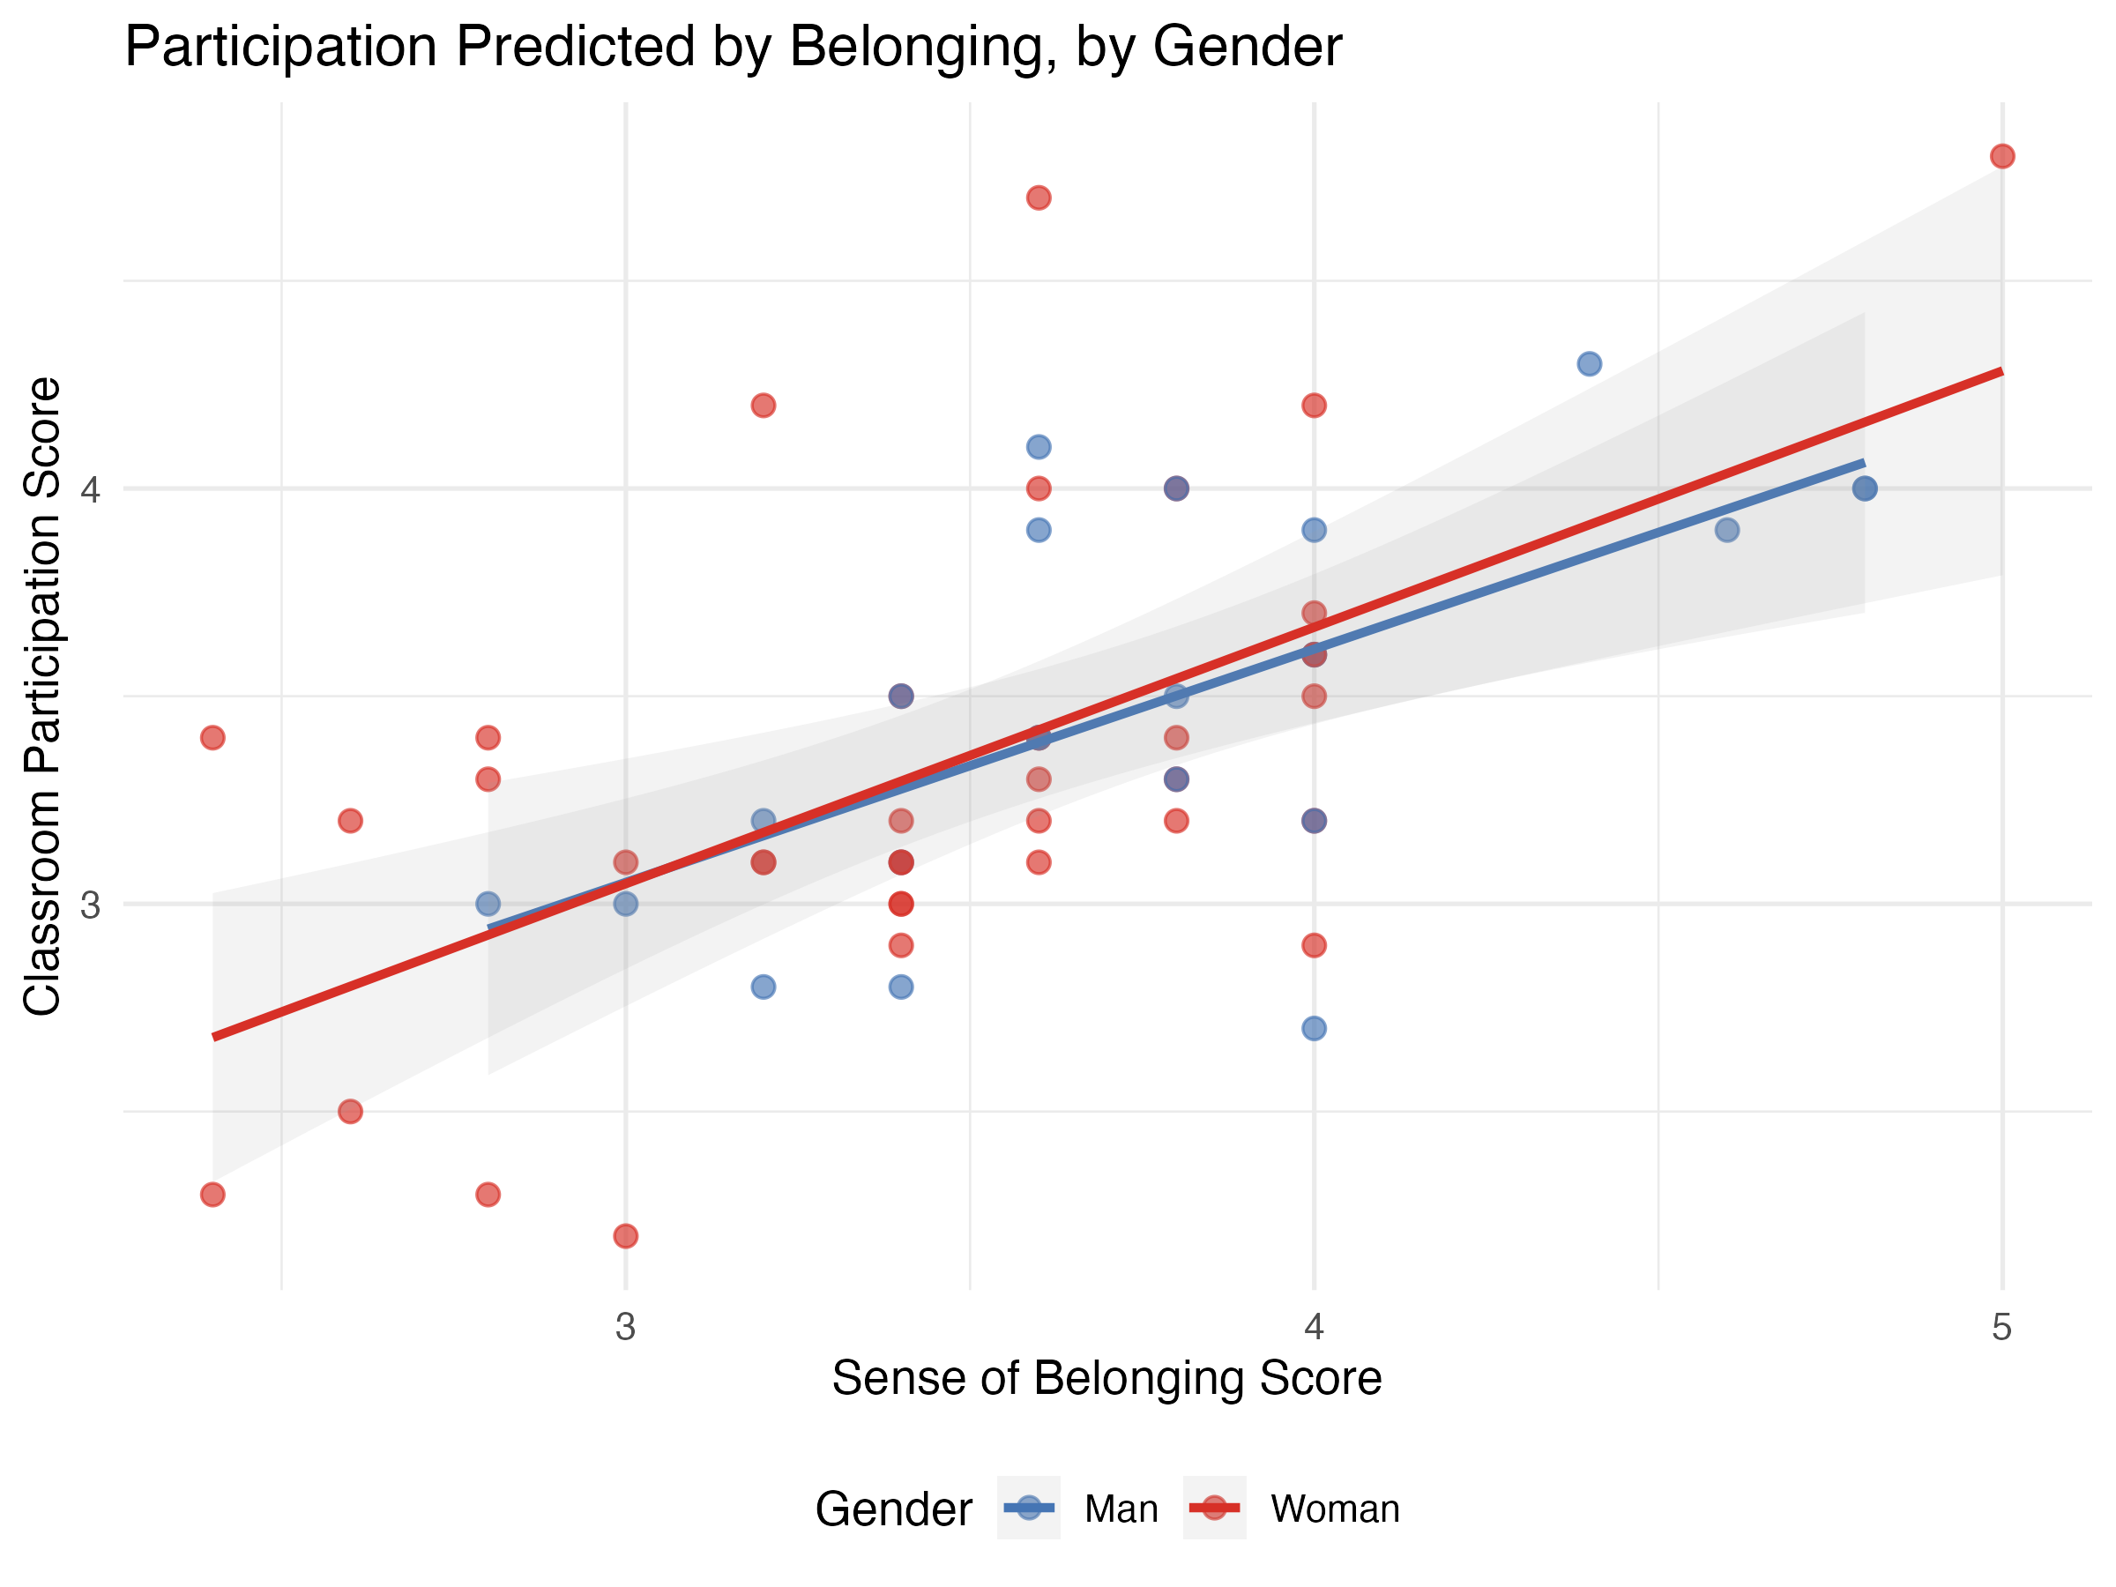
Inspired by: Invisible Women — Caroline Criado Perez (2019)
St. Lawrence University · Independent Research Project
Invisible in the Classroom
Gender Differences in Sense of Belonging and Participation in Education
Harper Eskey, Data Science | Professor Jennifer Hansen, Philosophy
Harper Eskey, Data Science · Advisor: Jennifer Hansen, Philosophy · St. Lawrence University
Introduction & Motivation
Research Questions & Method
Normality
Results
In Invisible Women (2019), Caroline Criado Perez documents how the systematic exclusion of women from data collection has shaped everything from crash test dummies to medical research, with consequences that range from inconvenient to fatal. Her central argument is that this gap is not the product of malice but of structural oversight: men go without saying, and so women do not get said at all. Higher education is no exception.
If classrooms are built around an implicit male default, women's experiences of those spaces may differ in ways that are real but rarely counted. Sense of belonging is one such dimension: difficult to observe, easy to overlook, and potentially consequential for who speaks up, persists, or eventually leaves.
This study brings that logic to St. Lawrence University, drawing on data across departments to examine whether gender differences in sense of belonging exist within undergraduate classrooms and whether belonging predicts participation. In doing so, it attempts to make visible what structural defaults so often leave unmeasured.
Research Questions
This study addressed three questions. First, do men and women differ significantly in sense of belonging within undergraduate classrooms? Second, is belonging correlated with other classroom experiences, such as perceptions of grading, group dynamics, and instructor preference? Third, does sense of belonging predict classroom participation?
Sample
68 undergraduate students across departments at St. Lawrence University participated in the study. After data cleaning, the final sample was 59 participants: 22 men and 37 women. Non-binary and gender non-conforming participants were excluded from group comparisons due to insufficient sample size.
Measures
Participants responded to six scales, each rated from 1 to 5, where higher scores indicate more positive experiences. The measures captured sense of belonging, classroom participation, perceptions of grading, group dynamics, and instructor preference. Instructor preference was assessed twice: once reflecting the least preferred instructor and once reflecting a preferred instructor, allowing for comparison between lived and desired classroom experience.
Analysis
Group differences between men and women were examined using comparison tests suited to the distribution of each variable. Correlations between measures were assessed to explore how belonging relates to other classroom experiences. Finally, regression analysis was used to test whether sense of belonging predicts participation. Normality and variance were checked prior to each analysis to ensure appropriate methods were applied.
Do men and women differ in sense of belonging?
Men reported a higher average sense of belonging (3.78) than women (3.44), a statistically significant difference (p = .022) with a medium effect size (Hedges’ g = 0.63), suggesting the gap reflects a real difference in average experience.
Is belonging correlated with other classroom experiences?
Belonging was positively correlated with all other measures, with its strongest association being participation. Belonging appears to sit at the center of the classroom experience, touching nearly every dimension measured.
Does belonging predict participation?
Yes. Belonging was the strongest predictor of classroom participation, accounting for 37% of its variance. It is not a peripheral concern but a meaningful driver of how students show up in the classroom.
Figure 1: Do Men & Women Feel Equally Welcome?
Figure 2: Belonging Predicts How Much Students Participate
Sense of Belonging by Gender
Men's scores cluster noticeably higher, with a median around 3.75 and most of the distribution sitting between 3.5 and 4.0. Women's scores are more spread out, with a lower median and a longer tail reaching down toward 2.5. While both groups contain the full range of individual variation, the pattern is consistent: men more often occupy the upper end of the belonging scale, women the lower.
This difference is statistically significant (p = .022) and represents a medium effect size (Hedges’ g = 0.63). Belonging was the only one of the six measures to differ significantly by gender.
That distinction matters. If women enter the classroom already feeling less welcome, the effects are unlikely to stay contained to belonging alone; participation, engagement, and confidence may all be pulled downward with it.
Participation vs. Belonging by Gender
Each dot represents one student, with men in blue and women in red. Both trend lines slope upward at nearly the same angle, indicating that the relationship between belonging and participation holds consistently across gender. What differs is where each group's dots tend to sit: women cluster toward the left of the plot, reflecting their lower average belonging scores, which in turn corresponds to lower participation.
The correlation between belonging and participation was the strongest in the dataset (r = 0.61, p < .001). Belonging alone accounts for 37% of the variation in participation scores, and neither grading nor group dynamics improved this meaningfully, suggesting that belonging is the primary driver of participation in this sample.
Discussion
Conclusions
Limitations & References
Women reported meaningfully lower sense of belonging than their male peers despite sharing the same classroom, the same instructor, and the same curriculum. That this gap appeared for belonging and not for perceptions of grading, group dynamics, or instructor preference suggests it is not a generalized dissatisfaction but something more specific: a feeling of not quite fitting a space that was not built with them in mind. This is precisely the dynamic Criado Perez describes. An environment need not be hostile to produce unequal experiences; it only needs to assume a particular kind of student as its default.
Belonging also proved to be more than an attitudinal measure. It was the strongest predictor of participation in the dataset, accounting for 37% of its variance and outperforming every other variable tested. This finding reframes a familiar observation. When women participate less in classrooms, the explanation is often located within them, framed as a matter of confidence or competence. This study suggests the explanation may lie in the classroom itself. If women begin from a lower sense of welcome, reduced participation may be a rational response to that experience rather than a personal shortcoming.
Gender differences in sense of belonging are detectable, meaningful in magnitude, and consequential for participation. The patterns observed here reflect broader dynamics documented across disciplines and institution types, suggesting these gaps are systemic rather than isolated.
Addressing participation gaps may require attending first to belonging: not just who shows up in the data, but who goes quiet within it. Disengagement may reflect environmental factors rather than individual deficits, and future efforts toward equitable participation should treat belonging as a foundational target of intervention.
Limitations
This study has several limitations. Its cross-sectional design means causality cannot be established, and findings from a single institution limit generalizability. The male subsample was small (n = 22), and non-binary participants could not be included in group comparisons due to insufficient sample size. Finally, all measures were self-reported and may be subject to social desirability bias. Longitudinal, multi-site designs would better capture how belonging develops across contexts and over time. Larger and more gender-diverse samples would allow for more stable and inclusive group comparisons. Supplementing self-report measures with behavioral data could further strengthen the validity.
References
Criado Perez, C. (2019). Invisible women: Data bias in a world designed for men. Chatto & Windus.
Data Science Independent Project · St. Lawrence University · Spring 2026

