Slide 1
WorkshopPLUS – Azure: Infrastructure as Code Module 1 – Introduction
Notes:
Clicks: 0
Slide Author: Chase Dafnis - CHDAFNI

Slide 3
Objectives
Understand Azure development tools and processes
Obtain hands-on experience deploying Azure resources
Manage and configure Azure resources with tools discussed
Notes:
In this lesson, we will be exploring different tools that can be used to develop and manage the lifecycle of Infrastructure as Code files, including common code editors and version control systems

Slide 4
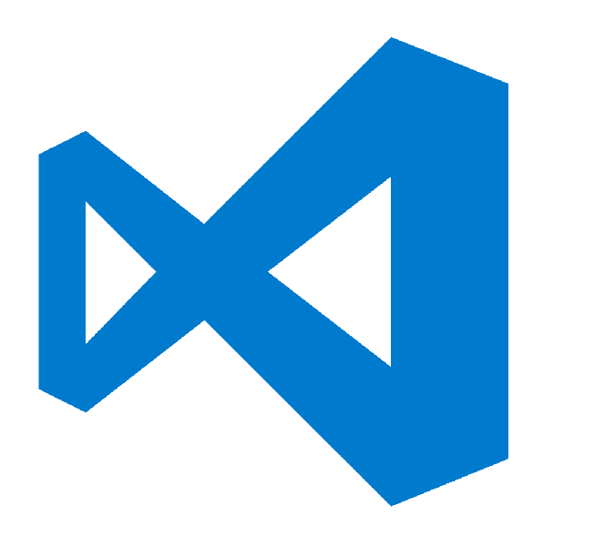
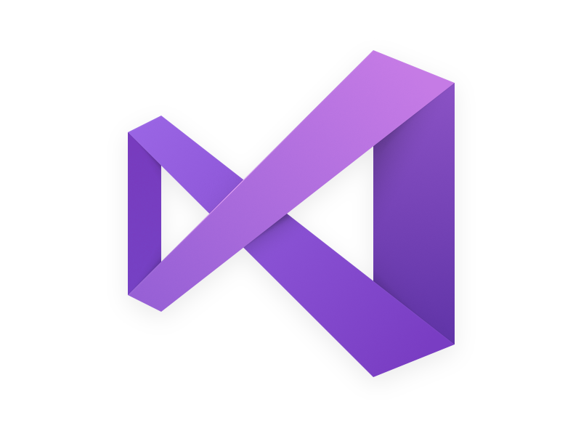
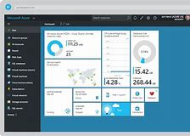
Code Editors – Covered
Visual Studio Code
Visual Studio
Azure Portal
Notes:
Visual Studio Code, also known as VS Code, is a lightweight but powerful source code editor which runs on your desktop and is available for Windows, macOS and Linux. It comes with built-in support for many languages and has a rich ecosystem of extensions to enhance the experience.
VS Code has great support for Azure through many first-party extensions and can deploy infrastructure and applications directly to Azure. It also includes support for multiple Source Control providers, such as Git integration with Azure DevOps and GitHub

Slide 5
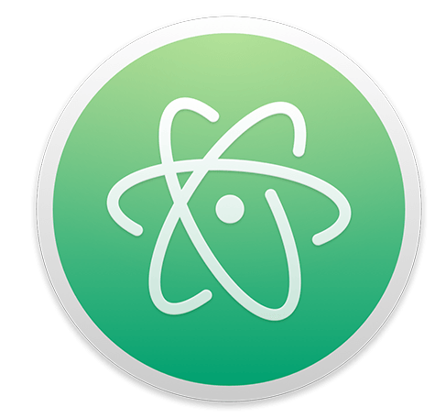


Code Editors - Other
Atom
Sublime
Notepad++
Notes:
There are many other powerful text editors that can be used for creating Infrastructure as Code files and support for Azure is not limited to Microsoft tools.
Some popular third-party editors include:
Atom - https://atom.io/
Sublime - https://www.sublimetext.com/
Notepad++ - https://notepad-plus-plus.org/

Slide 6




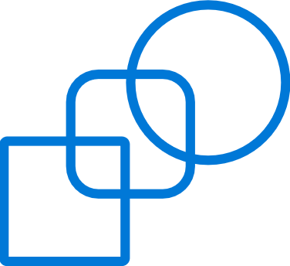



Cloud innovation presents challenges for IT
Azure Overview
How do I integrate with my existing IT investments?
What about my heterogeneous, complex IT landscape?
What about security and compliance?
Notes:
As you think about using the public cloud, there are some top-of-mind issues you have to reckon with.
If you’re like most organizations, you have your existing servers and IT infrastructure (either on-premises in your own datacenters or in 3rd part colocation facilities). You also have an IT staff to manage these assets. So, as you think about using the public cloud, you’re not thinking of it in a silo – ideally where possible you’d want to integrate the public cloud with existing IT, manage it no differently, and even have applications with parts running on and off-premises. Latest IDC findings show 40% of enterprises are already adopting hybrid clouds today (source - http://www.infosys.com/newsroom/press-releases/Pages/cloud-ecosystem-integrator.aspx).
You’re also probably running a variety of OSs, databases, middleware and toolsets from multiple IT vendors. Your developers are proficient in multiple languages and your apps are written in multiple languages and frameworks. In other words, your IT environment is complex and heterogeneous. And you want to make sure the cloud you choose is able to handle your heterogeneous needs.
Next you have to abide by a bunch of security and compliance initiatives. The rest of the business trusts your IT org to run apps in a secure and reliable manner. So, you want to make sure the public cloud platform and the vendor who provides the service is using is trustworthy, i.e. has the right experience and expertise, and has necessary SLAs and security controls in place.

Slide 7
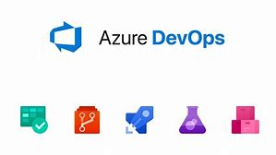

Version Control - Covered
Azure DevOps Git
Azure DevOps Server
GitHub
Notes:
Leveraging a version control system is critical for a successful Infrastructure as Code implementation. After infrastructure is built, it should continue to be maintained via code and that code should live in a version control system.
A version control system manages all code files and maintains a history of all changes. By keeping code in a version control system, a team of developers can work together on building their Infrastructure as Code files and makes sharing simple and secure.
Today, most popular version control systems are distributed and are Git based. By keeping the system distributed, each client maintains a full mirror of the code repository which limits the risk of a centralized server outage. Git based systems are fully distributed and can scale to support a project of any size.

Slide 8

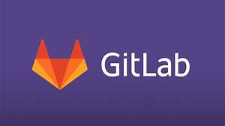

Version Control - Other
Bitbucket
GitLab
Beanstalk
Notes:
There are many other version control system offerings that can be used to manage Infrastructure as Code projects, including:
Bitbucket - https://bitbucket.org/
GitLab - https://about.gitlab.com/
Beanstalk - https://beanstalkapp.com/

Slide 9
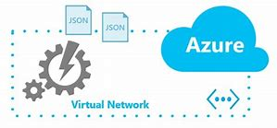
ARM Templates
Authoring
Template functions
Iterations and indexing

Slide 10

Azure Automation
Azure Automation Accounts
Assets
Runbooks
Desired State Configuration

Slide 11
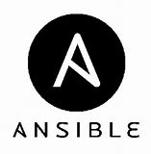
Ansible
Development Environment
Building Azure Infrastructure
Ansible Vault and Azure Key Vault

Slide 12

Terraform
Setup Azure Provider
Deploy an Azure Resource Group
Manage state with Remote Backend
Manage secrets

