Slide 1
WorkshopPLUS – Azure: Infrastructure as Code
Notes:
Clicks: 0
Slide Author: Chase Dafnis - CHDAFNI

Slide 3
Module 2: Tools - Code Lifecycle

Slide 4
Objectives
Understand which tools can be used for Infrastructure as Code development and lifecycle management
Code Editors
Version control systems
Notes:
In this lesson, we will be exploring different tools that can be used to develop and manage the lifecycle of Infrastructure as Code files, including common code editors and version control systems

Slide 5
Code Editors
Infrastructure as Code files are text based
Integrated Development Environments (IDE’s) enhance the development experience
Notes:
Infrastructure as Code files, such as ARM templates, are text based that do not require a special program to create. While any text based editor can be used to create Infrastructure as Code files, a proper Integrated Development Environment (IDE) enhances the development experience.
In the next set of slides, we will cover a few popular tools for creating Infrastructure as Code files

Slide 6
Code Editors - Visual Studio Code
Lightweight source code editor
Available for Windows, macOS and Linux
Rich ecosystem of extensions
Enhanced support for Azure
Built in Git version control
https://code.visualstudio.com/
Notes:
Visual Studio Code, also known as VS Code, is a lightweight but powerful source code editor which runs on your desktop and is available for Windows, macOS and Linux. It comes with built-in support for many languages and has a rich ecosystem of extensions to enhance the experience.
VS Code has great support for Azure through many first-party extensions and can deploy infrastructure and applications directly to Azure. It also includes support for multiple Source Control providers, such as Git integration with Azure DevOps and GitHub

Slide 7
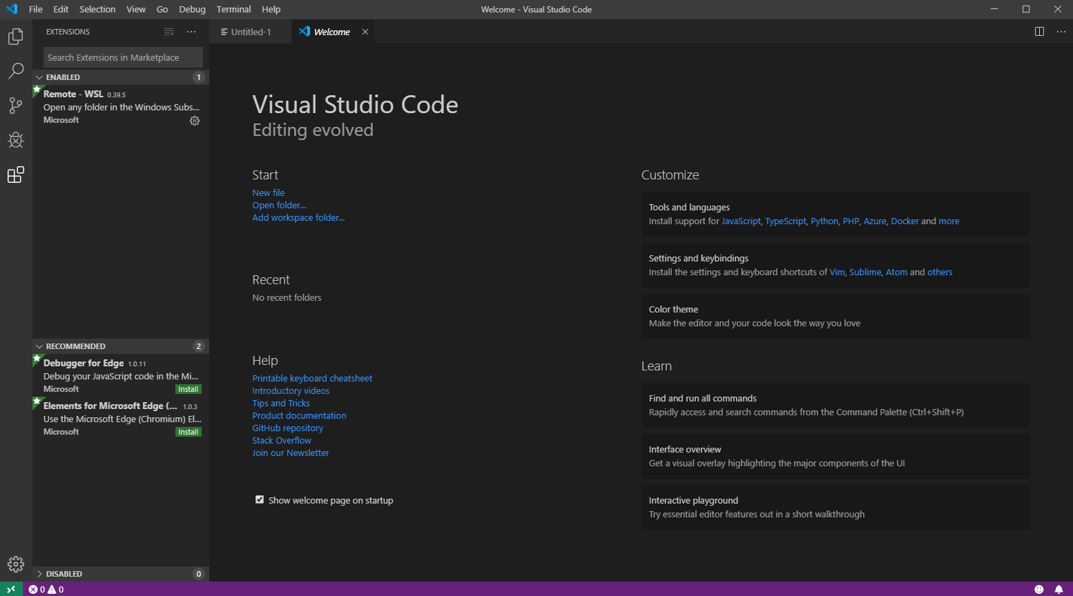
Code Editors - Visual Studio Code

Slide 8
Code Editors - Visual Studio
Fully-featured integrated development environment (IDE)
Available for Windows and macOS
Built in support for Azure
Built in Git version control
Notes:
Visual Studio is a full featured integrated development environment (IDE) that can be used to edit, debug, and build code, and then publish an app.
Like VS Code, it has great support for Azure and can directly deploy infrastructure and applications. It also includes support for multiple Source Control providers, such as Git integration with Azure DevOps and GitHub

Slide 9
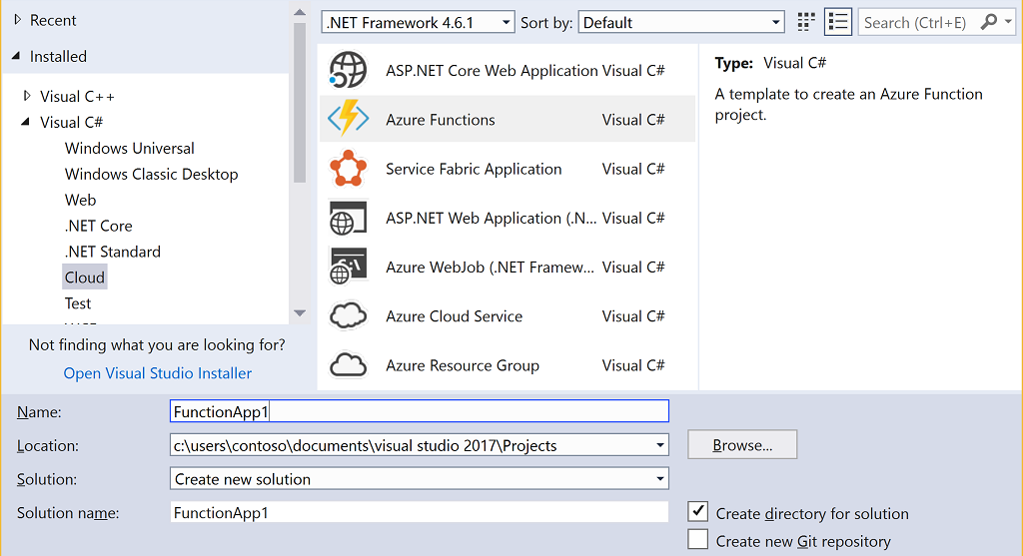
Code Editors - Visual Studio

Slide 10
Code Editors - Azure Portal
Includes a simple ARM template editor
Export resources as an ARM template
History of ARM template deployments
Notes:
The Azure Portal includes several tools for ARM template creation.
A built in ARM template editor is included as part of the custom Template Gallery. It offers limited IntelliSense but can be useful if a proper IDE is unavailable for use.
Azure resources can be exported into pre-built ARM templates with deployment files
A history of ARM template-based deployments is included in each Resource Group. These templates can be exported for later re-use
Most development work will happen outside of the Azure Portal, but the export tools are useful as a starting point for creating new templates.

Slide 11
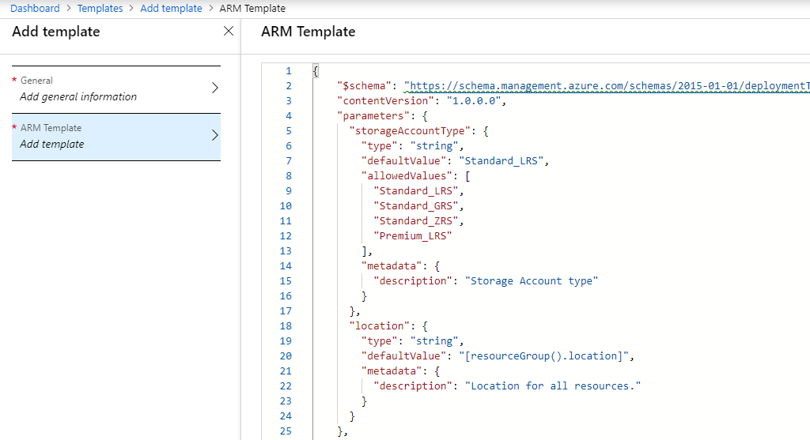
Code Editors - Azure Portal

Slide 12
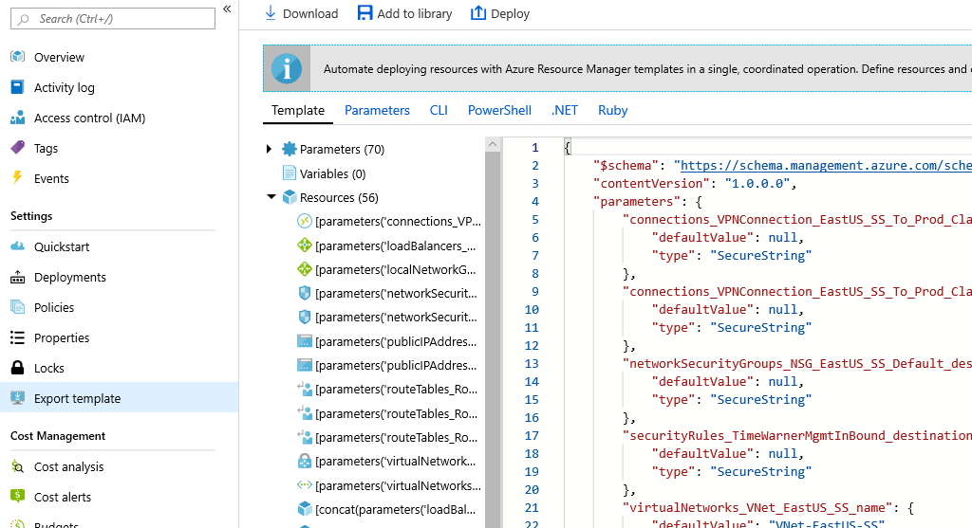
Code Editors - Azure Portal (Continued)

Slide 13
Code Editors - Other
Atom
Sublime
Notepad++
Notes:
There are many other powerful text editors that can be used for creating Infrastructure as Code files and support for Azure is not limited to Microsoft tools.
Some popular third-party editors include:
Atom - https://atom.io/
Sublime - https://www.sublimetext.com/
Notepad++ - https://notepad-plus-plus.org/

Slide 14
Version Control
Infrastructure as Code beyond build
Enables team-based development
Recover to prior state
Compare changes over time
Notes:
Leveraging a version control system is critical for a successful Infrastructure as Code implementation. After infrastructure is built, it should continue to be maintained via code and that code should live in a version control system.
A version control system manages all code files and maintains a history of all changes. By keeping code in a version control system, a team of developers can work together on building their Infrastructure as Code files and makes sharing simple and secure.
Today, most popular version control systems are distributed and are Git based. By keeping the system distributed, each client maintains a full mirror of the code repository which limits the risk of a centralized server outage. Git based systems are fully distributed and can scale to support a project of any size.

Slide 15

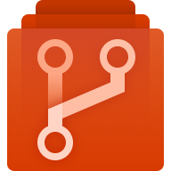


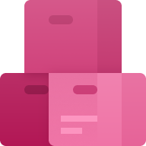
Version Control - Azure DevOps Services
Azure Boards
Azure Repos
Azure Pipelines
Azure Test Plans
Azure Artifacts
Plan, track, and discuss work across teams, deliver value to your users faster.
Unlimited cloud-hosted private Git repos. Collaborative pull requests, advanced file management, and more.
CI/CD that works with any language, platform, and cloud. Connect to GitHub or any Git provider and deploy continuously to any cloud.
The test management and exploratory testing toolkit that lets you ship with confidence.
Create, host, and share packages. Easily add artifacts to CI/CD pipelines.
Notes:
Formerly known as Visual Studio Team Services/VSTS, Azure DevOps Services is a cloud service for collaborating on code development. It includes a Git based version control system as well as several other integrated features:
Build and release services to support continuous integration and delivery of your apps
Agile tools to support planning and tracking your work, code defects, and issues using Kanban and Scrum methods
Many tools to test your apps, including manual/exploratory testing and continuous testing
Highly customizable dashboards for sharing progress and trends
Built-in wiki for sharing information with your team
There is a large ecosystem to integrate with other services, including GitHub, Microsoft Teams, Slack and Trello.
Public repositories are free and private repositories are free for up to 5 users.
If an on-premises hosted system is preferred over a managed cloud service, Azure DevOps Server (formerly known as Team Foundation Services/TFS) offers many of the same features.

Slide 16
Version Control - GitHub
Largest developer platform in the world
Integration with Azure DevOps Pipelines
Free public and private repositories
Notes:
GitHub is also a Git based, distributed version control system. As of 2018, it was the #1 developer platform in the world, with more than 1.1 billion updates to 96 million repositories. It has excellent support for integrating with other applications, including Azure DevOps, where a GitHub repository can be leveraged in an Azure DevOps pipeline.
GitHub can be leveraged both publicly, where anonymous users can read (but not update) the code repository, and privately where the code repository is hidden from unauthenticated and unauthorized users.
Public repositories are free and private repositories are free for up to 3 collaborators.

Slide 17
Version Control - Other
Bitbucket
GitLab
Beanstalk
Notes:
There are many other version control system offerings that can be used to manage Infrastructure as Code projects, including:
Bitbucket - https://bitbucket.org/
GitLab - https://about.gitlab.com/
Beanstalk - https://beanstalkapp.com/

