Slide 1
Workshop PLUS – Infrastructure as Code
Module 3 – Azure Overview
Update: 0.18.9.0

Slide 3
What will we accomplish?
Purpose of this Module
Understand the cloud concepts and principles
Expected outcomes
Understand Going Digital
Get familiar with the cloud and Microsoft Azure
Understand trends driving Azure adoption
Learn resiliency options and SLA for Azure
Understand cloud organizational challenges

Slide 4
High-level agenda
Digital Transformation overview
Cloud business and economic benefits
Microsoft Azure overview
Cloud organizational challenges
Cloud concepts and principles

Slide 5
Going digital
1 million/hour
new devices coming online by 2020
12 years average age of S&P 500 corporations by 2020
60% computing
in the public cloud by 2025
Notes:
Going digital
Why is this transformation important? Let’s take a look at the next few years before us…
In 2020, 1 million new devices are expected to come online every hour. The connectivity between people and data is creating billions of new relationships that are driven not only by data but by algorithms that keep customers engaged and buying.*
In 2020, the average age of a S&P 500 corporation is expected to be 12 years old. Compare that to the S&P 500 in 1960 when the average age was 60 years old.**
60% of computing will done done in the public cloud by 2025 – but what does that mean for the rest?
That’s 40% of computing we’re talking about.
Obviously, some things will need to stay on-premises – so being able to do both is important.
For digital transformation, mobility is the universal catalyst and cloud is the great enabler.
How are you planning for digital transformation?
Do you have the right people and the right technology in place to build your digital vision?
How can you use technology to shape your future?
*http://www.gartner.com/newsroom/id/3142917
**http://upstart.bizjournals.com/resources/author/2015/06/04/fortune-500-must-disrupt-or-die-writes-r-ray-wang.html?page=all
***http://www.emersonnetworkpower.com/en-US/Latest-Thinking/Data-Center-2025/Documents/002401_DataCenter2025Report_HR_INTERACTIVE.PDF

Slide 6
The world of IT is changing
Engage your customers
Transform your products
Digital transformation
Empower your employees
Optimize your operations
Notes:
Talking Points:
Startup agility, enterprise mentality - Stakeholders expecting better results, faster
Evolving business models - Moving away from infrastructure builds
Evolving IP models - Building new on-demand services, rather than focusing on infrastructure support
Digital transformation:
Technology is omnipresent.
It’s shaping how businesses plan for innovation and growth within their markets.
The importance of digital transformation is urgent; Since 2000, 52% of Fortune 500 companies are gone due to digital disruption.
We see companies responding by creating digital strategies across four core areas: engaging their customers, empowering their employees, optimizing their operations, and transforming their products.
Everyone is aware of how important this is. Look at a company like Uber for example.
They’ve created a digital model for the taxi industry that has allowed them to surpass every other taxi company by double or more, recently valued at $62.5 Billion.
They’ve created a significant shift in an industry that has been largely untouched for decades.
[This slide is a good opportunity to share a personal anecdote about yourself or one of your customers in which you/they realized the importance of digital transformation and how it influences customers and end user expectations.]

Slide 7



Why consider the cloud?
Speed
Scale
Economics
Notes:
In the last few years, we have seen an explosive growth in the use of the public cloud. While most of the initial adoption was seen by startups and smaller orgs, most of the new growth will come from larger organizations adopting the public cloud.
Now you might ask what’s causing cloud adoption at such a fierce rate. There are 3 fundamentals business drivers at play here:
SPEED: With minutes instead of days/weeks to procure & provision servers, the pace of innovation has dramatically increased. Reduced ‘time to develop’ & ‘time to market’ means your IT can be much more agile in servicing needs of the business units or developers. Embrace & enable innovation. Help your business move forward against the competition. In fact, it is the speed and agility that IT hasn’t been able to provide has resulted in what many call “Shadow IT,” in which business units are resorting to using credit cards to procure computing resources outside of the purview of the IT.
SCALE: Cloud gives you an almost infinite set of computing resources. Your applications will enjoy massive global scale, and can easily scale up or down depending on the demand. That means you never have to worry about running out of capacity or worry about overprovisioning. You use just enough resources for your needs - nothing more, nothing less.
ECONOMICS: And of course, you’re paying only for what you use in the cloud. This in itself saves you money for any app that has variable computing needs. For some organizations, there is also an additional benefit of changing CapEX to OpEX, which frees up capital from infrastructure investments so it can be put toward other uses.

Slide 8
Customer cloud journey
We’ve entered a new era of computing, but fundamental elements of computing remain the same:
Apps that create and contain data,
Data that flows into and out of applications,
Infrastructure that is the foundation for both
On-premises
b
Applications
Migration & modernization
Cloud-native
SaaS
Data + intelligence
Data reality
Rehost
Refactor
Rearchitect
Rebuild/New
Replace
Infrastructure
DevOps
Virtual Machines
Containers
App, Data, & AI Services
Notes:
We’ve entered a new era of computing, but fundamental elements of computing remain the same:
Apps that create and contain data,
Data that flows into and out of applications,
Infrastructure that is the foundation for both
In the context of application development, we provide different approaches to modernize your apps.
Application modernization is a journey to digitally transform your business applications to make them future-ready.
We meet your customers where they are: Some applications are ready to modernize; some may require minor changes in code; and still others may need a complete redesign to make them cloud-ready. Choosing the right migration approach for different applications in your portfolio can help you extract maximum value from cloud-enabled and innovative technologies.
On this section our focus is the impact, importance, and the business opportunity that application modernization provides to our partner ecosystem.

Slide 9
Microsoft Azure
Productive + Hybrid + Intelligent + Trusted

Slide 10












Microsoft Azure
^{App} ^{services}
Cloud services
Caching
Identity
Service bus
Media
Mobile services
Web sites
Integration
HPC
Analytics
^{Data} ^{services}
SQL database
HDInsight
Table
Blob storage
^{Infrastructure} ^{services}
Virtual machines
Virtual network
VPN
Traffic manager
CPN
Notes:
Microsoft Azure is a broad stack of services that runs in our datacenters globally.
Think of the different services as building blocks. These services can be categorized into three classes –
Infrastructure services which are lower level building blocks,
Data services that provide storage and data management capabilities to apps, and
App services which provide different capabilities to rapidly develop, scale, and run apps at a global scale.

Slide 11
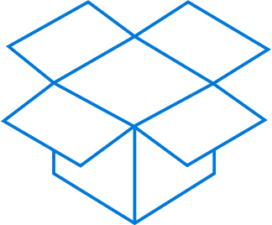
Microsoft Azure (Continued)
^{App} ^{services}
Apps
Cloud services
Caching
Identity
Service bus
Media
Mobile services
Web sites
Integration
HPC
Analytics
Cloud Services
Caching
Identity
Table
^{Data} ^{services}
SQL database
HDInsight
Table
Blob storage
^{Infrastructure} ^{services}
Virtual machines
Virtual network
VPN
Traffic manager
CDN
Notes:
You can use these blocks or puzzle pieces to rapidly build apps, and then choose an Azure datacenter to run them. Microsoft Azure takes care of the underlying management and provides your app the scale it needs.
This approach is what industry experts call a Platform as a Service.

Slide 12

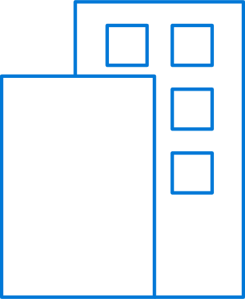
Microsoft Azure (Continued)
Azure datacenters,
your datacenters.
^{App} ^{services}
Cloud services
Caching
Identity
Service bus
Media
Mobile services
Web sites
Integration
HPC
Analytics
Virtual machines
Virtual network
VPN
^{Data} ^{services}
SQL database
HDInsight
Table
Blob storage
^{Infrastructure} ^{services}
Virtual machines
Virtual network
VPN
Traffic manager
CDN
VPN
Notes:
But that is not all that you can do with Azure. Microsoft Azure also provides infrastructure services which allow for more hands-on configuration and management similar to the servers you have today. However, they’re hosted in Microsoft datacenters letting you use Azure as if you were operating your own datacenter in the cloud. For example, you can provision VMs, give them private IP addresses, and connect to them using a VPN from your on-premises environment. Most importantly, this lets Microsoft Azure mimic your on-premises datacenter and run your current apps with little or no change without the expense of having to own servers of racks, cooling, and building costs. Furthermore, you can connect the “datacenter” you build in the cloud to your on-premises datacenter so the datacenter in the cloud becomes an extension to your on-premises infrastructure.
These “building blocks” lets Microsoft Azure to be used as an Infrastructure-a- a-service.
So, you see Microsoft Azure offers IaaS +PaaS in one platform. IaaS provides flexibility, PaaS eliminates complexity. Use PaaS where you can, use IaaS where you need. With Azure, you can use both together or independently, and build apps of the future. That uniquely differentiates us.

Slide 13
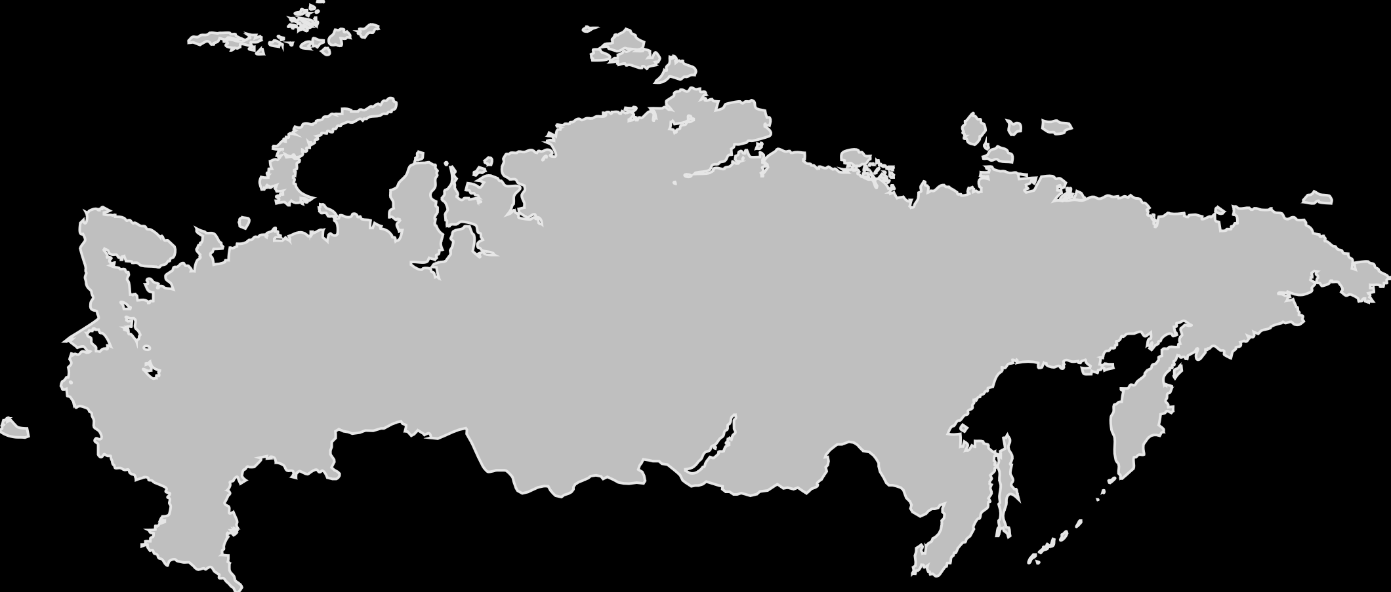
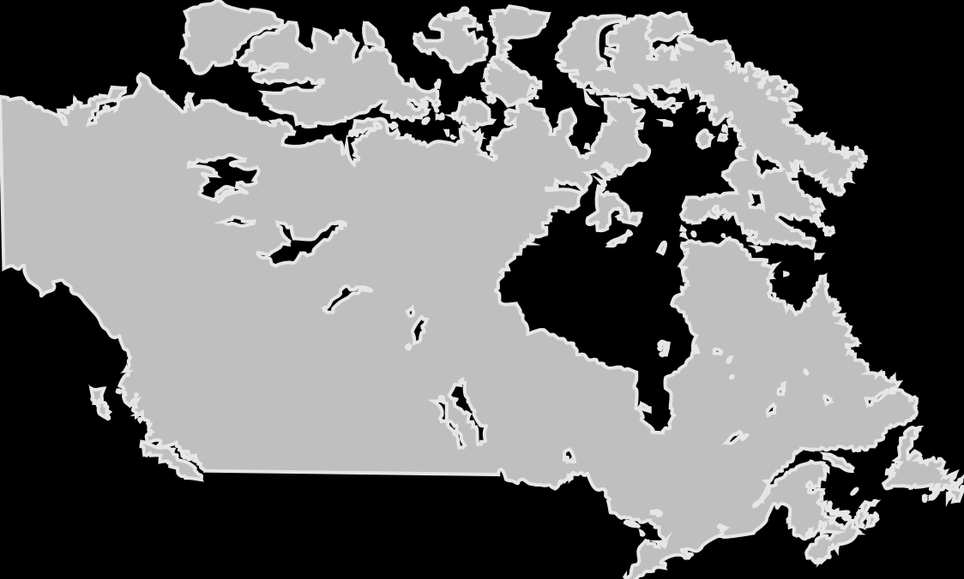
54
Azure regions
More than AWS & Google combined
100+ datacenters
One of the top 3 networks in the world (coverage, speed, connections)
2x AWS and 6x Google number of offered regions
G Series – Largest VM available in the market – 32 cores, 448GB Ram, SSD…
Notes:
In order to help organizations meet data residency, sovereignty and compliance requirements, Azure has more global regions than any other cloud provider—offering the scale needed to bring applications closer to users around the world, preserving data residency, and offering comprehensive compliance and resiliency options for customers.

Slide 14
Most comprehensive resiliency and best SLA
Industry-only
Industry-leading high availability SLA
Industry-leading disaster recovery
VM SLA
VM SLA
VM SLA
Regions 54
99.9%
99.95%
99.99%
Region 1
Region 2
Single VM
Availability sets
Availability zones
Region pairs
Protection with Premium Storage
Protection against failures within datacenters
Protection from entire datacenter failures
Protection from disaster with Data Residency compliance
Notes:
Comprehensive set of native business continuity solutions
industry’s only single VM SLA.
99.9% SLA guarantee on Single Instance Virtual Machines which are backed by Premium Storage
High availability across datacenters
Availability zones – protect against loss of entire datacenters, 99.99% SLA at GA
Combination – higher than any other vendor
Disaster recovery and backup solutions
DR via Azure Site Recovery provides orchestrated failover.
Only Azure provides this comprehensive level of service

Slide 15











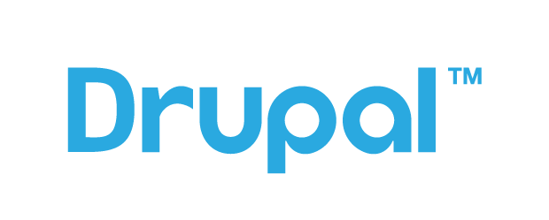



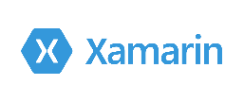

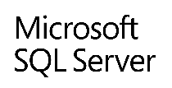








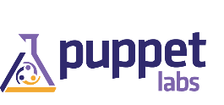

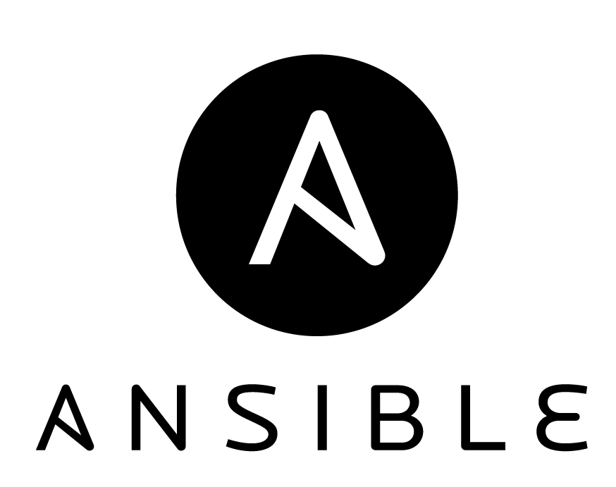
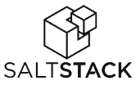

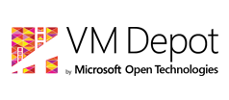

Azure is open
Microsoft-integrated
Ecosystem-provided
Languages, Dev Tools and App Containers
Bring your own
CMS and Apps
Web App Gallery
Dozens of .NET and PHP CMS and Web applications
Devices
Via HTMl/JS, cross-platform and native
Databases
DocDB
Management
libcloud
jclouds
Operating systems
Ubuntu, SUSE, OpenSUSE,
OpenLogic CentOS-based
Oracle Linux, CoreOS
Bring
your own

Slide 16

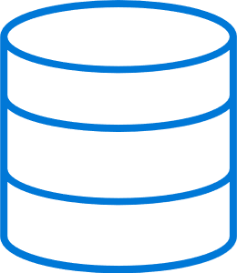

Extend your infrastructure
Microsoft Azure infrastructure services
Virtual Machines with on-demand scale & compute
Spin up and tear down in minutes, no hardware provisioning
Connect with on-premises Active Directory and domains
Integrates Azure Virtual Networks
Use what you know, manage with System Center
Integrates with Azure Platform, Apps, and Storage Services
Virtual Network
Active Directory
SharePoint
Microsoft Azure
SQL Server
Your datacenter
Internet
Notes:
The strength of the hybrid strategy is about the continuum of capabilities across the offerings, it’s not just about the platform.
Hybrid is more than just being able to move an application into the cloud.
There are critical elements from identity, data, and security and management that have to be addressed.
You don’t have to be stuck in an all-or nothing choice – hybrid gives you the flexibility to move to the cloud when and how you want to.

Slide 17
Azure covers 78 compliance offerings
Global
ISO 27001:2013
ISO 27017:2015
ISO 27018:2014
ISO 22301:2012
ISO 9001:2015 ISO 20000-1:2011
SOC 1 Type 2
SOC 2 Type 2
SOC 3
CSA STAR Certification
CSA STAR Attestation
CSA STAR Self-Assessment WCAG 2.0
US Gov
FedRAMP High
FedRAMP Moderate EAR
DoD DISA SRG Level 5
DoD DISA SRG Level 4 DoD DISA SRG Level 2 DFARS
DoE 10 CFR Part 810 NIST SP 800-171
NIST CSF
Section 508 VPATs
FIPS 140-2 ITAR
CJIS
IRS 1075
Industry
PCI DSS Level 1
GLBA
FFIEC Shared Assessments FISC (Japan) APRA (Australia) OSFI (Canada
FCA + PRA (UK) MAS + ABS (Singapore)
23 NYCRR 500 SEC 17a-4 CFTC 1.31 FINRA 4511
SOX HIPAA BAA HITRUST 21 CFR Part 11 (GxP) MARS-E NHS IG Toolkit (UK)
NEN 7510:2011 (Netherlands) FERPA CDSA
MPAA
FACT (UK) DPP (UK)
Regional
Argentina PDPA
Australia IRAP Unclassified Australia IRAP Protected
Canada Privacy Laws China GB 18030:2005 China DJCP (MLPS) Level 3
China TRUCS / CCCPPF
EN 301 549
EU ENISA IAF EU Model Clauses EU – US Privacy Shield GDPR Germany C5
Germany IT-Grundschutz workbook India MeitY
Japan CS Mark Gold
Japan My Number Act Netherlands BIR 2012 New Zealand Gov CIO Fwk
Singapore MTCS Level 3
Spain ENS
Spain DPA UK Cyber Essentials Plus UK G-Cloud UK PASF
https://aka.ms/AzureCompliance
Notes:
The deepest and most comprehensive compliance coverage in the industry
See https://aka.ms/AzureCompliance for more information.
Jul-2018: Azure compliance coverage includes 78 offerings. Latest addition: OSFI (Canada), SEC 17a-4, CFTC 1.31, FINRA 4511
Microsoft has proven experience delivering cloud services at global scale and uses this deep knowledge to develop best practices and technology innovations that support increased reliability and compliance readiness. Microsoft Trustworthy Computing (TwC) is a long-term, collaborative effort to create and deliver secure, private, and reliable computing experiences for everyone. TwC principles and processes inform every aspect of Microsoft Azure from design to development to operations, helping to deliver a more secure, private, and compliant platform for customers.
Microsoft also engages in industry-leading security efforts through the creation of centers of excellence:
Microsoft Digital Crime Unit (DCU). The DCU brings together a unique team of lawyers, investigators, business professionals, intelligence specialists, and forensic analysts – deploys trailblazing techniques to fight a wide array of online criminal activity.
Microsoft Cybercrime Center. An effort of the DCU, the Microsoft Cybercrime is a secured facility at the company’s Redmond campus. It houses groundbreaking Microsoft technologies that allow the team to visualize and identify global cyber threats developing in real time. The Cybercrime Center includes a separate and secure location for third-party partners, allowing cybersecurity experts from around the world to work in the facility with Microsoft experts. With nearly 100 attorneys, investigators, technical experts, and forensic analysts based around the world, the Microsoft Cybercrime Center is well positioned to make it safer for people online worldwide.
Microsoft Malware Protection Center (MMPC). By continuously gathering and analyzing data, and by working with organizations inside and outside Microsoft, the MMPC helps combat evolving threats. Labs in Redmond, Washington, U.S.A.; Munich, Germany; Vancouver, Canada; and Melbourne, Australia—with the help of additional researchers in other locations around the world—ensure that a response team is always online.

Slide 18
Cloud is a shared responsibility
On-Premises
IaaS
PaaS
SaaS
Applications
Data
Runtime
Middleware
O/S
Virtualization
Servers
Storage
Networking
Customer
Microsoft
Notes:
We have a shared responsibility for security, privacy, and compliance. Microsoft Azure helps reduce the security and compliance burden for customers with internal tools, processes, and controls, and enables customers to use their own tools, processes, and policies. For example, Microsoft uses access controls to protect the system administrator privileges while the customer is responsible for end-user access control. The shared responsibility approach provides a more flexible and secure foundation for all users while giving individual customers the flexibility to build the solution that meets their specific security, privacy, and compliance needs.

Slide 19
Cloud organizational challenges

Slide 20
Why organizations move to the cloud
Innovation
Move away from outsourcing models
Shadow IT is here to stay
Datacenter is at capacity
Cost – pay for use
It is an industry trend
… and more
Notes:
Migration triggers:
Datacenter contracts expiry
Quickly integrate acquisitions
Urgent capacity needs
Software and hardware refresh
Security threats
Compliance
Application innovation
Software end of support

Slide 21


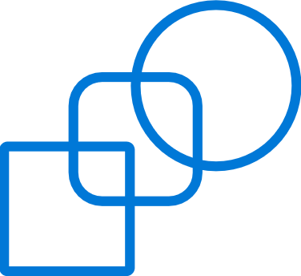



Cloud innovation presents challenges for IT
How do I integrate with my existing IT investments?
What about my heterogeneous, complex IT landscape?
What about security and compliance?
Notes:
But as you think about using the public cloud, there are some top-of-mind issues you have to reckon with.
If you’re like most organizations, you have your existing servers and IT infrastructure (either on-premises in your own datacenters or in 3rd part colocation facilities). You also have an IT staff to manage these assets. So, as you think about using the public cloud, you’re not thinking of it in a silo – ideally where possible you’d want to integrate the public cloud with existing IT, manage it no differently, and even have applications with parts running on and off-premises. Latest IDC findings show 40% of enterprises are already adopting hybrid clouds today (source - http://www.infosys.com/newsroom/press-releases/Pages/cloud-ecosystem-integrator.aspx).
You’re also probably running a variety of OSs, databases, middleware and toolsets from multiple IT vendors. Your developers are proficient in multiple languages and your apps are written in multiple languages and frameworks. In other words, your IT environment is complex and heterogeneous. And you want to make sure the cloud you choose is able to handle your heterogeneous needs.
Next you have to abide by a bunch of security and compliance initiatives. The rest of the business trusts your IT org to run apps in a secure and reliable manner. So, you want to make sure the public cloud platform and the vendor who provides the service is using is trustworthy, i.e. has the right experience and expertise, and has necessary SLAs and security controls in place.

Slide 22
Cloud organizational challenges
Chargeback and/or showback
Requires process and organizational maturity
IT must become a Service Provider
Enable innovation with lifecycle management
Manual on premise work not automated
Cloud consumers/customers’ new responsibilities; tenant ownership, service relationship management, service catalog

Slide 23
Cloud concepts and principles

Slide 24
Cloud concepts and principles
Cloud services and solutions are based on the following concepts and principles
Principles
Achieve business value through measured continual improvement
Perception of infinite capacity
Perception of continuous service availability
Take a Service Provider’s approach
Optimization of resource usage
Take a holistic approach to availability design
Minimize human involvement
Drive predictability
Incentivize desired behavior
Create a seamless user experience
Concepts
Favor resiliency over redundancy
Homogenization of physical hardware
Pool compute resources
Virtualized infrastructure
Fabric management
Elastic infrastructure
Multitenancy
Partitioning of shared resources
Resource decay
Service classification
Cost transparency
Consumption-based pricing
Security and identity
http://blogs.technet.com/b/cloudsolutions/archive/2013/08/15/cloud-services-foundation-reference-architecture-principles-concepts-and-patterns.aspx#Application
Notes:
Detailed explanation in the following slides…

Slide 25
Cloud principles
Principles
Achieve business value through measured continual improvement
Perception of infinite capacity
Perception of continuous service availability
Take a Service Provider’s approach
Optimization of resource usage
Take a holistic approach to availability design
Minimize human involvement
Drive predictability
Incentivize desired behavior
Create a seamless user experience
Notes:
The principles provide general rules and guidelines to support the evolution of a cloud infrastructure.
The highlighted principles provide the focus for the new onboarding experience:
Create a seamless user experience ->
Consumers of an IT service should not encounter anything which disrupts their use of the service as a result of crossing a service provider boundary
Support modern concepts and roles: DevOps, Service Broker
Drive predictability ->
Ruthlessly eliminate unnecessary friction
Well-managed change, configuration, and release management processes
Highly effective, highly automated incident and problem management processes
Incentivize desired behavior ->
IT will be more successful in meeting business objectives if the services it offers are defined in a way that incentivizes desired behavior from the service consumer
Optimization of resource usage ->
The cloud should automatically make efficient and effective use of infrastructure resources
Brief description of the principles ( source: http://social.technet.microsoft.com/wiki/contents/articles/4346.private-cloud-principles-concepts-and-patterns.aspx ) :
Achieve business value through measured continual improvement
The productive use of technology to deliver business value should be measured via a process of continual improvement
Perception of infinite capacity
From the consumer’s perspective, a cloud service should provide capacity on demand, only limited by the amount of capacity the consumer is willing to pay for
Perception of continuous service availability
From the consumer’s perspective, a cloud service should be available on demand from anywhere and on any device
Take a Service Provider’s approach
The provider of a cloud should think and behave like they are running a Service Provider business rather than an IT department within an enterprise
Optimization of resource usage
The cloud should automatically make efficient and effective use of infrastructure resources
Take a holistic approach to availability design
The availability design for a solution should involve all layers of the stack and employ resilience wherever possible and remove redundancy that is unnecessary
Minimize human involvement
The day-to-day operations of a cloud should have minimal human involvement
Drive predictability
A cloud must provide a predictable environment, as the consumer expects consistency in the quality and functionality of the services they consume
Incentivize desired behavior
IT will be more successful in meeting business objectives if the services it offers are defined in a way that incentivizes desired behavior from the service consumer
Create a seamless user experience
Consumers of an IT service should not encounter anything which disrupts their use of the service as a result of crossing a Service Provider boundary

Slide 26
Cloud concepts
Concepts
Favor resiliency over redundancy
Homogenization of physical hardware
Pool compute resources
Virtualized infrastructure
Fabric management
Partitioning of shared resources
Resource decay
Service classification
Cost transparency
Consumption-based pricing
Multi-tenancy
Elastic infrastructure
Security and identity
Notes:
The following concepts are abstractions or strategies that support the principles and facilitate the composition of a cloud. They are guided by and directly support one or more of the principles above.
The highlighted principles provide the focus for providing end to end managed services
Service classification ->
Allows consumers to select the service they consume at a price and the quality point that is appropriate for their requirements. The classification also allows for the provider to adopt a standardized approach to delivering a service
Predictability -> Deliver an underlying infrastructure that assures a consistent experience to the hosted workloads in order to achieve this predictability.
Ruthlessly eliminate unnecessary friction
Well-managed change, configuration, and release management processes
Highly effective, highly automated incident and problem management processes
Elastic infrastructure
The concept of an elastic infrastructure enables the perception of infinite capacity
Consumption-based pricing -> Paying for what you use as opposed to a fixed cost irrespective of the amount consumed. The unit of consumption is defined in the service class and should reflect, as accurately as possible:
The true cost of consuming infrastructure services
The amount of Reserve Capacity needed to ensure continuous availability
The user behaviors that are being incented
IT Budget becomes variable this means that the amount of FTEs might be variable and demand should be closely managed through analytics.
Fabric management -> Traditionally, servers, network and storage have been managed separately, often on a project-by-project basis, fabric management can be thought of as an orchestration engine, which is responsible for managing the life cycle of a consumer’s workload, it responds to service requests, Systems Management events and Service Management policies.
Virtualized infrastructure -> abstraction of hardware components (server, network, and storage) into logical entities impact current tasks required to provide:
Resource management
Portability
The ability to share resources
Brief description of the concepts ( source: http://social.technet.microsoft.com/wiki/contents/articles/4346.private-cloud-principles-concepts-and-patterns.aspx ) :
Predictability
Delivering an underlying infrastructure that assures a consistent experience to the hosted workloads
Resiliency over redundancy
The perception of availability and the business impact of unavailability become the measures of success
Homogenization of physical hardware
The underlying infrastructure must provide a consistent experience to the hosted workloads in order to achieve predictability
Pool compute resources
Collection of shared resources composed of compute, storage, and network that create the fabric that hosts virtualized workloads
Virtualized infrastructure
Abstraction of hardware components into logical entities to achieve lesser or no downtime and the ability to share resources.
Fabric management
Abstracts service from specific hypervisors and network switches. Can be thought of as an orchestration engine, which is responsible for managing the life cycle of a consumer’s workload
Elastic infrastructure
The concept of an elastic infrastructure enables the perception of infinite capacity
Partitioning of shared resources
Regulatory requirements, business drivers, or issues of multi-tenancy can require various levels of resource partitioning
Resource decay
Treating infrastructure resources as a single Resource Pool allows small hardware failures without significant impact on the overall capacity
Service classification
Allows consumers to select the service they consume at a price and the quality point that is appropriate for their requirements. The classification also allows for the provider to adopt a standardized approach to delivering a service
Cost transparency
True cost of utilizing shared resources can be gained through service classification and consumption modeling
Consumption-based pricing
This is the concept of paying for what you use as opposed to a fixed cost irrespective of the amount consumed
Security and identity
Security for the cloud is founded on two paradigms: protected infrastructure and network access
Multi-tenancy
Multi tenancy refers to the ability of the infrastructure to be logically subdivided and provisioned to different organizations or organizational units

Slide 27
Questions for you…
Are there compelling events or trends driving your Azure adoption?
What do you aspire to gain from Azure that you cannot do in your current environment?
Have you made any organizational or operational changes already for cloud adoption?
What topic areas are of most interest to you?

Slide 28
Knowledge Check
Explain why cloud is a shared responsibility.
Why consider the cloud?
What are some of the challenges an organization should consider moving to cloud
What are some of the principles and concepts cloud services are based on?

