Slide 1
Introduction Terraform & Azure

Slide 3
Schedule
Start Time | End Time | Topic | Duration
9:00 AM | 9:20 AM | Intro/Briefing | 0:20 mins
9:20 AM | 10:20 AM | Core Concept Prereqs | 1:00 mins
10:20 AM | 10:35 AM | Section 0 Presentation (Setup) | 0:15 mins
10:35 AM | 11:00 AM | Section 0 Lab | 0:25 mins
11:00 AM | 11:20 AM | Section 1 Presentation (Setup Azure Provider) | 0:20 mins
11:20 AM | 12:05 PM | Section 1 Lab | 0:45 mins
12:05 PM | 1:05 PM | Lunch | 1:00 mins
1:05 PM | 1:25 PM | Section 2 Presentation (Setup Remote Backend) | 0:20 mins
1:25 PM | 2:10 PM | Section 2 Lab | 0:45 mins
2:10 PM | 2:30 PM | Section 3 Presentation (Create Module) | 0:20 mins
2:30 PM | 3:30 PM | Section 3 Lab | 1:00 mins
3:30 PM | 3:45 PM | Section 4 Presentation (Deploying Resources) | 0:15 mins
3:45 PM | 4:45 PM | Section 4 Lab | 1:00 mins
Notes:
Take time to set expectations on the schedule.
Address any need to know facility awareness if needed; such as, parking, restroom location, snack location, locations for lunch/lunch plans, etc.
Set expectations on how interruptions and distractions will be handled during the delivery of this workshop

Slide 4
Introductions
Who are we?
Who are you?
Terraform experience level
I’m an expert
I’m pretty good
Basic knowledge
I know nothing
Azure experience level
Notes:
Describe who you are, your role within Microsoft and your experience with the content. If multiple resources are delivering, then have everyone do the same.
Drive interaction here to get verbal answers or a show of hands to learn who has experience with Terraform and Azure.
Ideally, everyone has some basic level of experience in both at a minimum.

Slide 5
Who is this workshop for?
Someone who wants to know the basics of Terraform in Azure
Notes:
Ideally, the attendees in this workshop will have some level of experience with both Terraform and Azure. However, we’re not covering very deep topics as far as Terraform HCL and execution control. Also, we’re not covering any deep Azure concepts. So, even if there are some with no experience in either, there should still be benefit from working through the content.

Slide 6
What are we doing?
See how Terraform integrates with Azure
Use several Azure Modules
Ease secret challenges
Notes:
During this workshop we will start by getting our development environment setup. We will show you some tools that make Terraform playbook creation a bit smoother regardless of what platform you prefer to work on (macOS, Windows and Linux).
Then, we’ll start creating resources in Azure. We’ll do this by using some of the common Terraform modules for Azure. We will see what it’s like to create things like Vnets, VMs, NICs, etc.
We’ll also work through storing our master password in Azure Key Vault so that it’s secure and we don’t have to type it in every time we run Terraform apply

Slide 7
Infrastructure as Code (IaC)
What is it?
Why do you care? Why is it important?
What are some IaC characteristics?
Notes:
Infrastructure as Code is the process of managing and provisioning computing infrastructure and its configuration through machine-processable definition files. It treats the infrastructure as a software system, applying software engineering practices to manage changes to the system in a repeatable, structured and safe way.
Infrastructure as Code characteristics
Our infrastructure deployment example has the following infrastructure provisioning characteristics, which will be explained in the following paragraphs:
Declarative
Single source of truth
Increase repeatability and testability
Decrease provisioning time
Rely less on availability of persons to perform tasks
Use proven software development practices for deploying infrastructure
Repeatable and testable
Faster to provision
Idempotent provisioning and configuration (calls can be executed repeatedly while producing the same result)

Slide 8
What are your expectations today?
Notes:
Ask the class what their expectations are for today. Hopefully, they align with the intentions of the workshop. If not, let’s learn how we can update the workshop or better communicate the value proposition of the workshop.

Slide 9
How can I get the most out of today?
Take your time in labs, understand what you’re doing
Deep dive the commands with --help
Ask questions!
Notes:
The workshop is only one day long, but there will be opportunities to learn a lot of new things. My recommendation is to make sure you understand what you’re doing as you work through the labs. If you don’t understand something, don’t hesitate to ask, we’re all here to learn together. Also, feel free to checkout any of the commands we use in more detail. There is no way to cover everything so throw that –help on the end of a command and investigate what else it does. We’ll be using the typical Terraform commands and a couple of others as well.
Remember, most of all, ask questions.

Slide 10
Follow up questions?
Notes:
Any questions before we get started?

Slide 11
Section 0 Configuring Terraform Environment
Notes:
In Section 1 we will cover how to configure your development workstation to get started with Terraform and Azure together.

Slide 12
Objectives
Running Terraform on your favorite platform
Setting up Terraform to work with a team
Notes:
Running Terraform on your favorite platform
Setting up Terraform to work with a team

Slide 13
Platforms:
macOS, FreeBSD, Linux, OpenBSD, Solaris, Windows
Terraform is distributed as a single binary.
Notes:
Terraform runs on the shown platforms.

Slide 14
Azure Cloud Shell
Platform neutral
State persists in Azure Storage Account
Has Terraform pre-installed
Terraform –-version
Bash or PowerShell options
Notes:
Cloud shell is a great way to get up and running instantly with both Azure and Terraform. This is because Cloud shell has Terraform and the Azure CLI built in by default.
You can use Bash or PowerShell for your Cloud Shell. Additionally, many other tools are preinstalled and ready to be used right out of the box; such as, InSpec, Chef, Terraform and more.

Slide 15

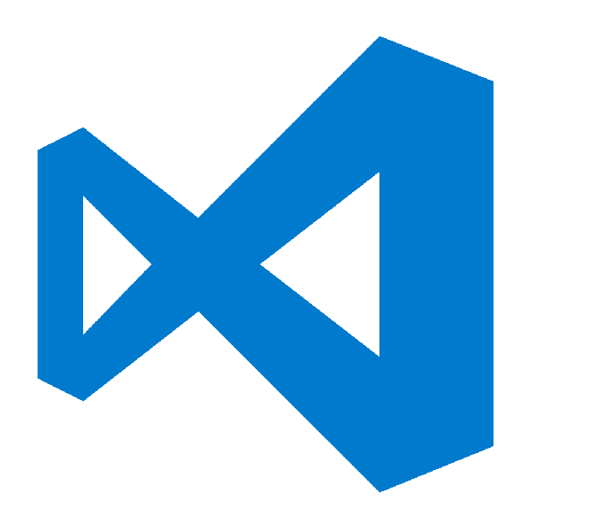


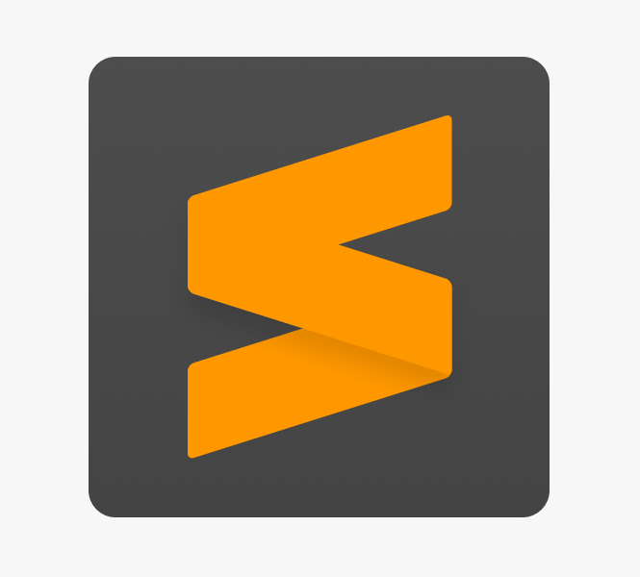


Editing
Editing
Use your favorite
code editor!
Use your favorite code editor!
Notes:
Feel free to use your favorite editor when creating and editing playbooks and other files related to Terraform. There are a ton of great options out there.

Slide 16
VS Code
Open Source editor maintained by Microsoft
Supports Azure Authentication
Wide range of extensions
Excellent Azure Terraform Extension
Notes:
VS Code is a great editor! It is open source and has seen amazing adoption over it’s first few years of life. VS Code has great support for both Terraform and Azure. There are plugins that make logging into Azure and deploying Azure resources simpler.
Also, there is a great Terraform extension, let’s look at some of the features it provides.

Slide 17
Editing
What’s your favorite editor?
Use your favorite code editor!
Notes:
Let’s take a minute to ask our participates which is their go-to editor. This can drive some fun conversation.

Slide 18

Lab: Environment Setup & Configuration
Installing and Configuring a Terraform Development Environment

Slide 19
Follow up questions?

Slide 20
Section 1 Setup Azure Provider

Slide 21
Objectives
Understand how to set up the Azure Provider
Successfully Authenticate
Deploy an azurerm resource
Notes:
In this section we’ll cover Authenticating with Terraform. There are many ways to authenticate, but we will simply authenticate via az login through the azure cli.

Slide 22
Authentication
Notes:
Two of the most common authentication methods are Service Principal authentication and standard Azure AD User account authentication.

Slide 23
Service Principal
client_id
tenant_id
Secret
subscription_id
Credentials are stored in environment variables or a credentials file
Profile Configuration at ~/.azure/credentials
Notes:
A service principal is commonly used for programmatic access to Azure. Service principals are favored because access can be restricted via RBAC for least privilege access to the required services. Service principals can be setup using certificate or password authentication.
Service principals can be created via the Azure CLI using the following command:
az ad sp create-for-rbac --name ServicePrincipalName --password <Choose a strong password>
To make use of a service principal you need the following information about your account:
client_id
tenant_id
subscription_id
secret/certificate
This information can be stored in a profile, environment variables or specified on the azure resource itself in the terraform file.
Using Service Principals is the standard way of deploying infrastructure through Automation like in Jenkins, Azure DevOps, Octopus, etc.

Slide 24
Lab: Setup Azure Provider
Notes:
Let’s kick off a lab that shows how to deploy some Azure infrastructure.
After the lab, perform a simple knowledge check.

Slide 25
Knowledge Check
What is the name of the Azure Provider?
What’s the difference b/w .tf and .tfvars files?
What are the 4 different ways of Authenticating to Azure with Terraform?
Notes:
Question 1 Answer:
azurerm
Question 2 Answer:
A variables.tf file is used to define the variables type and optionally set a default value.
A terraform.tfvars file is used to set the actual values of the variables.
You could set default values for all your variables and not use tfvars files at all.
Actually the objective of splitting between the definitions and the values, is to allow the definition of a common infrastructure design, and then apply specific values per environment.
Using multiple tfvars files that you give as an argument allows you to set different values per environment : secrets, VM size, number of instances, etc.
Question 3 Answer:
Authenticating to Azure using the Azure CLI
Authenticating to Azure using Managed Service Identity
Authenticating to Azure using a Service Principal and a Client Certificate
Authenticating to Azure using a Service Principal and a Client Secret (which is covered in this guide)

Slide 26
Follow up questions?

Slide 27
Section 2 Setup Remote Backend
Notes:
Great! We can now authenticate and build Terraform resources. That’s great!
You’ll notice that once you run terraform apply, a ./.terraform/terraform.tfstate file was created for you. That is the local state. That is how terraform is able to reconcile deployed resources with Terraform configurations.
My teammate may be working on the same code, but her/his state file may be different from mine? How do I collaborate with other teammates? In this section, we will enable team collaboration by setting up the remote backend state

Slide 28
Objectives
Learn how to securely manage terraform state on Azure with Azure Key Vault
Learn how to work on a team with Terraform
Notes:
In this section we’ll
Learn how to manage terraform state on Azure
Learn how to work on a team with Terraform

Slide 29
What is Azure Key Vault?
Azure Key Vault is a tool for securely storing and accessing secrets. Key Vault helps solve the following problems:
Secret management
Key management
Certificate management
Store secrets backed by HSMs
Notes:
Cloud applications and services use cryptographic keys and secrets to help keep information secure. Azure Key Vault safeguards these keys and secrets. When you use Key Vault, you can encrypt authentication keys, storage account keys, data encryption keys, .pfx files, and passwords by using keys that are protected by hardware security modules (HSMs).
Key Vault helps solve the following problems:
Secret management: Securely store and tightly control access to tokens, passwords, certificates, API keys, and other secrets.
Key management: Create and control encryption keys that encrypt your data.
Certificate management: Provision, manage, and deploy public and private Secure Sockets Layer/Transport Layer Security (SSL/TLS) certificates for use with Azure and your internal connected resources.
Store secrets backed by HSMs: Use either software or FIPS 140-2 Level 2 validated HSMs to help protect secrets and keys.

Slide 30
Lab: Managing Terraform State on Azure
Notes:
Let’s kick off a lab that shows how to Managing Terraform State on Azure by Setting up the remote backend

Slide 31
Knowledge Check
Can a terraform state file include sensitive information?
What are 4 different ways for authenticating terraform remote backend to an Azure Storage Account?
Notes:
Q1
Yes, terraform state will see things in plain text.
Q2 https://www.terraform.io/docs/backends/types/azurerm.html
using the Azure CLI or a Service Principal
using Managed Service Identity (MSI)
using the Access Key associated with the Storage Account
using a SAS Token associated with the Storage Account

Slide 32
Follow up questions?

Slide 33
Section 3 Terraform Modules
Notes:
A module is a container for multiple resources that are used together. Modules can be used to create lightweight abstractions, so that you can describe your infrastructure in terms of its architecture, rather than directly in terms of physical objects.
The *.tf* files in your working directory when you run terraform plan or terraform apply together form the root module. That module may call other modules and connect them together by passing output values from one to input values of another.

Slide 34
Objectives
Learn how to create your own custom Terraform Modules with some tips and trick along the way
Learn how to deploy to multiple environments

Slide 35
Lab: Create a Terraform Module

Slide 36
Knowledge Check
What would be a good use case for creating a custom module?
How would I get the 16th ip address in the CIDR address prefix 10.12.127.0/20 using Terraform?
When would it be good to use Terraform locals?
Notes:
Q1
Keep this in mind https://www.terraform.io/docs/modules/index.html#when-to-write-a-module
Yes, creating a resource group is a terrible example. The answers can vary. Think of this as a team
Q2
This question is not really related to what we learned, but hopefully the audience picked up where to find this when scavenging for the Terraform functions
cidrhost("10.12.127.0/20", 16)
Q3
https://www.terraform.io/docs/configuration/locals.html#when-to-use-local-values

Slide 37
Follow up questions?

Slide 38
Section 3 Deploying Resources
Notes:
In this lab, we will learn how to deploy multiple Azure resources that depend on each other

Slide 39
Objectives
Learn how to deploy resources that depend on each other
Learn how to provision resources

Slide 40
Lab: Deploy Resources

Slide 41
Knowledge Check
If you have a resource named azurerm_network_interface.vm, and need to deploy a virtual machine that depends on this resource, how do you explicitly ensure that azurerm_network_interface.vm is provisioned completely before the vm?
How do I reference an existing Azure Key Vault secret in Terraform?
What command is used to generate a visual representation of either a configuration or execution plan.
Notes:
A1
Depends_on = [azurerm_network_interface.vm]
A2
data "azurerm_key_vault_secret" "main" {
name = var.admin_pw_name
key_vault_id = var.key_vault_resource_id
}
A3
https://www.terraform.io/docs/commands/graph.html
Terraform graph

Slide 42
Follow up questions?

Slide 44
Photo layout 1

Slide 45
Objectives
Running Terraform on your favorite platform
Test
Editing playbooks

Slide 46
Lab: <<Add Lab Name: >>
<< Add Lab Description >>

Slide 47
Knowledge Check
Question #1
Question #2
Question #3
Notes:
Question 1 Answer:
Question 2 Answer:
Question 3 Answer:

