Slide 1
Pandemic Analytics Major Project: Haryana
Harpinder Singh

Slide 2
TASK 1
DATA VISUALIZATIONS
Present State Analytics

Slide 3
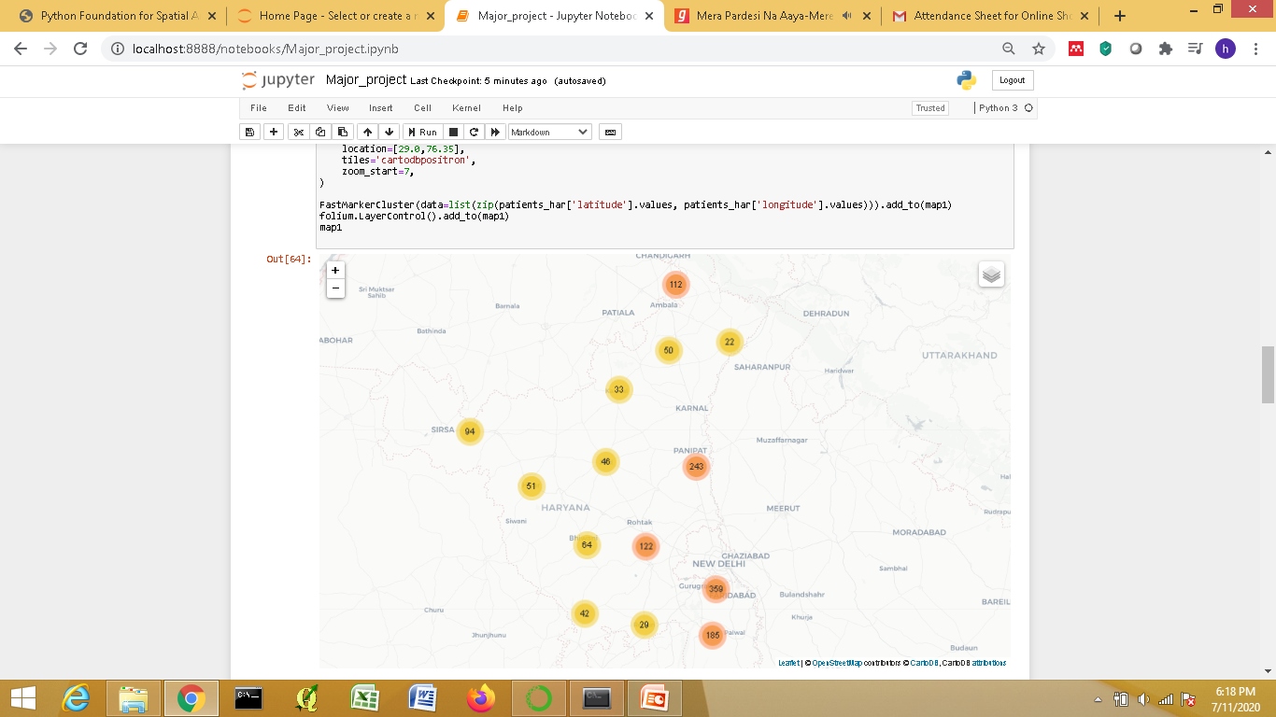
Interactive Map of the Infected Cases in Haryana using Folium
User can Zoom In and Zoom Out

Slide 4
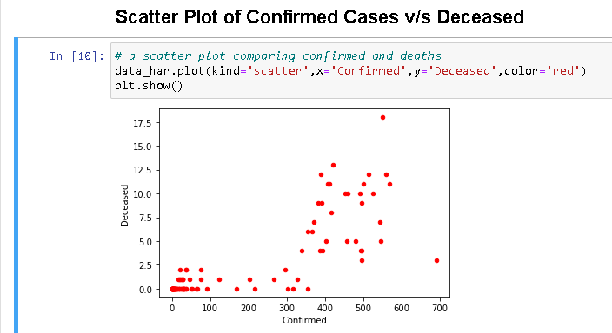

Slide 5
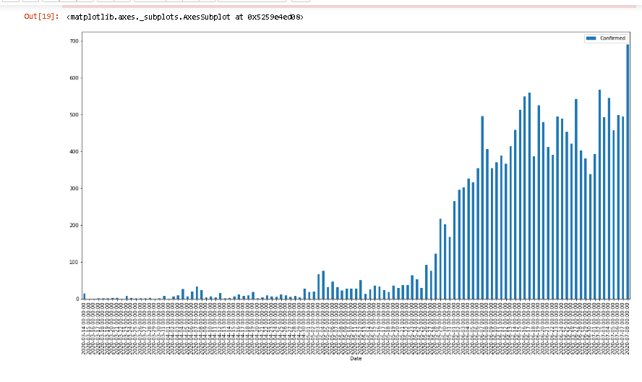
Bar Graph showing the Increase of the Confirmed Cases in Haryana

Slide 6
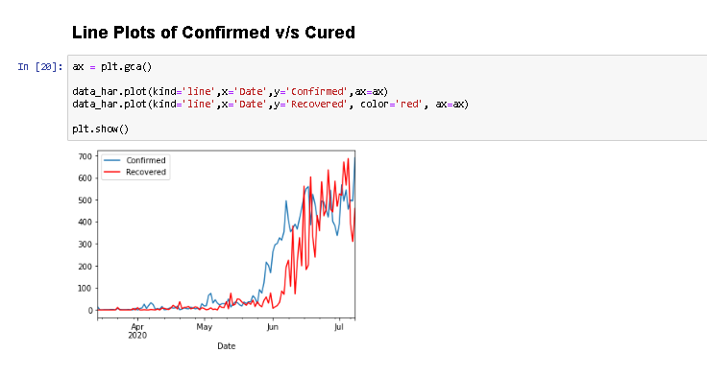

Slide 7
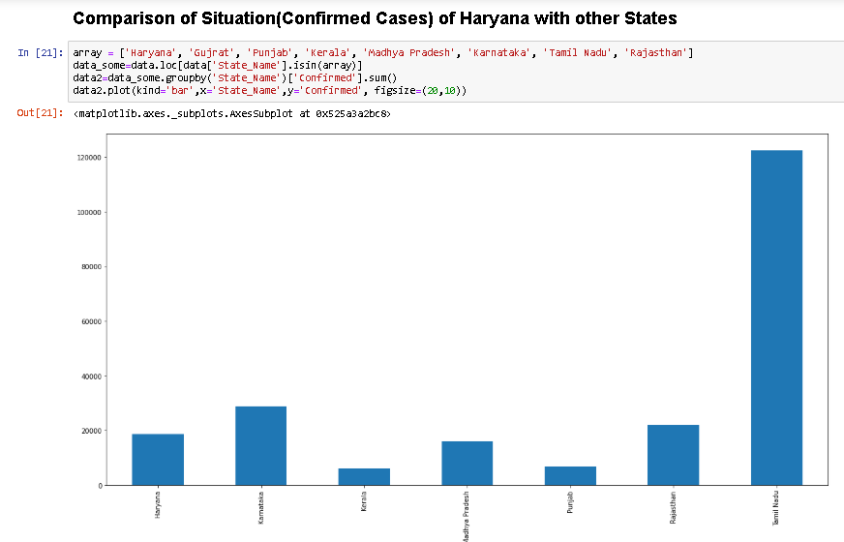

Slide 8
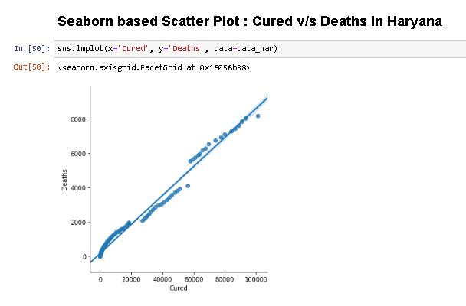

Slide 9
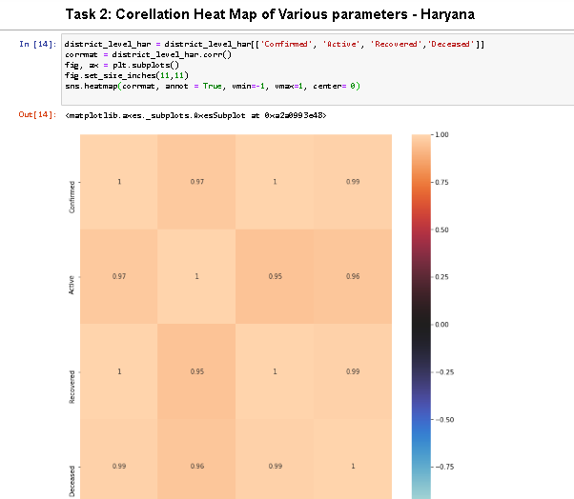
TASK 2

Slide 10
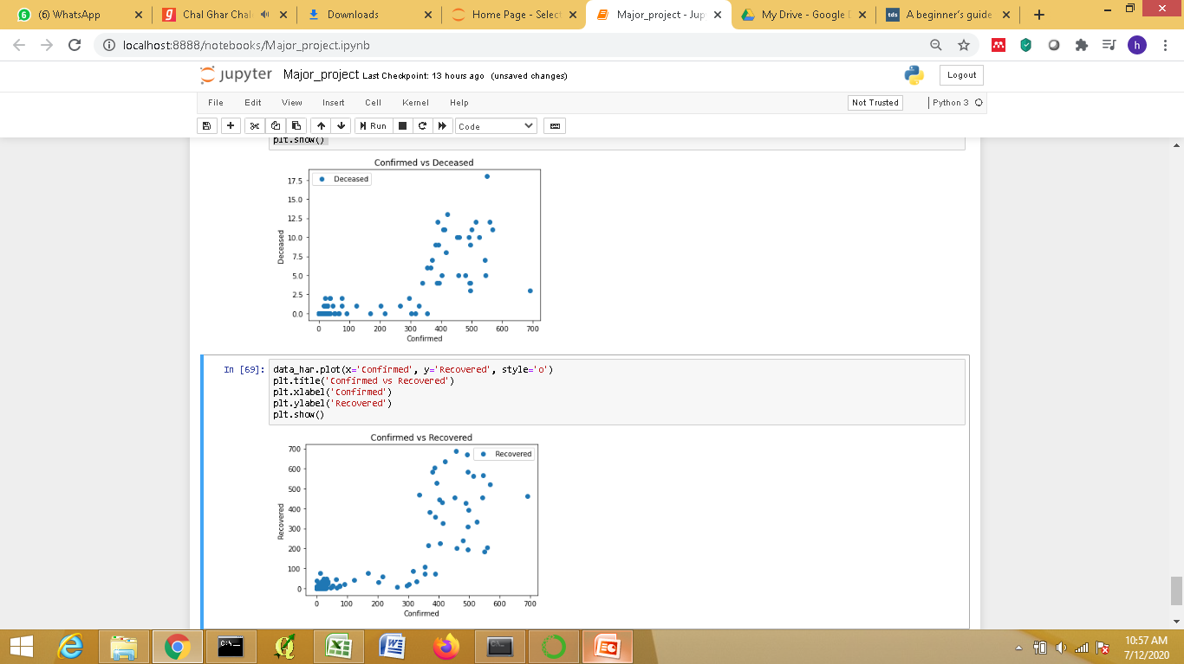
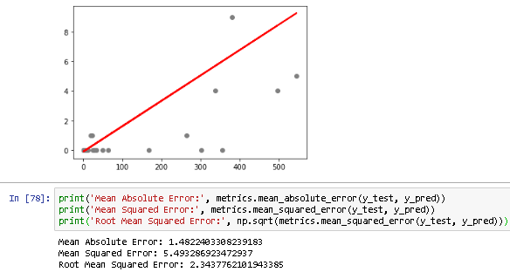
Regression
TASK 3

Slide 11
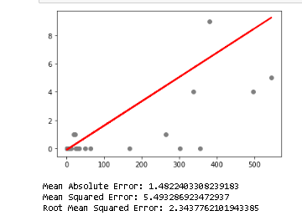
Regression
TASK 3
continued

Slide 12
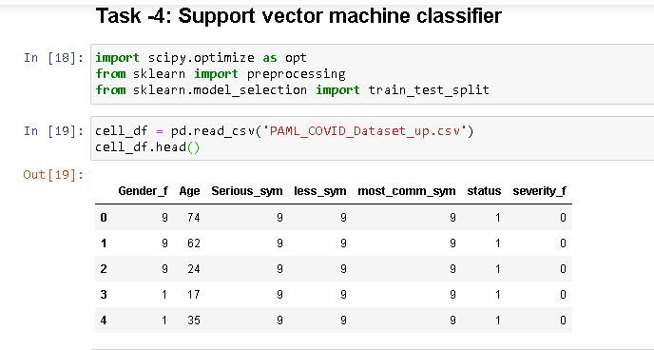
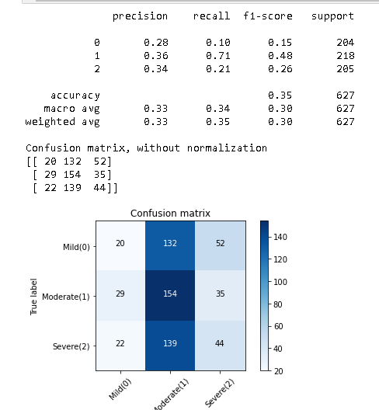
TASK 4

