Slide 1
Pandemic Analytics Minor Project: Maharashtra
Harpinder Singh

Slide 2
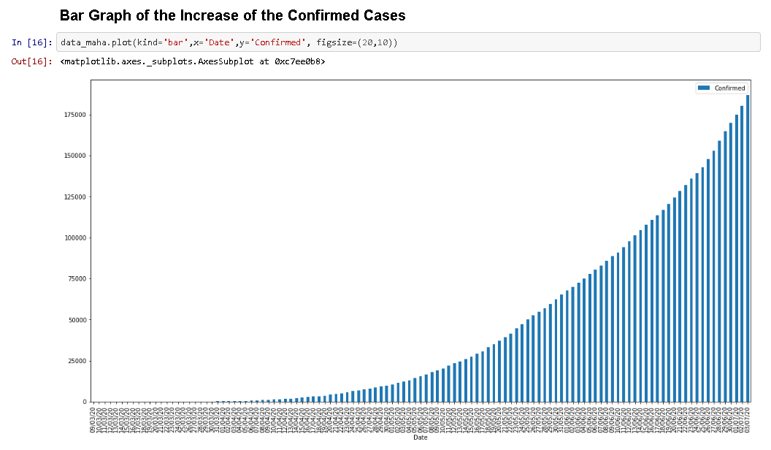
Bar Graph showing the Increase of the Confirmed Cases in Maharashtra

Slide 3
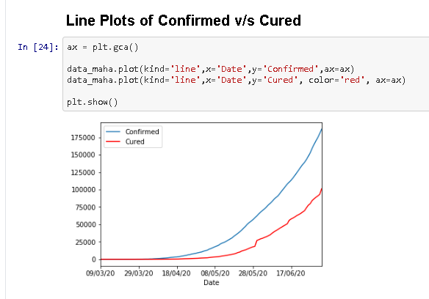

Slide 4
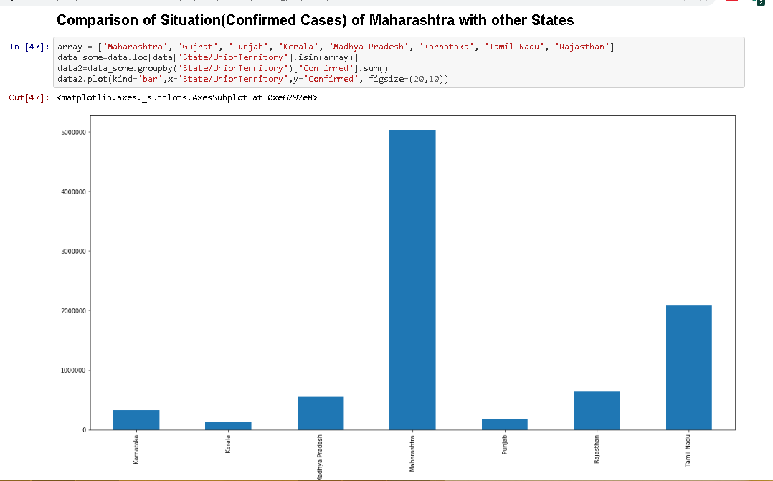

Slide 5
