Slide 1
Pandemic Analytics Major Project: Haryana
Harpinder Singh

Slide 2
Prediction of Confirmed Cases using Open source Facebook Prophet library Date Dates : 14 March to 8 July 2020
TASK 1
India Statistics

Slide 3
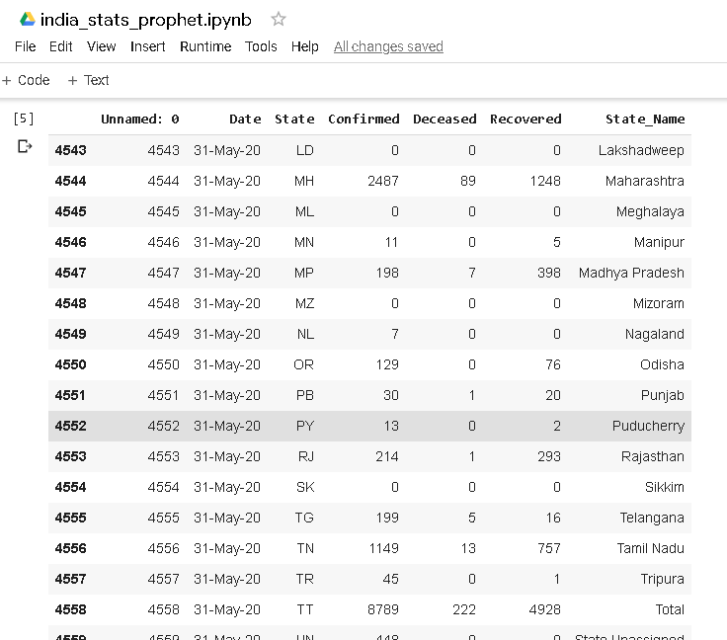
India Statistics: Data

Slide 4
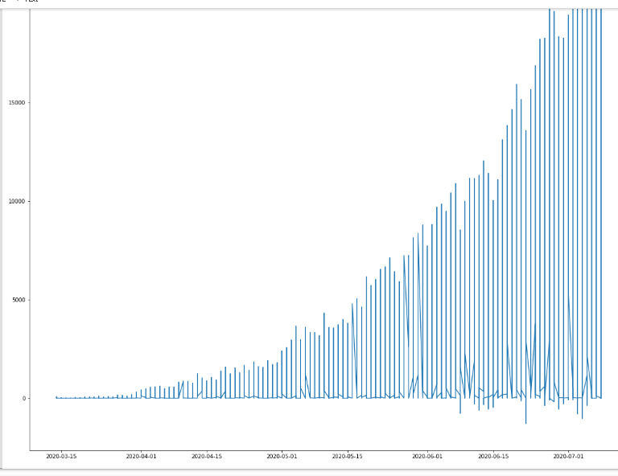
India Statistics: Date wise Confirmed Cases

Slide 5
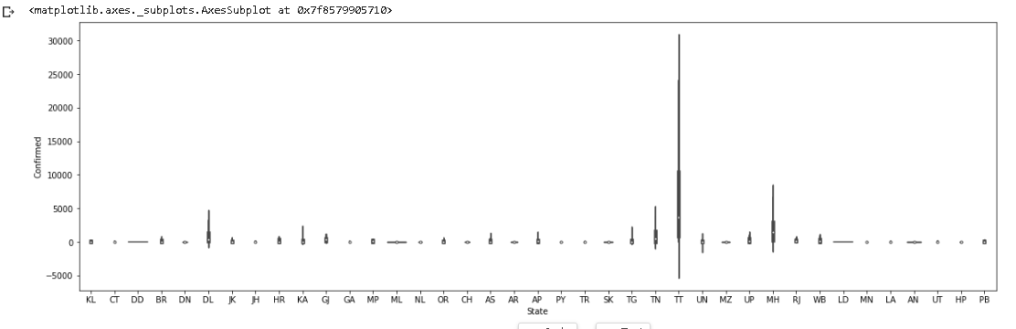
India Statistics: Violin Plot of state wise confirmed cases

Slide 6
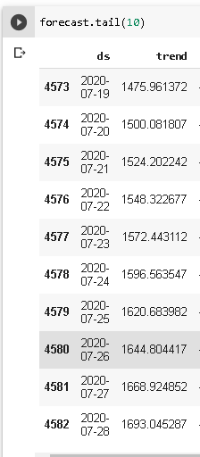
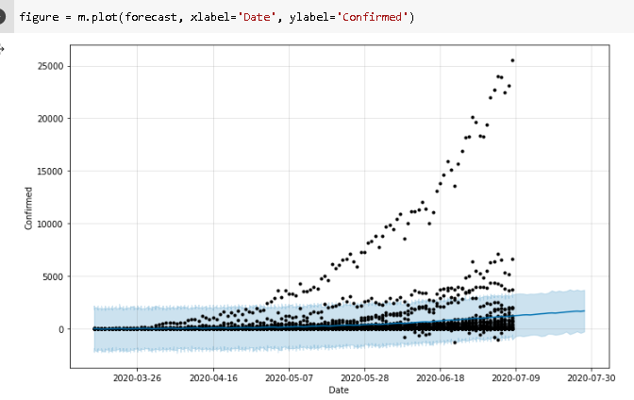
India Statistics: Prediction for the next 20 Days of Confirmed Cases
Historic Data
Predicted Data

Slide 7
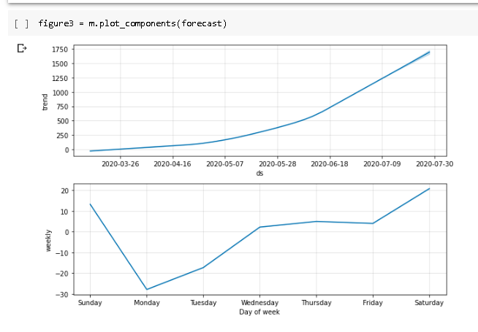
India Statistics: trend (Confirmed Cases) for the next 20 days

Slide 8
Haryana State

Slide 9
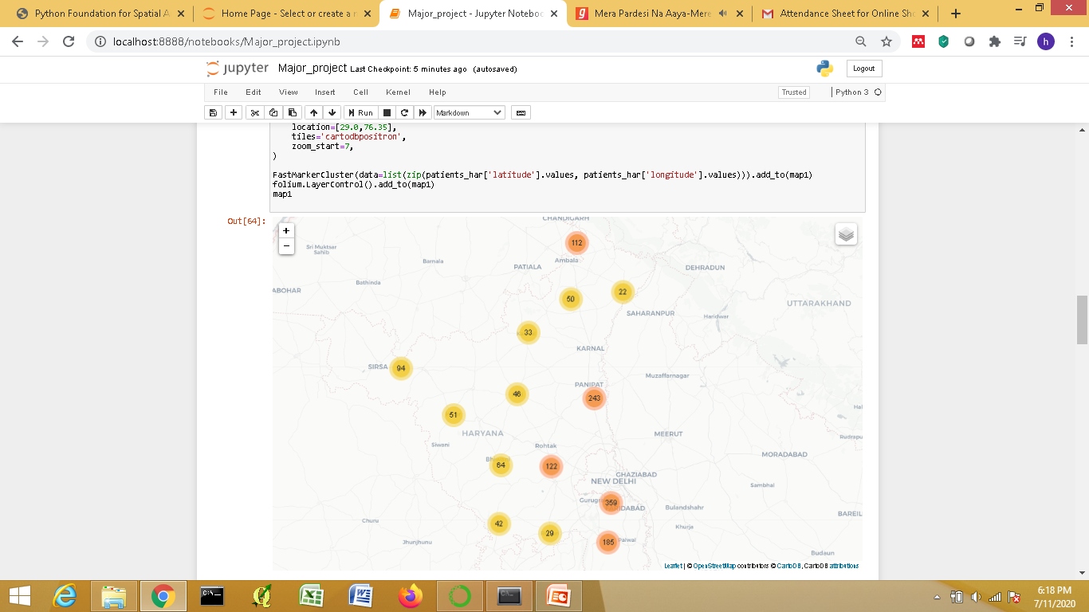
Interactive Map of the Infected Cases in Haryana using Folium
User can Zoom In and Zoom Out

Slide 10
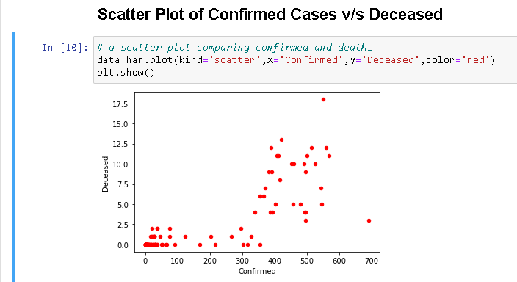

Slide 11
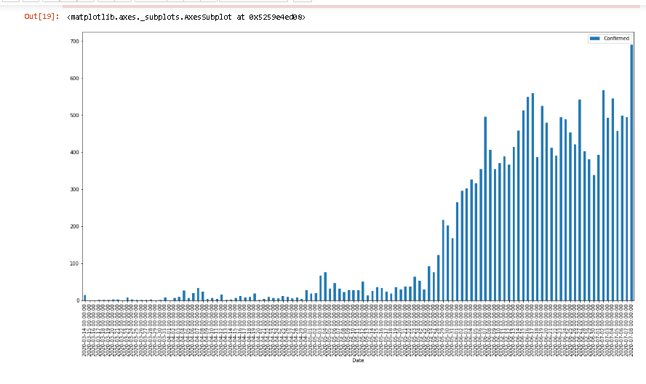
Bar Graph showing the Increase of the Confirmed Cases in Haryana

Slide 12
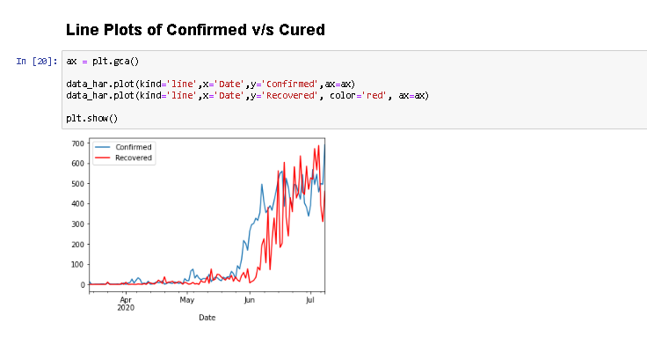

Slide 13
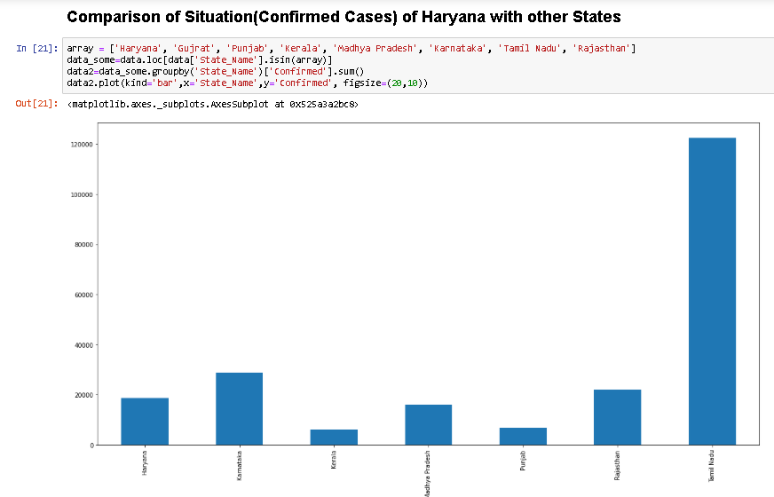

Slide 14
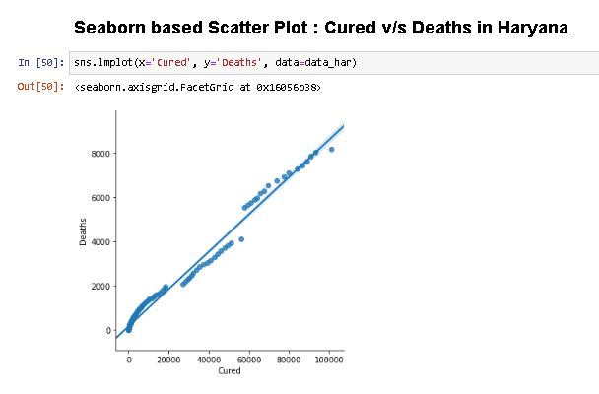

Slide 15
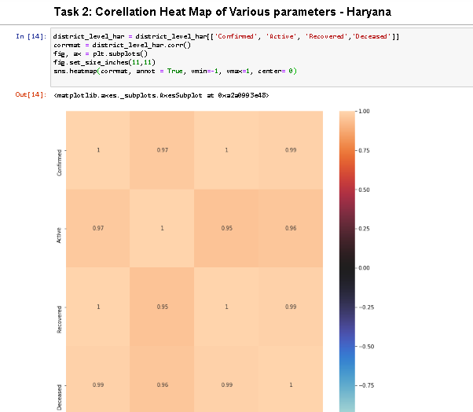
TASK 2

Slide 16
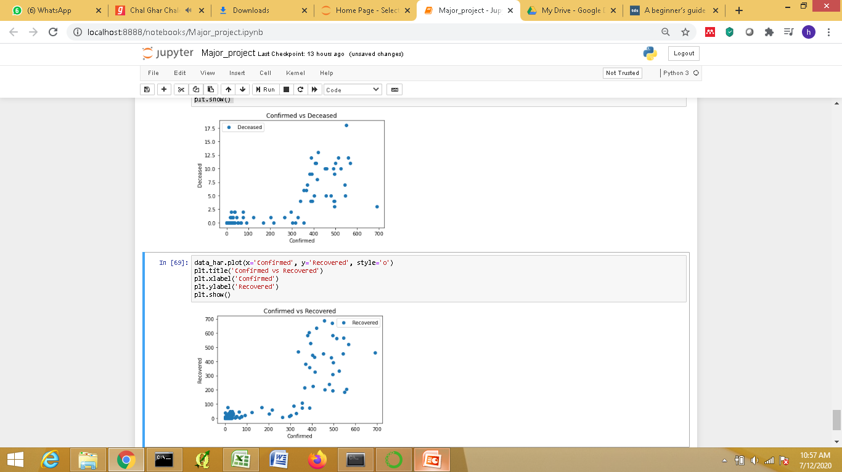
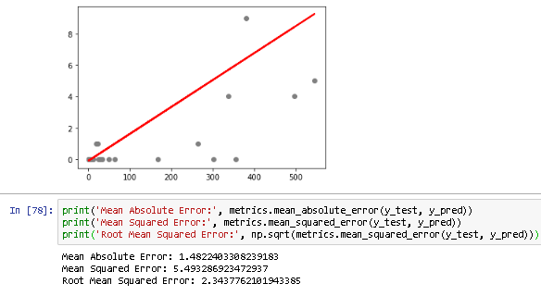
Regression
TASK 3

Slide 17
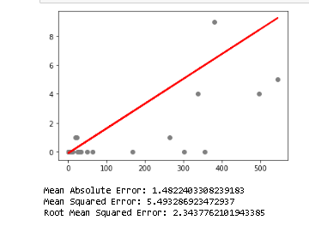
Regression
TASK 3
continued

Slide 18
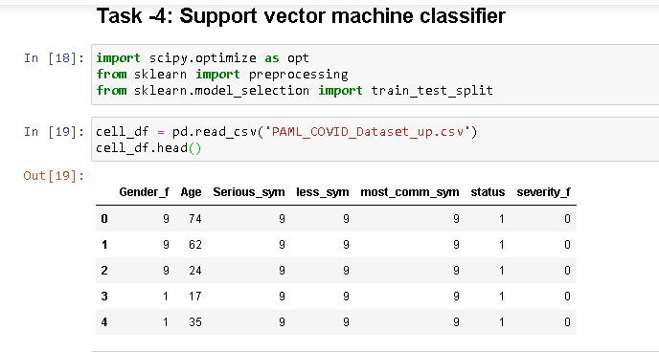
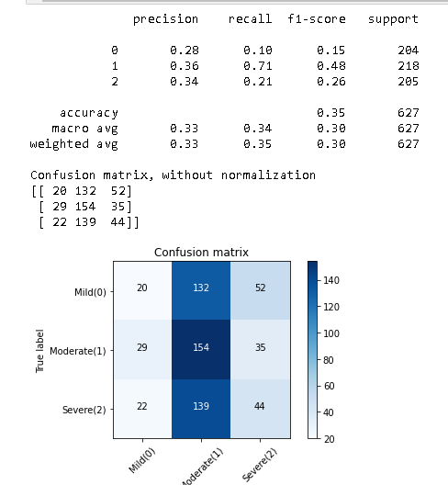
TASK 4

