Slide 1

BANK MARKETING
Harpreet Kang, harpreet.kang@torontomu.ca
Supreet Saini, supreet.saini@torontomu.ca
Prashanth Vijayaraja, prashanth.vijayaraja@torontomu.ca
Notes:
Title slide

Slide 2
Workload Distribution
Member Name | List of Tasks Performed
Harpreet Kang Supreet Saini Prashanth Vijayaraja | Data Preparation (Harpreet)
Supreet Saini Harpreet Kang Prashanth Vijayaraja | Model (Supreet)
Prashanth Vijayaraja Harpreet Kang Supreet Saini | Recommendation (Prashanth)

Slide 3

OVERVIEW

Slide 4
Aim of the Project
Problem:
The dataset pertains to the issue of telemarketing for a Portuguese bank, which aims to develop an efficient strategy for promoting long-term deposit accounts such as bonds and savings accounts.
Task:
The marketing campaigns relied on phone calls, and it was common to make multiple contacts to determine whether a customer would opt for a long-term deposit account. Our objective is to assist the bank in identifying such customers and creating an efficient telemarketing strategy using data analytics techniques applied to the provided dataset.

Slide 5
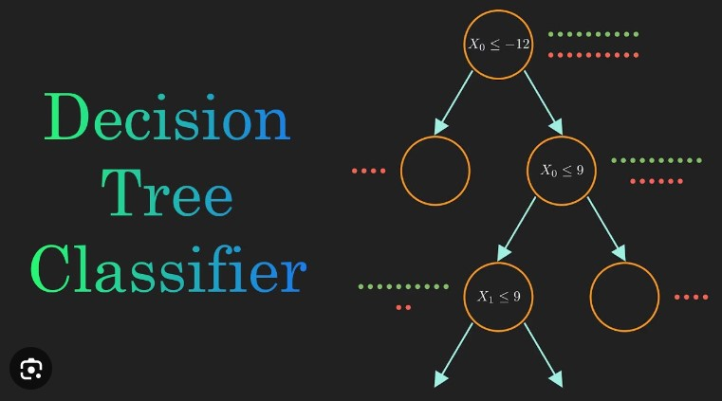



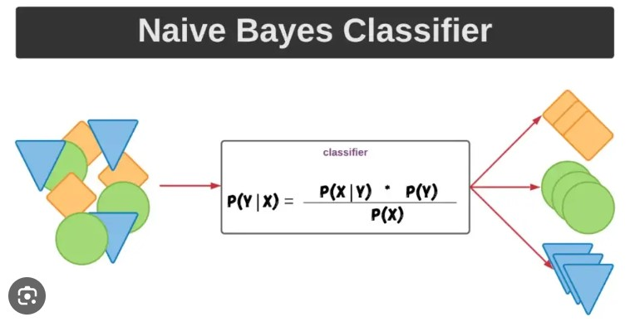
Tools Used
ML Methods Used
Python (Weka & Sklearn)
SAS
RStudio
Decision Tree
Naive Bayes

Slide 6
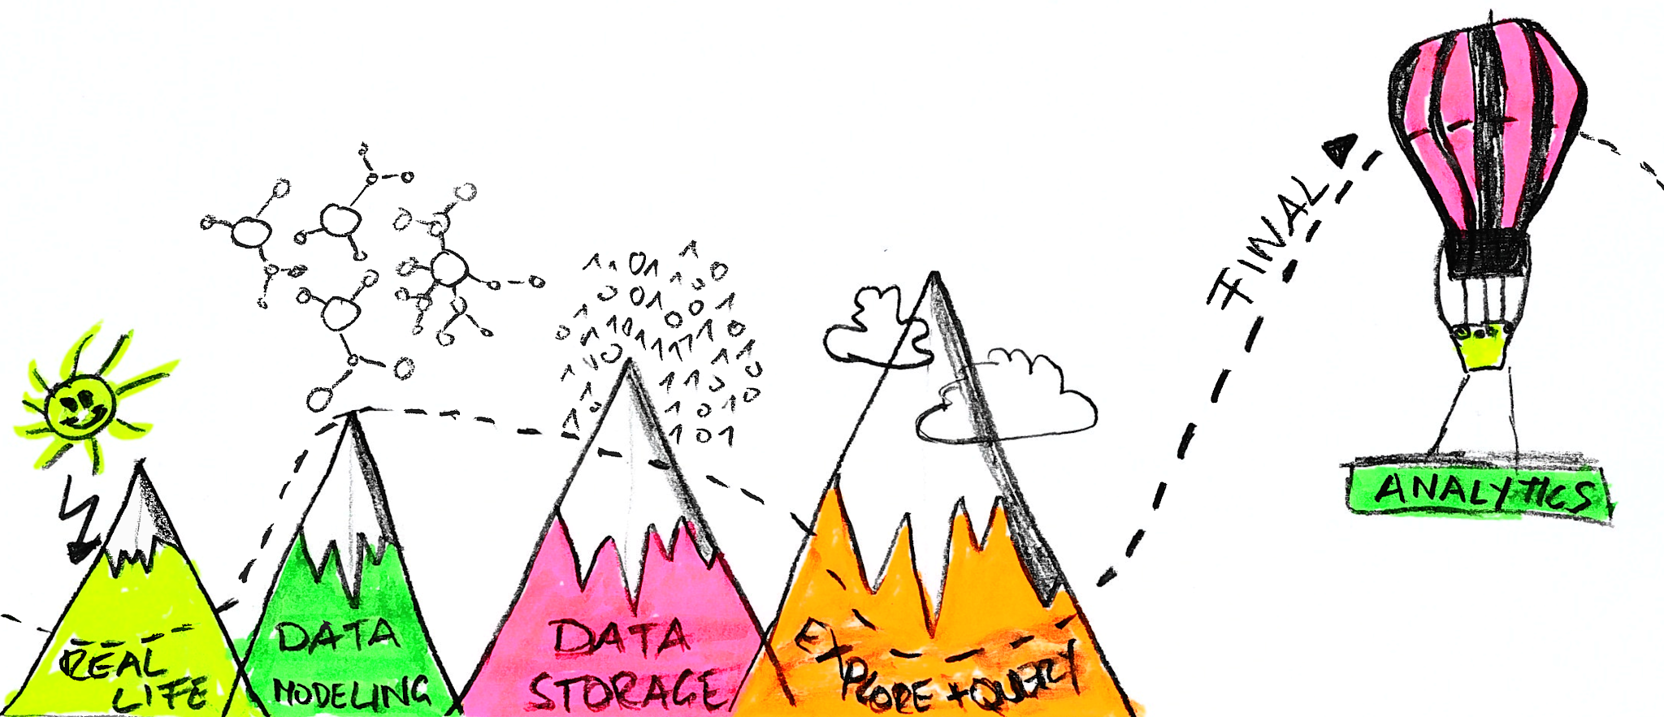
DATA PREPARATION

Slide 7

Understanding the Dataset
Bank Marketing Dataset
4521 Rows
17 Attributes
Age Day
Job Month Marital Duration
Education Campaign
Default Pdays
Balance Previous
Housing Poutcome
Loan Y
Contact

Slide 8
Feature | Data Type | Mean | Min | Max | Standard Deviation | Object
Y | Nominal (Label) | - | - | - | - | Qualitative (Yes/No)
Balance | Continuous | 1, 449.33 | -3, 313 | 71, 188 | 2, 993.73 | Numeric
Duration | Continuous | 263.96 | 4 | 3, 025 | 259.86 | Numeric
Age | Discrete | 41.17 | 19 | 87 | 10.58 | Numeric
Campaign | Discrete | 2.79 | 1 | 50 | 3.11 | Numeric
Day | Discrete | 15.92 | 1 | 31 | 8.25 | Numeric
PDays | Discrete | 40.59 | -1 | 871 | 99.79 | Numeric
Previous | Discrete | 0.54 | 0 | 25 | 1.69 | Numeric
Education | Ordinal | - | - | - | - | Qualitative
Month | Ordinal | - | - | - | - | Qualitative
Contact | Nominal | - | - | - | - | Qualitative
Default | Nominal | - | - | - | - | Qualitative
Housing | Nominal | - | - | - | - | Qualitative
Job | Nominal | - | - | - | - | Qualitative
Loan | Nominal | - | - | - | - | Qualitative
Marital | Nominal | - |  | - | - | Qualitative
POutcome | Nominal | - | - | - | - | Qualitative
16 features
1 label
4,521 records
No Missing Values

Slide 9
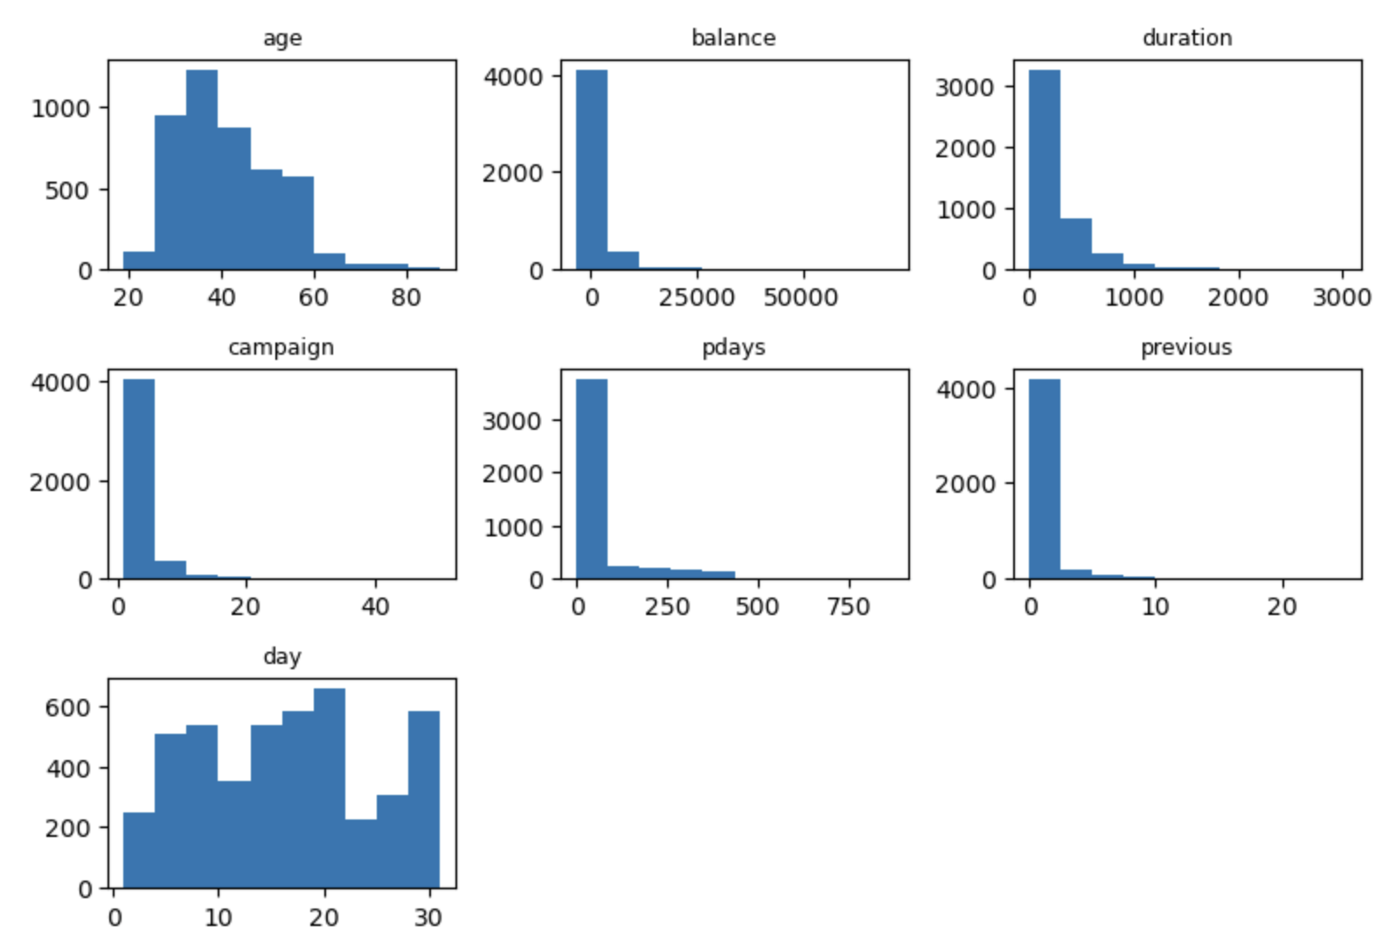
Distributions
As shown below, by plotting the features {Age, Balance, Duration, Campaign, PDays and Previous} the distributions are skewed to the right. The ‘day’ feature does not show significant distribution.

Slide 10
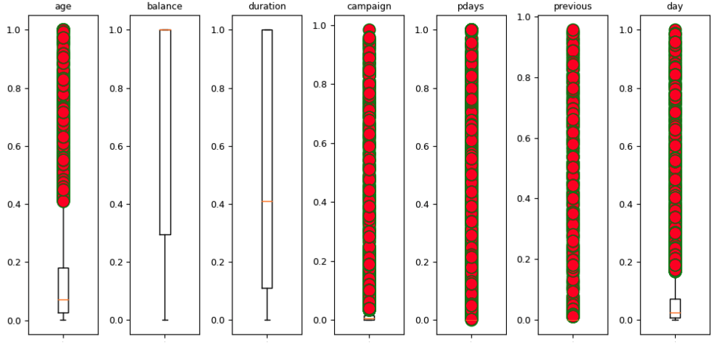
Outliers
As shown below, by plotting the features {Age, Balance, Duration, Campaign, PDays, day and Previous} on the box plot visually shows the amount of outliers that are present in the collective dataset.

Slide 11
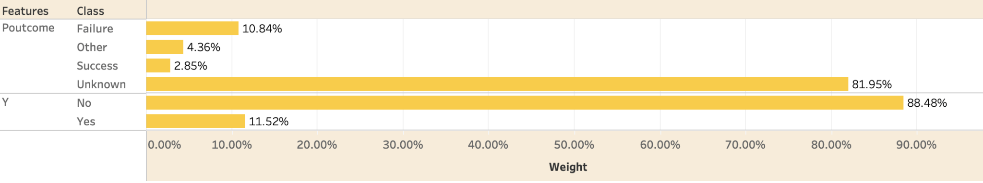

Imbalanced
The label of this dataset is unbalanced.
These results will give biased results when completing the machine learning algorithms.

Slide 12
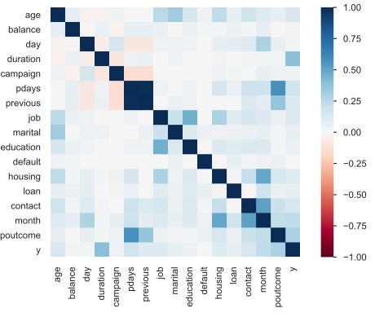
Correlation
Features Correlated | Correlation Strength | Correlated Features to Drop | Scientific Tool
Pdays, Previous, Poutcome | High | Poutcome Pdays | Pandas Profile Report
Contact, Month | High |  | Pandas Profile Report

Slide 13

PREDICTIVE MODELING

Slide 14
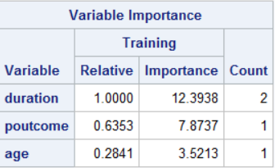
Feature Selection/Processing
According to sklearn documentation:
“Able to handle both numerical and categorical data. However, the scikit-learn implementation does not support categorical variables for now. Other techniques are usually specialized in analyzing datasets that have only one type of variable”
We used all the features for the first test of both models.
We selected features based on Sklearn, R, SAS , and Weka.
We used the Min Max normalization to scale the features,
Under Sampling and Over Sampling,
Grid Search CV and K Folds.
R | SAS | Weka
Duration | Duration | Duration
Poutcome | Poutcome | Poutcome
Job | Age | Age
Month
Balance
Marital

Slide 15
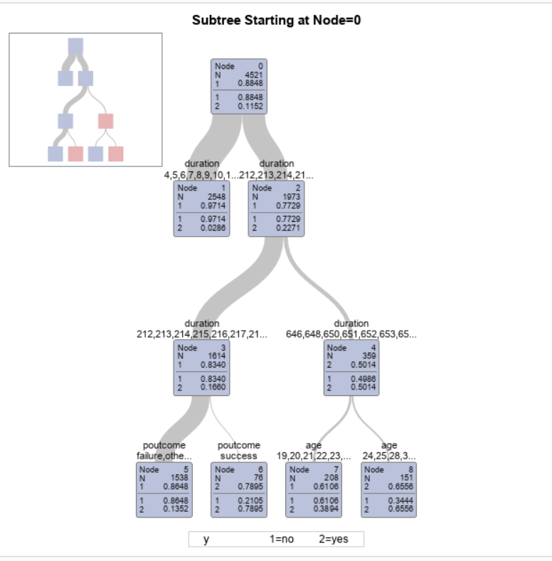
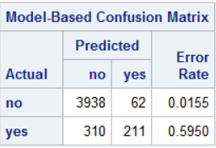
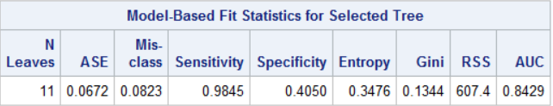
Decision Tree with all columns considered - SAS
The HPSplit Procedure

Slide 16
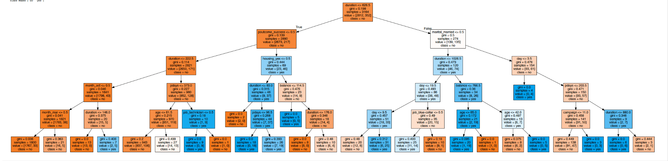
Decision Tree with all columns considered - Python

Slide 17
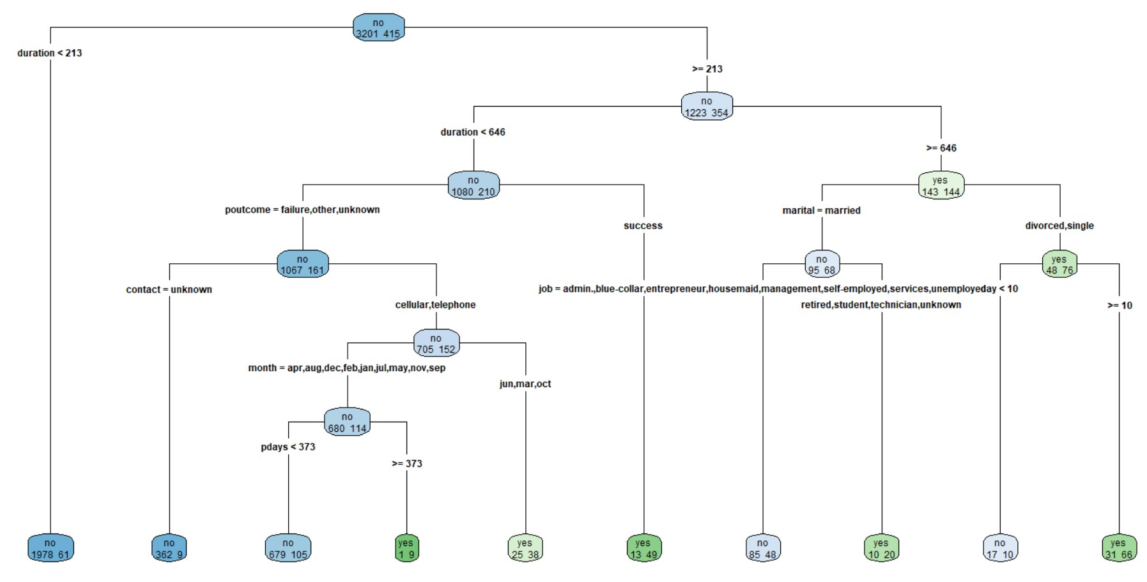
Decision Tree with all columns considered - R

Slide 18
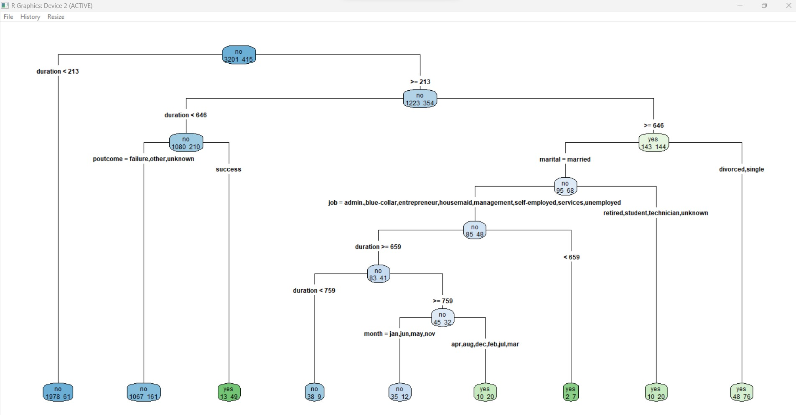
Decision Tree with selected columns considered - R
Decision Tree with Selected variables (duration, outcome, job, month, balance, marital and age)

Slide 19
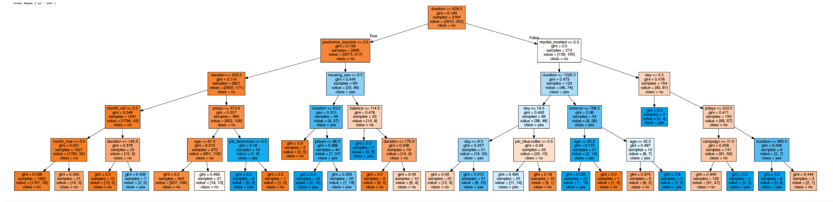
Decision Tree with 7 selected columns considered - Python

Slide 20
Decision Tree (All Results)
All Features
Class No | Actual (+) | Actual (-)
Predicted (+) | TP : 761 | FP: 50
Predicted (+) | FN: 44 | TN: 49
Compared to R, SAS, and Sklearn.
Accuracy | Precision | Recall | F1 Score
89.60% | 93.83% | 94.53% | 94.18%
Selected Features
MinMaxScaler
KFolds
Grid Search CV
Balanced Class
Class No | Actual (+) | Actual (-)
Predicted (+) | 786 | 23
Predicted (+) | 67 | 29
Label | Weight
Y | Yes: 44.44% No: 55.56%
Accuracy | Precision | Recall | F1 Score
90.06% | 97.16% | 92.15% | 94.59%

Slide 21
Naive Bayes
All Features
Class No | Actual (+) | Actual (-)
Predicted (+) | TP : 741 | FP: 64
Predicted (+) | FN: 49 | TN: 50
Accuracy | Precision | Recall | F1 Score
87.50% | 93.80% | 92.05% | 92.92%
Selected Features
Class No | Actual (+) | Actual (-)
Predicted (+) | 778 | 20
Predicted (+) | 86 | 21
Selected Features
MinMaxScaler
KFolds
Grid Search CV
Balanced Class
Accuracy | Precision | Recall | F1 Score
88% | 90% | 97% | 94%

Slide 22
Conclusion of Predictive Modeling
Model | Accuracy | Precision | Recall
Baseline decision tree | 89.60% | 93.83% | 94.53%
Decision tree on selected features | 90.06% | 97.16% | 92.15%
Baseline Naïve Bayes | 87.50% | 93.80% | 92.05%
Naïve Bayes on selected features | 88% | 90% | 97%

Slide 23
Recommendations
As evident from the models developed from Python, R and SAS-
The related variables to be considered for achieving high customer turnover for long-term investment falls in the following criteria-
Aged 24 and above
Call duration should be more than 10 minutes.
Single and divorced individuals are more likely to invest
Students, Retired persons and Technicians under Job category
pday (delay from the previous contacted date) > 296 days
Impact is more when contacted in the month of Feb, March, April, July, August and December.

Slide 24
Thank you

