Slide 1
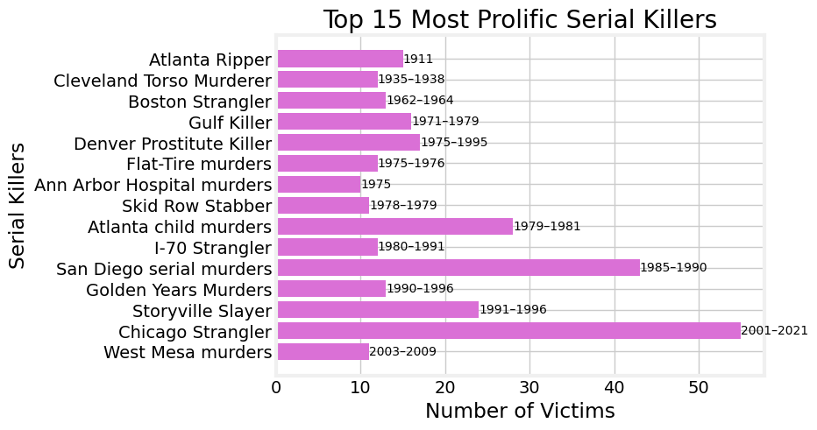
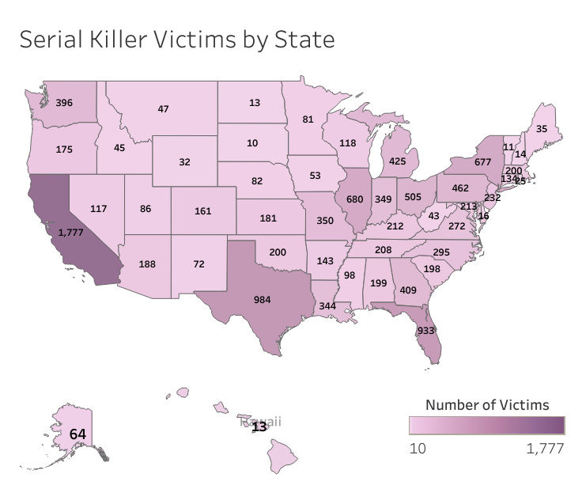
Serial Killers in the United States
Kaylee Harp, Northwest Missouri State University
The FBI estimates there are between 25 to 50 active serial killers at any given time. I was curious which states were more prone to having a serial killer and when were serial killers more common.
Results
Serial killers with the highest confirmed victim counts remain unidentified, hence they are commonly referred to by names media monikers gave them.
The era between 1970 and 1990 saw the peak of activity for the majority of the top 15 serial killers.
Regions with lower population densities typically report fewer victims, while states boasting large cities and higher populations tend to have a higher incidence of both victims and serial killers.
Introduction
Conclusion
Only proven victims are
included in the victim count.
The numbers along the graph are the dates each serial killer was active
Information from two different websites was gathered, cleaned, and studied. Beautiful Soup was used to extract the data that was in html format to a useable dictionary format. Pickle was used to save the information gathered to not re-hit the websites API. Matplotlib was used to give an accurate representation of the data.
Tableau was used to create the choropleth map of the U.S.
Materials and Methods
Bibliography
Price, C. (2024, January 3). The US states with the most serial killings. WorldAtlas. https://www.worldatlas.com/crime/the-us-states-with-the-most-serial-killings.html#h_6780997095481704292206547
Wikimedia Foundation. (2024, April 14). List of serial killers in the United States. https://en.wikipedia.org/wiki/List_of_serial_killers_in_the_United_States
Acknowledgments
Further Information
Other than the top 4 serial killers who were sadly able to murder more than 24 people, the majority of serial killers killed less than 17 people. In the future it would be beneficial to look at the population of each state in the years that the serial killers were active.
I would like to think Professor Eloe for teaching the information necessary to have a good foundation and giving me the ability to put my new skills to use.

