Slide 1
Superstore Sales: Data Storytelling and Business Insights
Internship Task 9 Data Storytelling and Business Insights
Tools: Python, Pandas, Matplotlib, Seaborn

Slide 2
Business Objective & Dataset
Business Objective
Analyze sales performance across products, regions, and customer segments.
Identify high- and low-performing areas.
Understand order patterns and sales trends over time.
Identify opportunities for business growth and improvement.
Support data-driven business decision-making.
Dataset Overview
9,800 records
18 columns
Contains information about customers, products, sales, regions, shipping, and orders.
Analysis performed using Python, Pandas, Matplotlib and Seaborn.

Slide 3
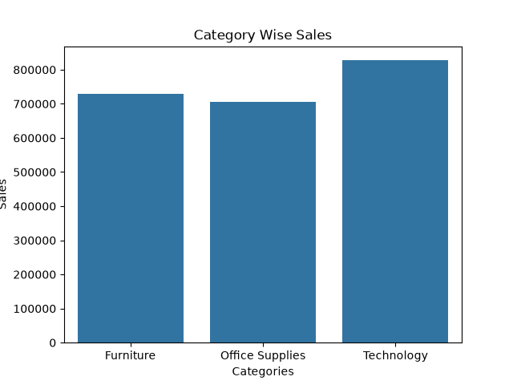
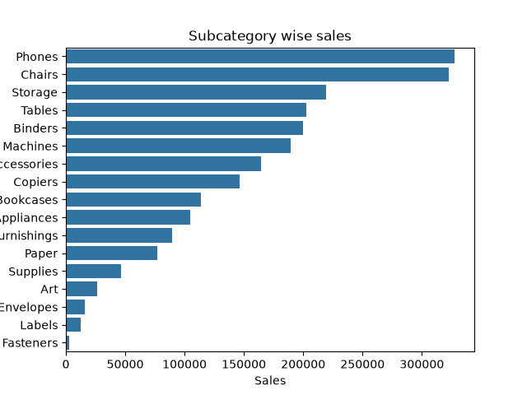
Product Performance
Key Findings
Technology — Highest Revenue Category
Total Sales: $827,455.87
Followed by Furniture: $728,658.58
Office Supplies: $705,422.33
Phones — Highest Revenue Sub-Category
Total Sales: $327,782.45
Chairs followed closely: $322,822.73
Business Takeaway
Technology and its high-performing sub-categories are important contributors to overall revenue and should be monitored for further growth opportunities.

Slide 4
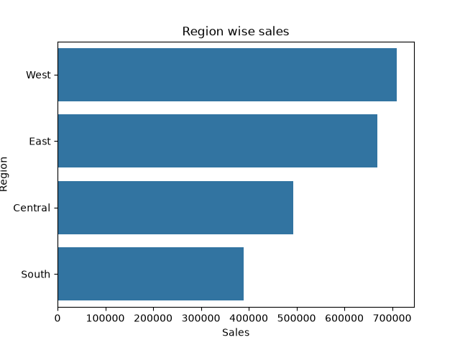
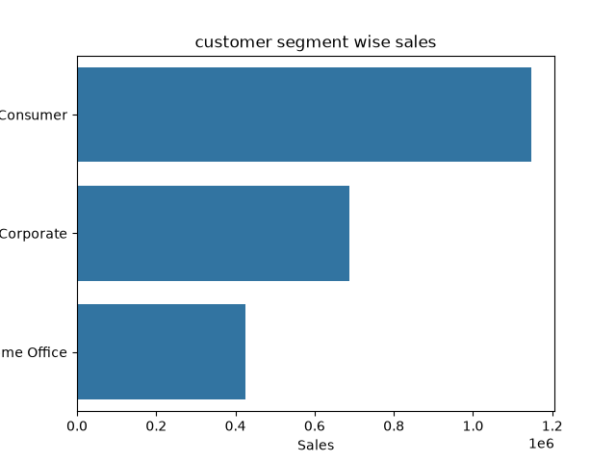
Regional & Customer Performance
Regional Performance
West: $710,219.68 — Highest
East: $669,518.73
Central: $492,646.91
South: $389,151.46 — Lowest
Customer Segment Performance
Consumer: ~$1.148M — Highest
Corporate: ~$688K
Home Office: ~$425K
Business Takeaway
West and Consumer segments are the strongest revenue contributors, while the South region and lower-performing customer segments present opportunities for further investigation and growth.

Slide 5
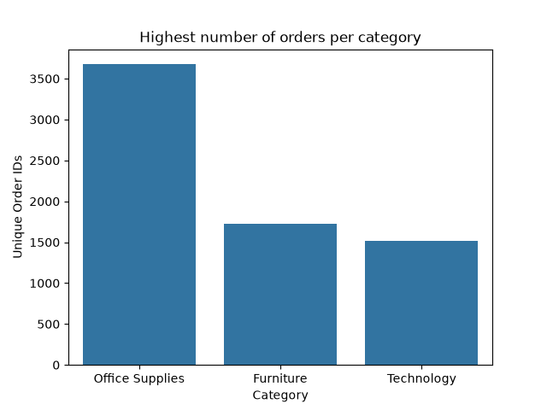
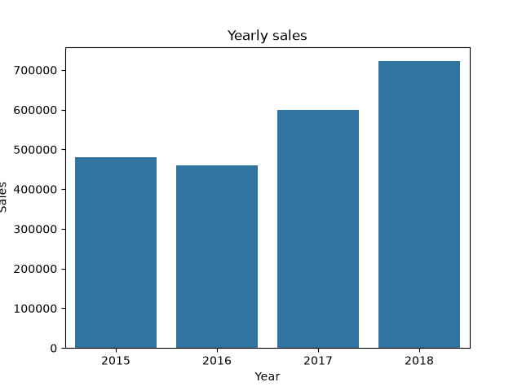
Order Patterns & Sales Trend
Order Performance
Office Supplies: 3,676 unique orders
Furniture: 1,727
Technology: 1,519
Interesting finding: Office Supplies has the highest order volume, while Technology has the highest revenue.
Sales Trend
2015: $479,856
2016: $459,436
2017: $600,193
2018: $722,052 — Highest
Business Takeaway
Order volume and revenue contribution do not necessarily follow the same pattern, while overall sales show a positive trend over time.

Slide 6
Business Recommendations
1. Maintain Technology Performance Continue focusing on strong-performing Technology products and explore further growth opportunities.
2. Improve South Region Performance Investigate the reasons behind lower sales and identify targeted growth opportunities.
3. Increase Revenue from Office Supplies Explore ways to increase the value generated from the category's high order volume.
4. Strengthen Corporate & Home Office Segments Explore strategies to increase revenue from lower-performing customer segments.
5. Sustain Sales Growth Maintain the positive sales momentum and investigate the factors behind the strong growth in 2017 and 2018.

Slide 7
Conclusion
Technology is the strongest revenue-generating category.
Phones is the highest-revenue sub-category.
West is the highest-performing region, while South requires greater attention.
Consumer customers contribute the largest share of revenue.
Office Supplies has the highest order volume, despite lower total revenue.
Sales show an overall positive trend, with 2018 recording the highest sales.
Final Takeaway
The analysis highlights strong-performing areas and potential growth opportunities that can support more informed, data-driven business decisions.

