Slide 1
E-Commerce Sales Data Analysis Using SQL

Slide 2
Project Overview:
Objective: Analyze e-commerce sales data to uncover meaningful business insights.
Tools Used: SQL.
Dataset: 30,000 records across Customers, Products, Orders, and Payments tables.

Slide 3
Key Objective:
The aim of this project is to analyze e-commerce sales data using SQL to extract meaningful insights about customer behavior, product performance, sales trends, and payment methods. By exploring the data, the project identifies regions with the highest customer activity. It also focuses on analyzing product sales by category and price range, highlighting best-selling items and underperforming products.
Additionally, the project uncovers order patterns, such as frequency, seasonal trends, and peak sales periods, while analyzing revenue growth on a monthly and quarterly basis. Payment insights, including customer preferences for payment methods.

Slide 4
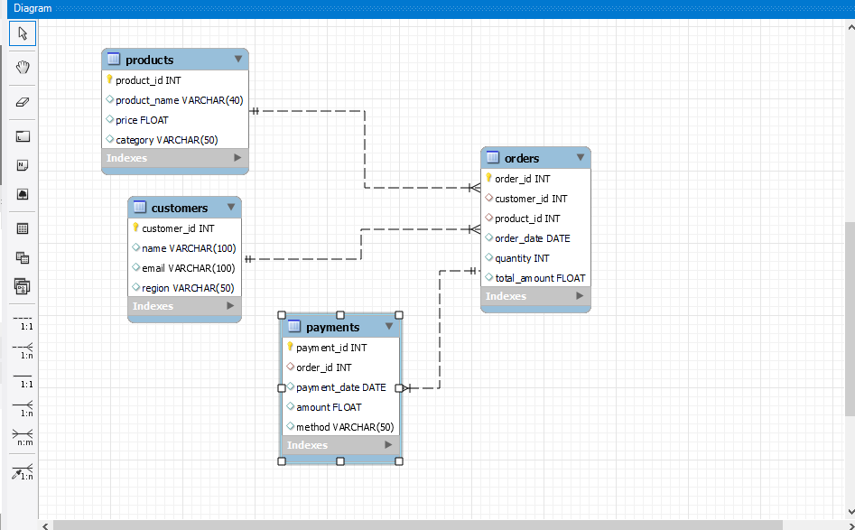
Database Schema:

Slide 5
SQL Techniques Used:
Joins: For combining data across tables (INNER JOIN, LEFT JOIN).
Aggregations: To calculate totals, averages, and trends.
Window Functions: To compute running totals and ranks.
Case Statements: To categorize data dynamically.
Optimization: Improving performance for large datasets.

Slide 6

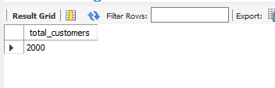
Customer Analysis:
Question : Count the total number of customers

Slide 7

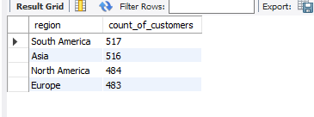
Question : Find the count of customers from each region. Display the region name along with the total number of customers.

Slide 8
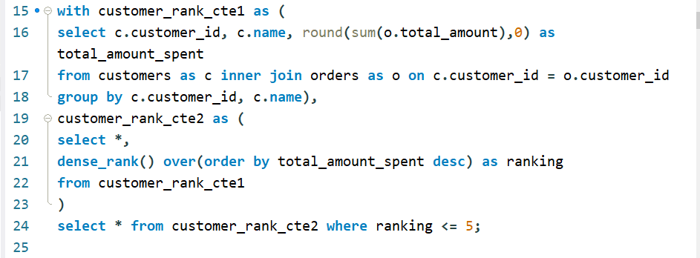
Question : Identify the top 5 customers who have contributed the most revenue (total amount spent). Display the customer name, total amount spent, and their rank based on the descending order of revenue.

Slide 9
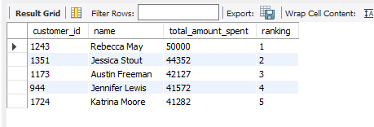

Slide 10
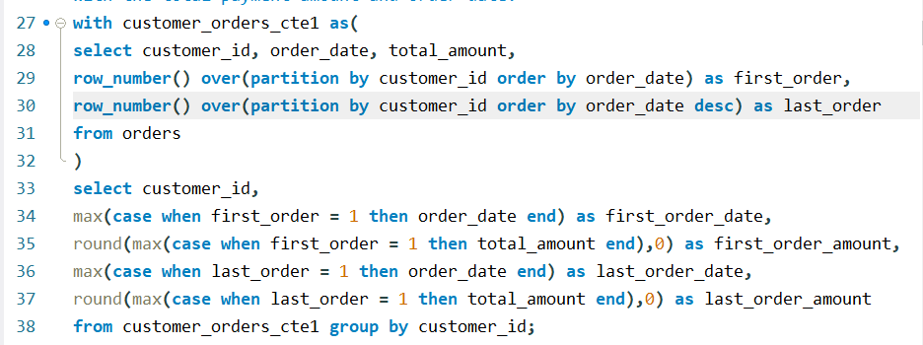
Question : For each customer, retrieve the very first order, the most recent order along with the total payment amount and order date

Slide 11
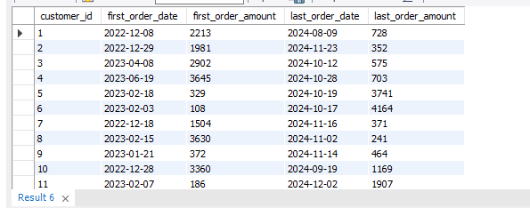

Slide 12
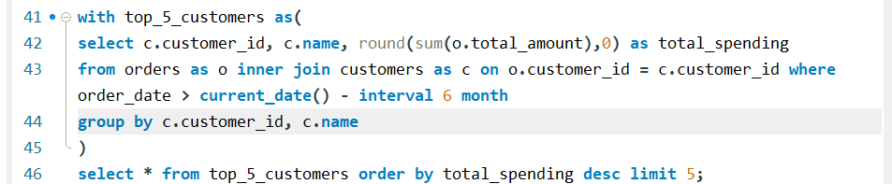
Question : Write a sql query to find the top 5 customers with the highest total spending in the last 6 months

Slide 13
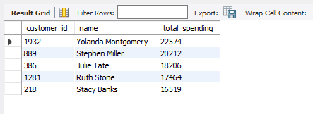

Slide 14
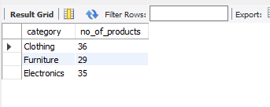
Product Analysis:
Question : List all product categories and the number of products in each category. Display the category name along with the corresponding product count.

Slide 15
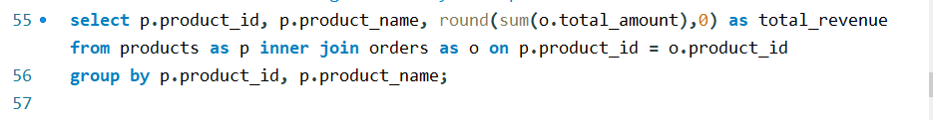
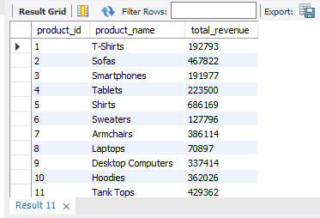
Question : Find the total revenue generated by each product.

Slide 16
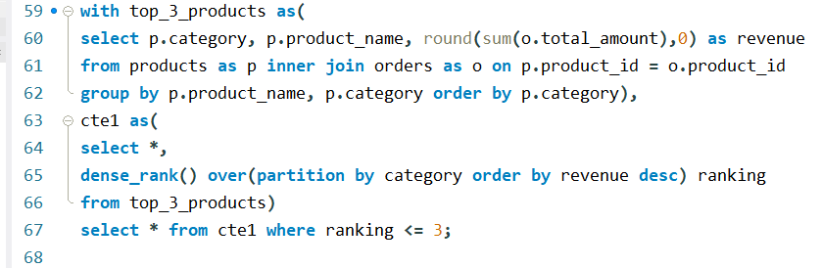
Question : Find the top 3 products in terms of revenue for each category.

Slide 17
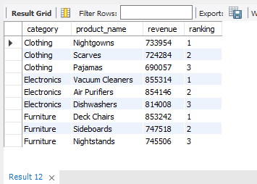

Slide 18
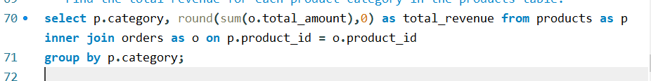
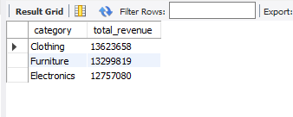
Question : Find the total revenue for each product category in the products table.

Slide 19
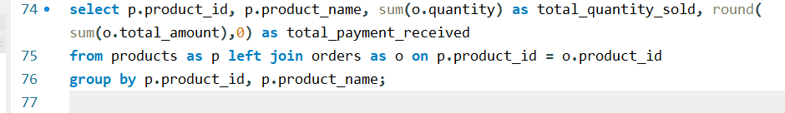
Question : For each product, calculate the total quantity sold, the total payment received.

Slide 20
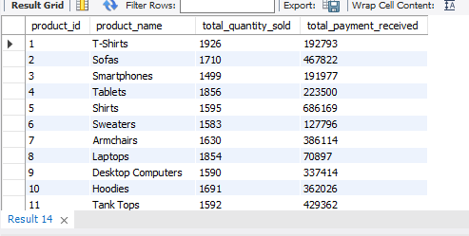

Slide 21
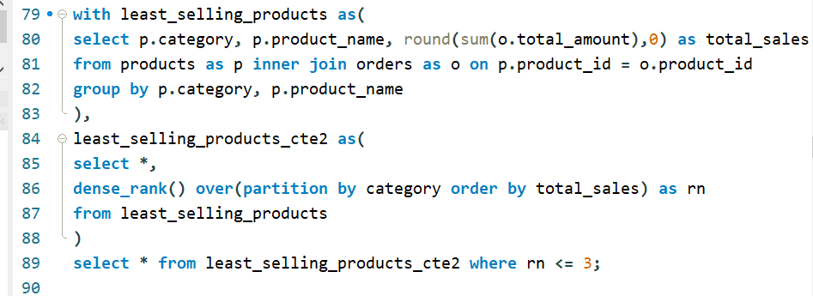
Question : Write an SQL query to find the three products with the lowest total sales (revenue) in each category.

Slide 22
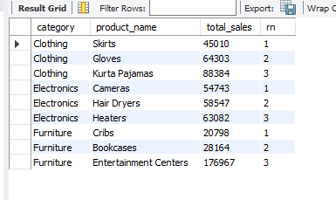

Slide 23


Order Trends:
Question : Count the total number of orders placed.

Slide 24

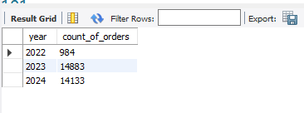
Question : Find the number of orders placed in each year. Display the year along with the total count of orders.

Slide 25
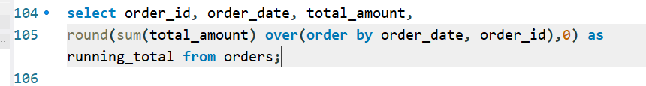
Question : Calculate the running total (total_amount) for each order in the orders table, ordered by order_date.

Slide 26
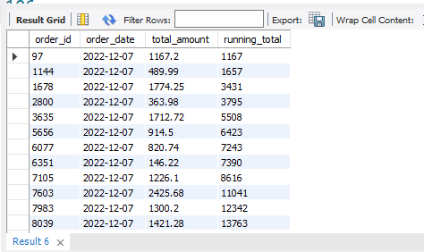

Slide 27
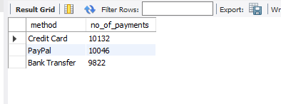
Payment Insights:
Question : Identify the payment method through which the maximum number of payments were made. Display the payment method and the corresponding total count of payments.

Slide 28
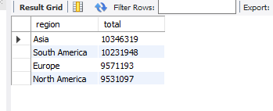
Comprehensive Sales Analysis:
Question : Find the total sales (total_amount) for each region.

Slide 29
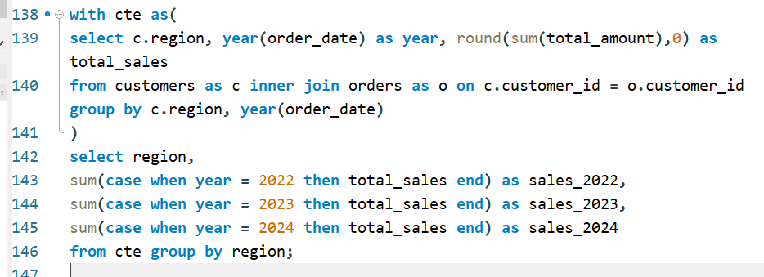
Question : Write an SQL query to calculate the total sales for each region, displaying the total sales for each year (from the earliest year in the dataset to the latest year).

Slide 30
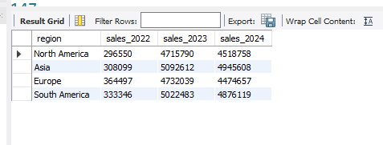

Slide 31
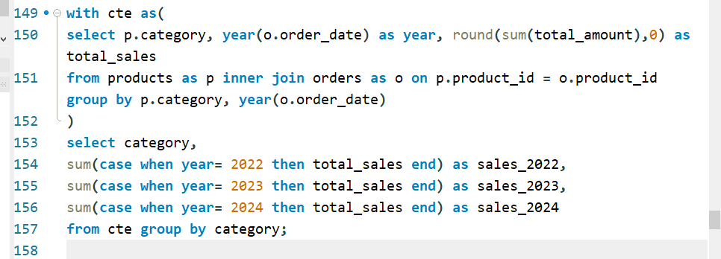
Question : Write an SQL query to calculate the total sales for each category, displaying the total sales for each year (from the earliest year in the dataset to the latest year).

Slide 32
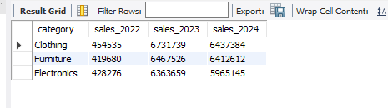

Slide 33
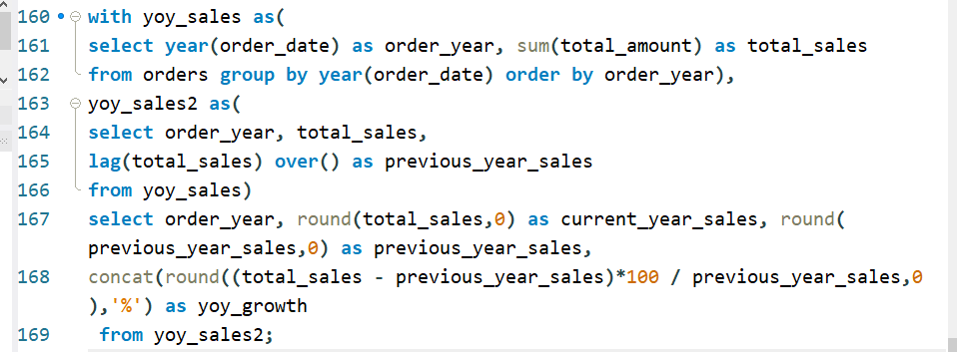
Question : Write a sql query to calculate year over year growth in sales from a orders table.

Slide 34
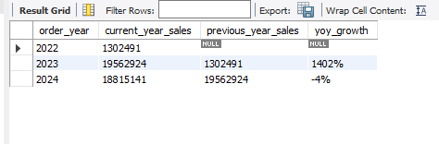

Slide 35
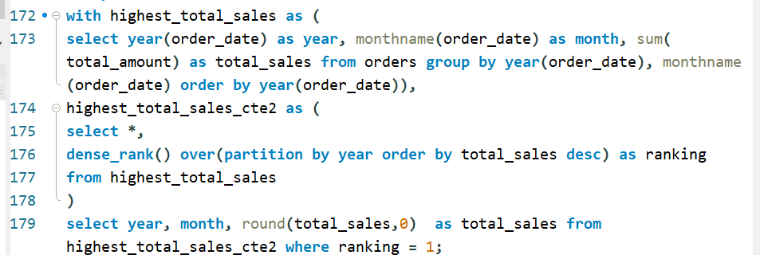
Question : Determine the month with the highest total sales for each year. Display the year, month, and the total sales amount.

Slide 36
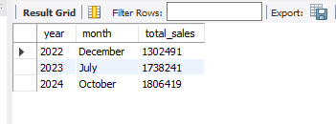

Slide 37
Key Findings :
Identified the top 5 customers contributing significantly to total revenue, with Rebecca May leading at $50,000, followed by Jessica Stout at $44,352.
South America leads with the highest number of customers at 517, followed closely by Asia with 516, North America with 484, and Europe with 483.
In product range, the maximum number of products are under the clothing category, totaling 36, followed by electronics with 35, and finally furniture with 29.

Slide 38
The maximum revenue is generated by the clothing category, amounting to 13,623,658, followed by furniture with 13,299,819.
The maximum number of orders were placed in the year 2023, totaling 14,883, followed by 2024 with 14,133, and finally 2022 with 984.
The most popular payment method among customers is credit card, with 10,132 customers making payments through it, followed by PayPal with 10,046, and finally bank transfer with 9,822.

Slide 39
The highest sales are from Asia region, amounting to 10,346,319, followed by South America with 10,231,948.
In 2022, total sales amounted to 1,302,491, while 2023 saw a record-high sales figure of 19,562,924. In 2024, sales reached 18,815,141.

Slide 40
Recommendations:
Based on the spending behavior and frequency of orders, focus on personalized marketing strategies or loyalty programs to engage high-value customers and retain repeat buyers.
Identifying and rewarding top customers can help increase their lifetime value.
Customers who have contributed significantly to revenue could be targeted with exclusive offers, enhancing retention and increasing future sales.

Slide 41
Consider analyzing the product categories with the lowest sales or least revenue-generating products. Introducing promotional campaigns or discounts for low-performing products could improve their sales performance.
Identifying top-selling products within each category can help optimize inventory management, ensuring that high-demand products are sufficiently stocked and marketed.
Analyze payment trends to understand customer preferences for different payment methods. If a particular method shows a higher adoption rate, it may be beneficial to focus on offering incentives to customers using those methods.

Slide 42
Focus on analyzing month-over-month and year-over-year growth trends to adjust sales and marketing strategies. A clear understanding of sales patterns will help in forecasting and preparing for seasonal or market shifts.

Slide 43
Thank You

