Slide 1
BATTLESHIP
Developed by: Harpreet kaur, Manureet kaur, Prabhjot kaur

Slide 2

Meaning of Battleship
Battleship is a guessing game between two players.
It was published by Milton Bradley company in 1931 as the pad-and-pencil game .
And as a board game in 1967.

Slide 3
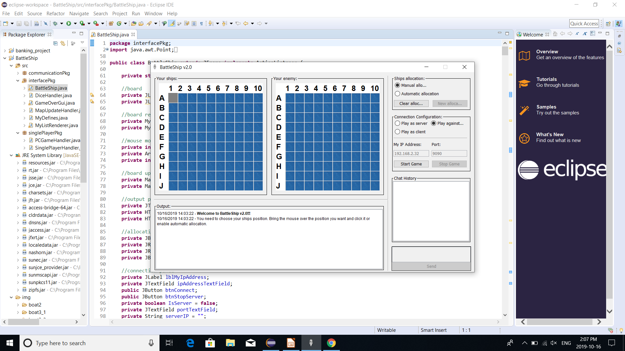
Screenshot of Initial stage

Slide 4
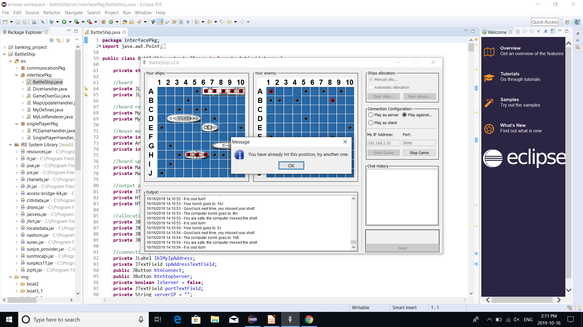
Screenshot of playing stage

Slide 5
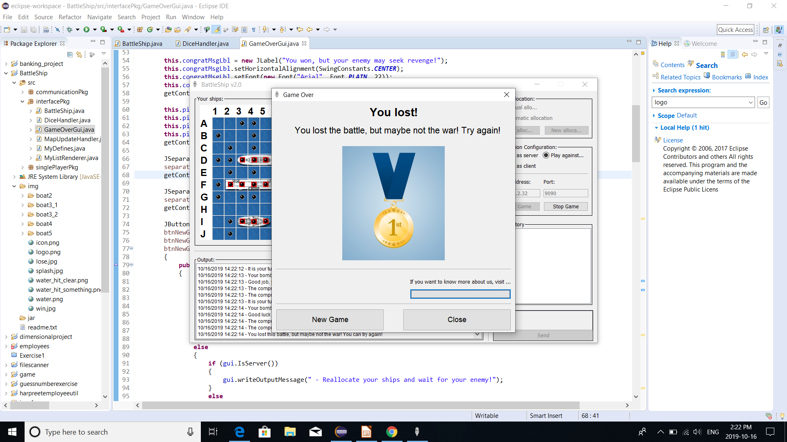
Final decision

Slide 6
Thank you...

