Slide 1
Program Next Level (PNL) Architectural Overview and Workflow

Slide 2
PNL : A powerful answer engine which creates simplified, interactive and one page stories of every search query.
Capabilities
Quickly search the web to produce right and precise information.
Add context to your search queries using your personalized data from social networking sites and blogs resulting in re-ranked pages.
Add meaning to your search queries using Natural Language Processing tool.
Storing the indexed data in graphical format using highly scalable ,robust native Neo4j graph database.

Slide 3
Overall Solution Architecture
PHP rendering
Search component
caching
No SQL DB
User search
Input text
Input text
tokens
Enterprise Platform (EIB)
HTML
XML/ schema
tokens
text
Results
Social media( Facebook, LinkedIn )
crawler
Hadoop
SolR cloud
Knowledge graphs(Neo4j)
NLP

Slide 4
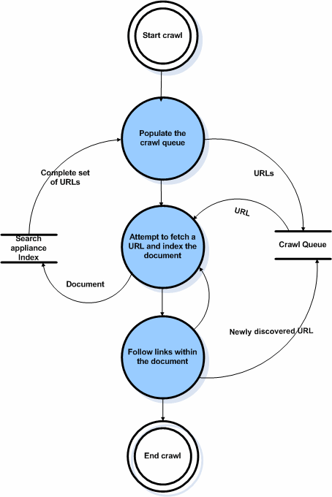
Stage 1: Data crawling Workflow
Populate the crawl queue with the seed and complete set of URLs
Fetch the URL from the crawl queue and start crawling the data
Process the documents using Hadoop Map Reduce paradigm
Follow links within document for crawling.
Store the processed and indexed data in SOLR

Slide 5
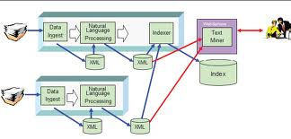
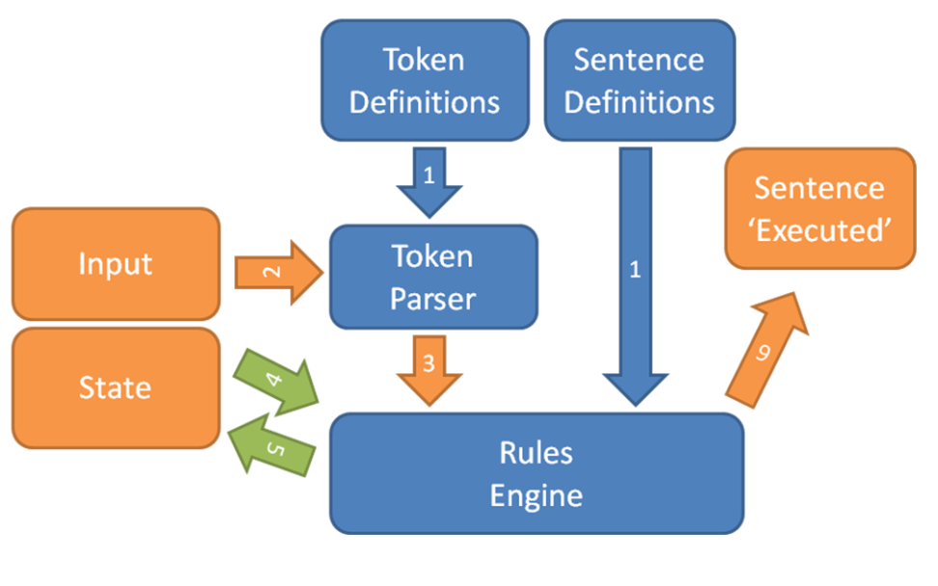
Stage 1(b): Natural Language Processing
This involves
Classify the content into different categories
We are working on this step & defining ontologies

Slide 6
Stage 2: Personalized Data Workflow
Profile
Name
DOB
Gender
etc
Embed the user preference and query related search intent into user-specific topic spaces.
This involves
User specific information i.e. name, date of birth , gender, language ,country, will be considered to distinguish the exact intentions of the user queries.
User ‘s social activities such as rating, tagging and commenting will be considered to indicate the user’s interest and preference in a specific document.
User’s social network i.e. friend list social activities' to indicate the affinity between user and user’s friends for better decision making for every search query.
Finally , storing this data in Neo4j graphical database.
has
User
Activities
Blog
Tag
Comment
has
belong to
many
Network
Social annotations produced by act as quality descriptors of the web pages and topics and indicator of web users interests. Build regularization framework for query expansion.
Augmented Query
Topic Models
Pre-indexed
Crawled data

Slide 7
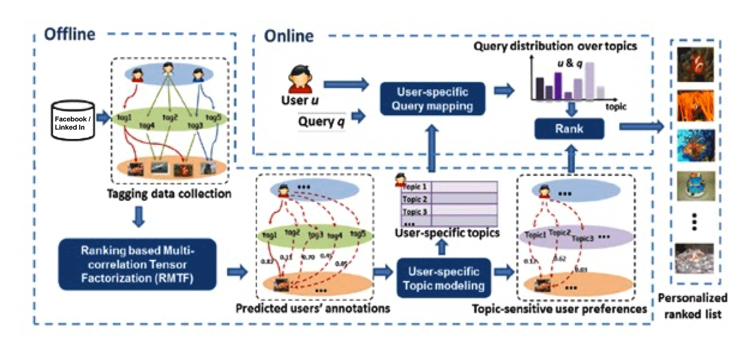
Stage 2 (b): Personalized Data Workflow

Slide 8
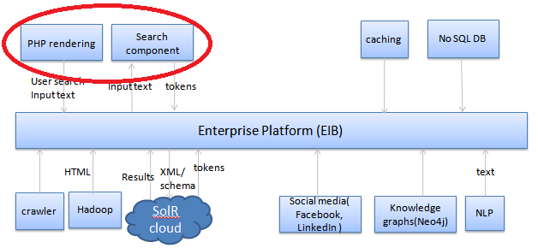
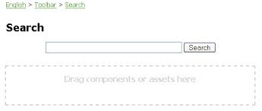
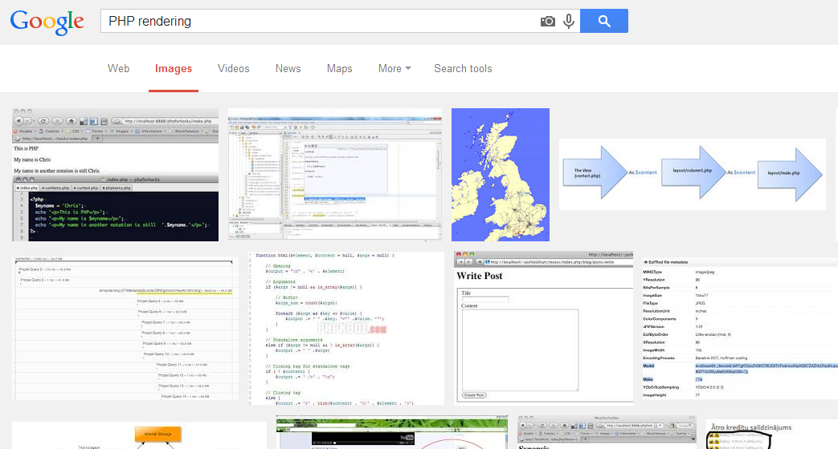
Stage 3: User Interaction

Slide 9
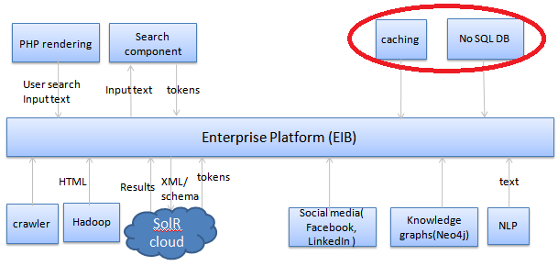
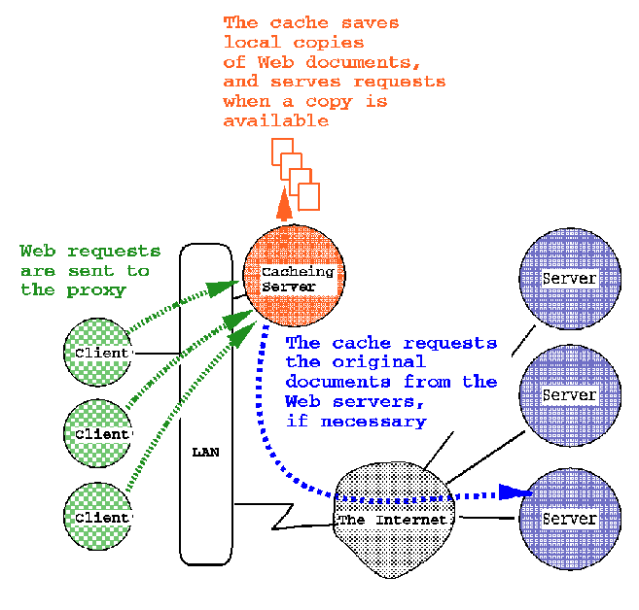
Stage 4: Preparing Results

