Slide 1
PNL

Slide 2
PNL
Tag line: Creates simplified, interactive and one page stories of every search query.
Pitch your Venture To Us (be specific and succinct):
What is your Product or Service?
PNL is an online answer engine for mobile and conventional devices that answers queries through an externally sourced curated database and user search history to tailor responses to individual users.
How does it work and what unmet need does it fulfill?
PNL takes input through text queries, organizes it into various fields, combines it with user search history, runs data analytics and displays an interactive page with top videos, pictures and data.
Web traffic on mobile devices is growing at an exponential rate (6% per year), but even now there is no successful free search engine optimized for mobile devices that can provide simplified answers in an interactive manner to user queries.
Who are your competitors?
Major Competitors: Answers.com and wolfram alpha - In one market area
What differentiates your Product or Service over your competitors’ products or services?
The product has combined the concept of curated data, data analytics, and user search history to create a powerful interactive search engine for both mobile and conventional devices that will have more simplification, less noise, superior user interface, and provide users one page categorized stories to their queries. And provide text based search for rural areas in developing economies.

Slide 3
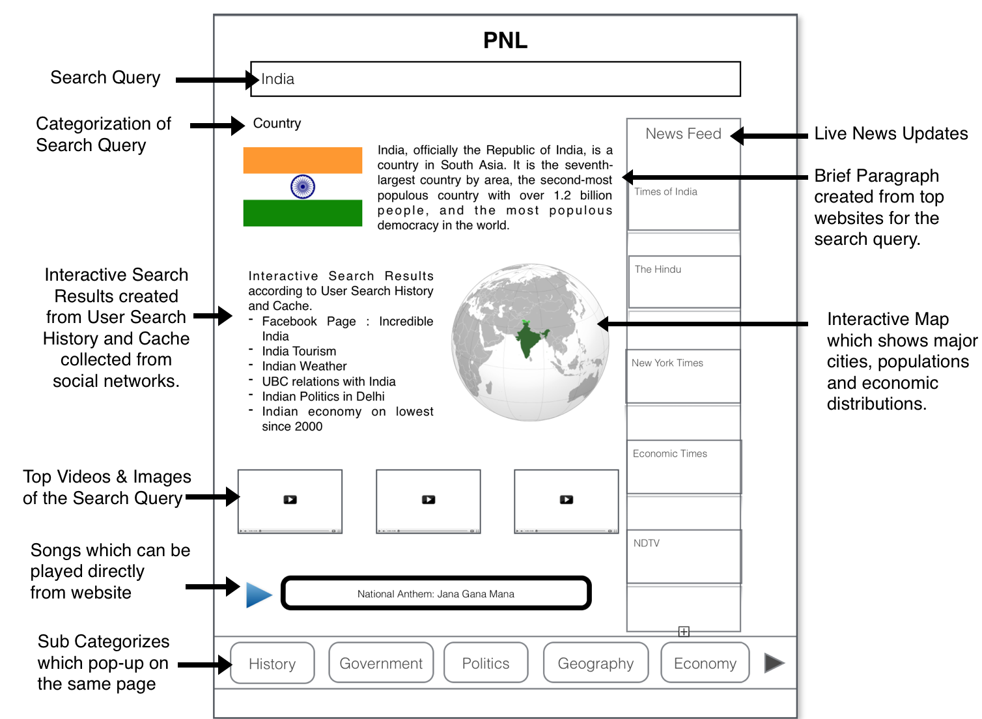
Basic Mock-up of our product:

Slide 4
Next Steps in the Development of your Product or Service
Get, Keep, and Grow
At the moment we have conceptualized the idea and are in the process of coming up with the next steps to put together a technology team to start work on the MVP. We hope to have a team ready by end of next week and work to start in a day or two after that.
We hope to complete a mock-up of the product before end of March that we will be able to test and experiment within our target market. At the same time we will be signing a contract with a data server company to host the terabytes of curated data for our MVP and explore opportunities of patenting the technology being used.
Lastly the MVP will have two different concepts tested for our product and according to customer feedback, we will work towards the final product.

