Slide 1
C# Basics
[A Review Of Programming Concepts and Syntax]

Slide 2
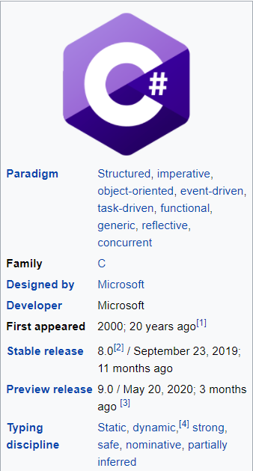
C# Basics
Object-oriented programming language.
Objects that interact with each other by actions.
Actions that an object can take are called methods.
Objects of the same kind are “in the same class”.
Design goals intended C# to be a simple, modern, general-purpose object-oriented programming language.
Do you remember C# from Programming I and II?
[Source: Wikipedia]

Slide 3
C# Basics
Overview of a C# Console Application
Variables, data types and constants.
Documentation (flowcharts, comments, pseudocode)
Formatting numbers.
Reading from (and writing to) the console.
Operators
Exception handling
Arrays and lists
Control flow / conditional statements

Slide 4
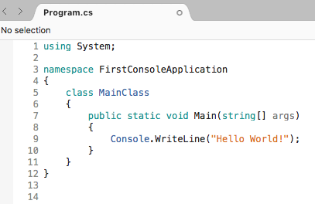
C# Console Application
The Main() method is the entry point of all C# console applications.
When a console application starts, the Main() method is the first method to be called.
Can take in an array of strings as input (command line args)
Tells the compiler that our program uses the System namespace
Keyword makes the method accessible without an instance of MainClass.

Slide 5
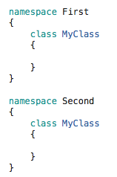
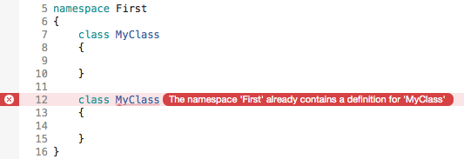
Namespace
A namespace is a grouping of related code elements.
C# comes with a large amount of pre-written code that is organised into different namespaces.

Slide 6
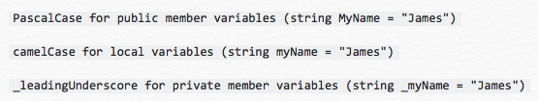
Variables
Variables are names given to data that we need to store and manipulate in our programs.
Variable names are case sensitive.
Two naming conventions are camel case and using underscores.
The .NET standard does not require you to follow a consistent naming convention although it is strongly recommended.

Slide 7
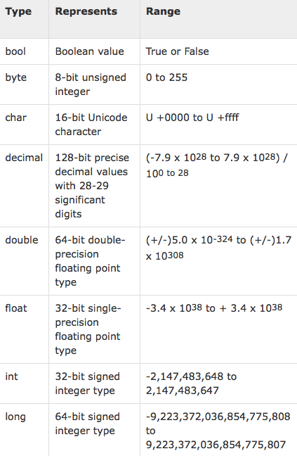
Data Types
C# is a strongly-typed language.
Before a value can be stored in a variable, the type of variable must be specified.
Type must be specified for simple, built-in types and also for complex or custom types.
[https://www.tutorialspoint.com/csharp/csharp_data_types.htm]

Slide 8


Numeric Data Types
Numeric data types store a number in a variable.
Most common: int (32 bit) (whole numbers only), double (64 bit) (real numbers 15 digits precision) decimal (128 bit)(real numbers 28 digits precision)
You can assign int values to int variables.
You cannot assign double values to int variable (loss of data).
You cannot assign decimal value to int variable (loss of data).
These will cause errors

Slide 9
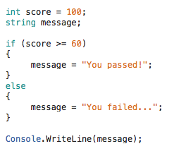
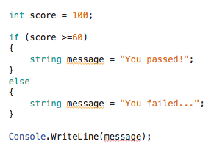
Variable Scope
The scope of a variable determines its visibility to the rest of the program.
Variables declared inside a method’s code block are available to any other parts of the method.

Slide 10
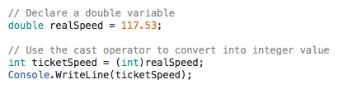

Cast Operator
The back door for these compatibility rules is the cast operator.
Casting says “I know what I’m doing and I accept the risk of data loss!”

Slide 11
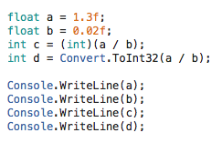
Conversion Methods
C# offers a range of built-in type conversion methods, e.g. ToDateTime, ToInt32, ToInt64, ToString, ToChar, ToDecimal.
It can be confusing to decide when to cast and when to convert.
What do we expect our output to be?

Slide 12

Conversion Methods
C# offers a range of built-in type conversion methods, e.g. ToDateTime, ToInt32, ToInt64, ToString, ToChar, ToDecimal.
It can be confusing to decide when to cast and when to convert.

Slide 13
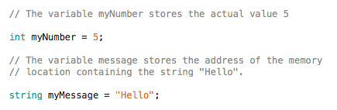
Value and Reference Types
All data types in C# are either value or reference types.
A value type is a variable that stores its own data.
A reference type does not store the data. It stores a reference to it.

Slide 14


Constants
Fixed values that the program can not change during execution.
Only built-in data types can be declared as const.
They make widespread changes easier throughout an application, and also make applications more self-explanatory / easier to follow.

Slide 15
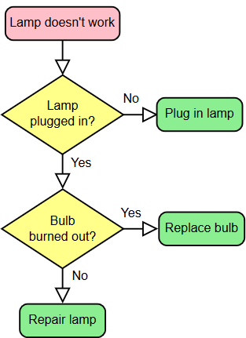
Flowcharts
Often used to describe a program’s execution flow.
A type of diagram that represents an algorithm, workflow or process, showing the steps and their order.
Often considered a graphical alternative to pseudocode.
[Wikipedia]

Slide 16
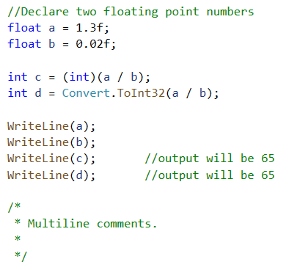
Comments
A comment contains information that the programmer wants to add to the program (usually to describe what a piece of code does).
We can write single line, multiple line or trailing comments.
Single line
Trailing line
Multiple line

Slide 17
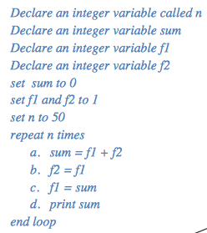
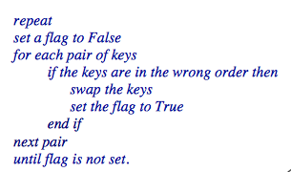
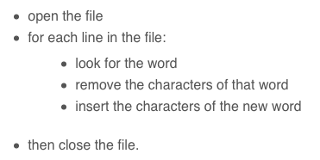
Pseudocode
Informal high-level description of an algorithm.
Intended for human reading.
No standard syntax.

Slide 18
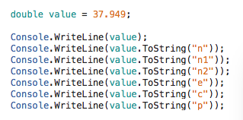
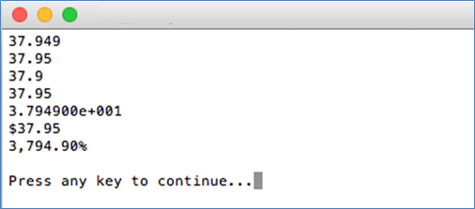
Formatting Numbers
Numbers can be formatted in many ways. (e.g. align with spaces/zeros, as a currency value or a percentage, or a custom formatting such as phone numbers, SIN, etc.)
Using the ToString method:

Slide 19
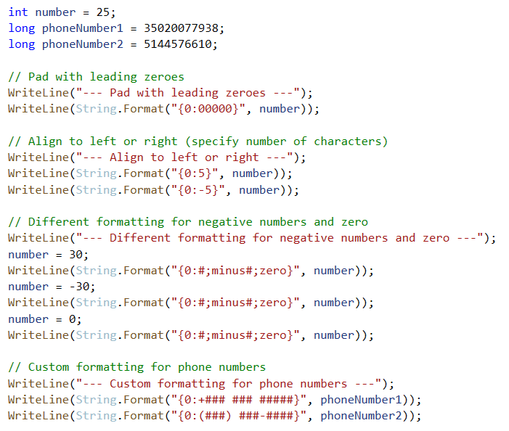
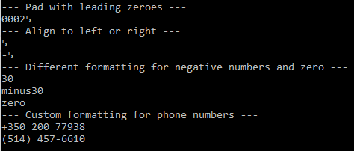
Formatting Numbers (cont.)

Slide 20

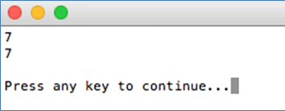
Reading From The Console
The Console class in the System namespace provides ReadLine() function for accepting input from the user (in string format).
You can insert a Console.ReadLine method call at the end of the Main method. This will ensure the terminal window is not dismissed by Windows immediately upon completion of the program. Note: Not necessary in Mac.

Slide 21
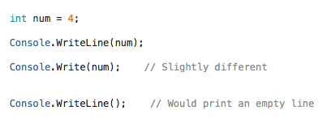
Writing To The Console
The Console class in the System namespace provides WriteLine() function to output a string with a new line to the console.
To print some special / “unprintable” characters, use escape characters e.g. \t (tab) and \n (new line).

Slide 22



Writing To The Console (cont.)
There are several overloads we can use with this method.
We can use placeholders to insert variables into a string.
Can specify exactly how we want numbers to appear.

Slide 23
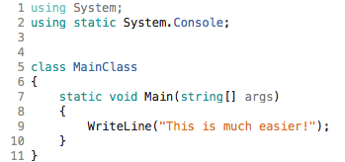
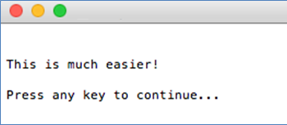
Writing To The Console (cont.)
If you don’t want to keep typing Console. when using the Read, ReadLine, Write or WriteLine methods, you can add a “using” to your code.
This is available in Visual Studio 2017 and newer.

Slide 24
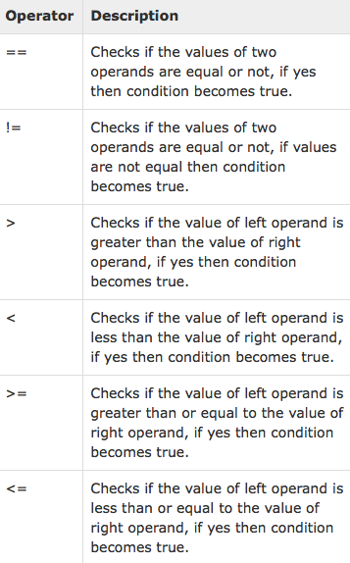
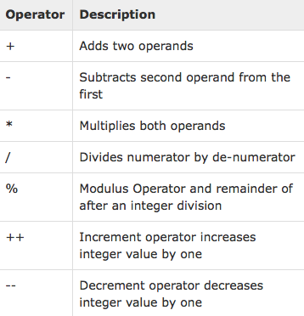
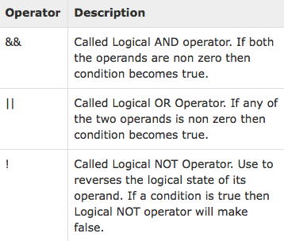
Operators
C# supports all the arithmetic, relational and logical operators you are used to.
[https://www.tutorialspoint.com/csharp/csharp_operators.htm]

Slide 25
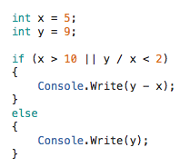
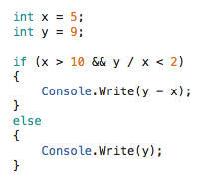
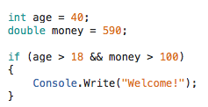
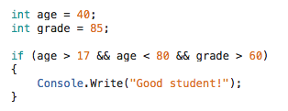
Operators (cont.)
What would the output be in these examples?

Slide 26
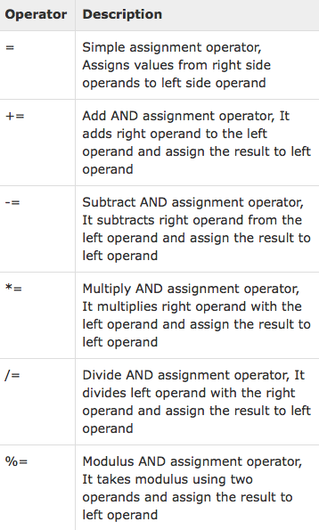
Operators (cont.)
C# supports assignment operators.
These include multiply / divide / modulus and assignment (which you might not have used before).
[https://www.tutorialspoint.com/csharp/csharp_operators.htm]

Slide 27
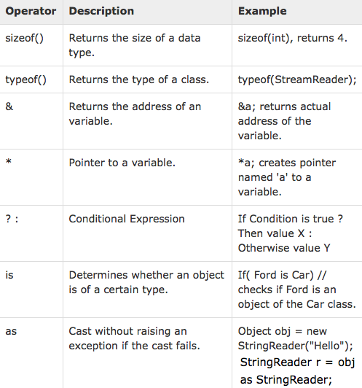
Operators (cont.)
Other useful operators you may not have seen before.
[https://www.tutorialspoint.com/csharp/csharp_operators.htm]

Slide 28
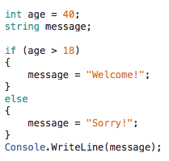
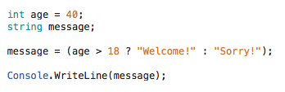


Operators (cont.)
The ? operator can be used to evaluate expressions elegantly.
What is the value of x and y in these examples?

Slide 29
Modulo Operator exercise
25 % 3 =
30 % 6 =
40 % 7 =
84 % 9 =

Slide 30
Exception Handling
Exception handling helps you deal with unexpected situations that occur when a program is running. Used to avoid system failure in an unexpected manner.
Exception handles the failure situation that may arise.
Use the try, catch and finally keywords (in addition to throw).
Exceptions should be used to communicate exceptional conditions. Do not use exception to communicate events that are expected (e.g. reaching the end of a file).

Slide 31
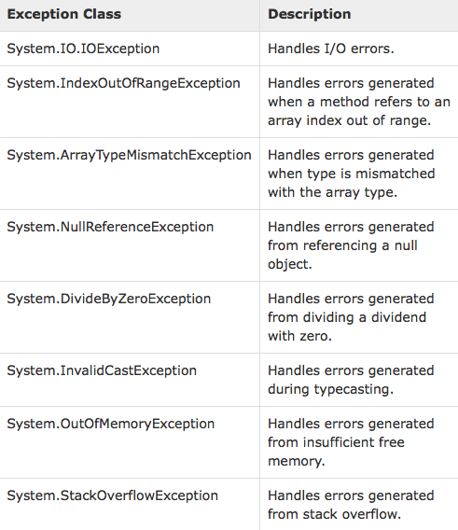
Catching Exceptions
Standard and user-defined exceptions.
System.Exception is the base class for all exceptions in C#.
Other exception classes inherit from this class, e.g. ApplicationException and SystemException.
You can define your own exception class (but it still has to inherit from either Exception class or one if its standard derived classes).
[https://www.tutorialspoint.com/csharp/csharp_exception_handling.htm]

Slide 32
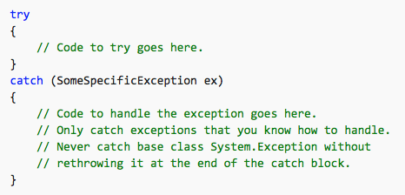
When Should You Catch Exceptions?
You have a good understanding of why the exception might be thrown, and you can implement a specific recovery.
You can create a throw a new, more specific exception.
You want to partially handle an exception before passing it on.
Specify the type of exception to catch (exception filter).
Can have multiple catch blocks with different exception filters. Evaluated from top-to-bottom. Only one catch block executed for each exception thrown.
[Taken from https://docs.microsoft.com/en-us/dotnet/csharp/programming-guide/exceptions/exception-handling]

Slide 33
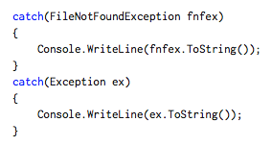
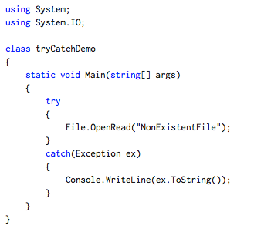
Using Multiple Catch Blocks
All exceptions will be caught here because the type is base exception type.
Using multiple catch blocks
If the file does not exist, a FileNotFoundException exception will be thrown and caught by the first catch block.
If a PathTooLongException exception is raised, the second catch block would catch it because there is no catch block for this specific exception.
The generic catch block will catch all other exceptions.
[http://csharp-station.com/Tutorial/CSharp/Lesson15]

Slide 34
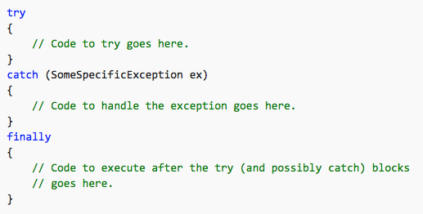
Using Finally Blocks
The finally block always runs (regardless of whether an exception is thrown, or a catch block matching the exception type is found).
Enables you to clean up actions that are performed in a try block, e.g. releasing resources (file streams, database connections, etc.)
Not required, but better to plan for the worst. Will make your program more robust.

Slide 35
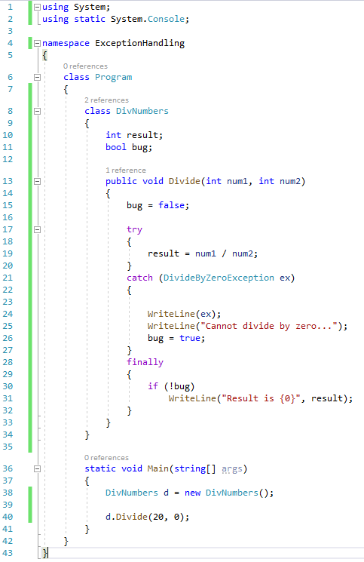
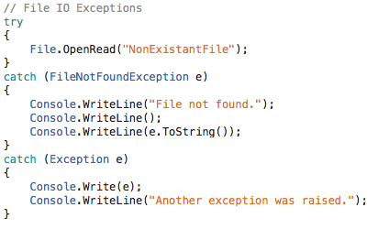
Examples
We want to catch a DivideByZero
exception
Finally block always runs.
Try and catch a FileNotFound exception. If this is not the case, deal with any other exception.
Use Division function to divide these numbers

Slide 36

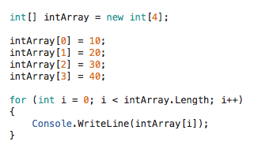

Arrays
An array is a fixed-size sequential collection of elements of the same data type. Often used to store a collection of data.
A specific element in an array is accessed by an index.
Declare array of four integers
Initialise the array elements (index always starts at 0)
Output the values in the array
We did not specify the length of the array
(compiler does this for us)

Slide 37
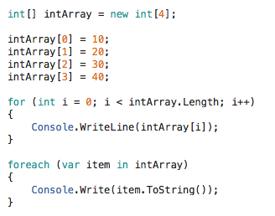
Looping Through Arrays
We can retrieve the values in an array using for or for each loops.
Two ways of retrieving the values in an array

Slide 38


Arrays (cont.)
You can find the length (size) of an array using the Length property.
Arrays can have more than one dimension (multi-dimensional arrays).
This would create an array of three rows and three columns

Slide 39
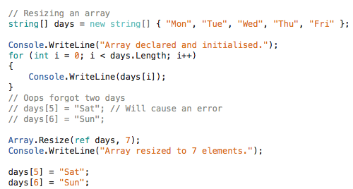
Resizing An Array
Making an array bigger / smaller can be done using the Array.Resize method. This method can only be used for one-dimensional arrays.
Need this ref keyword

Slide 40
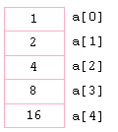
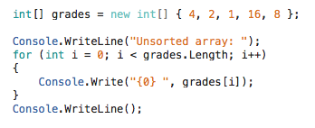

Sorting An Array
We can sort arrays in ascending and descending order using the Array.Sort and Array.Reverse methods.
What will your array look like?

Slide 41
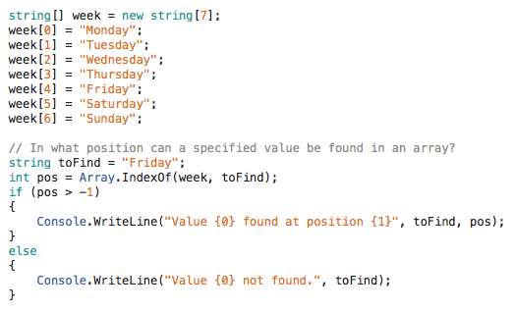
Searching For Values In An Array
You can use Array.IndexOf to find the position of a value in an array.

Slide 42
Other Array Class Methods
There is a range of methods in the Array Class that you can use (e.g. we already used Array.Resize , Array.Sort and Array.Reverse.
Other methods to search through an array: Array.Find and ArrayExists.
You can clear an array (reset to zero, false or null) using Array.Clear.
To determine the type of an array, you can use Array.GetType.
You can see the entire list in MSDN: https://msdn.microsoft.com/en-us/library/system.array_methods(v=vs.110).aspx

Slide 43
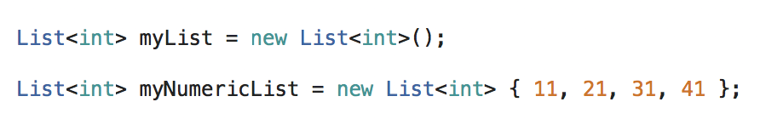
Lists
A list stores values like an array but gives us more flexibility in adding or removing elements easily.
To access elements in a list, we use the same notation as when we access elements in an array.
System.Collections.Generic.
List keyword indicates you are declaring a list.
Data type in angular brackets.
Initialize the list at the point of declaration

Slide 44
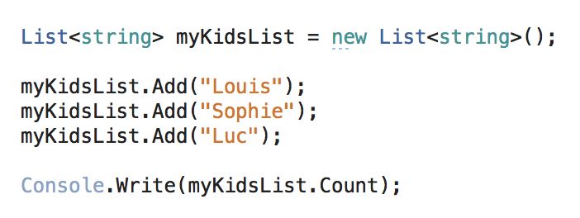

Lists (cont.)
You can add members to a list using the Add() method.
Find out the number of elements in a list using the Count property.
Same notation as array
Why can we just use WriteLine()?

Slide 45

Lists (cont.)
You can insert members to a list using the Insert() method

Slide 46


Lists (cont.)
You can remove an item from a list using the Remove() method.
Can also use RemoveAt() method if you know the index location.

Slide 47

Lists (cont.)
To check if a list contains a certain member, use Contains() method.
To remove all items in a list, use the Clear() method.
You can see the entire list of list methods and properties in MSDN: https://msdn.microsoft.com/en-us/library/6sh2ey19(v=vs.110).aspx
True or False

Slide 48



Conditional Processing
The If statement is the most commonly used conditional processing statement.
You can use the If Else statement if you want to execute one piece of code when the condition is met and another when it is not.

Slide 49


Conditional Processing (cont.)
The Switch statement provides a way to handle multiple branching.

Slide 50

The For Loop
Probably the most commonly used loop.
In its basic form it provides a variable that counts the number of iterations that the loop should perform.
Condition
Boolean predicate that must be true in order for the code within the loop to be executed.
Initialisation Assigns initial value to the variable that will be used as the counter or loop control variable.
Iteration / Incrememt
Contains a command that is executed upon completion of each loop iteration.
Single line of code does not need { }

Slide 51


The For Loop (cont.)
The loop control variable can be declared before the loop executes or inside the initialisation part of the loop.

Slide 52


The For Loop (cont.)
The initialisation and iteration sections of the the For Loop can be taken out if not needed (but the semi-colons are necessary).

Slide 53



The For Loop (cont.)
The loop control variable does not need to be included in the condition.
Loops can be nested. Each time the outer loop iterates, the inner loop is executed in full.
A for loop can contain more than one control variable, each with their own independent initialisation and iteration information.

Slide 54

The For Loop (cont.)
You can break out of a for loop using the break statement, but this should be used with care.
The continue statement can be used to stop the current iteration and continue with the next.

Slide 55

The Foreach Loop
The foreach provides a looping structure to cycle through each object (or variable) in a collection (e.g. an array).
Each item in the collection is processed until every item has been referenced or the loop has been halted (you can use break).
Iterates through each value in the array and identifies the largest.

Slide 56

The While Loop
While a condition is true, loop though the following command(s).
The condition is checked each time the looping code is about to be processed.
Note: If the condition is false for the first iteration, the body of the loop will never execute, e.g. int i = 500;
What is the output?

Slide 57

The While Loop
While a condition is true, loop though the following command(s).
The condition is checked each time the looping code is about to be processed.
Calculates the powers of 3 between 1 and 100
Note: If the condition is false for the first iteration, the body of the loop will never execute, e.g. int i = 500;

Slide 58


The Do While Loop
Do this process while a condition is true.
The condition is checked after each iteration of the loop, so the code within the loop is guaranteed to run at least once.
The break and continue commands are also available in While loops and Do While loops.

Slide 59


The Do While Loop (cont.)
A common use of the break statement in a do while loop is to compare user input with an “exit” command and break the loop.

Slide 60
Work on Assignment 1

