Slide 1
LINQ
[Language Integrated Query]

Slide 2
LINQ
Language Integrated Query Language Integrated = part of programming language syntax Query = used for querying data (of different types)
A programming language syntax in C# that is used to query data from different types of sources including relational databases, objects, XML, etc.
Two forms of LINQ operations – queries and methods. Query syntax is considered more readable and easier to understand. Method syntax uses Lambda expressions.

Slide 3
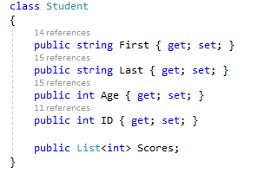
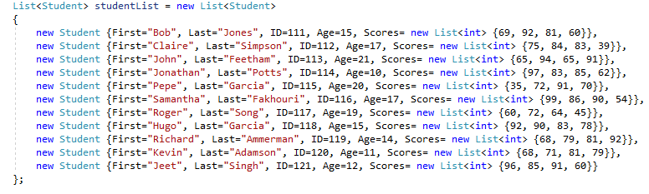
Why We Need LINQ
Auto-implemented properties
Using Object Initializer

Slide 4
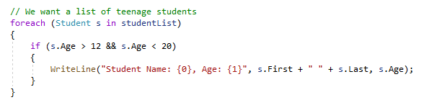
Why We Need LINQ (cont.)
From a list of Student objects, we need a list of teenage students. What if we wanted this list in alphabetical order, or order of age?
Using foreach loop in C#

Slide 5
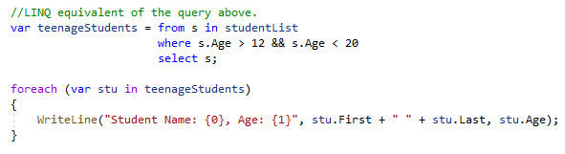
Why We Need LINQ (cont.)
Using LINQ Query Syntax
Note: You will need a using directive for the System.Linq namespace:
using System.Linq;

Slide 6


Always be aware of the data type returned by LINQ
In Visual Studio, hover your mouse over
var teenageStudents and you will see:
What is the data type of teenageStudents?

Slide 7
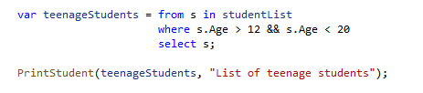
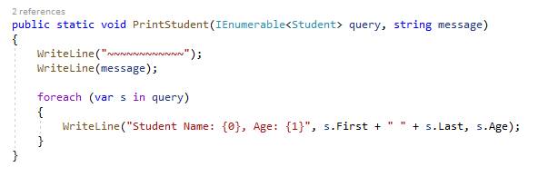
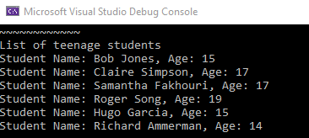
Methods & LINQ

Slide 8
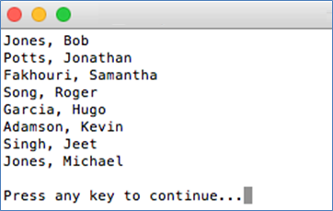

Example
Produce a list of all students who scored over 90 in their first test.
Implicitly-typed variable (Compiler determines and assigns the most appropriate type)
The query is not actually executed until you iterate through it.

Slide 9
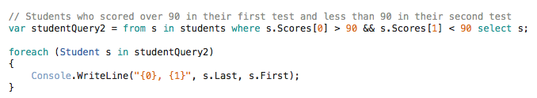
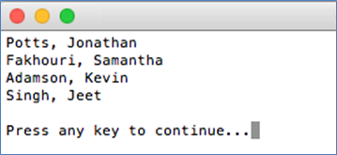
Example (cont.)
Return all students who scored over 90 in their first test but less than 90 in their second test.

Slide 10


Sorting Results
We can modify the results to be displayed in any order we want using the orderby clause.

Slide 11
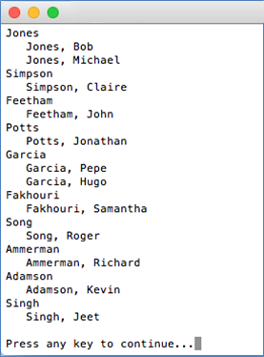
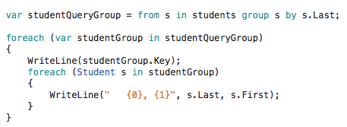
Grouping Results
A query using the group clause produces a sequence of groups with a key and a sequence of objects.
Key
What do we get if we change the key to s.Last[0]?

Slide 12
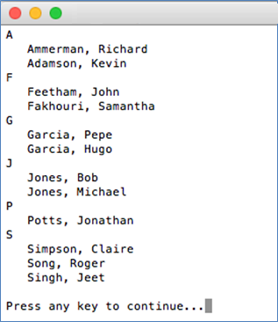

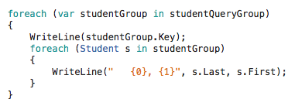
Ordering Grouped Results
To use the orderby clause in a grouped result, you need an identifier to the groups created by the group clause. You do this using the into keyword.

Slide 13
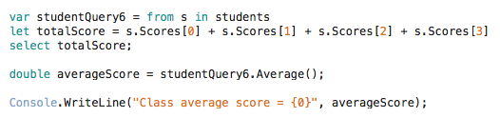
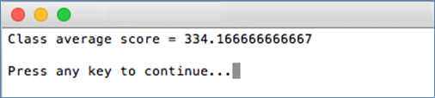
Performing Calculations
We can use the let keyword to introduce an identifier for any expression, e.g. to perform calculations such as adding up items and using mathematical formulas.

Slide 14
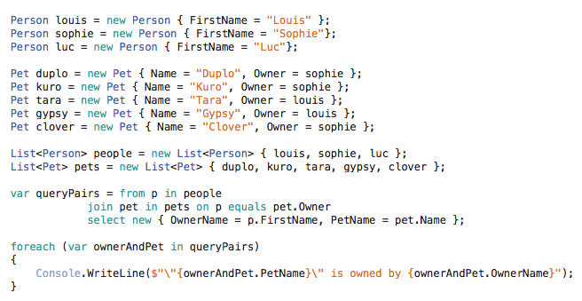
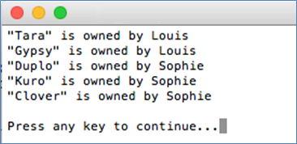
Joins
You can use LINQ to perform joins between collections of objects.
Inner Join
Create a collection. Each element contains owner name and pet name.
Note: Luc does not appear on this list. Why not?

Slide 15
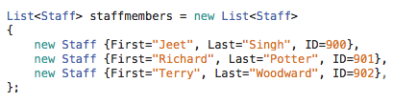
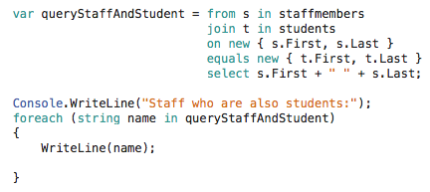
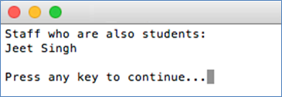

Joins (cont.)
Using our previous example of students, we also have a list of staff. We want to find out how many of our staff are also students.
What is the data type of queryStaffAndStudent?

Slide 16
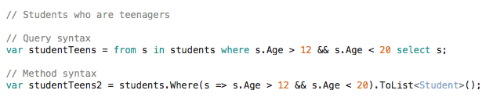
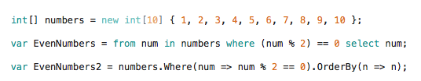
Query vs Method Syntax
Query syntax is considered more readable.
The compiler converts query syntax to method syntax at compile time.
Query syntax
Method syntax
Method syntax uses Lambda expressions…

Slide 17
Lambda Expressions*
Input parameter
Expression
In this example, we can say that num is the input parameter which goes to anonymous function, and this function returns true if the input is even.
* We shall look at this in more detail later on.

Slide 18

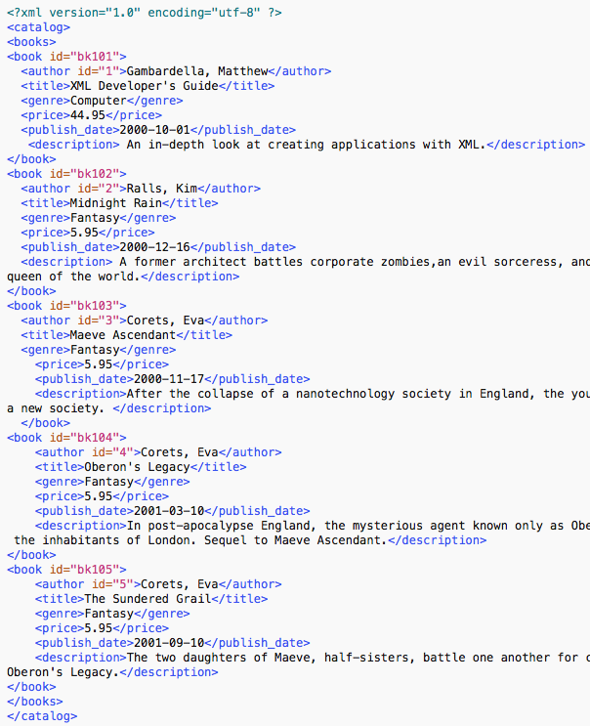
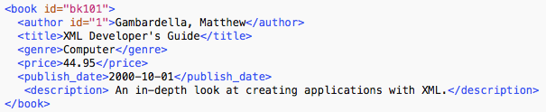
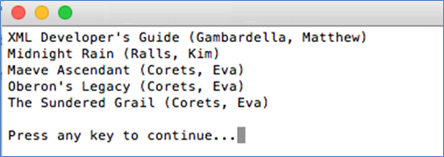
Using LINQ With XML
Need this directive!
[Taken from http://www.c-sharpcorner.com/UploadFile/dhananjaycoder/reading-xml-file-through-linq-a-few-tips/]

Slide 19
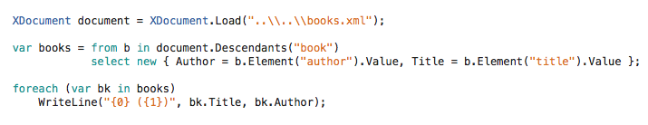

Using LINQ With XML
Need this directive!
XML
[Taken from http://www.c-sharpcorner.com/UploadFile/dhananjaycoder/reading-xml-file-through-linq-a-few-tips/]

Slide 20
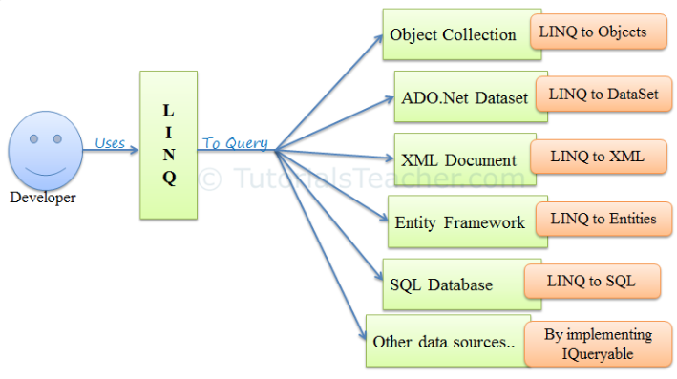
LINQ Uses

Slide 21
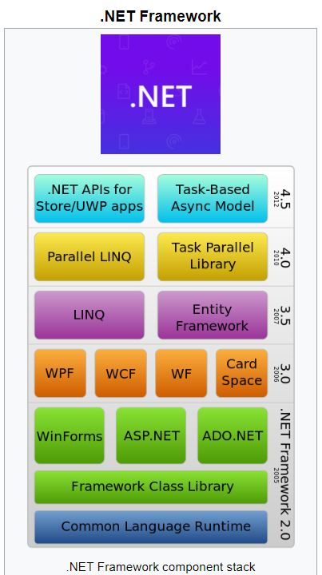
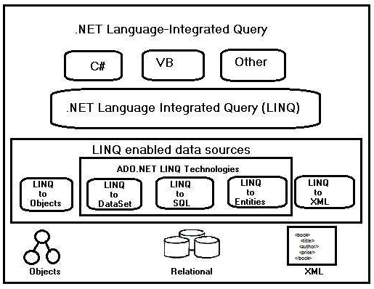

Slide 22
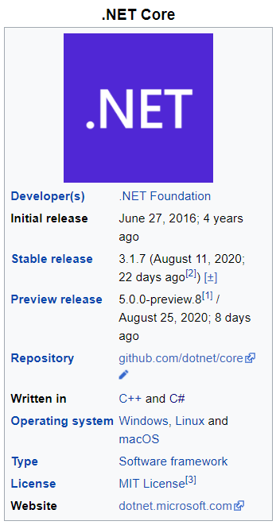
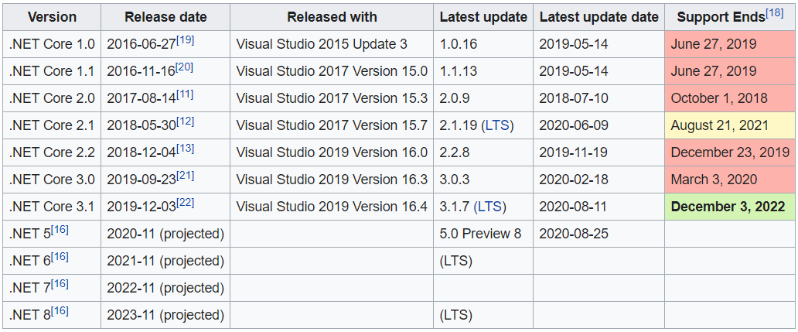
.NET Core is a free and open-source, managed computer software framework for Windows, Linux, and macOS operating systems.
It is a cross-platform^{[5]} successor to .NET Framework.

Slide 23
Resources
LINQ
Intro: https://msdn.microsoft.com/en-us/library/bb397906(v=vs.120).aspx
Practice: https://docs.microsoft.com/en-us/previous-versions/visualstudio/visual-studio-2013/bb397900(v=vs.120)
Samples: https://docs.microsoft.com/en-us/samples/dotnet/try-samples/101-linq-samples/
Samples: https://www.tutorialsteacher.com/linq/linq-standard-query-operators
LINQ With XML
http://www.dotnetcurry.com/linq/564/linq-to-xml-tutorials-examples (Section 1 only - Read XML and Traverse the XML Document using LINQ to XML)

Slide 24
Work on Assignment 2

