Slide 1
C# Classes
[A Review Of Object-Oriented Concepts]

Slide 2
C# Classes
Object oriented-programming
Overview of classes
Fields and properties
Methods (including ToString() and static keyword)
Constructors, initializers and destructors
Overloading operators
Inheritance and polymorphism
Abstract classes and interfaces

Slide 3


Object-Oriented Thinking
[http://www.freepik.com/free-icon/steering-wheel_692134.htm]
[http://laoblogger.com/childrens-animal-clipart.html]

Slide 4
Overview
Object-oriented programming is an approach that breaks a programming problem into objects that interact with each other.
A class is the fundamental building block of object-oriented software.
It is an abstract concept for an object and describes all the characteristics and behaviour of a type of object (a blueprint).
The objects based on the class are the concrete instances that occur at runtime.
It is common practice to use PascalCasing when naming classes (capitalise the first letter of each word; also known as proper case).

Slide 5
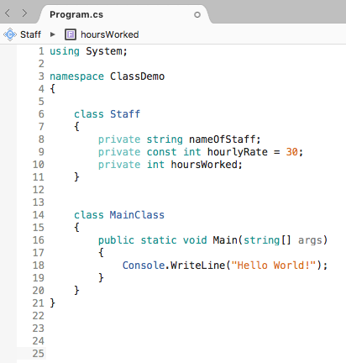
Types of Classes
Classes that are just application programs with a Main() method. These can contain other methods, but are not used as blueprints for objects.
Classes from which you instantiate objects. To instantiate an object is to create a tangible example of it. An object is an instance of a class.

Slide 6
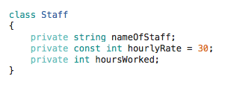
Fields
Fields (Instance variables)
A field is any variable declared inside a class.
Declaring fields as private means they can only be accessed from within the class itself.
No need for other classes to know about these fields (encapsulation);
We do not want other classes to be able to modify these values.
Encapsulation enables us to hide data and behaviour from other classes that do not need to know about them (implemented using access specifiers which define scope and visibility of class member).
Default
Access specifier (gate-keeper)

Slide 7
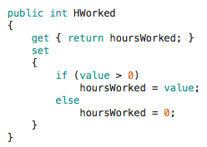


Properties
Commonly used to provide access to a private field.
Gives us greater control over these private fields.
PascalCasing
Known as the backing field of the property
We want other classes to have access to this property
Keyword used inside setter (refers to the value in assignment)
Can use properties to control what values are assigned to private fields!
Accessors (special methods) Getter / Setter
Getter and setter default to same access level as property
Shorthand getter/setter (no additional logic)

Slide 8

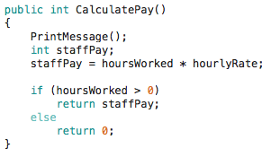
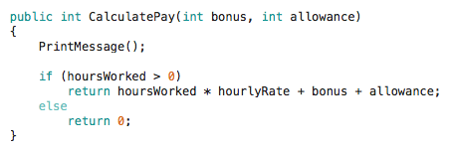
Methods
A method is a code block that performs a specific task.
Accessibility Return type Name
Parameters (inside brackets)
What the method does
(implementation)
More useful method Assigns product of private fields to a local variable.
Determine what result to return (if statement).
Overloading (must have different signature)

Slide 9
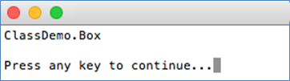


ToString()
Special method that returns a string representing the current class.
All classes come with pre-defined ToString() method.
Typically we override this method to display the fields and properties.
Default
If we override it as shown below

Slide 10

Static
Classes, methods, etc. that can be accessed without the need to create an object are defined using the static keyword.
Pre-written classes in C# are declared as static classes, e.g. Console. We do not need to create a Console object when we use methods from this class.

Slide 11


Constructors
When you instantiate an object, you are actually calling a constructor.
Each class is automatically supplied with a public constructor.
You can create your own constructors (with or without parameters).
You are actually calling a method named Employee() which is the default constructor method.

Slide 12
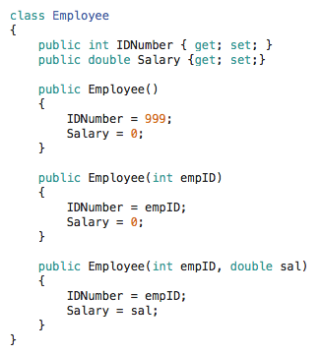


Constructors (cont.)
Multiple constructors
(each with different parameters)
Examples of how different types of Employees can be instantiated (using these constructors).
Sometimes your constructor doesn’t use the parameter (there may be a reason you want this specific constructor to be the one that executes).

Slide 13
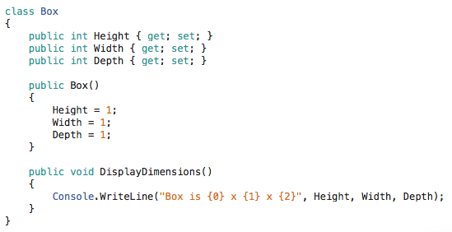
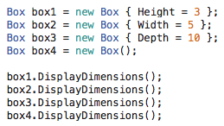
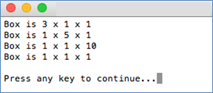
Object Initialisers
Assign values to members/properties of a class at instantiation without calling a constructor with parameters.
Can only be used if your class has a default constructor.
Object initializer

Slide 14
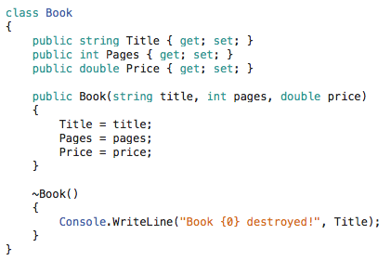
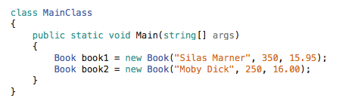
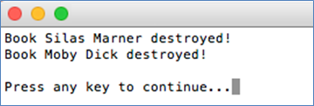
Destructors
A destructor contains the actions you require when an instance of a class is destroyed.
Automatically created for you, but you can create your own.
Cannot be overloaded. No return type.

Slide 15
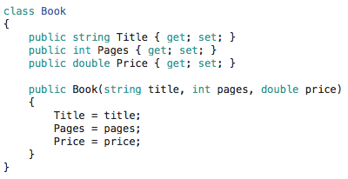

Overloading Operators
Assuming a class of Books, we can define what “adding” books means.
The new title could be a combination of old titles joined by the word “and”.
The number of pages in the new book is the sum of pages of original books.
Instead of charging twice as much for the new book, we could charge the most expensive of the two books plus an additional $10.
Overloading operator+

Slide 16
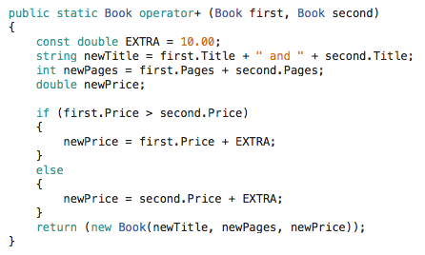
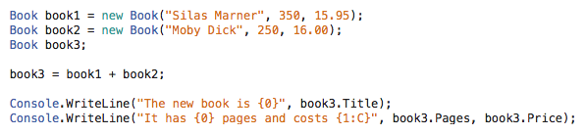

Overloading Operators (cont.)

Slide 17
Inheritance
The principle that you can apply your knowledge of a general category to more specific objects.
Allows us to create a new class from an existing class so we can reuse existing code effectively.
When you create a class that inherits from another, you are provided with fields and methods automatically.
[http://www.freepik.com/free-icon/steering-wheel_692134.htm]

Slide 18
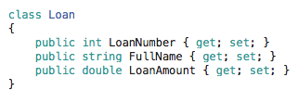

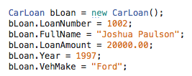

Inheritance (cont.)
A poodle is a dog (which is a pet) (and a pet is an animal).
Members of a gym can be normal members or VIP members.
We could have a Loan object, and extend it so we have a CarLoan (a CarLoan “is a” type of Loan). The CarLoan has all the attributes of a Loan but also has the year and make of the car.

Slide 19
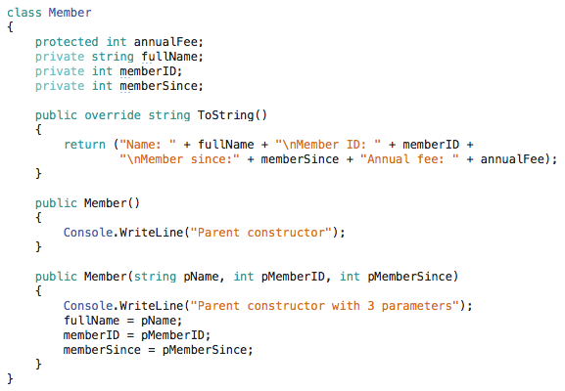
Example
Fields
Override ToString() method
Two constructors
Parent class

Slide 20

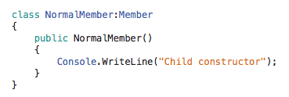
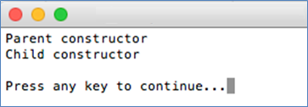
Example (cont.)
Let’s create a NormalMember class derived from Member class.
Base constructor is called first, then the derived constructor. In this case it is the constructors with no parameters.
Derived class
Constructor with no parameters

Slide 21

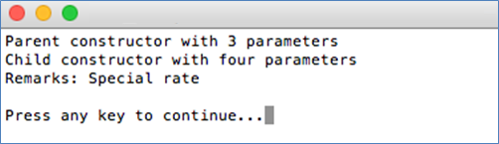
Example (cont.)
Base constructor is called first, then the derived constructor. In this case it is the base constructor with three parameters and the derived constructor with four parameters.
These parameters are sent to base constructor

Slide 22
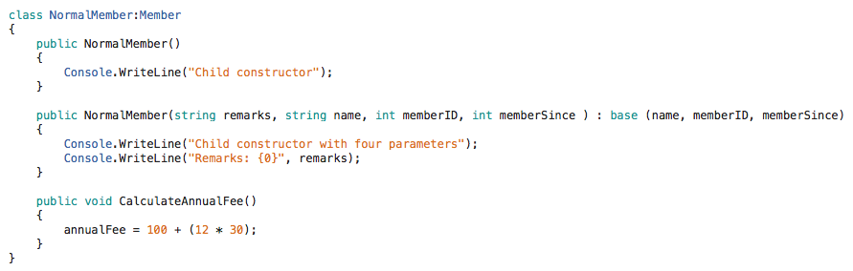
Example (cont.)
A child class has access to all public and protected fields of its parent class, so we can add methods in our NormalMember class that use the fields of the Member class.
Method to calculate the annual
fee and store it in the field.

Slide 23
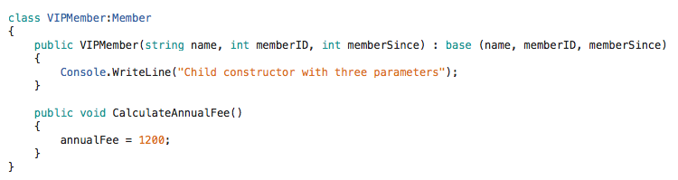
Example (cont.)
Let’s create a VIPMember class derived from Member class.
Base class
Same method name as before but in a different class.
These parameters are sent to the base constructor.

Slide 24
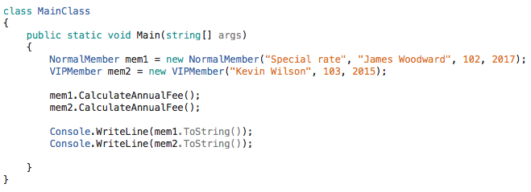
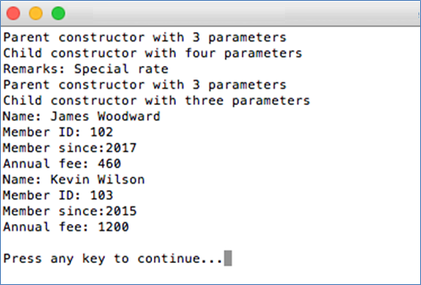
Example (cont.)
Which method is being executed?

Slide 25
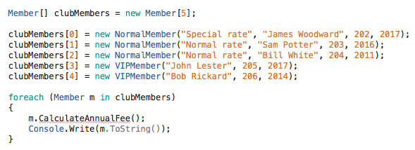
Polymorphism
Using the correct method for an object based on its type at runtime.
An array of Members
Can contain normal and VIP members
Causes an error because we don’t have CalculateAnnualFee method in Member class (it only exists in the NormalMember and VIPMember derived classes)

Slide 26



Polymorphism (cont.)
In base class, create method CalculateAnnualFee with keyword virtual.
In derived classes, declare method overrides the one in parent class.
Tells compiler that method may
be overridden in derived classes
Tells compiler that this method overrides the one in the parent class.
NormalMember
VIPMember

Slide 27
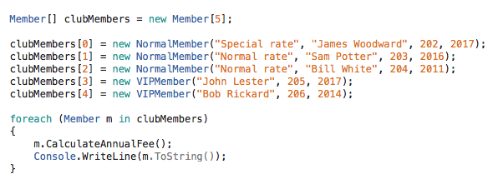
Polymorphism (cont.)
Tells compiler that this method overrides the one in the parent class.
NormalMember
VIPMember
What is the output? Write it in local notepad. Teacher will tell you when to paste it in the chat window.
The “runtime type” is either NormalMember or VIPMember

Slide 28
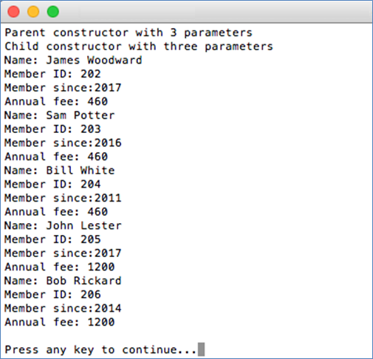
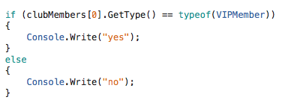
Polymorphism (cont.)
This is the result of polymorphism.
The “runtime type” is either NormalMember or VIPMember
If we want to know the runtime type of an object
ourselves…

Slide 29

Abstract Classes
A special type of class that is created strictly to be a base class for other classes to be derived from. They cannot be instantiated.
Can have fields, properties and methods but no static members.
Can have abstract methods (methods that have no body and are implemented in derived classes).
No body of code so we need semicolon.
In derived class, override the abstract method with override keyword.

Slide 30
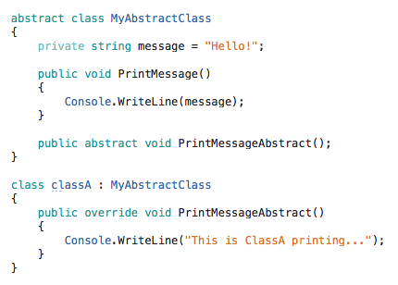

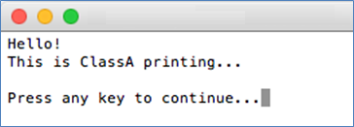

Abstract Classes (cont.)
Would this work? Yes or No? Write your answer in the chat and specify why yes or why no?

Slide 31
Abstract Classes (cont.)
Would give an error as you cannot create an instance of an abstract class.

Slide 32
Interfaces
Similar to abstract classes (cannot be instantiated).
Can only contain methods with no bodies, and can contain properties but no fields. Cannot have any static members.
When a child class inherits an interface, we say it implements it.
A class can only inherit one abstract class, but can implement multiple interfaces*.
The name of an interface is commonly prefixed with letter I.
All properties and methods of an interface are public.
Provide a way of implementing multiple inheritance in C#.
* We don’t need to know how this works right now.

Slide 33

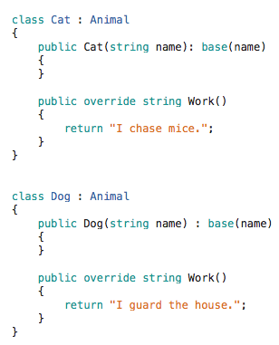
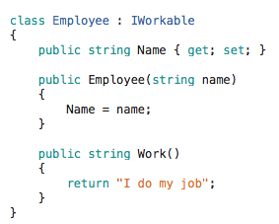
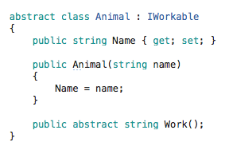
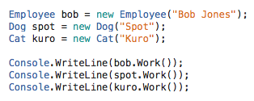
Interfaces (cont.)
What is the output? Write it in local notepad. Teacher will tell you when to paste it in the chat window.

Slide 34
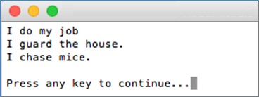
Interfaces (cont.)

Slide 35
Abstract Class or Interface?
Typically you create an abstract class when you want to provide some data or methods that derived classes can inherit (but you want these derived classes to override some specific methods).
You create an interface when you want derived classes to override every method.

Slide 36
Work on Assignment 1

