Slide 1
ASP.NET Core

Slide 2
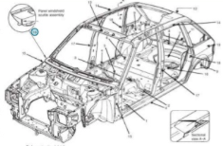
ASP.NET
A framework for the development of web applications. First released in 2002 (Active Server Pages) by Microsoft.
Its basic principle is to separate markup and code.
Since 2016, ASP.NET has been replaced with ASP.NET Core.
First the original ASP was enhanced by separating different code (e.g. the code for processing and the code for building the display). Later MVC was introduced (Model-View-Controller) providing more separation between the user interface and the processing code.
Structural support

Slide 3
ASP.NET Core
ASP.NET Core is a free and open-source web framework, and higher performance than ASP.NET, developed by Microsoft and the community.
It is a modular framework that runs on both the full .NET Framework, on Windows, macOS and Linux.
Current version is 3.1

Slide 4
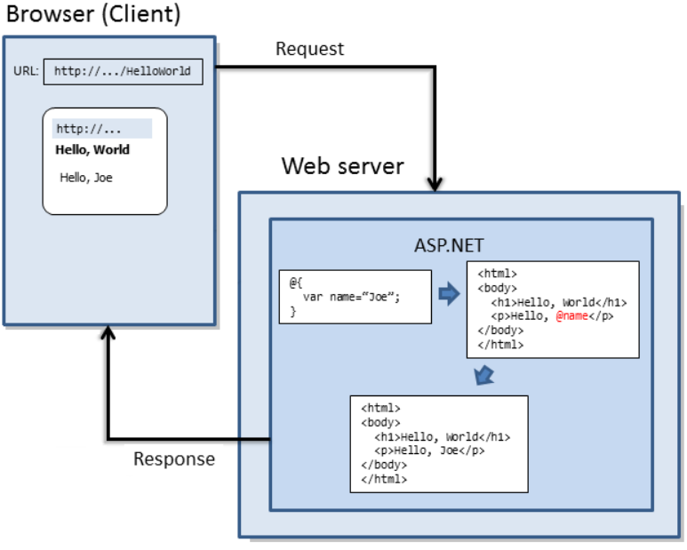

Slide 5
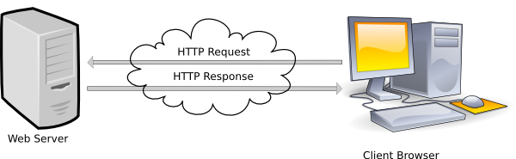
HTTP
Acts as the foundation for communication within the Internet.
Follows a request-response model between client and server.
Defines what the requests and responses should look like.
Includes methods (verbs) which describe the kind of action that should be taken on the item being requested.
[Image taken from http://kodhus.com/newsite/lesson-1-introduction-to-html/]

Slide 6
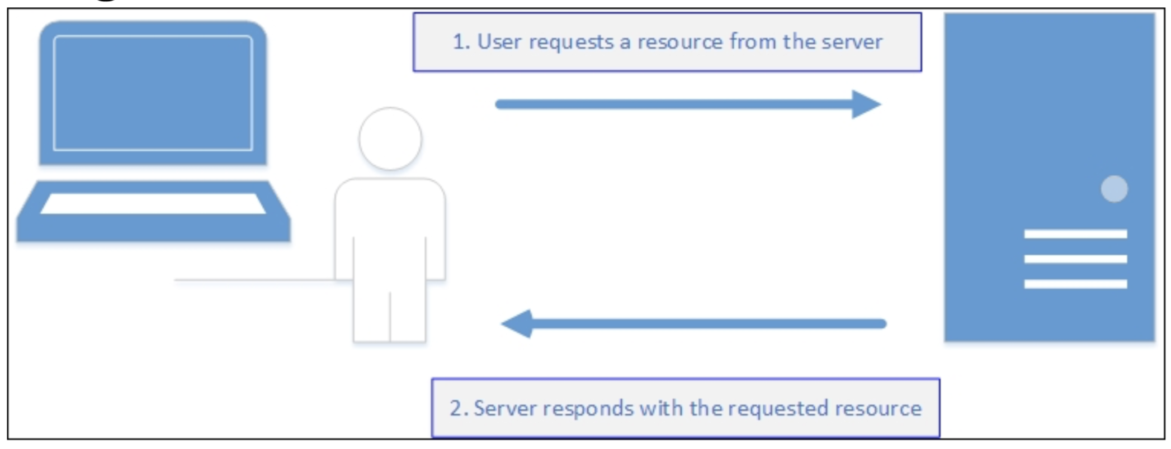
HTTP Request-Response Pattern
HTTP is stateless.
The HTTP protocol does not have any knowledge of the state of any of the previous requests received and served.
However, there are different mechanism to maintain the state.

Slide 7
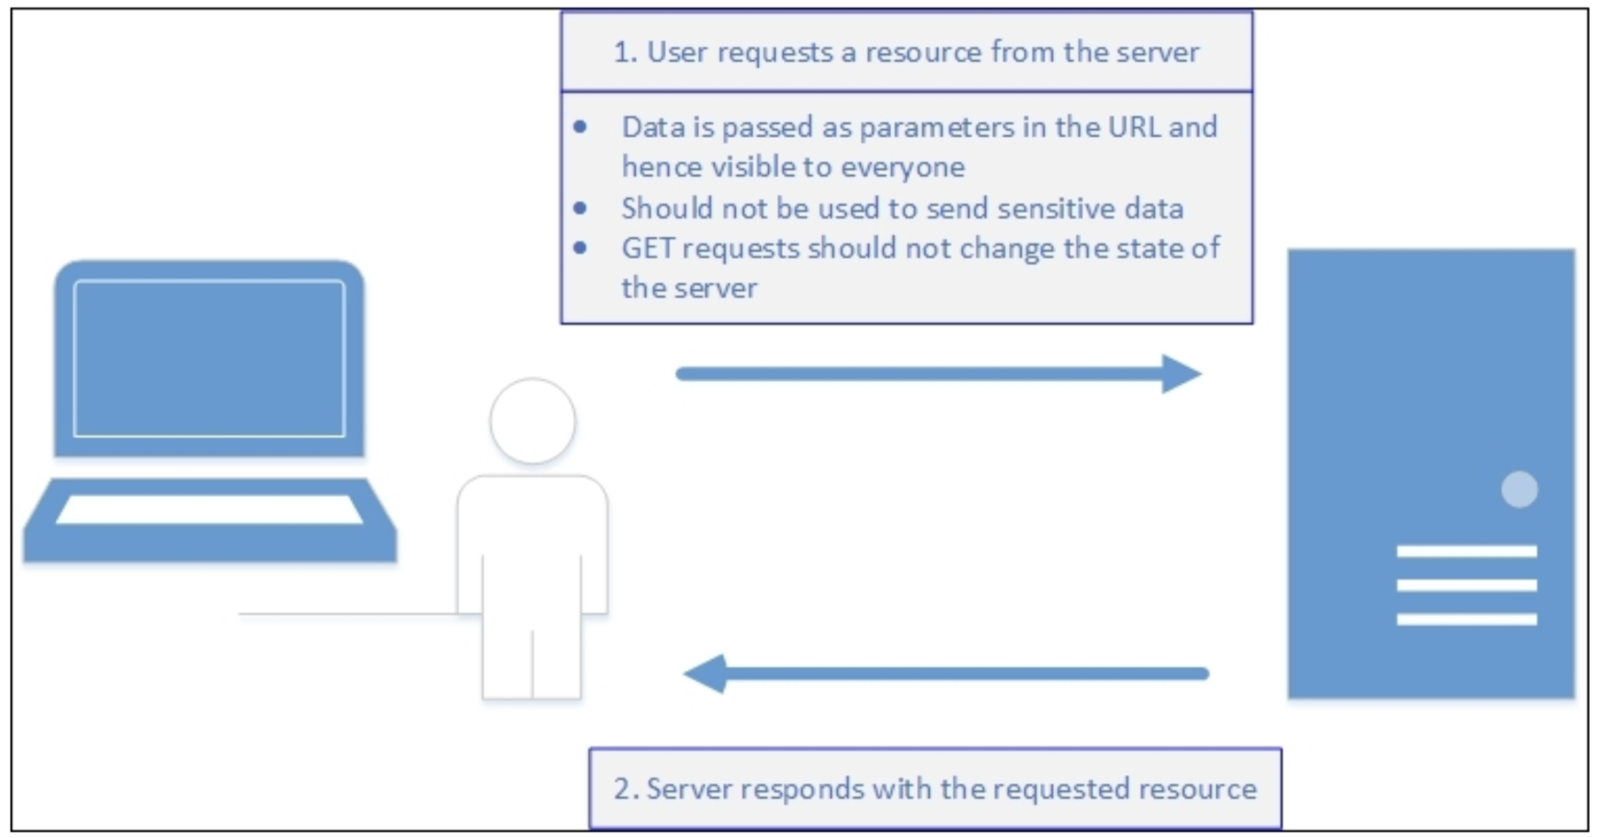
HTTP - GET Method
A GET is a request for a resource.
It should retrieve that resource without any other effect resulting from taking that action.
You should be able to GET a resource multiple times.
Example:
https://en.wikipedia.org/wiki/Hypertext_Transfer_Protocol#Request_methods

Slide 8
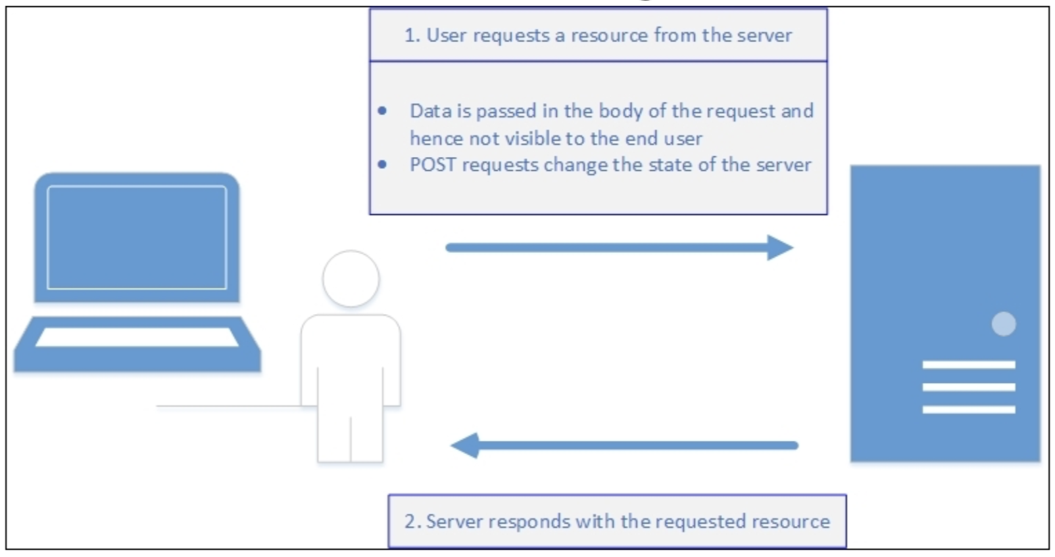
HTTP - POST Method
A POST indicates that there is information included in the request that should create a new version of the resource.
Any item posted should create a new version (so passing in the same information multiple times should result in multiple instances of that object being created).

Slide 9
HTTP Request / Response
A HTTP request includes the following:
Request line, e.g. GET/images/Logo.png HTTP/1.1
Request header fields, e.g. Accept-Language: en
Empty line
Optional message body (often used for POST and PUT)
A HTTP response includes the following:
Status line, e.g. HTTP/1.1 200 OK
Response header fields, e.g. Content-Type: text/html
Empty line
Optional message body

Slide 10
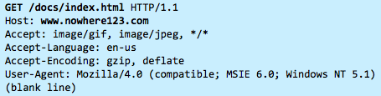
Example
When this request reaches the server, it can take the following actions:
Interpret the request received, maps the request into a file under the server's document directory, and returns the file requested to the client.
Interpret the request received, maps the request into a program kept in the server, executes the program, and returns the output to the client.
The request cannot be satisfied so the server returns an error message.

Slide 11
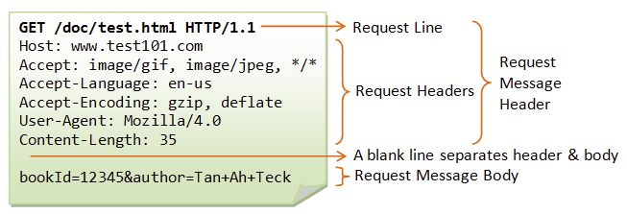
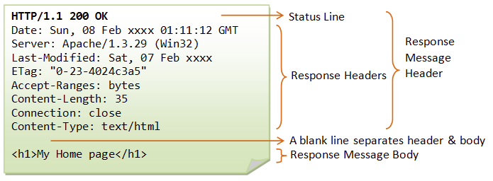
[Taken from https://www.ntu.edu.sg/home/ehchua/programming/webprogramming/HTTP_Basics.html]

Slide 12
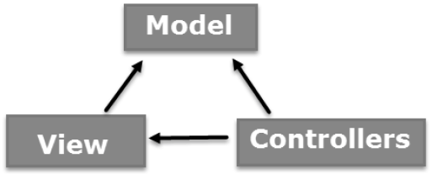
Model – View – Controller (MVC)
MVC is an architectural pattern used in software design.
MVC is away to organize your code and is NOT specific to .NET or Microsoft
ASP.NET Core MVC is a different approach to designing a web application.
Breaks everything into three parts: Model View Controller.
Separates the different aspects of an application (input logic, business logic and UI logic) by specifying where each will be located.
MVC is one of the most frequently-used industry-standard web development frameworks to create scalable and extensible projects. It enables you to work on one aspect of an implementation without affecting the code of another aspect.

Slide 13
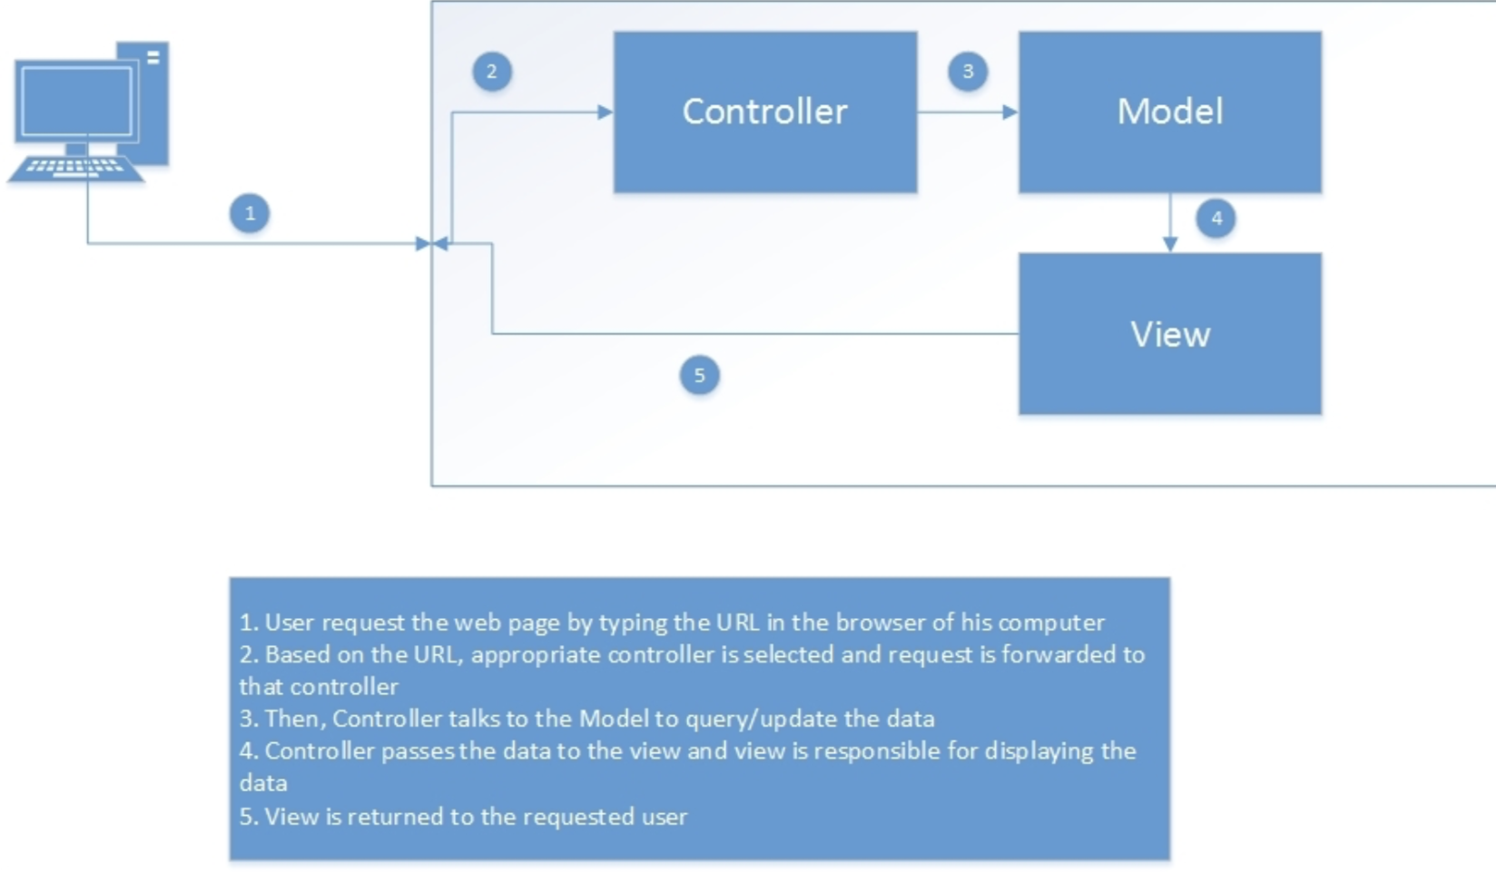
MVC

Slide 14
MVC
Model | View | Controller
Corresponds to the data-related logic that the user works with. This can represent the data that is being transferred between the View and Controller components or and business logic-related data. | Used for all the user-interface logic of the application. This will include all the UI components such as text boxes, drop-downs, etc. that the user will interact with. | Act as an interface between Model and View components. Process the business logic and user requests, manipulate data using the Model components and interact with Views to produce the final output.

Slide 15
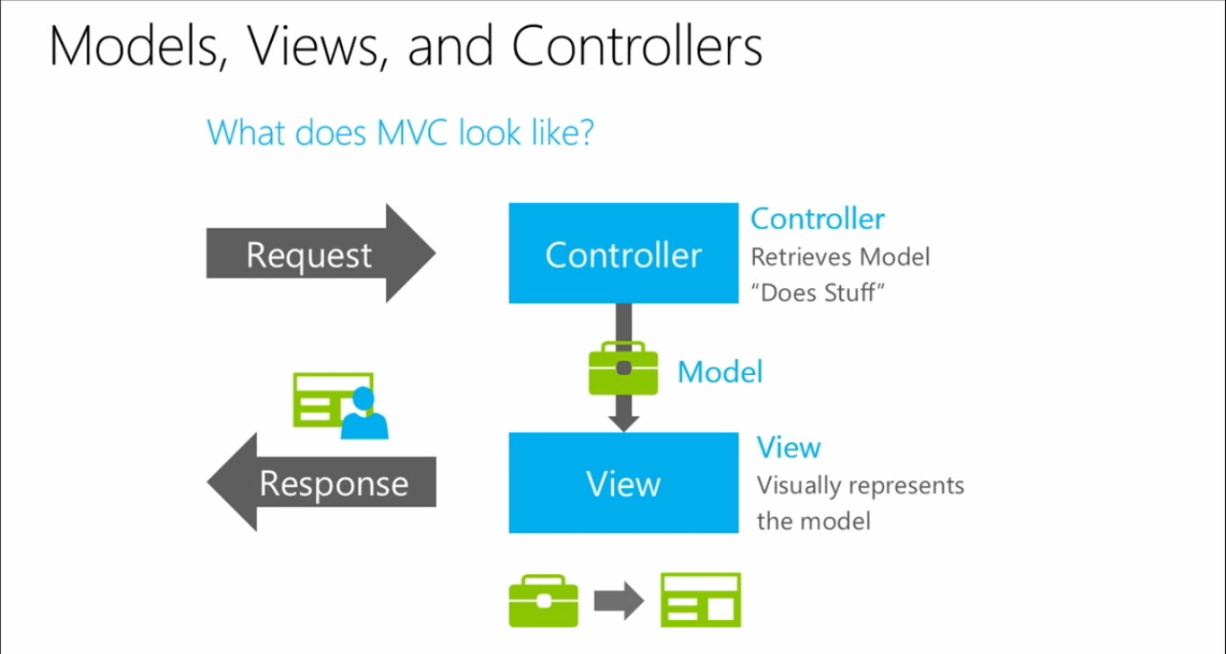
MVC dataflow diagram

Slide 16
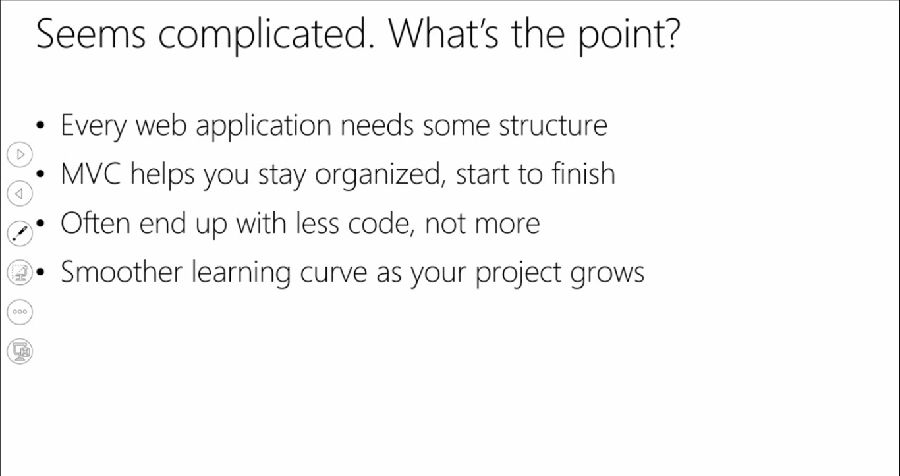
Why MVC is popular?

Slide 17
Lab Exercise
You will create your first ASP.NET MVC application. First I will demonstrate (and we can discuss what we see). Then you will try it out on your own. Tutorial: https://docs.microsoft.com/en-us/aspnet/core/tutorials/first-mvc-app/?view=aspnetcore-3.1 - Overview - Getting Started - Adding A Controller - Adding A View

