Slide 1
Software Development Life Cycle (SDLC)
Notes:
Updated: Fall 2020

Slide 2
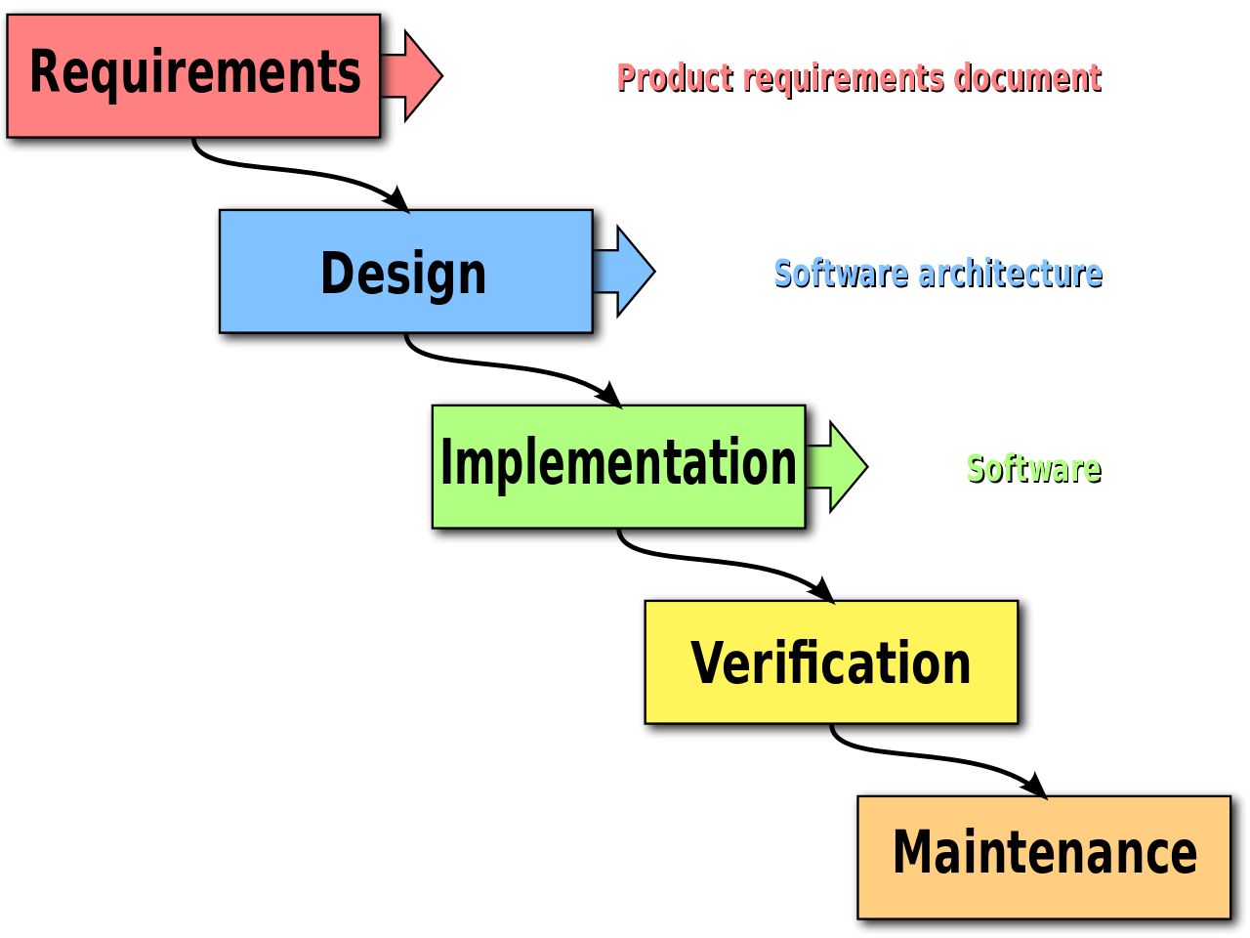
Waterfall Model
Created in the 1950’s and used up to 1980’s software development.
Popular languages of the era (not OOP):
Assembly language (1949)
Fortran (1958)
Pascal (1970)
C (1972)
C++ was created in 1985 (OOP)
[Taken from https://www.versionone.com/agile-101/agile-methodologies/]

Slide 3
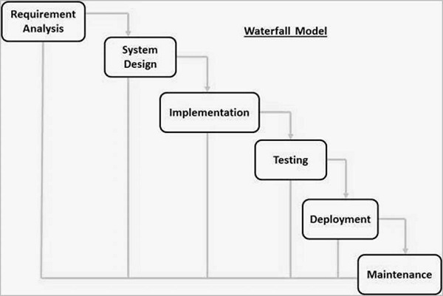
Waterfall Model
Requirement Gathering and analysis − All possible requirements of the system to be developed are captured in this phase and documented in a requirement specification document.
System Design − The requirement specifications from first phase are studied in this phase and the system design is prepared. This system design helps in specifying hardware and system requirements and helps in defining the overall system architecture.
Implementation − With inputs from the system design, the system is first developed in small programs called units, which are integrated in the next phase. Each unit is developed and tested for its functionality, which is referred to as Unit Testing.
Integration and Testing − All the units developed in the implementation phase are integrated into a system after testing of each unit. Post integration the entire system is tested for any faults and failures.
Deployment of system − Once the functional and non-functional testing is done; the product is deployed in the customer environment or released into the market.
Maintenance − There are some issues which come up in the client environment. To fix those issues, patches are released. Also to enhance the product some better versions are released. Maintenance is done to deliver these changes in the customer environment.
[Taken from https://www.tutorialspoint.com/sdlc/sdlc_waterfall_model.htm]

Slide 4
Waterfall Model - Application
Requirements are very well documented, clear and fixed.
Product definition is stable.
Technology is understood and is not dynamic.
There are no ambiguous requirements.
Ample resources with required expertise are available to support the product.
The project is short.
[Taken from https://www.tutorialspoint.com/sdlc/sdlc_waterfall_model.htm]

Slide 5
Waterfall Model - Advantages
Simple and easy to understand and use
Easy to manage due to the rigidity of the model. Each phase has specific deliverables and a review process.
Phases are processed and completed one at a time.
Works well for smaller projects where requirements are very well understood.
Clearly defined stages.
Well understood milestones.
Easy to arrange tasks.
Process and results are well documented.
[Taken from https://www.tutorialspoint.com/sdlc/sdlc_waterfall_model.htm]

Slide 6
Waterfall Model - Disadvantages
No working software is produced until late during the life cycle.
High amounts of risk and uncertainty.
Not a good model for complex and object-oriented projects.
Poor model for long and ongoing projects.
Not suitable for the projects where requirements are at a moderate to high risk of changing. So, risk and uncertainty is high with this process model.
It is difficult to measure progress within stages.
Cannot accommodate changing requirements.
Adjusting scope during the life cycle can end a project.
Integration is done as a "big-bang. at the very end, which doesn't allow identifying any technological or business bottleneck or challenges early.
[Taken from https://www.tutorialspoint.com/sdlc/sdlc_waterfall_model.htm]

Slide 7

Software Engineering Project Management History
Clear disadvantages of Waterfall model are explained in real life project management in the book
The Mythical Man-Month (1975):
https://en.wikipedia.org/wiki/The_Mythical_Man-Month

Slide 8
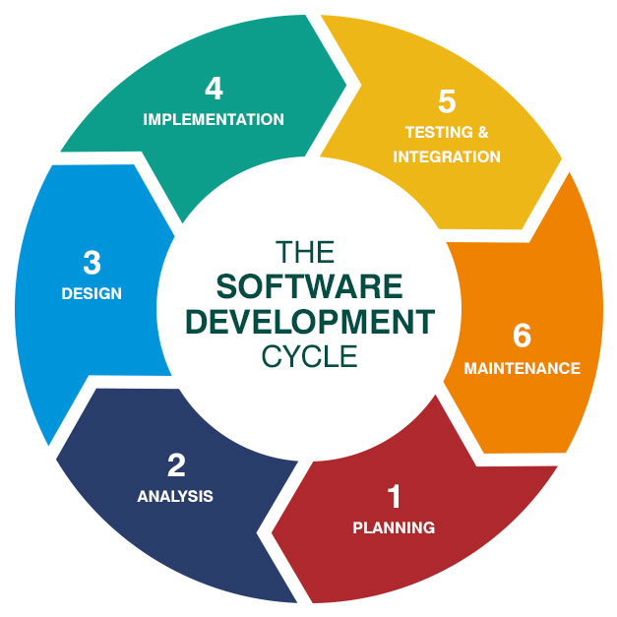
Software Development Life Cycle
Planning
Analysis
Design
Implementation
Testing and Integration
Maintenance
[Taken from https://online.husson.edu/software-development-cycle/]

Slide 9
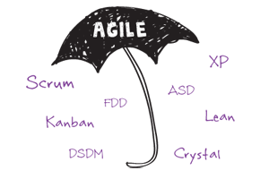
Agile Development
Agile Development is an umbrella term for several iterative and incremental software development methodologies.
Popular agile methodologies include Extreme Programming (XP), Scrum and Kanban (Lean Development).
[Taken from https://www.versionone.com/agile-101/agile-methodologies/]

Slide 10
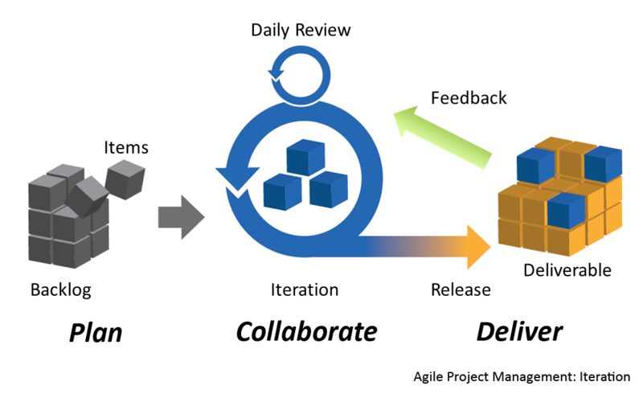
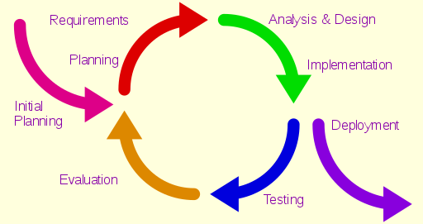
Agile Development
Agile Development is an umbrella term for several iterative and incremental software development methodologies.
[Taken from https://www.versionone.com/agile-101/agile-methodologies/ https://en.wikipedia.org/wiki/Iterative_and_incremental_development]

Slide 11
Read the Agile Manifesto
https://agilemanifesto.org/
Read:
Twelve Principles behind the Agile Manifesto
https://agilemanifesto.org/principles.html

Slide 12


The Agile Manifesto
Individuals and interactions
Process and tools
over
Working software
Comprehensive documentation
over
Customer collaboration
Contract negotiation
over
Responding to change
Following a plan
over
[Taken from www.agilemanifesto.org]

Slide 13
What Is Scrum?
Scrum is an agile process that allows us to focus on delivering the highest business value in the shortest time.
It allows us to rapidly and repeatedly inspect actual working software (every two weeks to one month).
The business sets the priorities, and teams self-organize to determine the best way to deliver the highest priority features.
Every two weeks to a month anyone can see real working software and decide to release it as is or continue to enhance it for another sprint.

Slide 14
What Is Scrum? (cont.)
Scrum has been used for commercial software, financial applications, ISO 9001-certified applications, video game development, websites, mobiles,24x7 and life-critical systems and more!
It has been used by Microsoft, Yahoo, Google, Electronic Arts, High Moon Studios, Nokia, Philips, John Deere, BBC, Capital One…
A typical team is 7 ±2 people. Scalability comes from teams of teams. Scrum has been used on multiple 500+ person projects
Created/developed by Ken Schwaber, Jeff Sutherland and Mike Cohn.

Slide 15
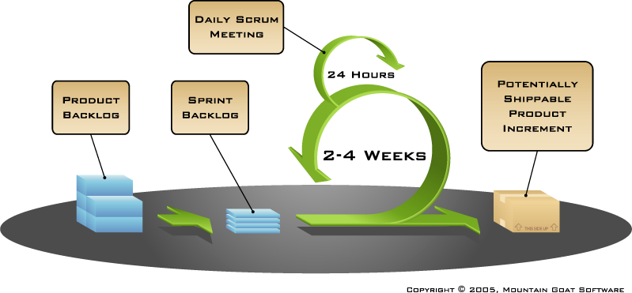
Scrum Overview
Product is designed, coded and tested during a Sprint.
SPRINT
Watch videos: https://www.mountaingoatsoftware.com/exclusive/scrum-foundations

Slide 16
The Scrum Framework
Roles
Product Owner
Scrum Master
Team
Ceremonies
Sprint planning
Sprint review
Sprint retrospective
Daily scrum meeting
Artifacts
Product backlog
Sprint backlog
Burndown charts

Slide 17
The Scrum Framework: Roles
Roles
Product Owner
Scrum Master
Team
Ceremonies
Artifacts

Slide 18
Product Owner
Roles
Product Owner
Scrum Master
Team
Maximises ROI by directing the team towards the most valuable work and away from the less valuable work.
Controls the priority of the items in the team’s backlog.
Makes sure the team fully understands the requirements.
Is responsible for recording the product requirements. Often as user stories: as a <role> I want a <feature> so that I can <accomplish something>
Adjusts features and priority every iteration, as needed.
Accepts or rejects work results.

Slide 19
Scrum Master
Roles
Product Owner
Scrum Master
Team
Acts as a coach, guiding the team to increase their cohesiveness, self-organisation and performance.
Is responsible for enacting Scrum values and practices.
Ensures that the team is fully functional and productive by removing any impediments that may arise.
Shields the team from external interferences.
Not a team boss. A peer position set apart by knowledge and responsibilities (not rank!)

Slide 20
Team
Roles
Product Owner
Scrum Master
Team
Typically consists of 5-9 people.
Cross-functional: Programmers, testers, designers, etc.
Members should be full-time (although there may be exceptions, e.g. Database Administrator).
Teams are self-organizing (preferably with no titles/hierarchy).
Membership should change only between sprints. You have been given the names of the members in your Scrum Team.

Slide 21
The Scrum Framework: Ceremonies
Roles
Ceremonies
Sprint planning
Sprint review
Sprint retrospective
Daily scrum meeting
Artifacts

Slide 22
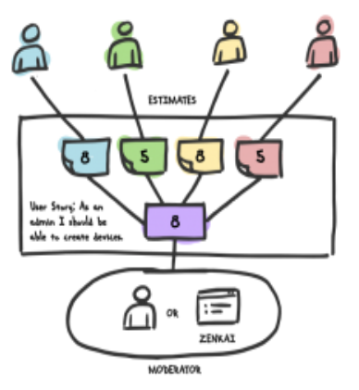
Sprint Planning
Ceremonies
Sprint planning
Sprint review
Sprint retrospective
Daily scrum meeting
Team selects items from the product backlog that they commit to completing in the upcoming sprint. This is the sprint backlog.
Tasks are identified and each is estimated. This is done in a collaborative manner (e.g. using planning poker) or putting tasks onto a swim lanes wall.
[https://blog.moove-it.com/asynchronous-planning-poker-estimations/]

Slide 23
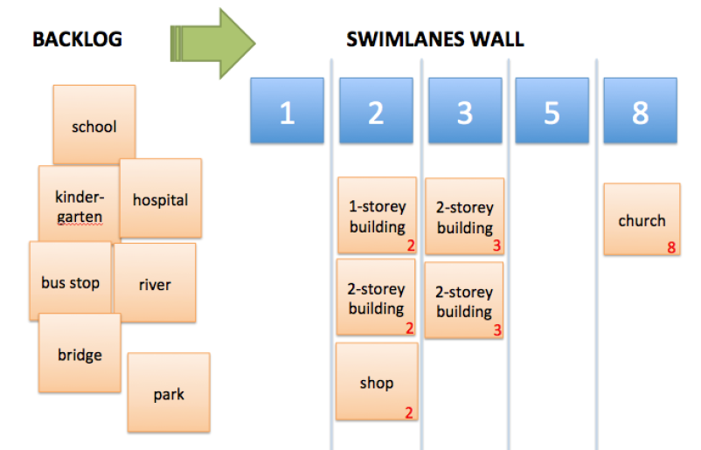
Sprint Planning (cont.)
Example of using planning poker or swimlanes to estimate stories.

Slide 24
Sprint Review
Ceremonies
Sprint planning
Sprint review
Sprint retrospective
Daily scrum meeting
Team presents what it accomplished during the sprint that just took place.
Typically take the form of a demonstration of new features.
The team participates (but the whole world can be invited).
At this point there should be a potentially shippable product increment (e.g. set of new features / updated version).

Slide 25
Sprint Retrospective
Ceremonies
Sprint planning
Sprint review
Sprint retrospective
Daily scrum meeting
Take a look at what is working well and what needs improvement.
Carried out after every sprint.
Typically 15-30 minutes.
Whole team participates.
Start/Stop/Continue (What I think we should start, stop and continue doing).
Expectations (What my team expects from me, what I expect from my team).
Post-It Notes (Everyone notes down their ideas then discuss as a group).

Slide 26
Sprint Retrospective (cont.)
Ceremonies
Sprint planning
Sprint review
Sprint retrospective
Daily scrum meeting
Do | Don’t
Make it a safe place to express issues. | Play the blame game.
Ask “What else?” instead of “Anything else?” | Suppress your feelings or anyone else’s.
Motivate the team to participate and make it fun. | Include uninvited external members.
Keep track of previous items and review results. | Allow distractions or take too long.

Slide 27
Daily Scrum Meeting
Ceremonies
Sprint planning
Sprint review
Sprint retrospective
Daily scrum meeting
Takes place daily (stand-up, 15mins max)
Not for problem solving.
Whole world is invited but only the team members, Scrum Master and Product Owner can talk.
Not a status report, it is a commitment in front of your peers.

Slide 28

Daily Scrum Meeting (cont.)
Ceremonies
Sprint planning
Sprint review
Sprint retrospective
Daily scrum meeting
Typically, each team member answers the following three questions at the daily scrum:
1
What did you do yesterday?
2
What will you do today?
3
Is anything in your way?

Slide 29
The Scrum Framework: Artifacts
Roles
Ceremonies
Artifacts
Product backlog
Sprint backlog
Burndown charts

Slide 30
Product Backlog
Is the master To Do List for the entire project. The agile equivalent of the traditional user requirements document.
Requirements initially create the product backlog. The highest priority items are broken down into user stories.
Is prioritized by Product Owner as required (and reprioritized as the start of each sprint.
Each item should have priority, description, estimate of effort and type (requirement / maintenance / improvement, etc.)
Backlog item | Effort Estimate
Allow a guest to make a reservation | 3
As a guest, I want to cancel a reservation. | 5
As a guest, I want to change the dates of a reservation. | 3
As a hotel employee, I want to run RevPAR reports (revenue-per-available-room) | 8
Improve exception handling | 8
… | …

Slide 31
User Stories
Features in the product backlog from a user’s perspective.
User stories are written in the following format: As a <role> I want a <feature> so that I can <accomplish something>
Some user stories are too large (epic) and need to be split into multiple smaller user stories before it can be worked on.
As a user I can backup my hard drive.
As a power user, I can specify files or folders to backup based on size, date created or date modified.
As a user I can indicate folders not to backup so that my backup drive isn’t filled with things I don’t need saved.

Slide 32
User Stories (cont.)
We add detail to user stories in two ways:
By splitting a user story into multiple smaller user stories.
By adding “conditions of satisfaction”.
User stories are written throughout the entire agile project. Everyone in the team participates with the goal of creating the product backlog which fully describes the functionality required.
Incomplete until a discussion about that story has taken place.
Must be precise in use of language.
Entrée comes with choice of soup or salad and bread. The user can enter a name. It can be 127 characters.

Slide 33
User Stories (cont.)
INVEST is the acronym used for qualities you want in your user stories:
Independent –should not need other stories to implement it (where possible).
Negotiable – product owner and development team discuss and expand details.
Valuable – shows product value to the customer (not technical steps required).
Estimable – refined enough that developers can estimate the effort required.
Small – small in executable size (so you can have 6-10 user stories per sprint).
Testable – needs to be testable so development team knows when it is done.

Slide 34
User Stories (cont.)
Video: http://www.agilenutshell.com/episodes/2-userstories
The product owner gathers user story on index card.
As a team, ask pertinent questions to the client (teacher).
Example:
What color is the house?
How big is the house?
What does success look like for each user story?
Write the acceptance criteria on the back of the index card.

Slide 35
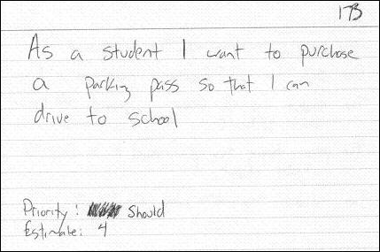
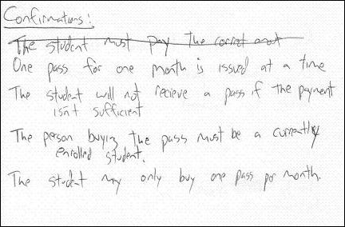
User Stories (cont.)

Slide 36
User Stories (cont.)
How to do effort estimations:
http://www.agilenutshell.com/episodes/3-estimation

Slide 37
Sprint Backlog
Individuals sign up for work of their own choosing
Work is never assigned
Estimated work remaining is updated daily
Any team member can add, delete or change the sprint backlog
Work for the sprint emerges
If work is unclear, define a sprint backlog item with a larger amount of time and break it down later
Update work remaining as more becomes known

Slide 38
Resources
What is Agile? https://docs.microsoft.com/en-us/azure/devops/learn/agile/what-is-agile
What is Scrum? https://docs.microsoft.com/en-us/azure/devops/learn/agile/what-is-scrum

Slide 39
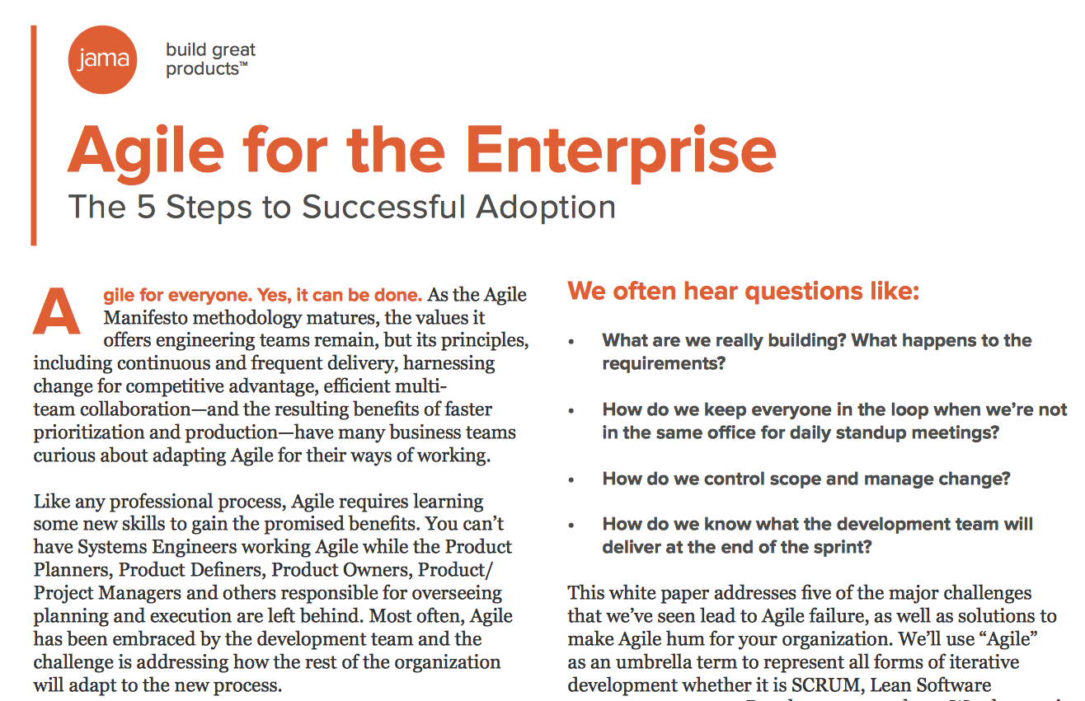
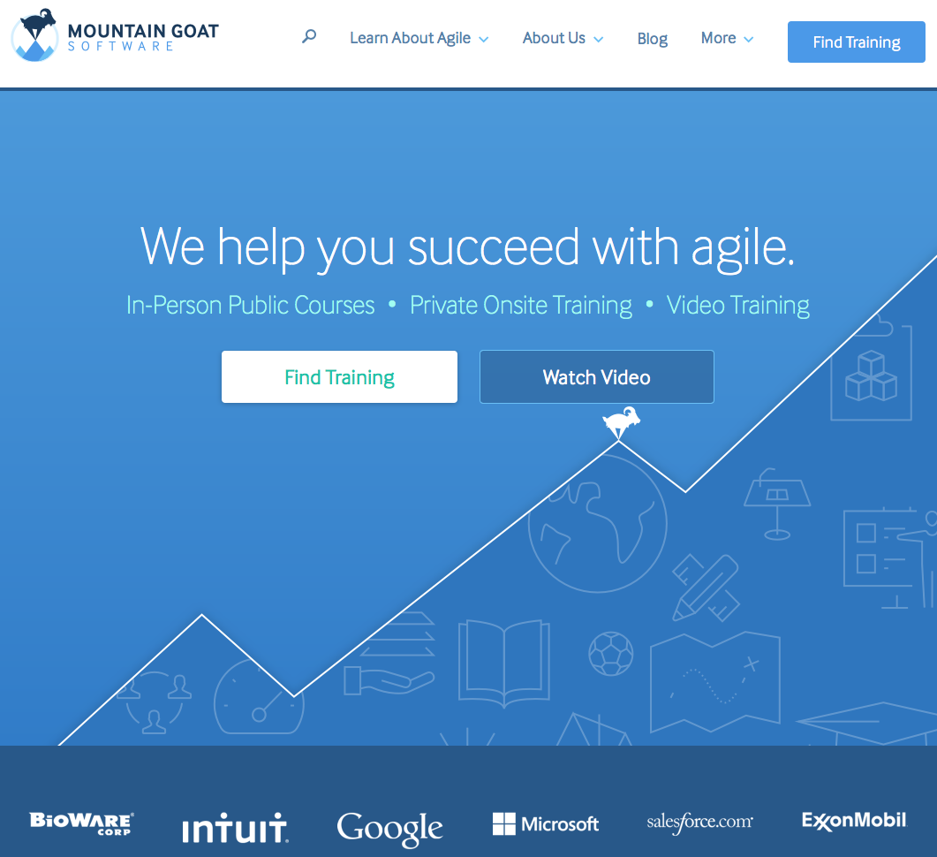
Resources
White Paper on Agile for the Enterprise
Mountain Goat Software

