Slide 1
Educational Organisation Using Service Now

Slide 2
Introduction to Educational Organization Using ServiceNow
ServiceNow is a cloud-based platform that streamlines various administrative and operational processes within educational institutions.
It helps in improving efficiency, transparency, and communication across departments.
This presentation explores how ServiceNow can be effectively implemented in educational organizations.
Notes:
Image source: https://www.servicenow.com

Slide 3

Key Features of ServiceNow for Education
ServiceNow offers a customizable platform tailored to the unique needs of educational institutions.
It includes modules for IT service management, student services, and facilities management.
Automated workflows and self-service portals enhance user experience and operational efficiency.
Notes:
Image source: https://learning.servicenow.com

Slide 4
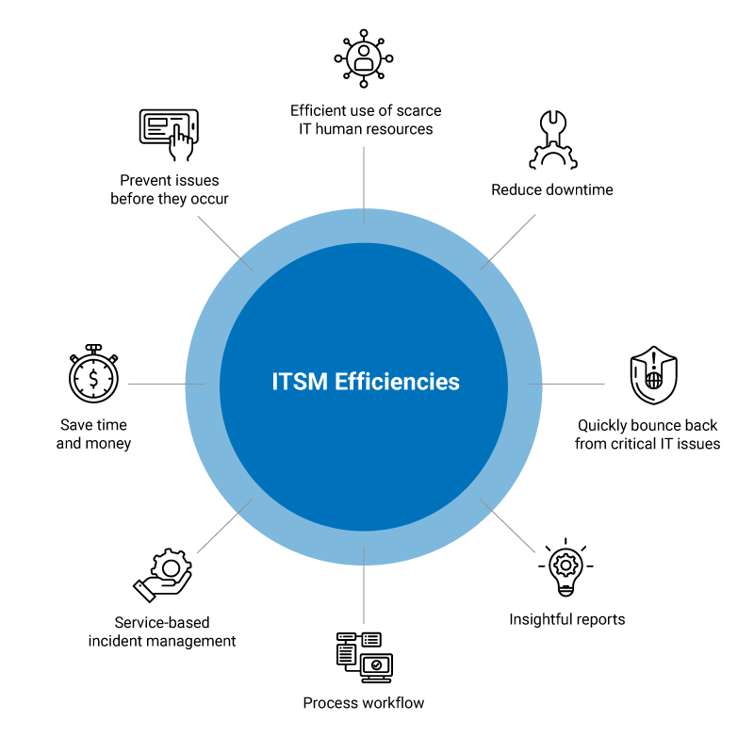
Benefits of Implementing ServiceNow in Education
Improved communication channels foster better engagement between staff, students, and faculty.
Centralized data management simplifies reporting and decision-making processes.
Automation reduces manual tasks, allowing staff to focus on core educational activities.
Notes:
Image source: https://arcticit.com

Slide 5
Student Services Management
ServiceNow enables streamlined handling of student inquiries, admissions, and course registrations.
Self-service portals empower students to access information and complete requests independently.
Integration with other systems ensures a seamless experience across multiple student services.
Notes:
Image source: https://learning.servicenow.com

Slide 6
IT Service Management in Education
ServiceNow facilitates efficient management of IT resources and support tickets.
Automated incident tracking and resolution improve the reliability of IT services.
Knowledge bases provide self-help options for students and staff, reducing resolution time.
Notes:
Image source: https://www.servicenow.com

Slide 7
Facilities and Asset Management
The platform tracks maintenance requests and schedules for campus facilities.
Asset lifecycle management helps in planning upgrades and replacements efficiently.
Real-time dashboards provide visibility into facility status and resource allocation.
Notes:
Image source: https://www.slidemake.com

Slide 8
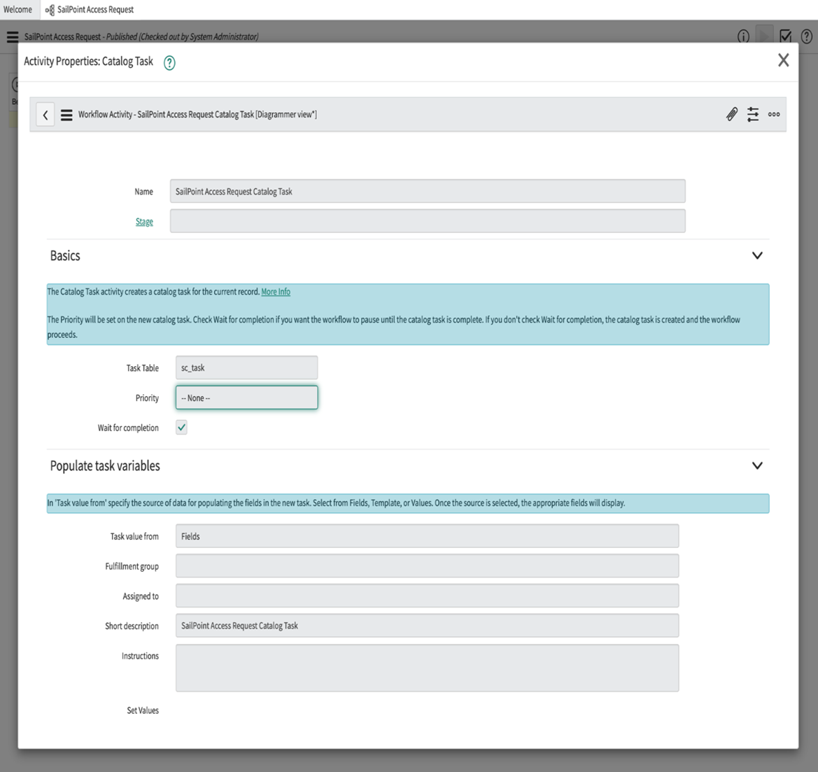
Workflow Automation and Customization
ServiceNow allows the creation of tailored workflows to meet institutional policies.
Automation minimizes manual intervention, reducing errors and delays.
Custom dashboards and reports provide insights for continuous improvement.
Notes:
Image source: https://documentation.sailpoint.com

Slide 9
Challenges and Considerations
Implementing ServiceNow requires careful planning and stakeholder buy-in.
Data security and privacy are critical when managing sensitive student and staff information.
Ongoing training and support are essential for maximizing platform adoption and effectiveness.
Notes:
Image source: https://www.slidemake.com

Slide 10

Case Studies and Success Stories
Several educational institutions have successfully integrated ServiceNow to streamline operations.
Examples include improved student service delivery and enhanced campus maintenance management.
These case studies demonstrate the platform’s potential to transform educational administration.
Notes:
Image source: https://risemrktg.com

Slide 11
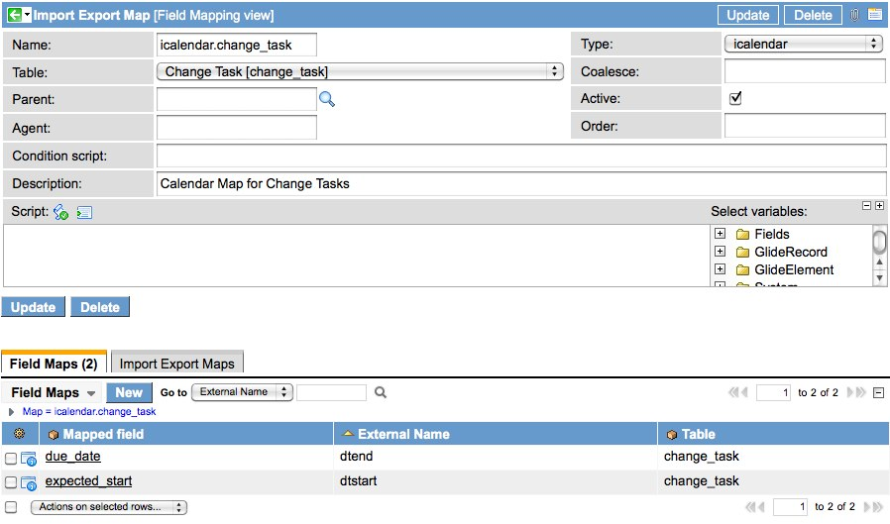
Conclusion and Future Outlook
ServiceNow offers a comprehensive solution for modernizing educational organization operations.
Continuous updates and integrations will expand its capabilities in the education sector.
Embracing digital transformation with ServiceNow can lead to more efficient, responsive, and student-centered institutions.
Notes:
Image source: https://servicenowguru.com

