Slide 1
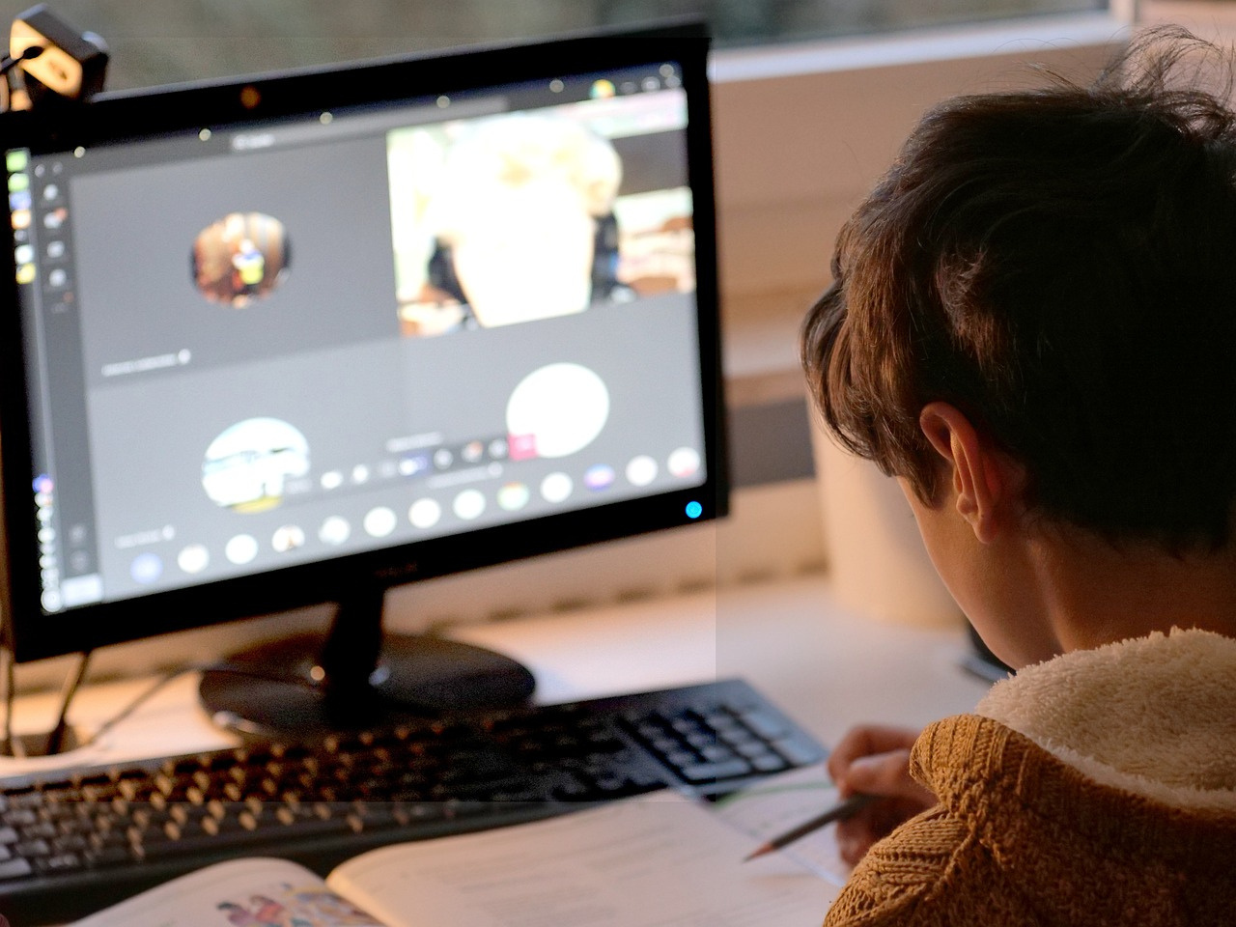
JUNIOR CODE
Presented by
Anam Fatima
Harram Sattar
Nasreen

Slide 2
OBJECTIVES
01
Simplify programming for beginners
Enhance logical thinking and creativity
Promote early interest in programming
Junior code

Slide 3
FEATURES
02
Beginner-friendly syntax
GUI interface using Tkinter
Supports basic programming constructs
Junior code

Slide 4
LANGUAGE SELECTION
Why Python?
Easy to understand and implement
Extensive libraries for GUI (Tkinter) and parsing (re)
Adaptive and flexible
Why Python?
03
Junior code

Slide 5







TIME LINE
Implementation
of Lexer
Interpreter/ Compiler
04
Grammar Defination
Implementation
of Parser
Graphical User Interface
Junior code

Slide 6
GRAMMAR DEFINITION
show for “printing”
var for “declaring variables “
ask for “taking input from user”
if else statement for “condition”
repeat for “for loop”
loop for “while loop”
05
Junior code

Slide 7
LEXER
Splitting the input into keywords, identifiers, operators, and other components.
Keeping track of the position in the code for error reporting.
Identifying reserved words like var, if, show, and operators like +, -, =, etc.
Token(type='IDENTIFIER', value='age', line=1, column=5)
06
Example
Junior code

Slide 8
PARSER
The Parser converts tokens from the Lexer into an Abstract Syntax Tree (AST), representing the program’s logical structure.
It processes variable declarations (var <name>: <type> = <value>) and ensures correct type declarations (int, float, string), raising errors for invalid types.
When ask is used, the Parser creates an AskNode to manage user prompts, assigning the input to a variable.
07
Junior code

Slide 9
COMPILER/INTERPRETER
08
Manages a dictionary of variables, including their values and types.
Supports arithmetic operations (+, -, *, /) and ensures type safety (e.g., disallowing 5 + "text").
Throws type errors when there’s a mismatch (e.g., assigning "abc" to an int).
Junior code

Slide 10
GUI IMPLEMENTATION
Tkinter Feature
TKINTER FEATURE
Input text box for writing code
Compile button to execute the code
Output display area
09
Junior code

Slide 11
Thank You

