Slide 1
Student’s
Grades
Through
Habits
May
2025
My Analysis
Elise Harrell
Data Science

Slide 2
Agenda
Intro to the Dataset/Goals
Data Visualization
Modeling
Analysis/Key Findings
References

Slide 3

Dataset : Student Habits vs
Academic Performance
“.... exploring how lifestyle habits affect academic performance in students. With 1,000 student records and 15+ features including study hours, sleep patterns, social media usage, diet quality, mental health, and final exam scores…”

Slide 4
Dataset Snippet
Student Id | Age | Gender | Study Hours Per Day | Social Media Hours | Netflix Hours | Part Time Job | Attendance Percentage | Sleep Hours | Diet Quality | Exercise Frequency | Parental Education Level | Internet Quality | Mental Health Rating | Extracurricular Participation | Exam Score
S1000 | 23 | Female | 0 | 1.2 | 1.1 | No | 85 | 8 | Fair | 6 | Master | Average | 8 | Yes | 56.2
S1001 | 20 | Female | 6.9 | 2.8 | 2.3 | No | 97.3 | 4.6 | Good | 6 | High School | Average | 8 | No | 100
S1002 | 21 | Male | 1.4 | 3.1 | 1.3 | No | 94.8 | 8 | Poor | 1 | High School | Poor | 1 | No | 34.3
Exam Score is our Dependent Variable

Slide 5

Goals
To predict student grades based on their habits as well as finding correlation between habits and other student variables.

Slide 6
Agenda
Intro to the Dataset/Goals
Data Visualization
Modeling
Analysis/Key Findings
References

Slide 7
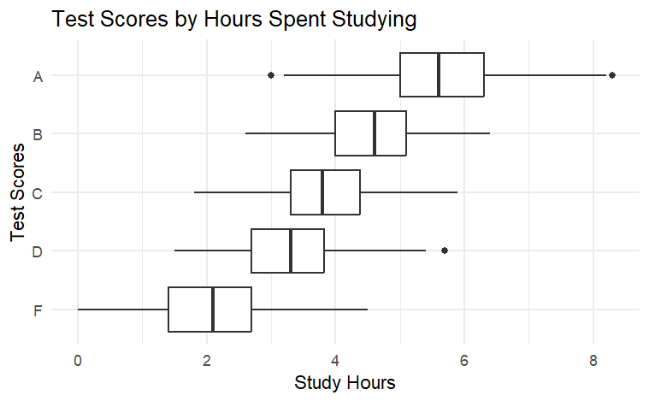
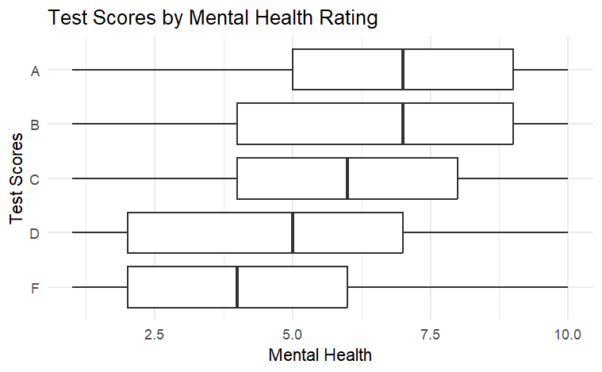

Slide 8
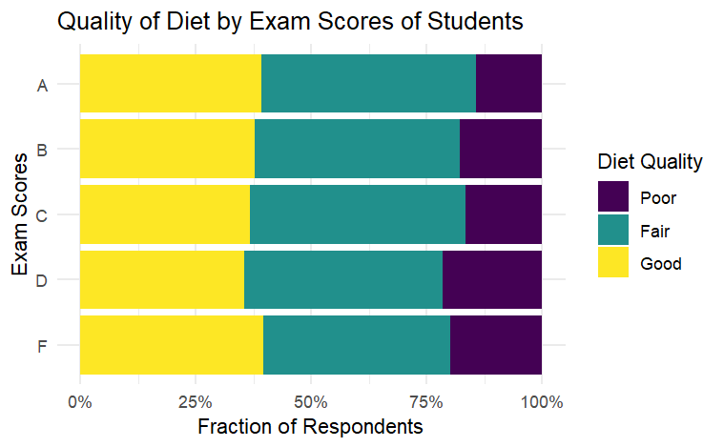
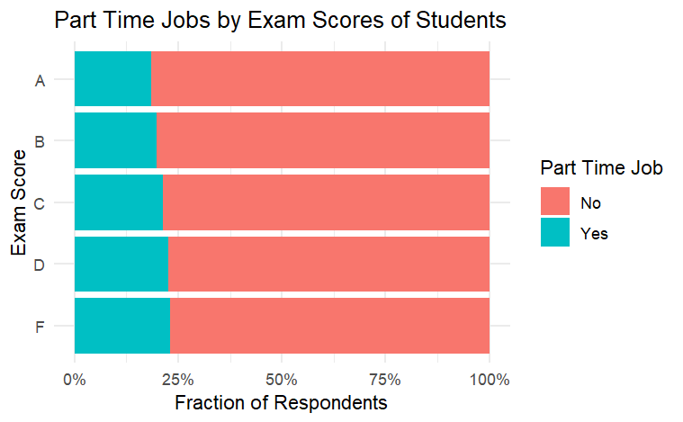

Slide 9
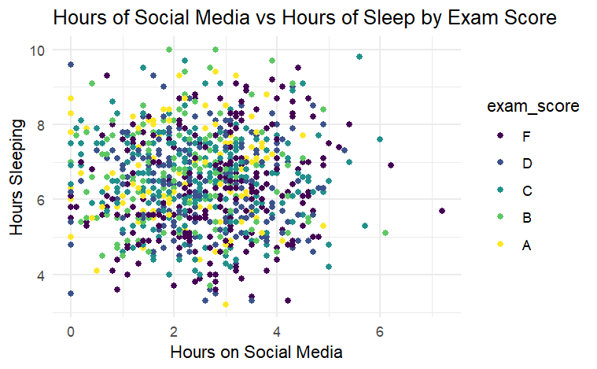
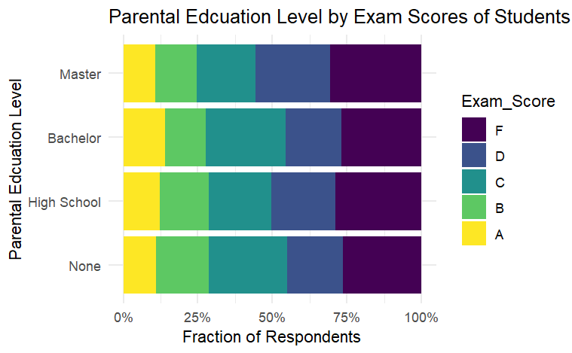

Slide 10
Agenda
Intro to the Dataset/Goals
Data Visualization
Modeling
Analysis/Key Findings
References

Slide 11
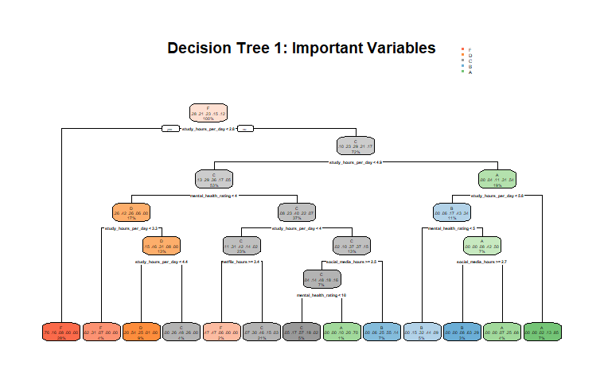

Slide 12
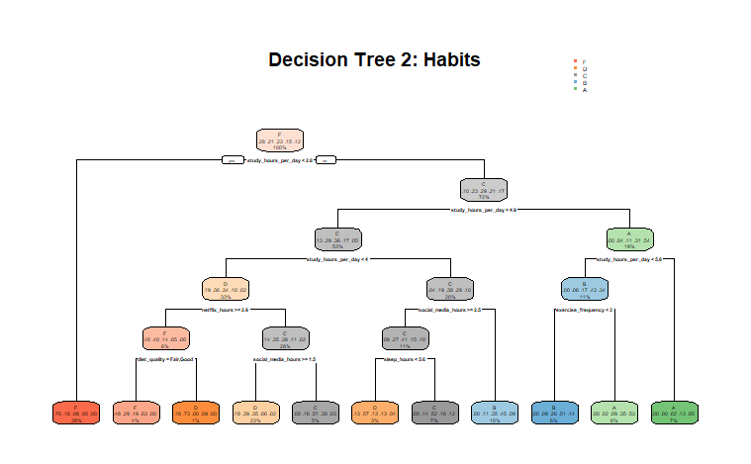

Slide 13
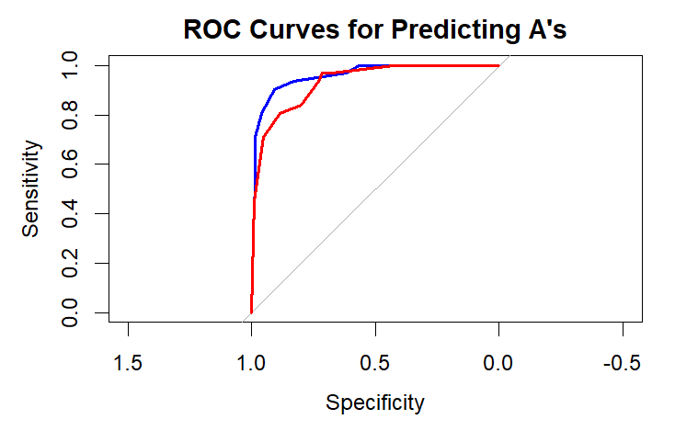
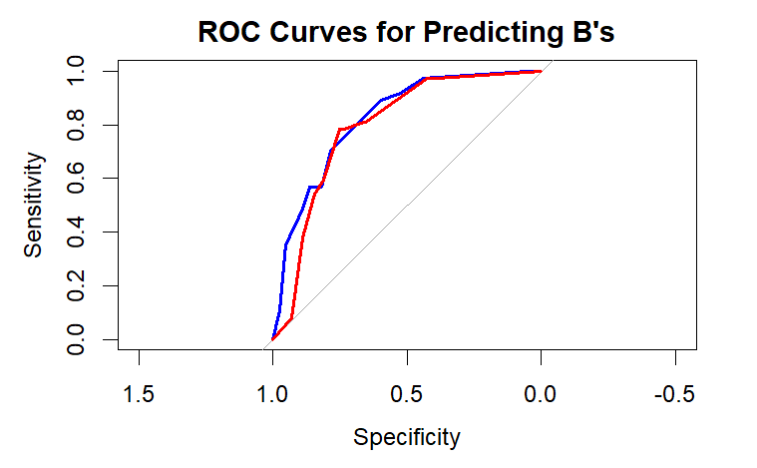
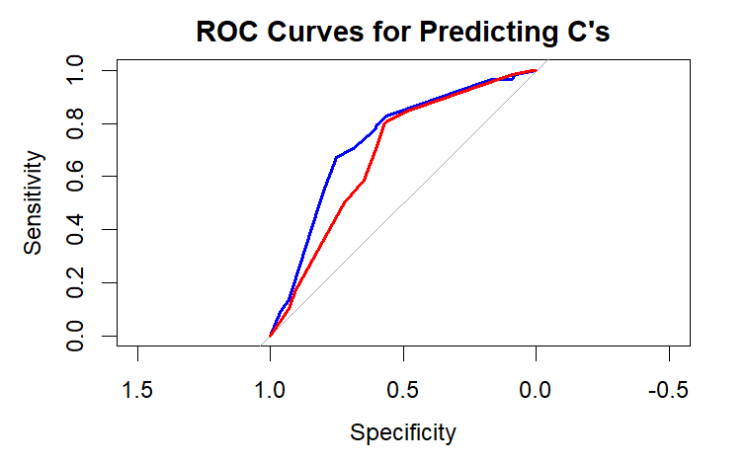
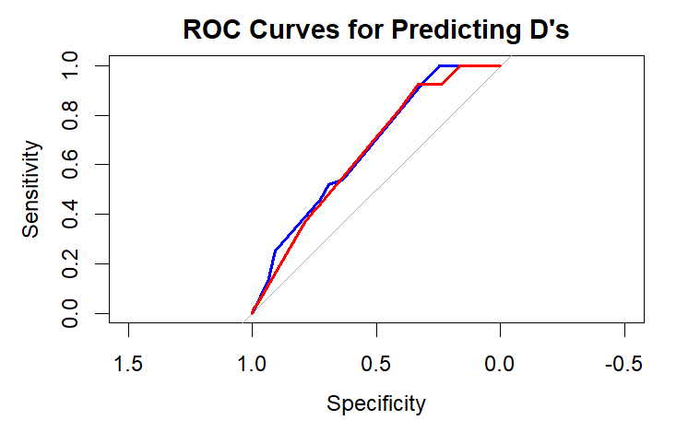
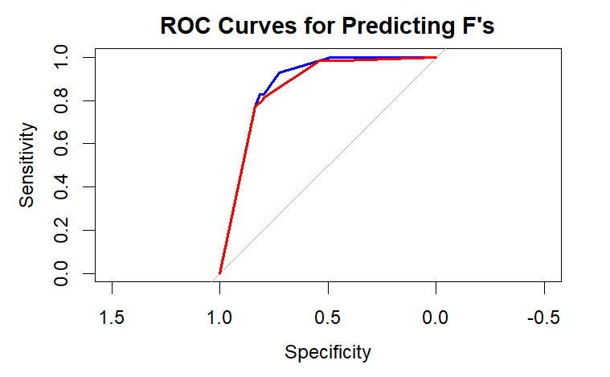
Imp Var
Habit

Slide 14
Confusion Matrix
Important Variables : Habits
Actual > Prediction \/ | F | D | C | B | A
F | 58 | 26 | 9 | 1 | 0
D | 7 | 7 | 4 | 2 | 0
C | 5 | 15 | 31 | 15 | 2
B | 0 | 4 | 12 | 18 | 7
A | 0 | 0 | 2 | 1 | 22
Actual > Prediction \/ | F | D | C | B | A
F | 56 | 22 | 12 | 1 | 0
D | 13 | 19 | 20 | 6 | 2
C | 1 | 7 | 10 | 9 | 1
B | 0 | 4 | 13 | 14 | 6
A | 0 | 0 | 3 | 7 | 22

Slide 15
Agenda
Intro to the Dataset/Goals
Data Visualization
Modeling
Analysis/Key Findings
References

Slide 16
Analysis
1
2
3
Important Variable Tree
Habit Tree
Weaknesses
The Important Variable Tree performs slightly better than the habit tree, getting more accurate results for the middle letter grades, specifically for ‘D’. Study hours and mental health rating are greatly correlated to exam grades.
The Habit Tree performs slightly worse than the important variable tree, especially when it comes to the middle grades, B, C, and D. It seems as if parental education and extracurricular participation, age, gender, and part_time_job really help make the difference in signifying the difference between those letter grades.
While both models perform decently well, they both struggle to predict the middle grades. The habits of students in these groups may not be distinct enough for a decision tree to separate. It is better for predicting an A grade or an F.

Slide 17
Next Steps
Feature Engineering
Get more data that could help predict. For example: motivation, confidence, enjoyment. These may improve class distinction.
Flexible Models
Try a more flexible model like a random forest model to improve class separation.
Re-level grades
Merging similar classes like B/C if the difference between them isn’t meaningful

Slide 18
Agenda
Intro to the Dataset/Goals
Data Visualization
Modeling
Analysis/Key Findings
References

Slide 19
References
Kaggle Dataset
https://www.kaggle.com/datasets/jayaantanaath/student-habits-vs-academic-performance/data
Confusion Matrix
https://www.digitalocean.com/community/tutorials/confusion-matrix-in-r
Neptune.ai Blog
https://neptune.ai/blog/balanced-accuracy

Slide 20
Any questions?

