Slide 1



Course: Explainable AI
Explainable & Ethical AI for Employee Attrition Prediction
Team Members: Group 9 - Hackathon 2026
⁠COSTE Thomas
BHATTARAI Govinda
MOUROUGAN Harreshh
⁠ZULFIQAR Marwa
⁠CHANUMOLU Lalith Adithya

Slide 2

Problem Statement
Employee attrition represents a major and costly challenge for organizations. Current AI systems have several critical shortcomings:
• They provide predictions without clear explanations
• They lack transparency, reducing user trust
• They can introduce bias into HR decisions
Key Message
Understanding why employees leave is essential for developing effective and ethical retention strategies.

Slide 3




Objectifs
Construire un système IA de confiance qui prédit l'attrition, explique les décisions du modèle, assure équité et usage éthique, et soutient la prise de décision RH.
Predicting Attrition
Explain the Decisions
Ensuring Ethics
Develop a reliable predictive model capable of identifying employees at risk of leaving before it is too late to intervene.
Provide clear and understandable explanations of the factors influencing each prediction to strengthen user confidence.
To guarantee the fairness of predictions by controlling potential biases and ensuring responsible and ethical use of the AI ​​system.

Slide 4

Dataset Presentation and Challenges
Dataset: HR Employee Dataset
311 employees, 36 variables, target: Termd (0=Active, 1=Left)
Key variables: salary, engagement survey, absences, performance score.
This dataset provides a solid foundation for analyzing attrition factors while also presenting significant challenges to overcome.
Problem 01
Problem 02
Problem 03
Missing values
Departure dates are missing for some employees, requiring logical validation and appropriate processing.
Inconsistencies
Discrepancies between identifiers and labels, raw data not directly usable (date formats).
Risk of bias
Sensitive variables (gender, demographics) may introduce bias into the model's predictions.

Slide 5

Inconsistency Removal
Removal of records with contradictory or invalid data, representing less than 1% of the total dataset.
01
Data Preprocessing
Missing Values ​​Management
Systematic processing of empty fields, including departure dates, by imputation or exclusion depending on the context.
02
Preprocessing is a crucial step to ensure the quality and reliability of the data before model training. Each step aims to eliminate noise and prepare a clean and usable dataset.
Logical Validation of Departures
Verification of consistency between the employee's status (Termd) and the associated dates to ensure the integrity of the labels.
03
Data Anonymization
Before Training the model remove the personal identifiers (names, IDs) to guarantee confidentiality and compliance with ethical principles.
04

Slide 6


Characteristics Engineering
Seniority
01
Days since assessment
02
Behavioral indicators
03
Absences and satisfaction
04
Improved interpretability
05
Model performance
06

Slide 7
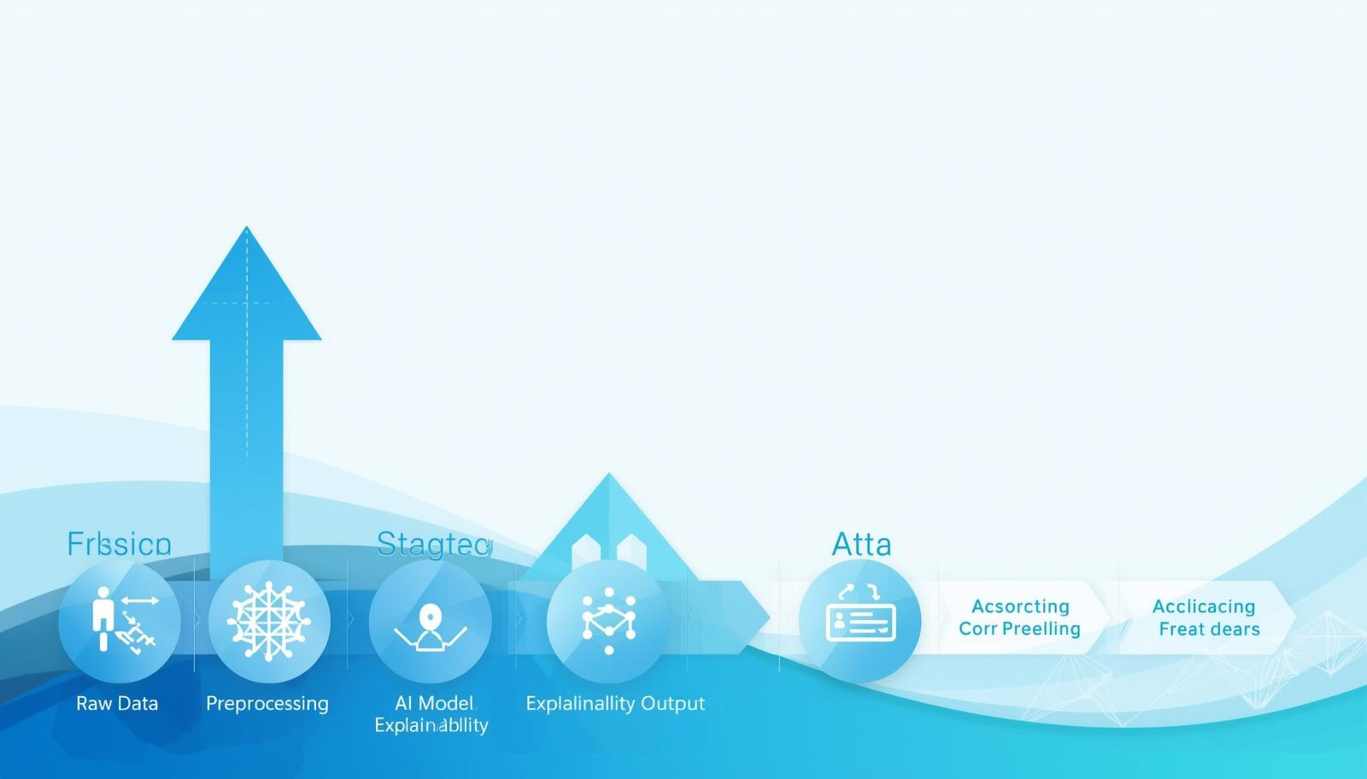
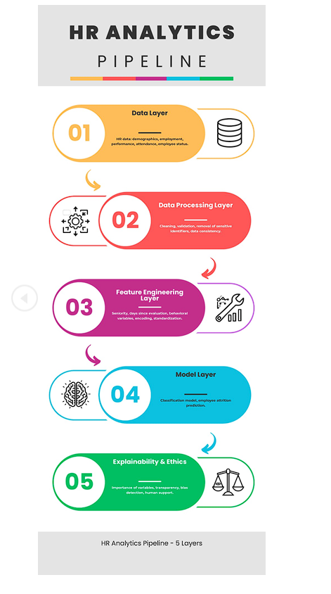
Architecture Diagram

Slide 8



Model Selection
Logistic Regression
Random Forest
Final Choice
Simple and interpretable base model. Useful for establishing a performance baseline and understanding linear relationships between variables.
Powerful ensemble model tested for its ability to handle complex data and non-linear interactions between features.
Random Forest selected for its robustness, management of complex data, and ability to provide variable importance.

Slide 9
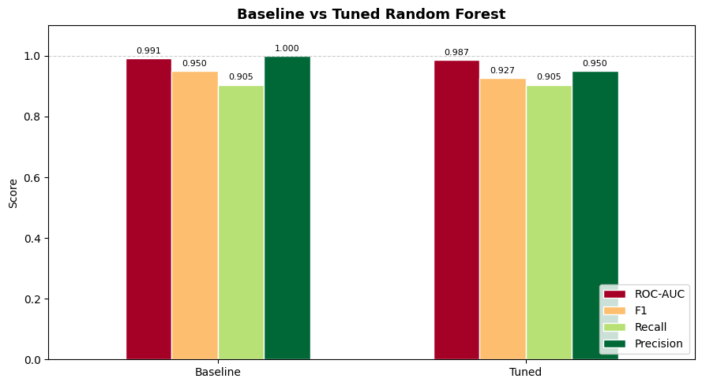
Results
Performance of the Random Forest model for predicting employee attrition. Results validated on the test set.
98.72%
90.48%
ROC-QUC
Recall
95%
92.68%
Accuracy
F1 Score

Slide 10

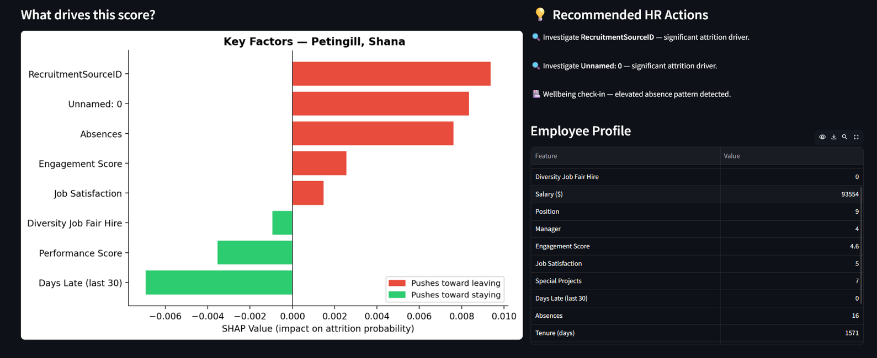
Explainable AI
Understand why an employee is at risk of leaving, not just predict it.

Slide 11


Ethical AI
Bias Control
Fair Predictions
Guaranteeing fair and non-discriminatory results. Responsible use of AI to support ethical HR decisions.
Systematic verification of bias according to gender and other demographic criteria. Ensures fairness in the model's predictions.

Slide 12



Use Case and Impact
Early Identification
Retention Strategies
Decision Support
Detect employees at risk before they leave thanks to predictive analysis. Proactive intervention to reduce turnover and its associated costs.
Develop targeted programs based on identified risk factors. Personalize loyalty actions according to the specific needs of each profile.
AI as an HR decision support tool, not a replacement. Explainable recommendations for informed and responsible choices.

Slide 13

Limitations and Future Work
Every AI system has constraints that are essential to recognize to ensure responsible use.
Our model, while high-performing, faces certain limitations inherent to the available data.
Problem 01
Problem 02
Problem 03
Limitation 01
Limited dataset size (311 employees) reducing generalization. Restricted demographic diversity that may mask certain biases.
Limitation 02
Potential undetected biases in variables. Lack of longitudinal data to track employee evolution over time.
Future Work
Integration of larger and more diversified datasets. Advanced algorithmic fairness techniques. Real-time dashboard for HR.

Slide 14

THANK YOU!
Explainable AI - Hackathon 2026

