Slide 1
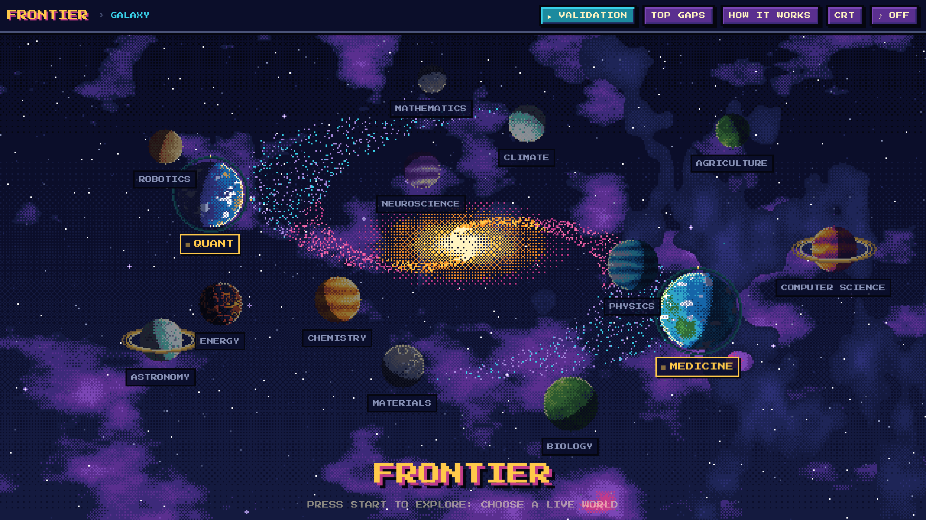
FRONTIER
Predicting which research ideas will meet next, and proving it with a backtest
35,813 real arXiv papers · Medicine and Quant
Notes:
FRONTIER turns research into a map. Every concept is a point, every paper that mentions two concepts draws a line between them, and the empty spaces between concepts that have never met are research gaps. We predict which gaps will be filled next, and we prove it: we froze the data at the end of 2018 and checked our predictions against the 35,813 papers. Two fields are live: Medicine and Quant.

Slide 2

New research often starts where two known ideas have never met
35,813
5,423
6.8M
real arXiv papers
live research concepts
never-studied pairs scored
Medicine and Quant, 1997 to Oct 2026
tagged in titles and abstracts
every pair, no sampling
The question: out of millions of concept pairs that no paper has ever combined, which ones will researchers combine next? A student, a lab or a research firm that knew this would know where to look first.
Notes:
Most real advances combine two things that already exist but had never been studied together. The space of possible combinations is enormous: millions of pairs even inside one field. FRONTIER ranks them all and points to the most promising ones.

Slide 3





From 35,813 papers to a ranked list of research gaps
1 Papers
2 Concepts
3 Network
4 Gap score
Real arXiv papers with titles, authors and every arXiv category (Person A's data pipeline). Medicine: 9,353. Quant: 26,460.
Research phrases tagged in each title and abstract, e.g. "proton therapy", "limit order book". Hub words and ~600 filler phrases removed.
Two concepts are linked once a paper mentions both. 1,106,862 links today; islands = sub-fields.
Every pair that has never been linked is scored with Resource Allocation. Gaps stay inside one field: never Medicine with Quant.
Output: 6.8 million never-studied pairs ranked, with the top gaps featured on every island
Notes:
Four steps. We start from real arXiv papers. We tag research concepts in each paper. We connect concepts that appear together in a paper, which gives a network for each field. Then we score every pair that has never been connected. Gaps are always within one field.

Slide 4
Shared, specialised neighbours signal a gap about to close
RA(u,v) = Σ 1 / degree(w)
degree 5 → 1/5
over every concept w that has already appeared in papers with both u and v. A specialised neighbour (few links) adds a lot; a hub that touches everything adds almost nothing.
degree 2 → 1/2
TODAY'S #1 QUANT GAP
Pricing problem + vanilla option
never studied together
u
v
RA 0.442
255 shared neighbour concepts, yet no paper has ever studied both (to Oct 2026)
Island: Pricing of Securities
degree 2 → 1/2
RA = 1/5 + 1/2 + 1/2 = 1.2
Notes:
Resource Allocation is the score. Look at the concepts that both u and v have already been studied with: their shared neighbours. Each one contributes one over its degree, so specialised neighbours count most and hubs count least. In the toy example, 1/5 + 1/2 + 1/2 = 1.2. Our top Quant gap today is pricing problem plus vanilla option: 255 shared neighbours, RA 0.442, and still no paper on both.

Slide 5
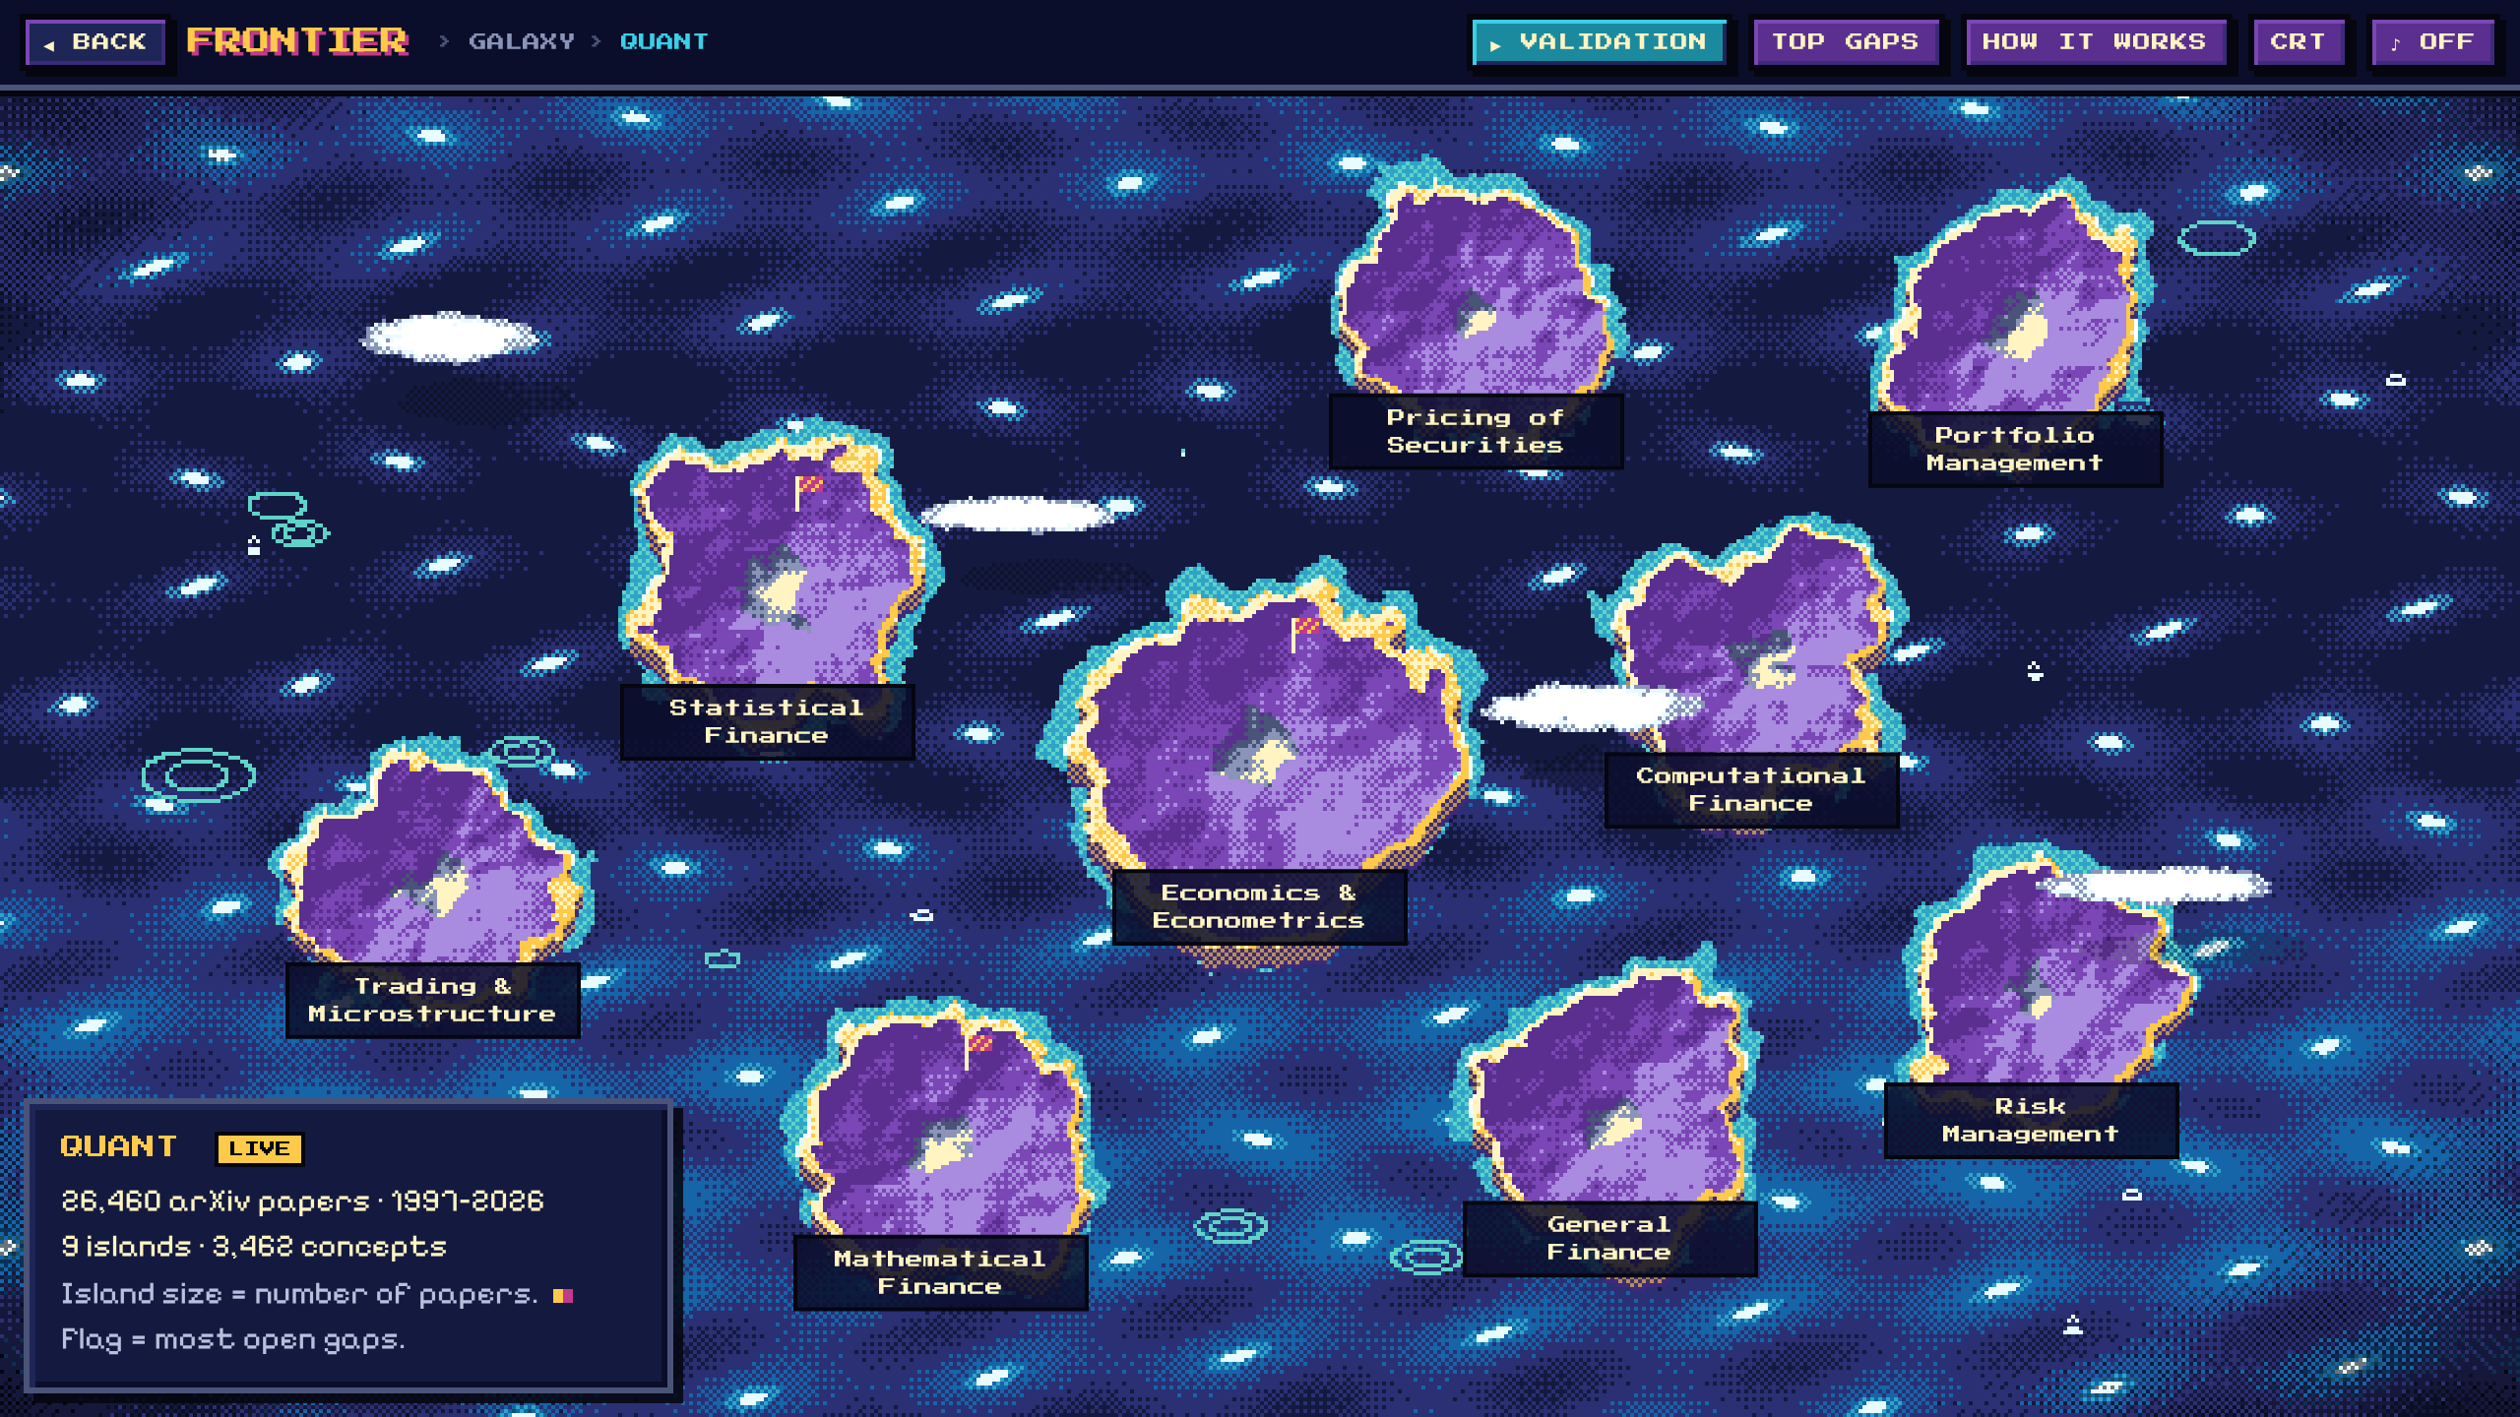
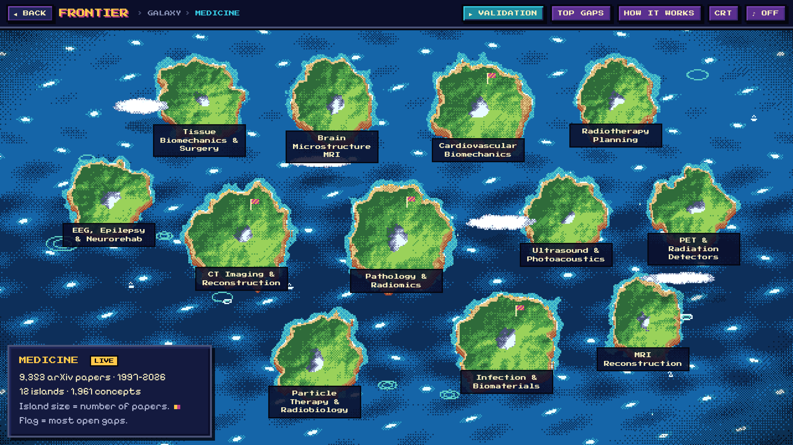
The product
Explore research as a 16-bit universe: galaxy, planet, island, gap
Notes:
Now the product. It is a static website in an original 16-bit pixel style, so anyone can explore it in a browser. Four levels: galaxy, planet, island, gap.

Slide 6
Each planet is a research field; two worlds are live
Medicine
9,353 papers · 12 islands · 1,961 concepts
Quant
26,460 papers · 9 islands · 3,462 concepts
12 more planets
Physics, Climate, Neuroscience and others are visible as "coming soon" sectors.
Notes:
The galaxy has 14 original pixel-art planets orbiting a rotating spiral galaxy. Medicine and Quant are live; the other twelve show a coming-soon message. All art is generated in code, nothing is copied from games or reference images.

Slide 7
Islands are sub-fields; size shows how much research they hold
Medicine: 12 islands found by clustering concepts (e.g. Radiotherapy Planning, Brain Microstructure MRI)
Quant: 9 islands from arXiv's own sub-categories (e.g. Pricing of Securities, Risk Management)
Flags mark the islands with the most open gaps.
Notes:
Clicking a live planet zooms into an ocean of islands. Each island is a sub-field and its size is its paper count. Quant uses arXiv's own sub-categories; medical physics has a single category, so we discovered its twelve sub-fields by clustering concepts that are studied together.

Slide 8
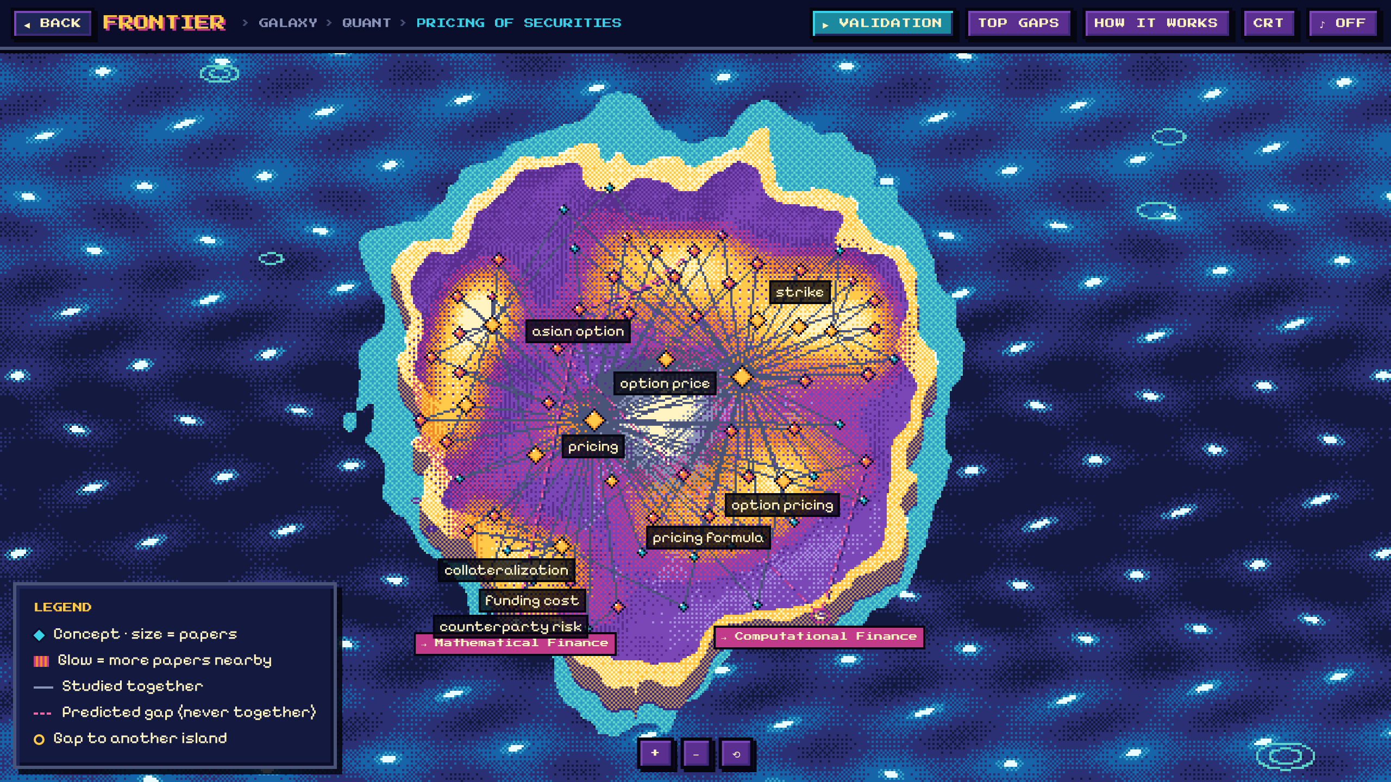
On each island, dashed lines are gaps no paper has filled yet
Crystal
a concept; size = number of papers
Glow
brighter where research is busiest
Solid line
already studied together
Dashed line
predicted gap: never in one paper
Portal
gap leading to another island
Notes:
This is the Pricing of Securities island in Quant. Each crystal is a concept, the warm glow shows where papers concentrate, solid lines are pairs already studied together, and the animated dashed lines are predicted gaps. Gaps that reach another island run to a portal on the coast.

Slide 9
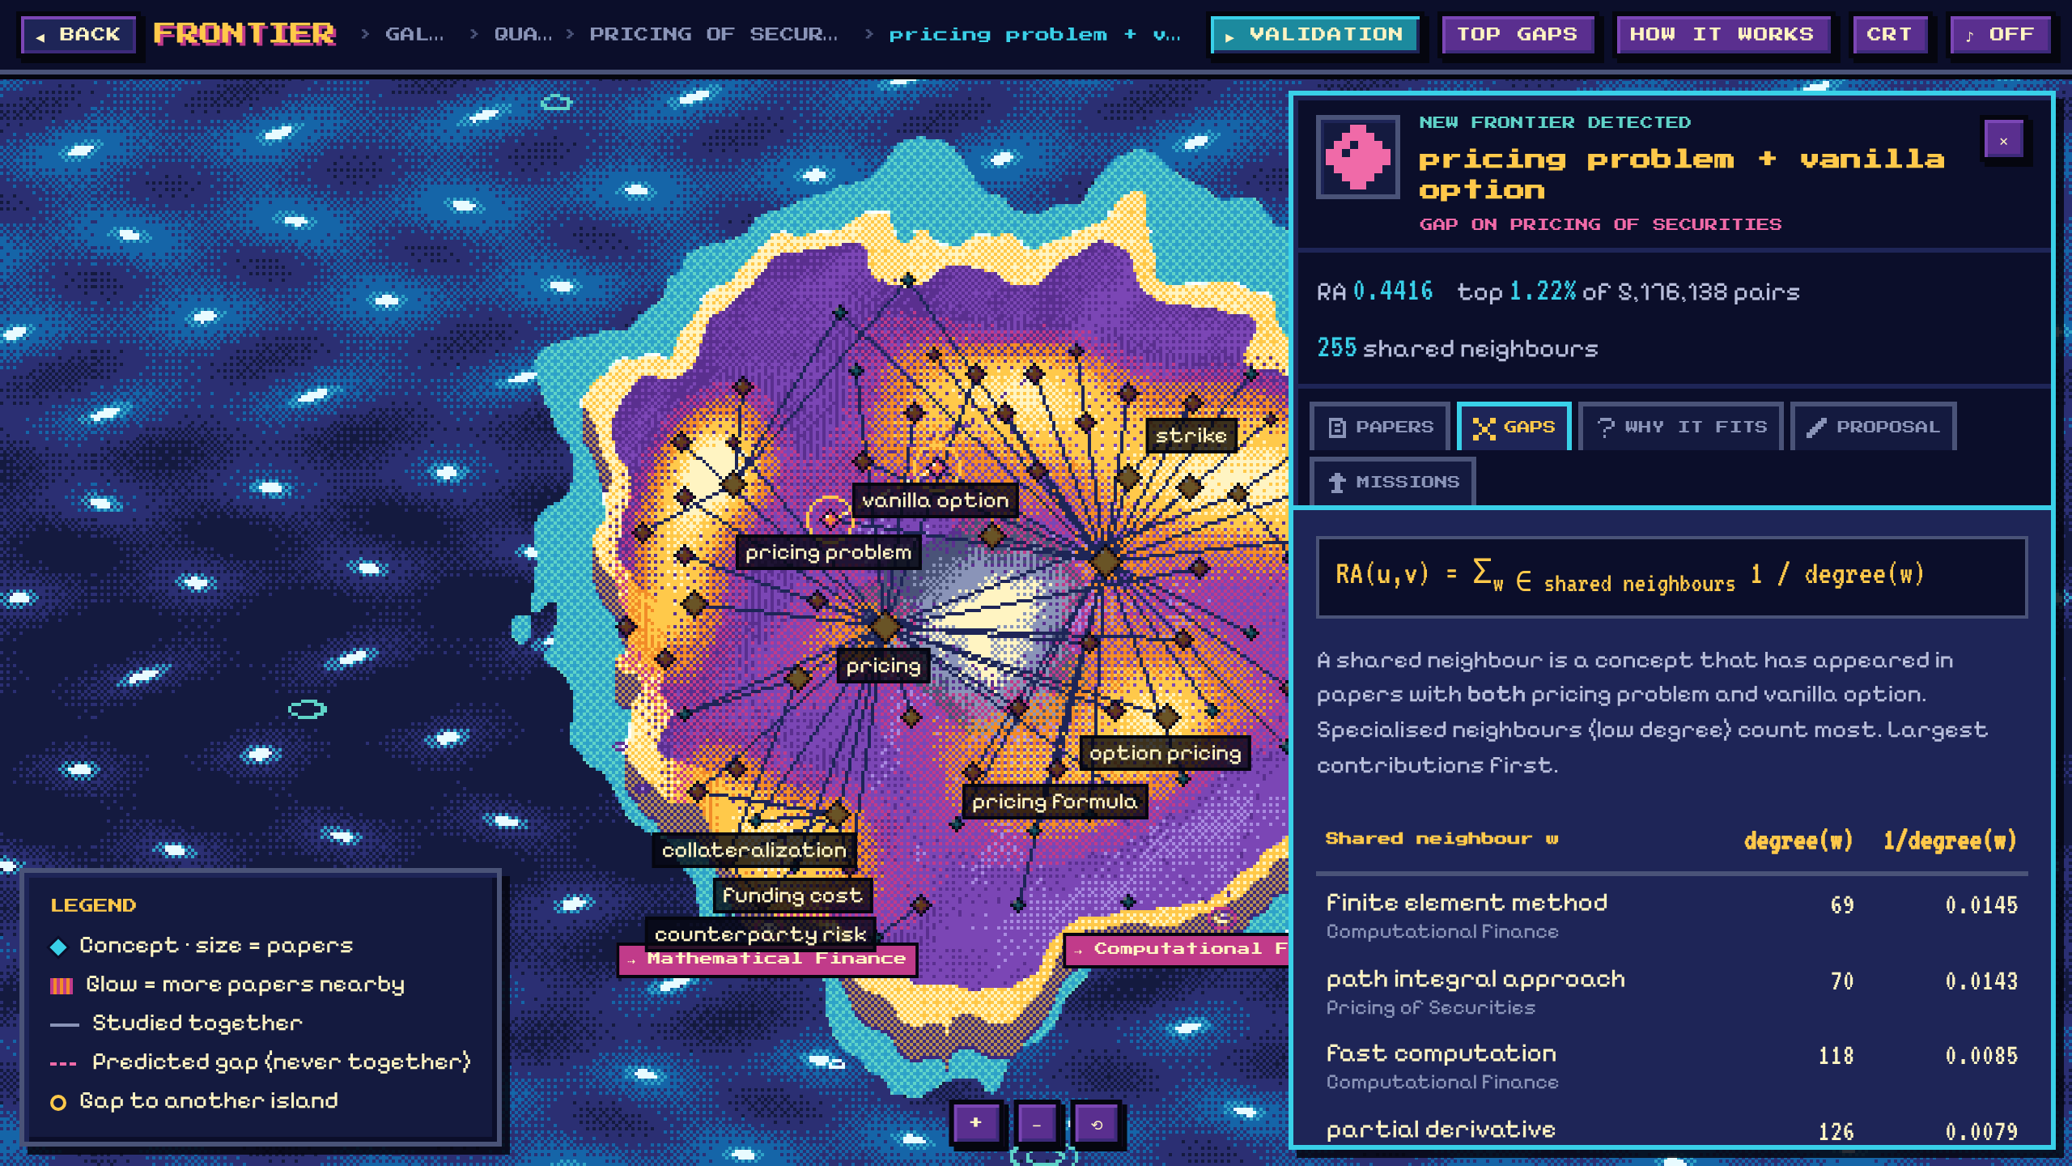
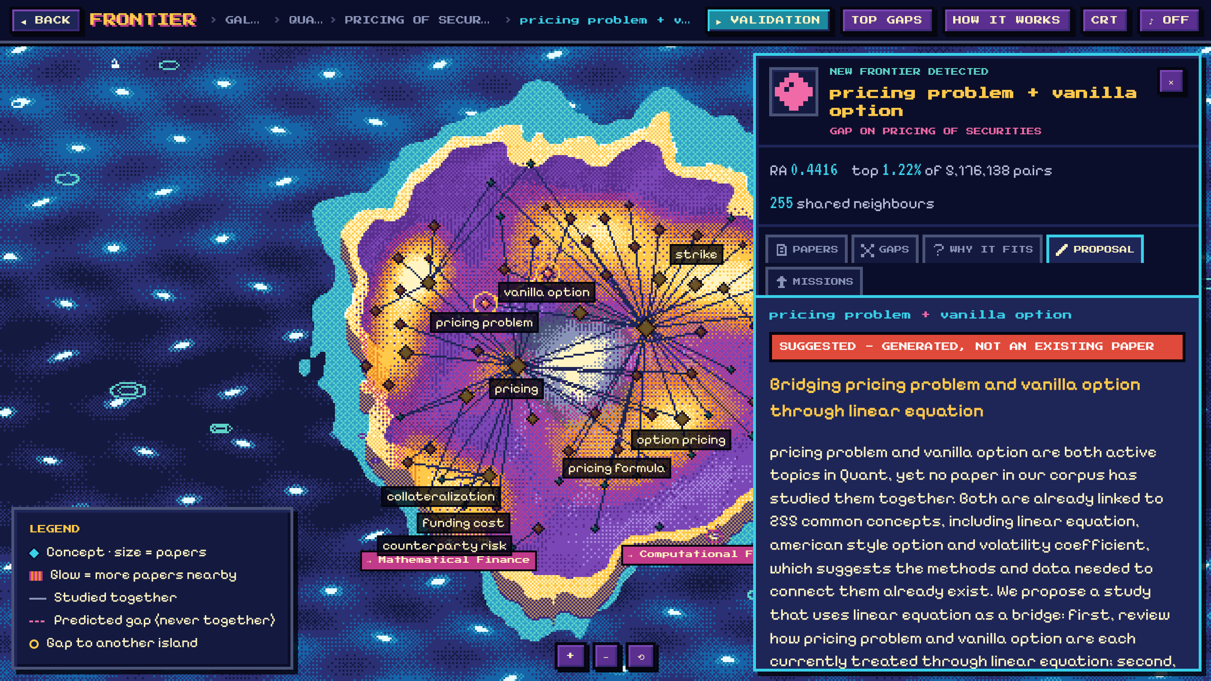
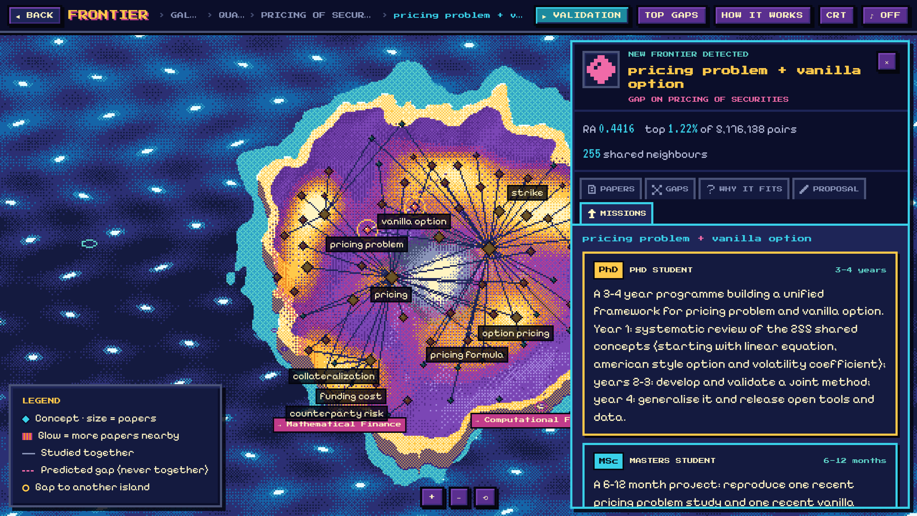
Every gap comes with its maths, real papers and three missions
Papers · the RA maths, neighbour by neighbour · why it fits · a suggested paper (labelled as generated) · PhD, Masters and industry missions
Notes:
Clicking a gap opens the side panel. The Gaps tab shows the Resource Allocation sum, one shared neighbour at a time, so anyone can check the score. Other tabs list real papers with authors and links, explain why the pair fits, suggest a paper title and abstract that are clearly labelled as generated, and offer missions for a PhD student, a Masters student and an industry team. The industry mission uses Marshall Wace only as an illustrative example.

Slide 10
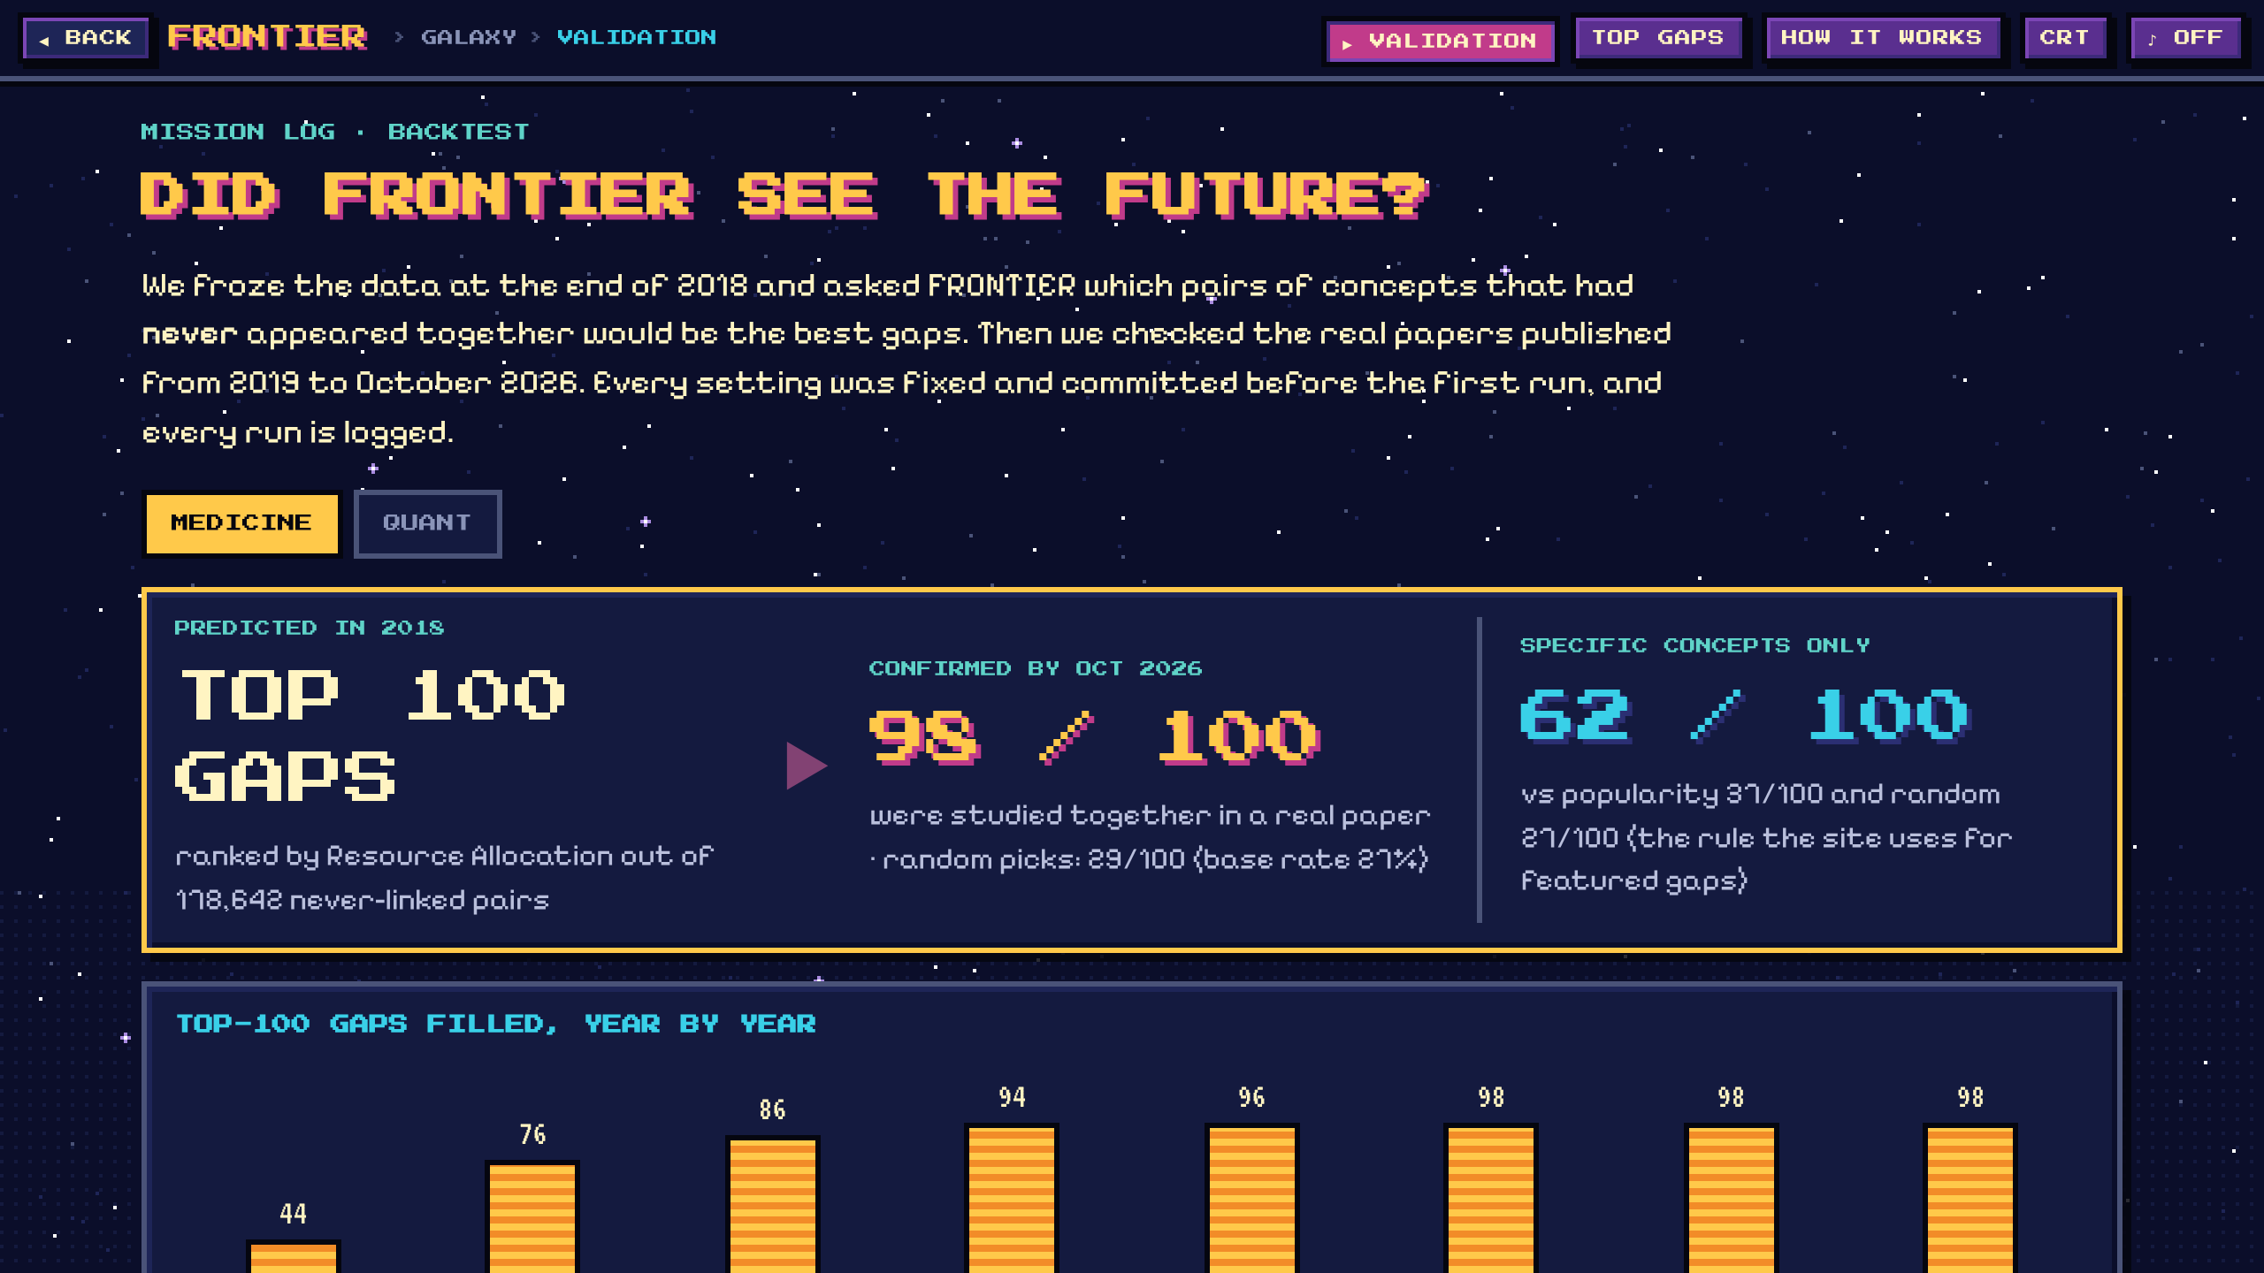
The proof
Could FRONTIER have seen the last eight years coming?
Notes:
A gap score is only useful if it predicts the future. So we tested it on the past.

Slide 11



We froze the data at 2018 and checked against 2019–2026
CUTOFF: 31 DEC 2018
Only this past is visible
Which predicted gaps got their first joint paper?
2014
2016
2018
2020
2022
2024
2026
Every pair scored
178,642 Medicine and 1,402,105 Quant never-linked pairs, no sampling
No lookahead
Features use only papers up to the cutoff; a test plants a paper one day later and checks nothing changes
No future-famous concepts
A concept counts only if it already had 10+ papers by the cutoff
Settings frozen first
Committed before the first run; every run logged with its commit in runs.csv
Notes:
The backtest. We froze everything at the end of 2018 and scored every pair of concepts that had never appeared together. Then we looked at what really happened from 2019 to October 2026. We guard against lookahead: only pre-cutoff papers are used, a concept must already have ten papers by 2018, and the settings were committed before the first run.

Slide 12
98 of our top 100 Medicine gaps and 93 in Quant were filled
MEDICINE
98 / 100
filled by Oct 2026 · random picks: 29
QUANT
93 / 100
filled by Oct 2026 · random picks: 17
Notes:
In 2018 we ranked every never-linked pair. Of our top 100, 98 Medicine gaps and 93 Quant gaps were studied together by October 2026; random picks managed 29 and 17. Honestly, popularity alone is almost as good here: two big topics tend to meet anyway. The next slide shows where our score really earns its keep.

Slide 13
For specific concepts, our score beats popularity in both fields
MEDICINE
62 vs 37
Ranking quality (AUC) 0.685 vs 0.625 for popularity
QUANT
49 vs 42
AUC 0.688 vs 0.604; the top-100 margin is small and within error
Specific = both concepts below the field's 75th degree percentile with 20+ papers, the rule the website uses for featured gaps, fixed before the first run.
Notes:
Restrict to specific concepts, the niche topics a researcher would actually act on, and popularity stops working. In Medicine our top 100 contained 62 real hits against 37 for popularity. In Quant it is 49 against 42: a smaller margin on the top 100, but a clear one on overall ranking quality. Precision is lower than on the previous slide because specific gaps are genuinely harder to predict.

Slide 14
Our 2018 predictions kept coming true, year after year
STRICTER TEST
96 / 82
Medicine / Quant top-100 still filled when a gap needs 2 joint papers, not one passing mention
SANITY CHECK
Shuffled answers give AUC 0.499 and 0.498: pure chance, as they should. The real answers give 0.774 and 0.750.
Notes:
Hits arrived steadily: in Medicine 44 of the top 100 were filled within a year and 98 by October 2026; in Quant 24 within a year and 93 by 2026. Even under the stricter rule that a gap needs two joint papers, 96 and 82 of the top 100 were filled.

Slide 15
The result holds at every cutoff from 2014 to 2020
Ours beats popularity in all 8 runs
4 cutoffs × 2 fields, each with a fixed 4-year window.
A machine-learning model did not clearly win
LightGBM, trained only on earlier years, is below our score in every Medicine run and ahead in Quant only at 2016, 2018, 2020. We keep the simple, explainable score.
Notes:
We repeated the whole test with cutoffs in 2014, 2016, 2018 and 2020. Our score beat popularity every time in both fields. We also trained a LightGBM model on earlier years only; it did not clearly beat our score, so we kept the transparent formula that anyone can check by hand.

Slide 16

Predicted in 2018, published years later: real examples
Asian option + local volatility
0.9 yrs
Pencil beam + VMAT
3.9 yrs
Flagged in 2018 (rank #3) · first joint paper 2019-11-29
Flagged in 2018 (rank #9) · first joint paper 2022-11-16
"Hedging short-maturity Asian options in local volatility models" (arXiv 1911.12944)
"Recent Advancements of Artificial Intelligence in Particle Therapy" (arXiv 2211.09038)
Deposition + neutron
2.2 yrs
Optimal policy + optimal trading strategy
6.1 yrs
Flagged in 2018 (rank #2) · first joint paper 2021-02-25
Flagged in 2018 (rank #5) · first joint paper 2025-02-06
"Bragg-Curve Simulation of Carbon-Ion Beams for Particle-therapy Applications: a study with the GEANT4 toolkit" (arXiv 2102.12743)
"On the Effect of Alpha Decay and Transaction Costs on the Multi-period Optimal Trading Strategy" (arXiv 2502.04284)
Notes:
Some concrete hits. In 2018 we flagged Asian option plus local volatility; under a year later a paper on hedging Asian options in local volatility models appeared. Pencil beam plus VMAT, two radiotherapy techniques, met in a 2022 review of AI in particle therapy, 3.9 years after our prediction. Every hit was checked: its first joint paper is dated inside the test window and is the earliest paper on both concepts.

Slide 17
Today's top open gaps, as of October 2026
Field | Gap (never studied together) | Island(s) | RA | Shared
Medicine | adaptive radiotherapy + dose volume histogram | Radiotherapy Planning | 0.384 | 169
Medicine | cortex + neurological disorder | Brain Microstructure MRI | 0.342 | 144
Medicine | bladder + VMAT | Radiotherapy Planning | 0.339 | 144
Medicine | linear energy transfer + tumor cell | Particle Therapy & Radiobiology | 0.337 | 139
Quant | pricing problem + vanilla option | Pricing of Securities | 0.442 | 255
Quant | integral equation + optimal trading strategy | Mathematical Finance | 0.376 | 238
Quant | barrier option + pricing problem | Computational Finance ⇄ Pricing of Securities | 0.371 | 222
Quant | asymptotic expansion + log price | Computational Finance ⇄ Mathematical Finance | 0.369 | 216
Featured gaps use specific concepts only (the rule validated on the previous slides). Each one opens in the website with its maths, papers, a suggested paper and missions.
Notes:
And here is what FRONTIER predicts now, using all data up to October 2026: the top open gaps in each field. These are the pairs we expect researchers to combine next. Each one is clickable on the website with its full explanation.

Slide 18


What we report openly
A filled gap can be a passing mention
So we also test a stricter rule: two joint papers. Results stay strong.
Concept tagging is automatic
Some generic words and unmerged synonyms remain; we removed ~600 by hand.
The phrase list saw 2026 data
The 10-papers-by-cutoff rule removes most of this effect, not all of it.
No AI-written text in this build
Proposals and missions are templates filled with real numbers and titles; Claude generation is ready once an API key is added.
Notes:
We are open about the limits. A gap counts as filled when two concepts appear in one abstract, which can be a passing mention, so we also report the stricter two-paper test. Concept tagging is automatic and not perfect. The phrase list was built with data up to 2026, which our ten-papers rule mostly neutralises. And the suggested proposals are templates, labelled as such.

Slide 19
Explore the frontier
Live site: FRONTIER on claude.ai
Next: more planets (Physics, Climate, Neuroscience) and Claude-written proposals from real abstracts
Notes:
Thank you. The site is live; every gap, number and paper you saw today is in it, and the full method and every backtest run are in the repository. Next steps: open more planets, and switch on Claude-written proposals grounded in the real abstracts.

