Slide 1




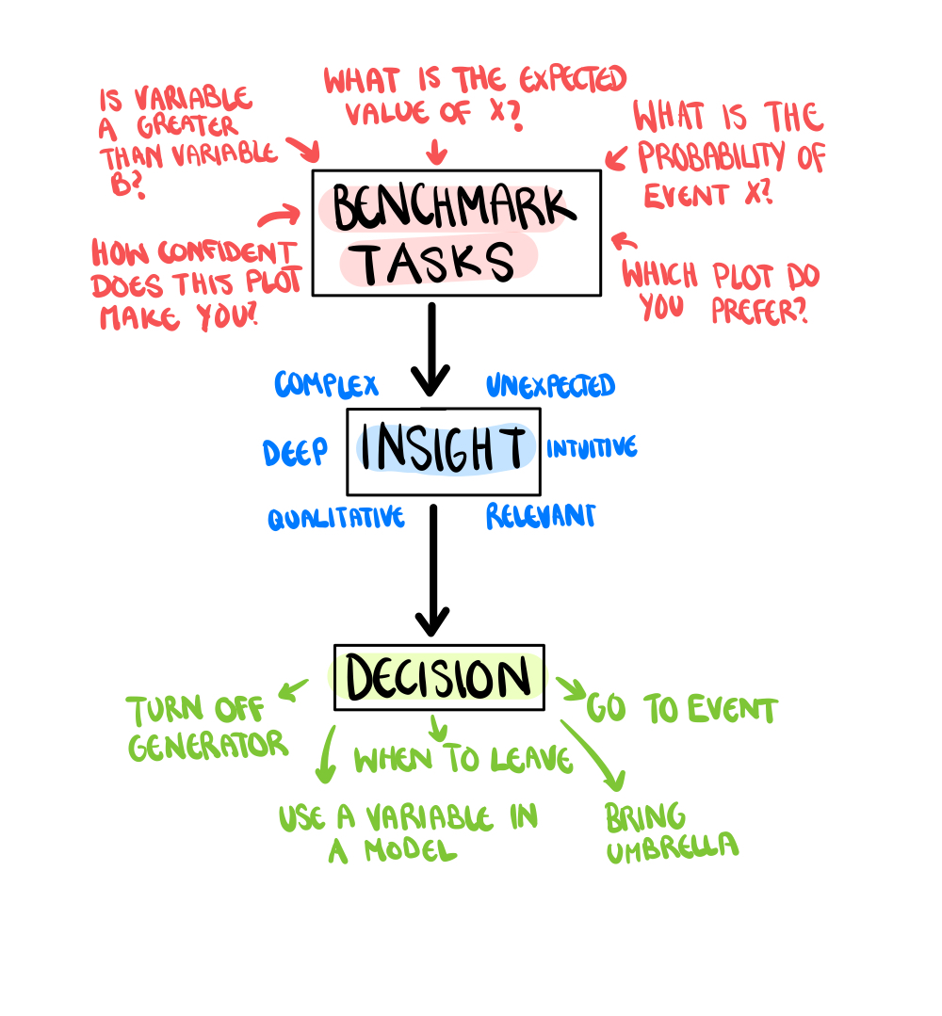
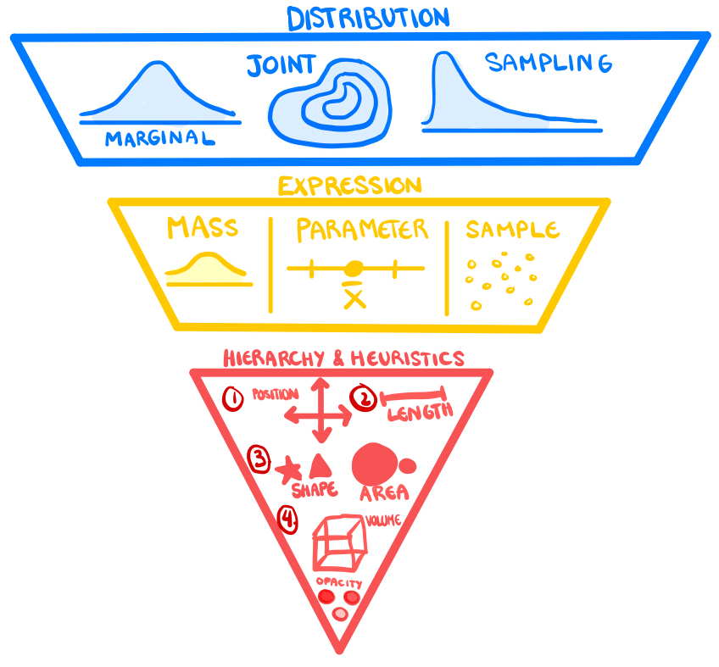
Plotting Apples, Oranges and Distributions
Harriet Mason, MD¹; Dianne Cook, PhD²; Sarah Goodwin; Ursula Laa; Emi Tanaka, MD, PhD^{1,2}
¹University of Affiliation, ²Medical Center of Affiliation
Abstract
Uncertainty Visualisation Experiments
Uncertainty visualisation is needed to communicate the risk associated with estimates and facilitate decision-making. The best visual encoding of uncertainty information relies on accurate estimation and appropriate depiction. While there is a reasonable amount of research into estimating uncertainty, effective visual representations of uncertainty are not as well researched. We believe this is primarily driven by a lack of consensus on how to assess the information depicted in a visualisation. We present a work-in-progress taxonomy that can be used to evaluate the information in a graphic.
A set of guidelines that highlight the information depicted in an uncertainty visualisation and the clarity with which that information is expressed would also benefit the authors of visualisation experiments.
The purpose of data visualisation is insight, but due to time limits or other constraints, most visualisation studies use multiple benchmark tests as a substitute for measuring the complicated phenomena of insight The connection between these tests and a final decision is shown in Figure 1. CITE. These benchmark tests commonly compare plots based on the accuracy with which users can report statistics CITE. In order to compare the visual features of different plots they need to contain the same information CITE. Additionally visualisations should aim to show enough information to solve a task while avoiding irrelevant distracting information CITE. While including additional features can increase the accuracy of some conclusions, it can also bias or discount others CITE.
If we are trying to test the benefits of using one plot over another, and there is a differences in the information conveyed by the two plots, then we cannot be sure if the one plot outperformed the other due to a better visual encoding of information or because of a difference in information itself. However, there is currently no reliable or standard approach to assess the information contained in a graphic. Therefore there are many experiments where one plot contains more relevant information than the other, and the conclusion of the paper is warped. Since there are numerous ways in which uncertainty information can be quantified and expressed, experiments comparing uncertainty visualisations suffer disproportionately from this issue. A taxonomy of the information contained in an uncertainty visualisation could alleviate this problem.
The Importance of Uncertainty Visualisation
The term "uncertainty" lacks a commonly accepted definition in the literature. Lipshitz and Strauss CITE even commented that “there are almost as many definitions of uncertainty as there are treatments of the subject”. The most encompassing definition comes from Walker et al. CITE who define uncertainty as "any deviation from the unachievable ideal of completely deterministic knowledge of the relevant system". This is the definition we will adopt for this paper.
In order to make an accurate decision using an estimate of a numerical quantity, a thorough understanding of the uncertainty around that estimate is needed. There is a large amount of research suggesting that presenting uncertainty information improves decision making and increases trust in predictions, both experimentally CITE and in practice CITE.
The most effective expression of uncertainty information is through visualisation, which provides a more complete picture of risks than numerical summaries alone. Something as simple as sketching a distribution before recalling statistics or making predictions can greatly increase the accuracy of those measures CITE.
Unfortunately uncertainty information is often complicated and difficult to express. This means uncertainty is not conveyed as often as it should be. A survey found that only a quarter of visualisation authors included uncertainty in 50% or more of their visualisations CITE. Two of the most common explanations authors gave for omitting uncertainty were an inability to calculate it and a fear of overwhelming their audience CITE. Therefore, a set of guidelines that make it easier for authors to clearly visualise the relevant uncertainty could improve their use.
Figure 1. A visualization of the process of benchmark contributing to insight and therefore decisions. There are a large number of common benchmark tests performed on plots, each of these small insights contribute to a larger understanding of the data that is then used to make informed decisions.
Our Taxonomy
Our taxonomy was developed by reviewing the current uncertainty visualisation literature and untangling what features seem to impact the accuracy with which information can be extracted from a plot. The three elements of the information taxonomy are distribution, expression, and hierarchy & heuristics. The taxonomy is visualised in Figure 2.
Distribution is the most important aspect of the taxonomy as it highlights the importance of showing the correct variable or relationship. Very often, a single marginal or conditional distribution is expected to answer a wealth of questions related to uncertainty, even when that distribution is statistically irrelevant to the question. For example, error bars are often considered poor practice by researchers due to being unable to communicate uncertainty that it does not express CITE.
Expression highlights which feature of the aforementioned distribution is visualised. While there are a large number of distributions that can be visualised, there only seems to be three ways to express a distribution. You can express a distribution using it's mass, specific parameters, or a real or simulated a sample. Different expressions of a distribution seem to be better at answering different questions. For example, a sample is most appropriate to answer questions about the frequency of an outcome.
Hierarchy & Heuristics identifies how easily a user can extract the information depicted in a graphic. Hierarchy identifies how efficiently information can be extracted using elementary perceptual tasks CITE. Heuristics leverage the existing mental connections we have between visual features and variables. For example, uncertainty can be intuitively mapped to fuzziness where more fuzzy means more uncertain CITE.
Figure 2. A visualization of the three layers that make up our taxonomy of visual information. Examples of the types of considerations that should be made at each stage of the taxonomy are provided in each section.
Conclusion
This work first highlighted the importance of visualising uncertainty for decision making by disputing several misconceptions that surround the practice. We then discussed the information gap in the visualisation evaluation literature that leads researchers to frequently compare two plots that differ on several metrics. Finally we presented a taxonomy for the information contained in an uncertainty visualisation.
Contact Information
References
Acknowledgements
<your name>
<your organization>
Email:
Website:
Phone:
Acknowledgements text goes here.

