Slide 1
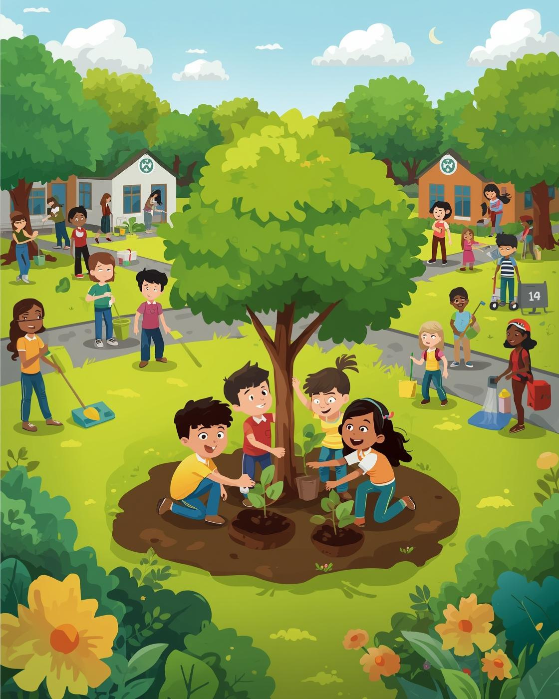

GreenBeans
Empowering Students for Environmental Impact
Presented by Campus Innovators, Environmental Advocate
November 22, 2025, Nairobi, Kenya

Slide 2

Passion Without Connection
Student Aspirations
Engagement Challenges
Students seek meaningful environmental projects to engage in positively.
Schools and NGOs struggle to effectively engage students in projects.
Initiative Limitations
Connection Gaps
Local environmental initiatives often lack scale and measurable impact.
Opportunities for collaboration are often disorganized and fragmented.
2

Slide 3
GreenBeans – The Student Environmental Hub
Student Participation
Verified Events
GreenBeans enables students to engage in verified projects.
Schools and NGOs can easily post approved engagement activities.
Recognized Participation
Reward System
Participation is acknowledged through certificates and achievement badges.
Gamification encourages ongoing student involvement and motivation.
3

Slide 4

Kenya’s student population presents a huge opportunity for engagement.
7 million students
Total Addressable Market for environmental projects
With 7 million students across the country, the potential for environmental engagement is vast. Among them, 2 million students and 1,000 active schools and NGOs represent significant opportunities for participation. The goal is to reach 500,000 targeted students in the next 1-2 years through the GreenBeans platform. By harnessing this large market, we can create impactful change in environmental sustainability and empower the next generation of changemakers.
4

Slide 5
Simple, Scalable
A Friendly Platform for Engagement
Discover Events
Partner Projects
Gamification
Students can easily discover and join various environmental events, promoting direct involvement in sustainability initiatives while fostering a sense of community and shared purpose.
Schools and NGOs can post verified projects to engage students effectively, ensuring that opportunities are accessible and well-coordinated to maximize participation and impact.
Gamification elements such as points, badges, and rewards motivate ongoing engagement, tracking participation to enhance student commitment and highlight their contributions to environmental causes.
5

Slide 6
Collaborating for Greater Environmental Impact
Competitors | what they do | How we are different
Greenwatch Kenya | Shares environmental news & campaigns | GreenBeans is interactive and student-focused
Kenya Green Building Society | Promotes sustainable building & training | GreenBeans is peer-to-peer and gamified
TreeSisters / Plant-for-the-Planet Kenya | Tree planting campaigns | GreenBeans tracks action digitally with clubs & challenges
Partners
Competition
GreenBeans collaborates with diverse environmental organizations.
Our unique advantages set us apart from others.
6

Slide 7
Fast Adoption
Engaging Students through Strategic Focus
University Outreach
Campus Ambassadors
Nationwide Scaling
We will target universities and high schools in urban centers, establishing connections and partnerships to maximize student engagement in environmental initiatives throughout the region.
Our approach includes a scalable model that allows for expansion into other counties, ultimately aiming for a nationwide presence and collaborative partnerships with multiple schools and NGOs.
Utilizing campus ambassadors allows us to foster community and drive awareness, as they can promote GreenBeans’ initiatives while engaging their peers in environmental action and participation.
7

Slide 8
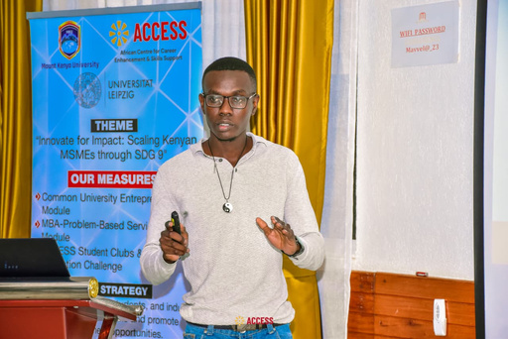


Turning Passion into Action
Empowering Students for Environmental Sustainability
GreenBeans aims to empower students as environmental changemakers, fostering a culture of sustainable action while providing measurable impact data for schools and NGOs throughout Kenya.
Francis Auka
Alicia Mbatha
Harriet Wambura
8

