Slide 1
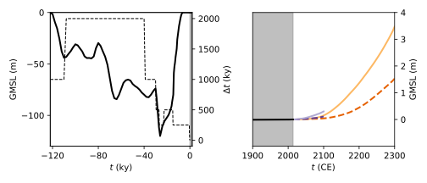
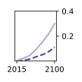
(A)
(B)
ICE6G + Schröder
timestep Δt
GMSL0.1 GMSL1.5
GMSL0.3 GMSL3.5

