Slide 1
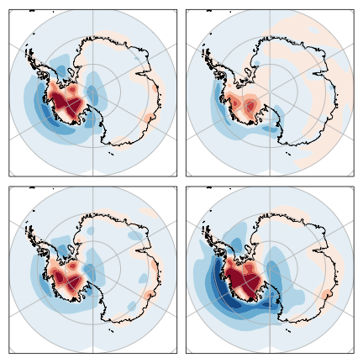
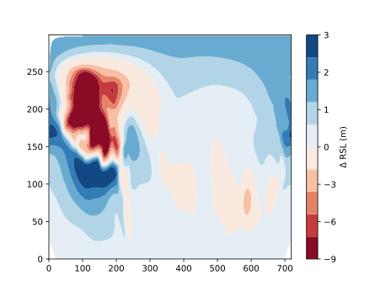
(A) 3T − 3D
(B) 3D − 1D
−13.1 m to 2.0 m
−6.9 m to +1.6 m
(C) 1T − 1D
(D) 3T − 1D
−10.2 m to +1.6 m
−19.6 m to 3.4 m

