Slide 1
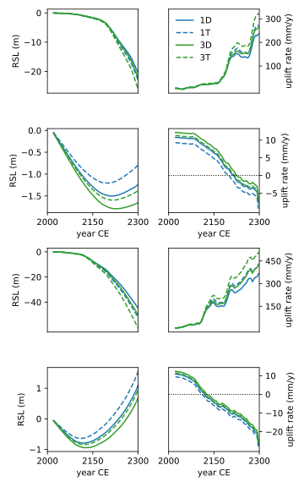
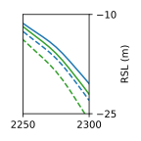
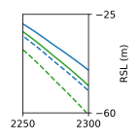
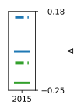
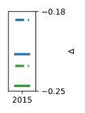
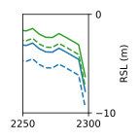
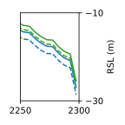
(A) GMSL1.5
(B) GMSL3.5
W. Antarctica Site
W. Antarctica Site
(i)
(ii)
(i)
(ii)
−10
−25
−25
−60
Hudson Bay Site
Hudson Bay Site
(iii)
(iv)
−0.18
(iii)
(iv)
−0.18
0
−10
−10
−0.25
−0.25
−30
1D 1T 3D 3T

