Slide 1
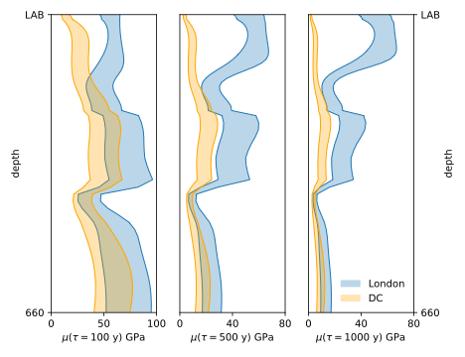
(A)
(B)
(C)

