Slide 1
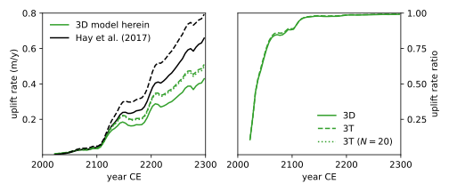
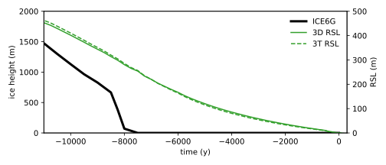
(A) 3D model (W. Ant)
(B) Pre-stress (W. Ant)
(C) Relaxation (Hudson Bay)

