Slide 1
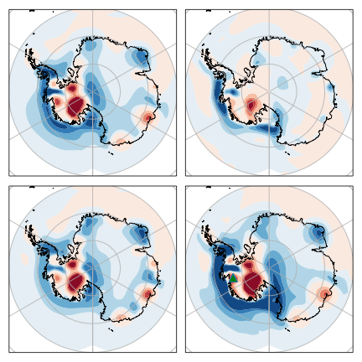
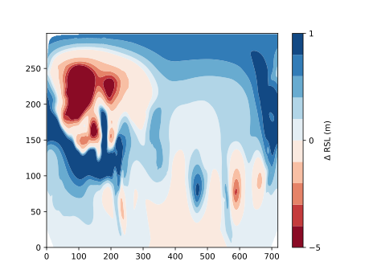
(A) 3T − 3D
(B) 3D − 1D
−9.5 m to 1.5 m
−4.7 m to +1.3 m
(C) 1T − 1D
(D) 3T − 1D
−7.9 m to +0.9 m
−14.1 m to +2.1 m

