Slide 1
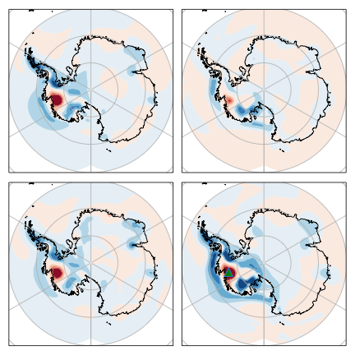
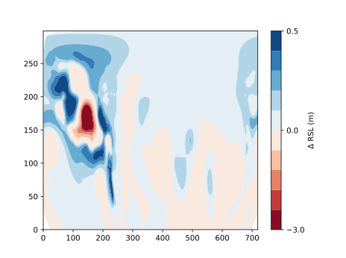
(A) 3T − 3D
(B) 3D − 1D
−7.3 m to 0.5 m
−2.0 m to +0.4 m
(C) 1T − 1D
(D) 3T − 1D
−5.2 m to +0.4 m
−9.3 m to +0.7 m

