Slide 1
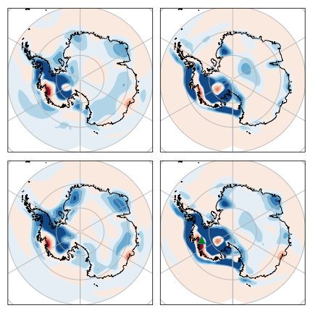
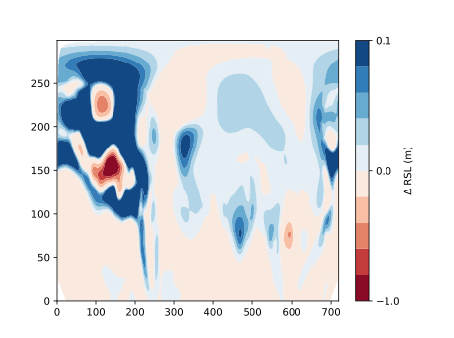
(A) 3T − 3D
(B) 3D − 1D
−1.6 to +0.2 m
−0.8 m to +0.4 m
(C) 1T − 1D
(D) 3T − 1D
−0.9 m to +0.2 m
−2.4 m to +0.6 m

