Slide 1
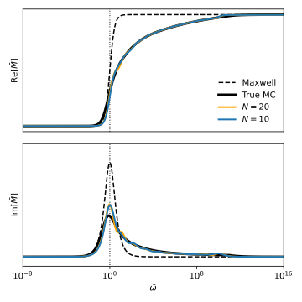
(A) Generalized Maxwell
(B) Fitting Results

