Slide 1

Expected operational solar wind forecast gains from assimilation of in situ L5 observations
Harriet Turner, Mathew Owens, Matthew Lang, Andy Smith, Pete Riley and Siegfried Gonzi

Slide 2
Solar wind forecasting – why
Stream interaction regions (SIRs) are a recurrent source of space weather
Coronal mass ejections (CMEs) drive the most severe space weather
Propagate through the solar wind
Upstream monitors only give 40 minutes of warning
Harriet Turner
h.turner3@pgr.reading.ac.uk
ESWW

Slide 3
Data assimilation (DA)
Observations
Data assimilation
Optimal state of the system
Model output
Forecast
Harriet Turner
h.turner3@pgr.reading.ac.uk
ESWW

Slide 4
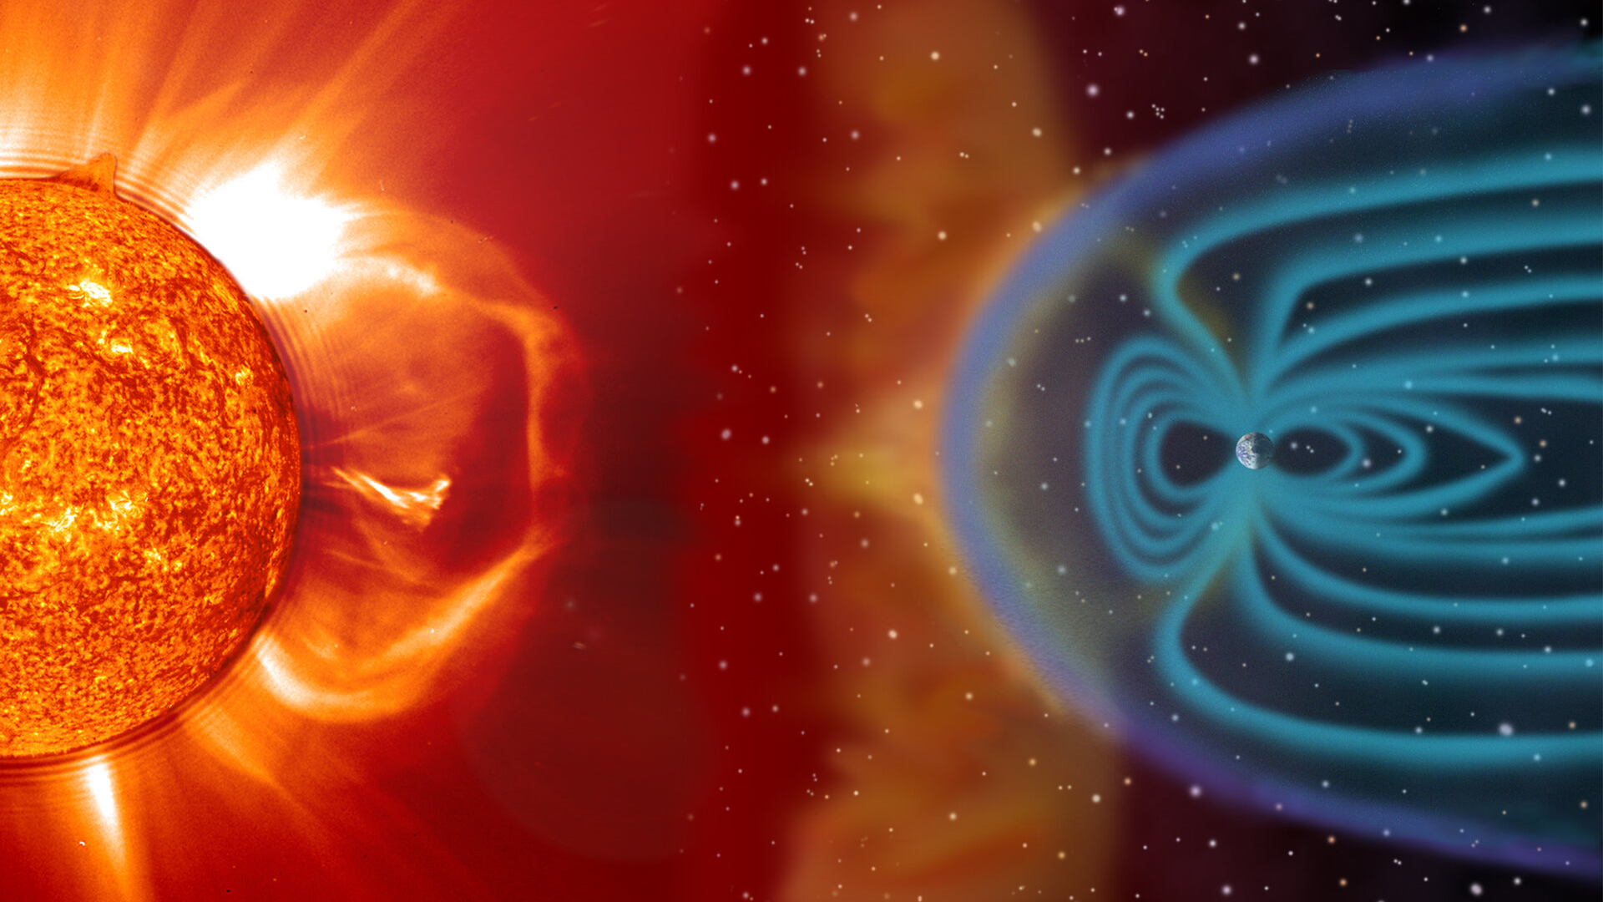
Use of DA in space weather
Ionosphere –
where Earth’s atmosphere reaches space
Photosphere – lowest layer of the Sun’s atmosphere that is observable
Solar wind
Harriet Turner
h.turner3@pgr.reading.ac.uk
ESWW

Slide 5
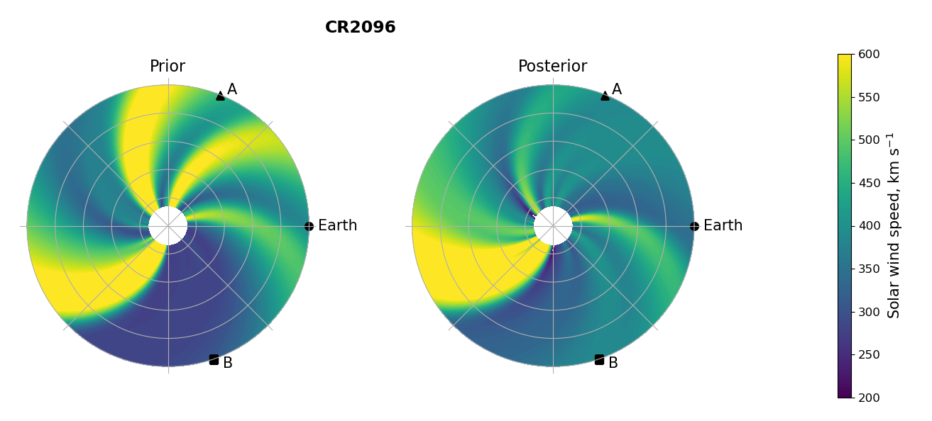
BRaVDA scheme
Burger Radius Variational Data Assimilation
Before DA
After DA
Harriet Turner
h.turner3@pgr.reading.ac.uk
ESWW

Slide 6
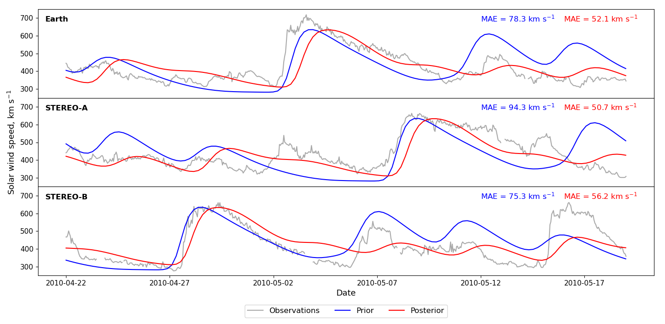
Time series
Harriet Turner
h.turner3@pgr.reading.ac.uk
ESWW

Slide 7
Observations
Solar Terrestrial Relations Observatory (STEREO)
Advanced Composition Explorer (ACE)
Deep Space Climate Observatory (DSCOVR)
For DA to be operational, it needs to work with real time observations
Harriet Turner
h.turner3@pgr.reading.ac.uk
ESWW

Slide 8
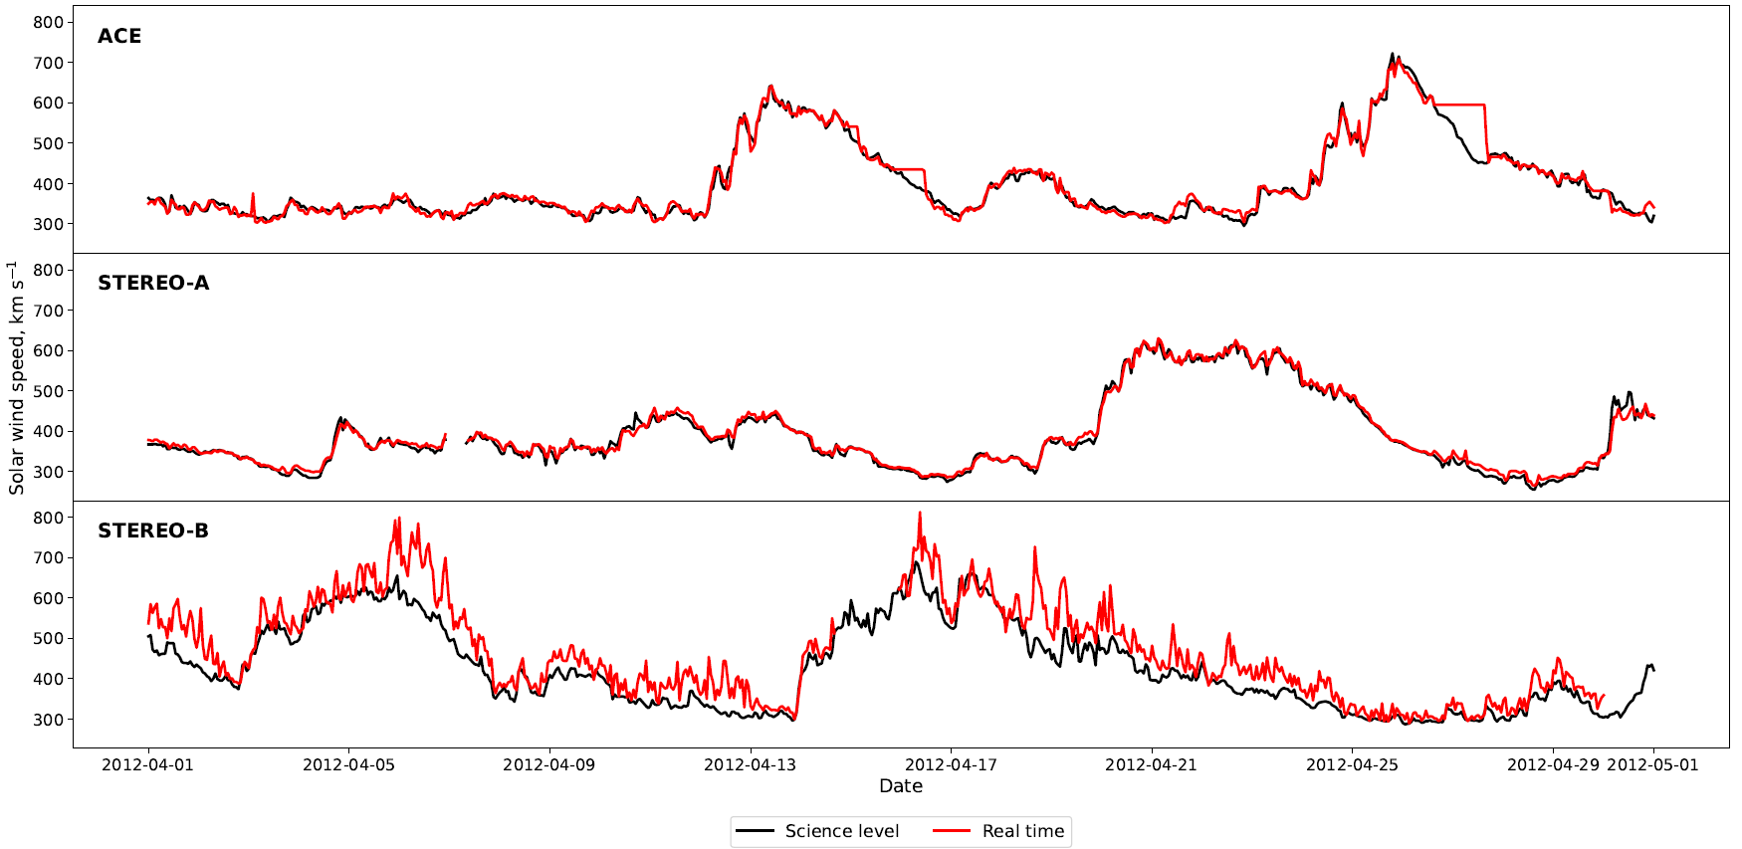
Real time data issues
Harriet Turner
h.turner3@pgr.reading.ac.uk
ESWW

Slide 9
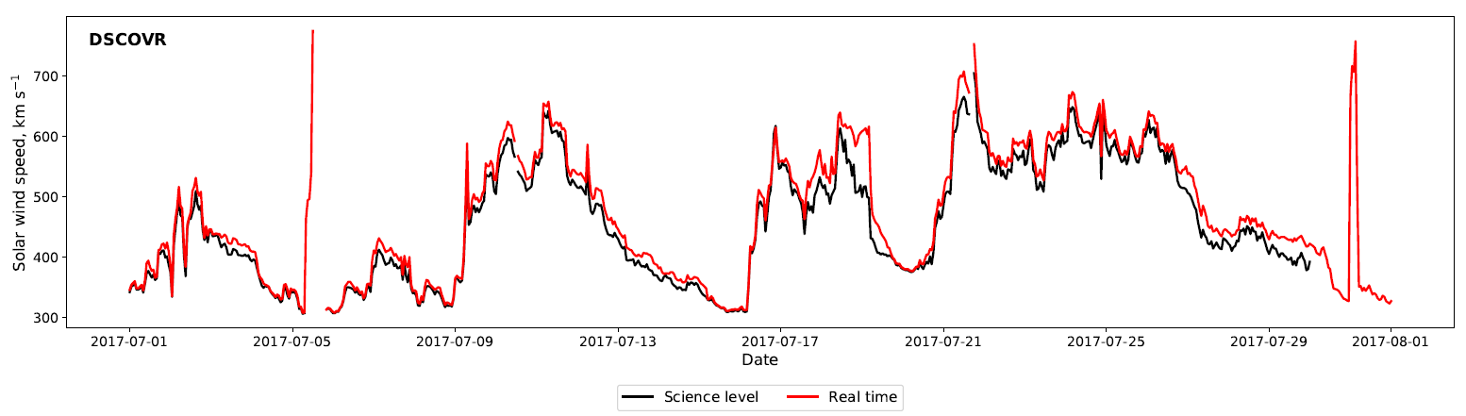
Real time data issues
Harriet Turner
h.turner3@pgr.reading.ac.uk
ESWW

Slide 10
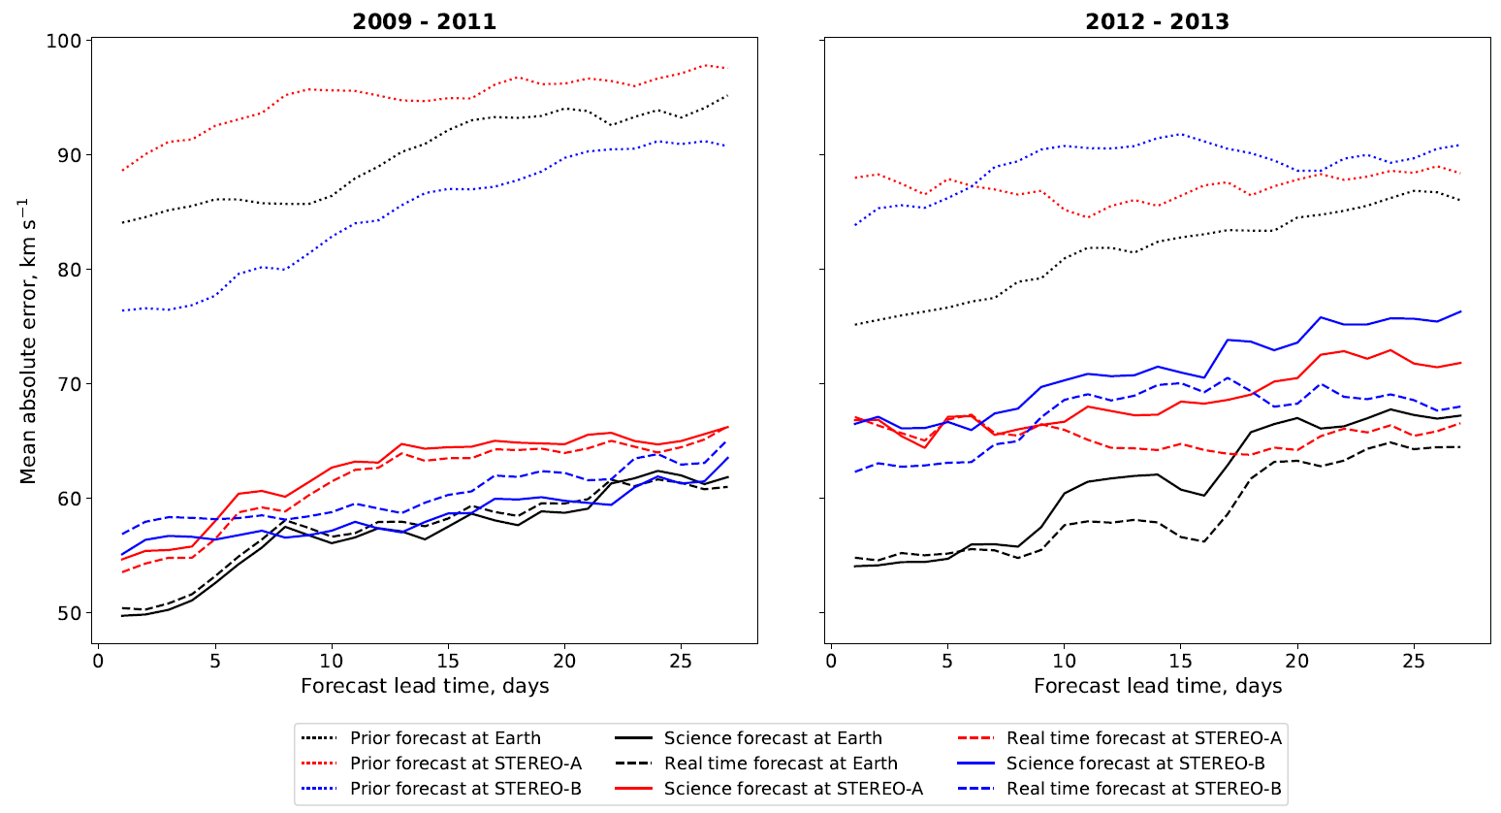
Assimilating multiple observations
Harriet Turner
h.turner3@pgr.reading.ac.uk
ESWW

Slide 11
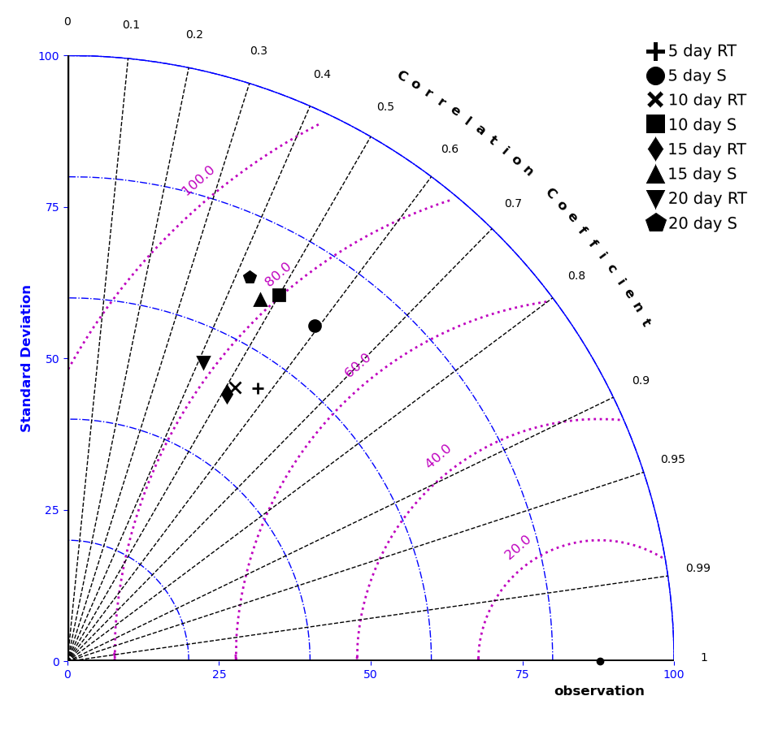
Why is real time performing better?
Harriet Turner
h.turner3@pgr.reading.ac.uk
ESWW

Slide 12
Why is real time performing better?
Harriet Turner
h.turner3@pgr.reading.ac.uk
ESWW

Slide 13
Why is real time performing better?
Harriet Turner
h.turner3@pgr.reading.ac.uk
ESWW

Slide 14
Why is real time performing better?
Harriet Turner
h.turner3@pgr.reading.ac.uk
ESWW

Slide 15
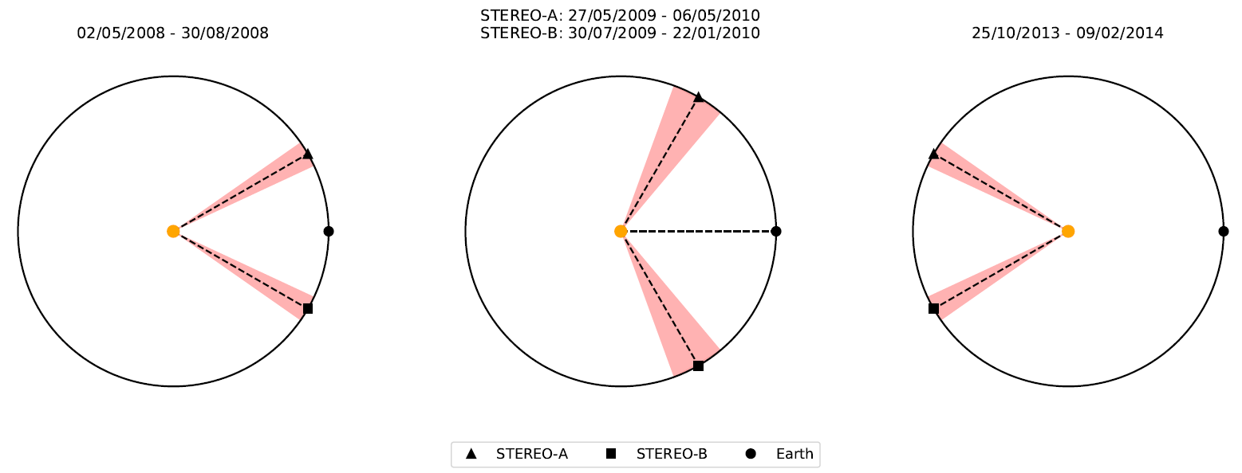
L5 experiments
Harriet Turner
h.turner3@pgr.reading.ac.uk
ESWW

Slide 16
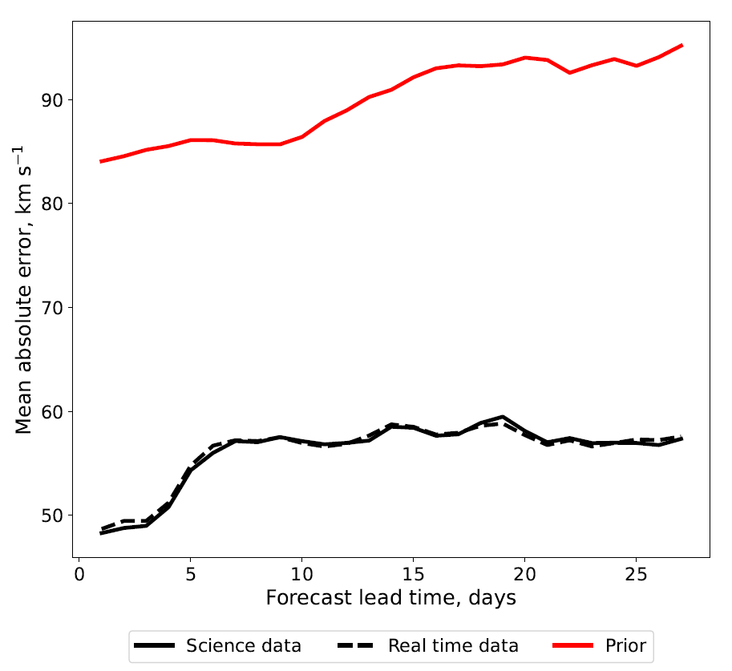
Does it work?
Harriet Turner
h.turner3@pgr.reading.ac.uk
ESWW

Slide 17
Conclusions
Data assimilation is underused in solar wind forecasting
An operational DA scheme would need to use real time data
We have verified the BRaVDA scheme with both real time and science level observations
Using real time data does not significantly worsen the forecasts
A future pairing of an L5 and L1 monitor could provide forecast gains for solar wind speed
Future work – investigate the impact of using DA on CME speed and arrival times
Harriet Turner
h.turner3@pgr.reading.ac.uk
ESWW
Notes:
Initial investigation into using DA for two events has shown an improvement in arrival time forecast from 10 hours early to 3 hours early.

Slide 18
Thank you!
Harriet Turner
h.turner3@pgr.reading.ac.uk
ESWW

Slide 19
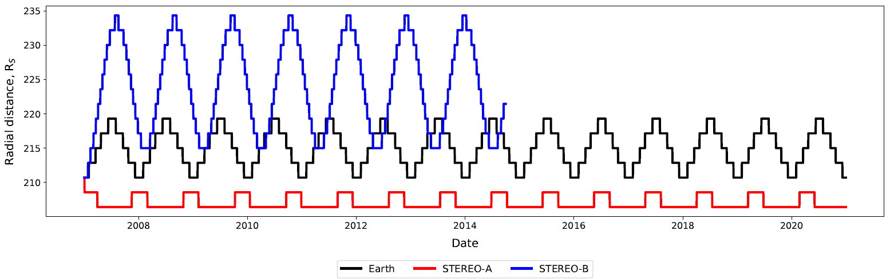
Radial variation
Harriet Turner
h.turner3@pgr.reading.ac.uk
ESWW

Slide 20
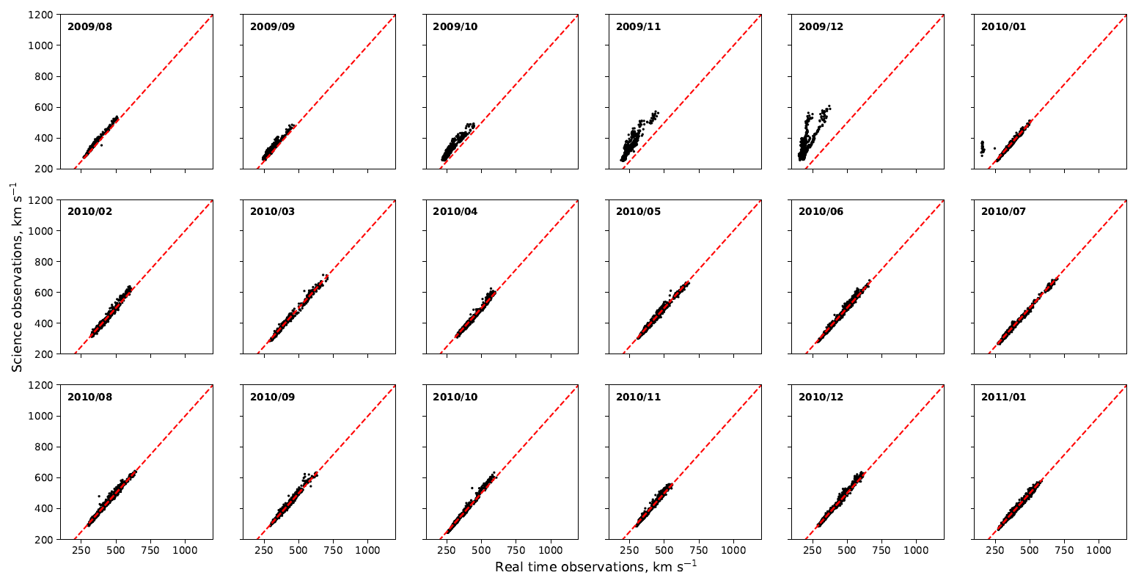
STEREO-A issue
Harriet Turner
h.turner3@pgr.reading.ac.uk
ESWW

Slide 21
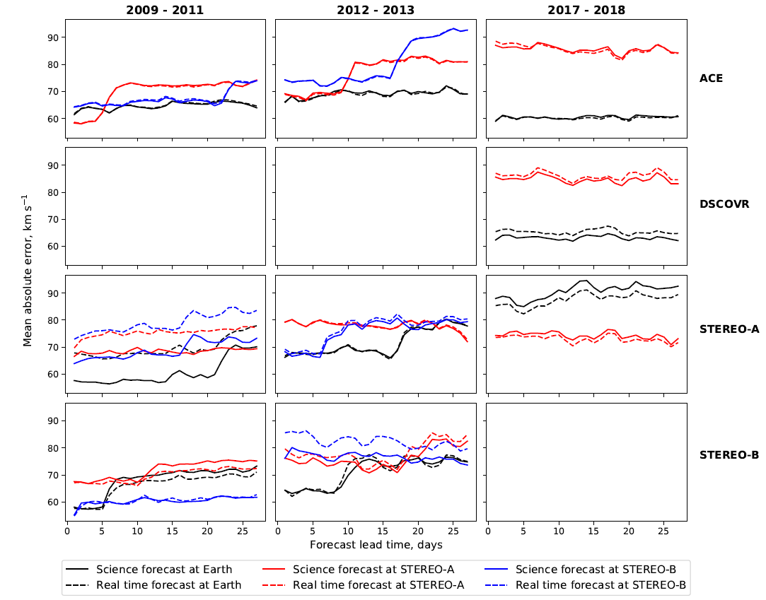
Assimilating single observations
Harriet Turner
h.turner3@pgr.reading.ac.uk
ESWW

Slide 22
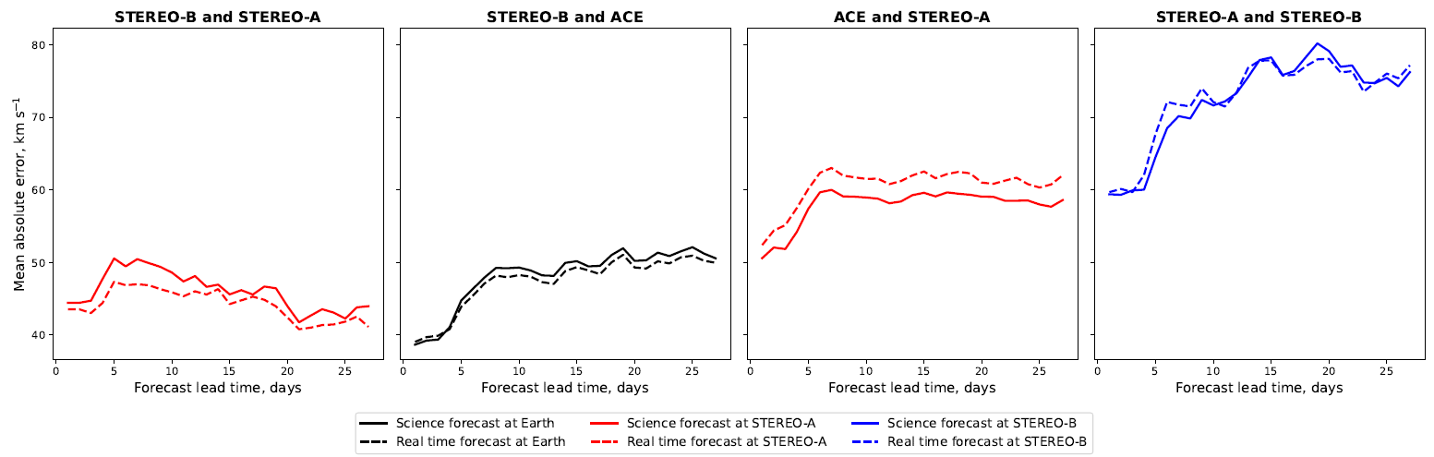
Testing an L5 – L1 pairing
Harriet Turner
h.turner3@pgr.reading.ac.uk
ESWW

Slide 23
Title
Text
Harriet Turner
h.turner3@pgr.reading.ac.uk
ESWW

