Slide 1
It takes a village
Data Science Campus @ONS Harriet Sands & Hillary Juma

Slide 2
My Career
Harriet Sands

Slide 3
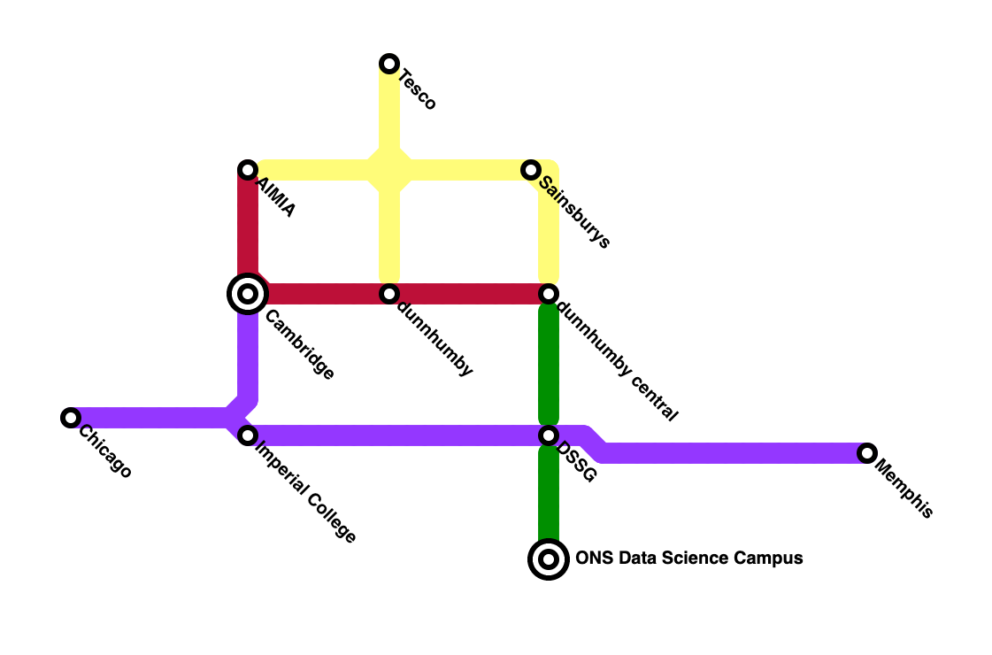

Slide 4
#+begin_{NOTES} nil#+end_{NOTES}

Slide 5


Slide 6


Slide 7


Slide 8
We apply data science
and build skills
for public good
We work at the frontier of data science and AI:
building skills and applying tools, methods and practices – to create new understanding and improve decision-making for public good.
We define data science as:
Applying the tools, methods and practices of the digital and data age to create new understanding and improve decision-making.
The goals of ONS’s Data Science Campus are:
to investigate the use of new data sources, including administrative data and big data for public good
to help build data science capability for the benefit of the UK
A new generation of tools and technologies are used to exploit the growth and availability of these new data sources and provide rich informed measurement and analyses on the economy, the global environment and wider society.

Slide 9
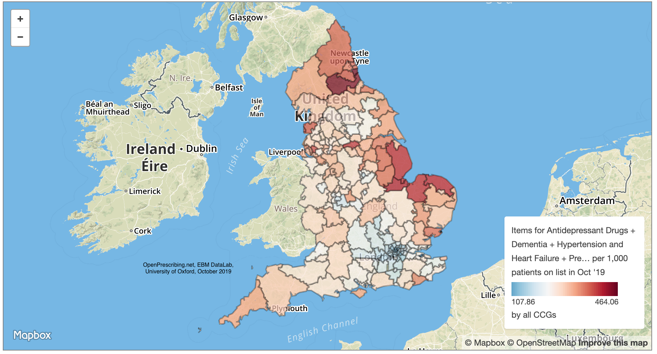

Slide 10
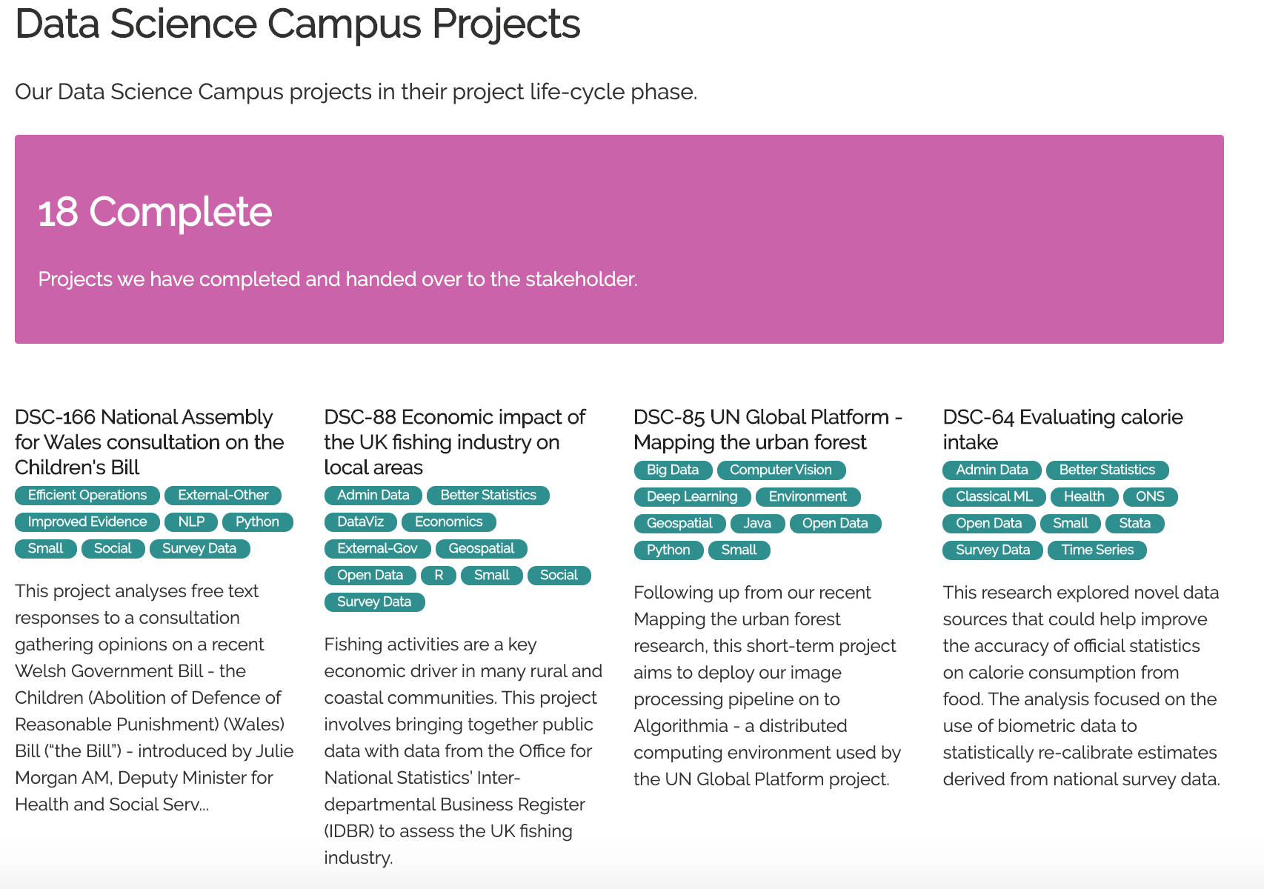

Slide 11
MDataGov
Data Science Accelerator
DSC courses:
Fundamentals of Data Science
The Art of the Possible

Slide 12
Community of Practice

Slide 13
