Slide 1

FIREWORKS DEPLOY BUILDATHON / MICROSOFT × NVIDIA
Pyro
grammers
Pyro helps you find the controls
you need in FL Studio.
A screenshot, a request, and a marked screen location.
San Francisco / November 2, 2026 / Team Pyrogrammers
Notes:
Cover claim describes the intended screenshot-to-coordinate and pointing workflow, not autonomous music production.

Slide 2
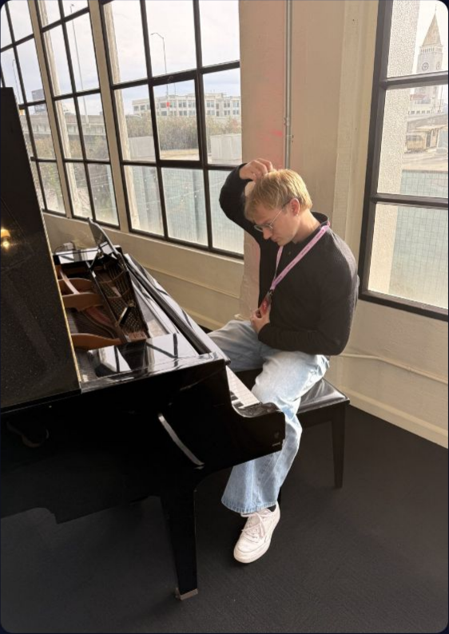
MEET CAMERON / OUR USER, ON OUR TEAM
Cameron knows the sound he wants
but is new to FL Studio.
He plays guitar and DJs. After 30 minutes of producing,
he needs help finding the controls for his ideas.
6 mo
30 min
0
DJing
producing
tracks released
PYROGRAMMERS / Built for first-time producers like Cameron
Notes:
User profile and photograph retained from the original user-supplied deck. Personal details were not independently verified.

Slide 3
HOW COMPACT WORKS
Compact names the panel and item in one model call.
1 Ask
2 Add context
3 Identify
4 Check
5 Show
Screenshot plus
FL Studio rules
Name the panel
Validate the point.
Map the point to
the user’s request.
distinguish panels,
and exact entity.
Compact uses
screenshot pixels.
Baseline asks only
named items and
Return a short
one model call,
The demo marks
for a click point.
control functions.
structured plan.
without a crop
the target for
or retry.
the user.
How it’s scored
Model and configuration
Hit = point inside the target box. All 57 FL Studio cases. Errors and missing points count as misses.
Same Qwen 3.8 deployment on Fireworks. Rerun: 8,192 output limit for every strategy. No fine-tuning.
PYROGRAMMERS
Notes:
Ground truth for benchmark results: /home/usr1/Downloads/harness_explainer.html. Rerun: baseline 26, recover 30, compact 31, selective 32 of 57. Output limit 8192 for all; baseline reused; up to 15 concurrent cases. Earlier panel_fast result is explicitly labeled. Compact: 10 fixes, 5 regressions, exact McNemar p=0.30. Score gain 5/57*100=8.77 percentage points. Observed mean latency reduction (8.4-7)/8.4*100=16.67%. Aggregate latency difference is descriptive, not a controlled causal speedup. Every individual gain p > 0.05. Demo details retained from the previous deck and local demo implementation; no benchmark result validates live demo success.

Slide 4
SCREENSPOT-PRO / FL STUDIO / 57 CASES
Compact gets five more targets right in less time.
BASELINE
PANEL COMPACT
26 / 57
31 / 57
45.6%
54.4%
+8.8 percentage points. 16.7% lower mean latency.
8.4 s baseline / 7.0 s compact. 10 fixes and 5 regressions. No fine-tuning.
Same Qwen 3.8 deployment. Rerun: 8,192 output limit for all strategies.
Exploratory, previously studied cases. Exact McNemar p = 0.30; not statistically significant.
PYROGRAMMERS
Notes:
Ground truth for benchmark results: /home/usr1/Downloads/harness_explainer.html. Rerun: baseline 26, recover 30, compact 31, selective 32 of 57. Output limit 8192 for all; baseline reused; up to 15 concurrent cases. Earlier panel_fast result is explicitly labeled. Compact: 10 fixes, 5 regressions, exact McNemar p=0.30. Score gain 5/57*100=8.77 percentage points. Observed mean latency reduction (8.4-7)/8.4*100=16.67%. Aggregate latency difference is descriptive, not a controlled causal speedup. Every individual gain p > 0.05. Demo details retained from the previous deck and local demo implementation; no benchmark result validates live demo success.

Slide 5
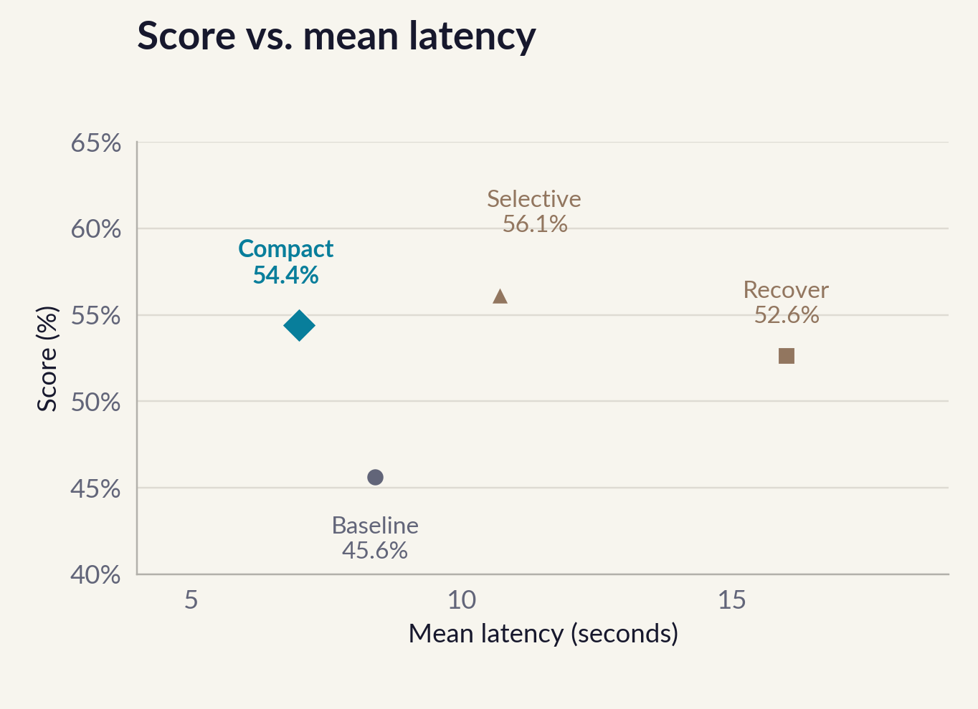
ACCURACY AND LATENCY / SAME RERUN
Compact is one target behind Selective and 3.7 seconds faster.
Correct predictions
Baseline
26/57
Panel recover
30/57
Panel compact
31/57
Panel selective
32/57
Full bar = 57 cases. All four results are from the rerun.
Rerun: matched 8,192 output limits. Exploratory results on studied targets; all individual gains p > 0.05.
PYROGRAMMERS
Notes:
Source: harness_explainer.html, rerun. Baseline 26/57 at 8.4 s; recover 30/57 at 16 s; compact 31/57 at 7 s; selective 32/57 at 10.7 s. Same 8192 output limit. Baseline reused. All individual gains p > 0.05. Score axis on scatter spans 40–65 percent.

Slide 6
RESULTS / ORDERED BY MEAN LATENCY
Compact has the lowest mean latency in this rerun.
CONFIGURATION
CORRECT / 57
ACCURACY
MEAN LATENCY
Panel compact
31/57
54.4%
7.0 s
Baseline
26/57
45.6%
8.4 s
Panel selective
32/57
56.1%
10.7 s
Panel recover
30/57
52.6%
16.0 s
Panel fast (earlier run)
30/57
52.6%
17.59 s
Rows ordered by observed mean latency. Panel fast is from the earlier run.
Compact: 54.4% at 7.0 s, versus baseline 45.6% at 8.4 s. Total tokens increase 8.3%.
Rerun output limit: 8,192 for all strategies. All individual gains have p > 0.05.
PYROGRAMMERS
Notes:
Ground truth for benchmark results: /home/usr1/Downloads/harness_explainer.html. Rerun: baseline 26, recover 30, compact 31, selective 32 of 57. Output limit 8192 for all; baseline reused; up to 15 concurrent cases. Earlier panel_fast result is explicitly labeled. Compact: 10 fixes, 5 regressions, exact McNemar p=0.30. Score gain 5/57*100=8.77 percentage points. Observed mean latency reduction (8.4-7)/8.4*100=16.67%. Aggregate latency difference is descriptive, not a controlled causal speedup. Every individual gain p > 0.05. Demo details retained from the previous deck and local demo implementation; no benchmark result validates live demo success.

Slide 7
DEMO / POINTING ASSISTANT
The demo turns your request into an on-screen marker.
“Where do I add reverb to the snare?”
1 Speak
2 Locate
3 Show
Hold Option+Z.
Fireworks receives the
A cyan marker indicates
Local Gemma transcribes
transcript and screenshot.
the predicted control.
the recorded request.
The harness finds a point.
You choose what to click.
The current voice frontend points without clicking.
The demo’s extra localization call is separate from the compact benchmark.
Live success for this exact request still needs verification.
PYROGRAMMERS
Notes:
Ground truth for benchmark results: /home/usr1/Downloads/harness_explainer.html. Rerun: baseline 26, recover 30, compact 31, selective 32 of 57. Output limit 8192 for all; baseline reused; up to 15 concurrent cases. Earlier panel_fast result is explicitly labeled. Compact: 10 fixes, 5 regressions, exact McNemar p=0.30. Score gain 5/57*100=8.77 percentage points. Observed mean latency reduction (8.4-7)/8.4*100=16.67%. Aggregate latency difference is descriptive, not a controlled causal speedup. Every individual gain p > 0.05. Demo details retained from the previous deck and local demo implementation; no benchmark result validates live demo success.

Slide 8
PYROGRAMMERS
Compact scores higher and responds faster without fine-tuning.
45.6% baseline / 54.4% with Compact
Mean latency: 8.4 s baseline / 7.0 s Compact. No fine-tuning.
Exploratory rerun on studied cases. Matched 8,192 limits; gains are not statistically significant.
Code: github.com/harrif23/pyrogrammers
PYROGRAMMERS
Notes:
Ground truth for benchmark results: /home/usr1/Downloads/harness_explainer.html. Rerun: baseline 26, recover 30, compact 31, selective 32 of 57. Output limit 8192 for all; baseline reused; up to 15 concurrent cases. Earlier panel_fast result is explicitly labeled. Compact: 10 fixes, 5 regressions, exact McNemar p=0.30. Score gain 5/57*100=8.77 percentage points. Observed mean latency reduction (8.4-7)/8.4*100=16.67%. Aggregate latency difference is descriptive, not a controlled causal speedup. Every individual gain p > 0.05. Demo details retained from the previous deck and local demo implementation; no benchmark result validates live demo success.

