Slide 1
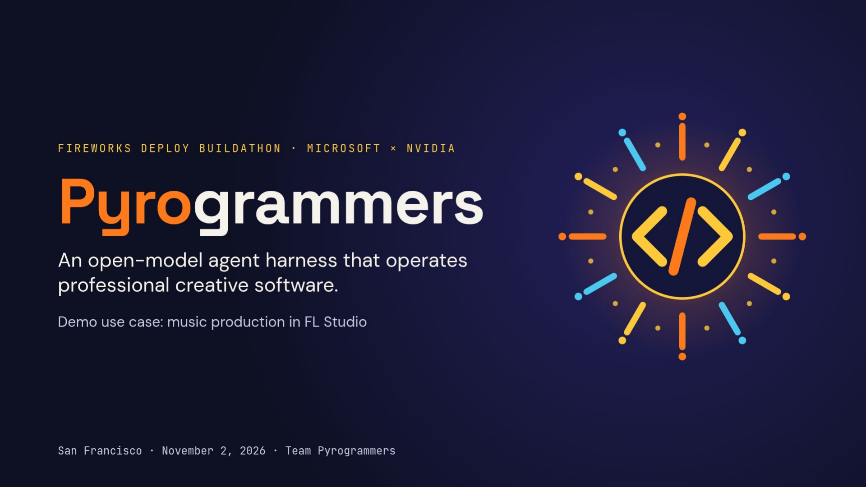
Notes:
Preserved unchanged from the original supplied PDF.

Slide 2
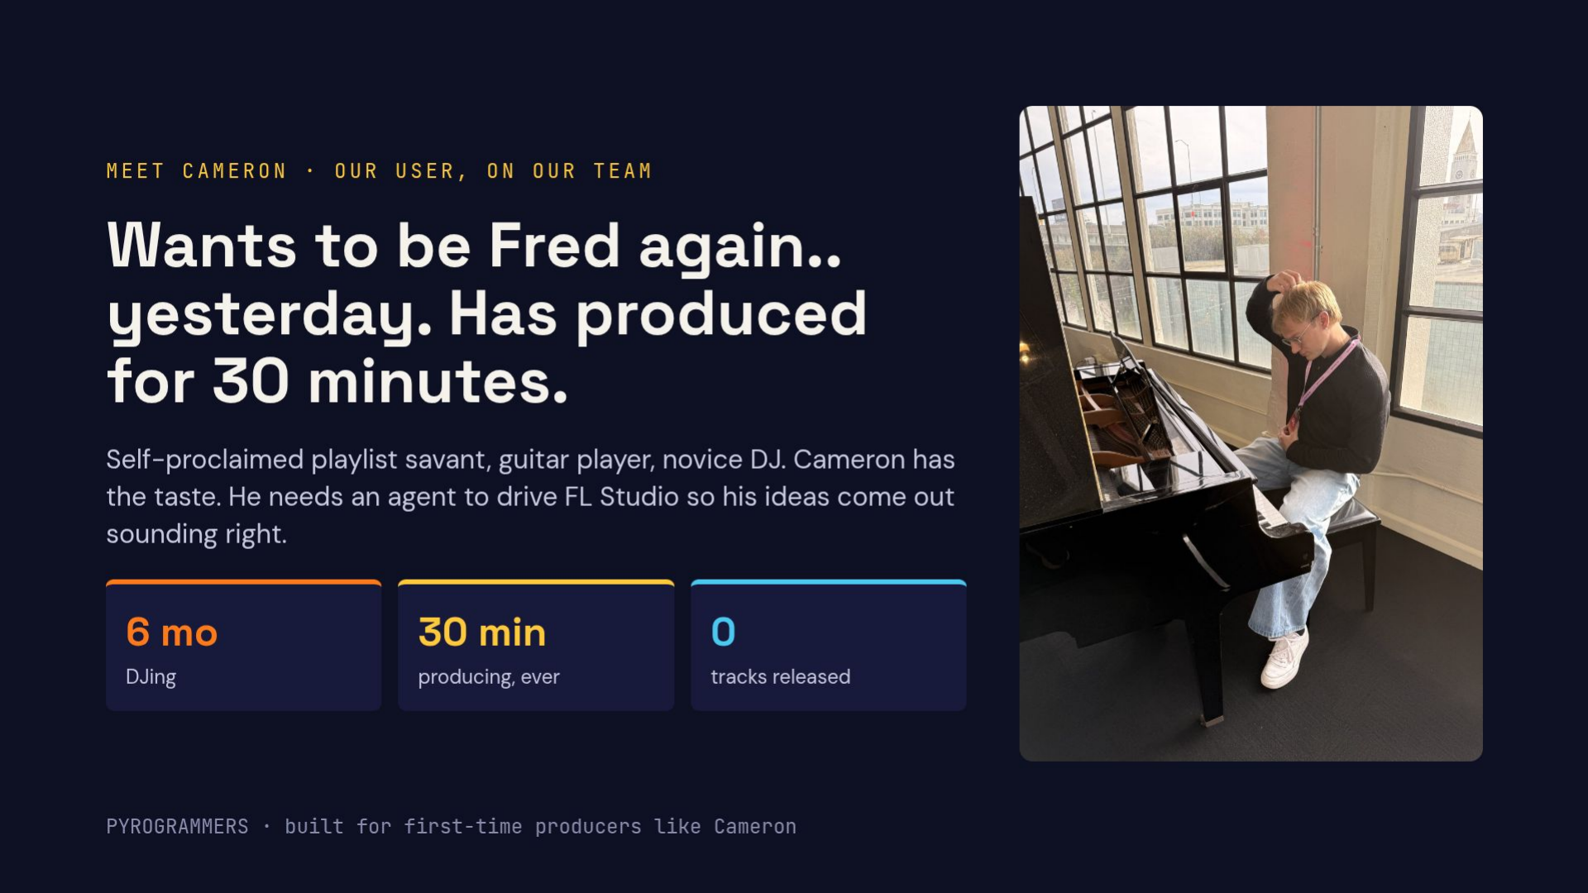
Notes:
Preserved unchanged from the original supplied PDF.

Slide 3
THE APPROACH / HARNESS AROUND QWEN 3.8
Pyro adds FL Studio context and structured localization
1 Ask
2 Add context
3 Identify
4 Check
5 Show
Screenshot plus
FL Studio rules
Name the panel
Validate the point.
Map the point to
the user’s request.
distinguish panels,
and exact entity.
Recovery retries
screenshot pixels.
Baseline asks only
named items and
Return a detailed
token exhaustion;
The demo marks
for a click point.
control functions.
or compact plan.
selective checks
the target for
ambiguity.
the user.
How it’s scored
Model and configuration
Hit = point inside the target box. All 57 FL Studio cases. Errors and missing points count as misses.
Same Qwen 3.8 deployment on Fireworks. Rerun: 8,192 output limit for every strategy. No fine-tuning.
PYROGRAMMERS
Notes:
Ground truth for benchmark results: /home/usr1/Downloads/harness_explainer.html. Rerun: baseline 26, recover 30, compact 31, selective 32 of 57. Output limit 8192 for all; baseline reused; up to 15 concurrent cases. Earlier panel_fast result is explicitly labeled. Every individual gain p > 0.05. Demo details retained from the previous deck and local demo implementation; no benchmark result validates live demo success.

Slide 4
SCREENSPOT-PRO / FL STUDIO / 57 CASES
Six additional correct predictions
BASELINE
BEST IN RERUN: PANEL SELECTIVE
26 / 57
32 / 57
45.6%
56.1%
+10.5 percentage points. No fine-tuning.
11 fixes and 5 regressions on the same hosted model deployment.
Same Qwen 3.8 deployment. Rerun: 8,192 output limit for all strategies.
Exploratory, previously studied cases. Exact McNemar p = 0.21; not statistically significant.
PYROGRAMMERS
Notes:
Ground truth for benchmark results: /home/usr1/Downloads/harness_explainer.html. Rerun: baseline 26, recover 30, compact 31, selective 32 of 57. Output limit 8192 for all; baseline reused; up to 15 concurrent cases. Earlier panel_fast result is explicitly labeled. Every individual gain p > 0.05. Demo details retained from the previous deck and local demo implementation; no benchmark result validates live demo success.

Slide 5
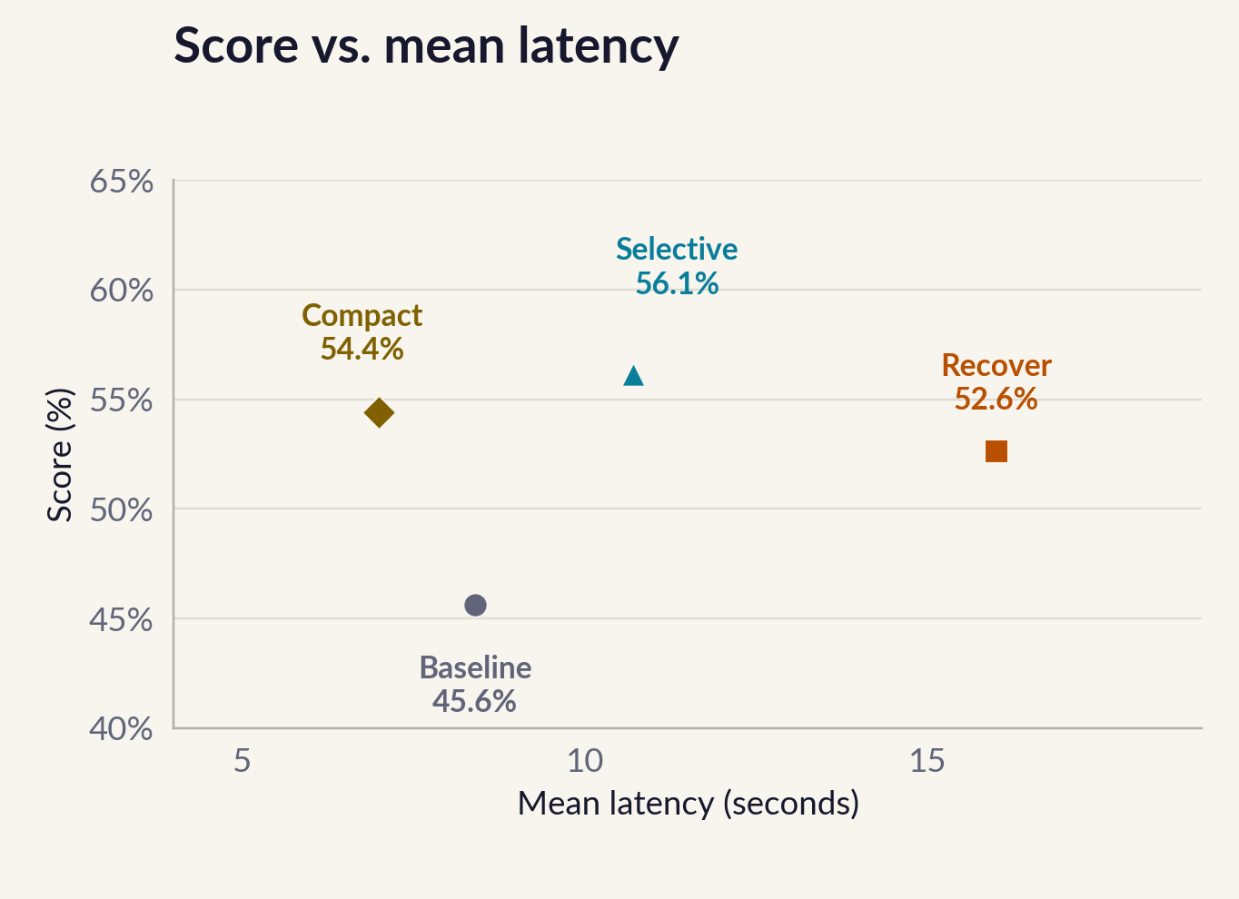
HARNESS CONFIGURATIONS / HITS OUT OF 57
Harness strategies trade accuracy for response cost
Correct predictions
Baseline
26/57
Panel recover
30/57
Panel compact
31/57
Panel selective
32/57
Full bar = 57 cases. All four configurations use the rerun.
Rerun: matched 8,192 output limits. Exploratory results on studied targets; all individual gains p > 0.05.
PYROGRAMMERS
Notes:
Source: harness_explainer.html, rerun. Baseline 26/57 at 8.4 s; recover 30/57 at 16 s; compact 31/57 at 7 s; selective 32/57 at 10.7 s. Same 8192 output limit. Baseline reused. All individual gains p > 0.05. Score axis on scatter spans 40–65 percent.

Slide 6
FULL-SET COMPARISON / SAME HOSTED DEPLOYMENT
Measured configurations, not a leaderboard ranking
CONFIGURATION
CORRECT / 57
ACCURACY
Baseline
26
45.6%
Panel recover
30
52.6%
Panel compact
31
54.4%
Panel selective
32
56.1%
Panel fast (earlier run)
30
52.6%
First four rows: rerun. Panel fast: earlier run. No public ranking is established.
Suggested default: panel_compact, with five more correct and 8.3% more tokens.
Rerun output limit: 8,192 for all strategies. All individual gains have p > 0.05.
PYROGRAMMERS
Notes:
Ground truth for benchmark results: /home/usr1/Downloads/harness_explainer.html. Rerun: baseline 26, recover 30, compact 31, selective 32 of 57. Output limit 8192 for all; baseline reused; up to 15 concurrent cases. Earlier panel_fast result is explicitly labeled. Every individual gain p > 0.05. Demo details retained from the previous deck and local demo implementation; no benchmark result validates live demo success.

Slide 7
DEMO / POINTING ASSISTANT
Ask for a control. See where it is.
“Where do I add reverb to the snare?”
1 Speak
2 Locate
3 Show
Hold Option+Z.
Fireworks receives the
A cyan marker indicates
Local Gemma transcribes
transcript and screenshot.
the predicted control.
the recorded request.
The harness finds a point.
The user stays in control.
The current voice frontend points without clicking.
An extra demo localization call is not included in the 32/57 benchmark result.
Live success for this exact request still needs verification.
PYROGRAMMERS
Notes:
Ground truth for benchmark results: /home/usr1/Downloads/harness_explainer.html. Rerun: baseline 26, recover 30, compact 31, selective 32 of 57. Output limit 8192 for all; baseline reused; up to 15 concurrent cases. Earlier panel_fast result is explicitly labeled. Every individual gain p > 0.05. Demo details retained from the previous deck and local demo implementation; no benchmark result validates live demo success.

Slide 8
PYROGRAMMERS
Computer use for creative professionals
We are building assistants that help people use
the professional creative tools they already have.
FL Studio is our first measured application.
45.6% baseline / 56.1% best harness in the rerun
Same Qwen 3.8 deployment. No fine-tuning.
Exploratory rerun on studied cases. Matched 8,192 limits; gains are not statistically significant.
Code: github.com/harrif23/pyrogrammers
PYROGRAMMERS
Notes:
Ground truth for benchmark results: /home/usr1/Downloads/harness_explainer.html. Rerun: baseline 26, recover 30, compact 31, selective 32 of 57. Output limit 8192 for all; baseline reused; up to 15 concurrent cases. Earlier panel_fast result is explicitly labeled. Every individual gain p > 0.05. Demo details retained from the previous deck and local demo implementation; no benchmark result validates live demo success.

