Slide 1

Real-Time Defect Detection in Manufacturing Using Big Data Technologies
ICS1612-Big Data Management Laboratory
Mini Project
Team Members
Harini J, 3122237001015
Jayasree R , 3122237001019

Slide 2
Problem Statement and Application Domain
Problem Statement :
Manufacturing industries rely on manual inspection for quality control, which is time-consuming, inconsistent, and prone to human error. Defective products may go undetected, leading to reduced product quality and financial losses.
Need for Solution:
Real-time defect detection
Automated inspection system
High-speed data processing
Application Domain:
Smart Manufacturing
Industrial Automation
Quality Control Systems

Slide 3
Objectives of the Project
Develop a streaming data ingestion pipeline using Apache Kafka
Perform ETL operations on streaming data using PySpark
Implement real-time defect detection using Spark MLlib
Store processed data in a scalable NoSQL database (MongoDB)
Perform real-time analytics on defect data
Enable visualization of analytical insights
Build a scalable and efficient big data processing pipeline

Slide 4
Development Environment
Apache Kafka – real-time data streaming
Apache Spark – distributed data processing
Spark MLlib – machine learning for defect detection
Python / PySpark – implementation and processing
MongoDB – NoSQL database for storage
OpenCV – image processing
Matplotlib – data visualization

Slide 5
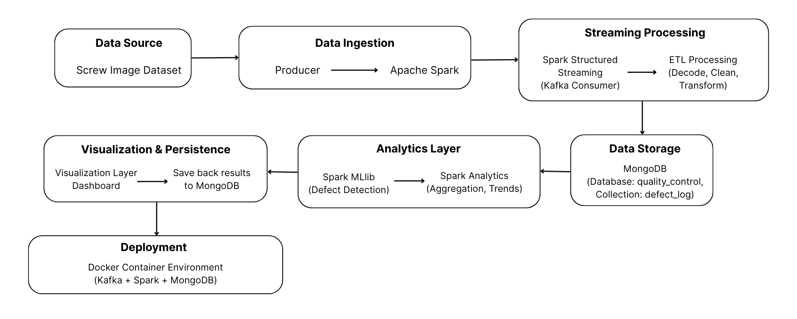
Overall System Architecture

Slide 6
Streaming Data Collection
Data Source:
Screw image dataset (good, scratch, thread defects)
Simulates real-time production line camera
Streaming Method:
Python producer reads images
Converts images into Base64 format
Sends data to Kafka topic
Kafka Configuration:
Topic: raw-sensor-images
Acts as a real-time data pipeline
Spark Integration:
Spark Structured Streaming consumes data from Kafka
Processes data continuously in real time

Slide 7
ETL Processing using Spark
Extract:
Data consumed from Kafka topic using Spark Structured Streaming
Base64 encoded image data received as stream
Load:
Convert processed data into structured DataFrame
Prepare output fields: product_id, status, confidence
Transform:
Decode Base64 image data
Perform data cleaning (remove invalid/corrupt data)
Apply filtering to process valid records only
Perform schema transformation to structured format
Apply defect detection logic using Spark MLlib

Slide 8
NoSQL Database Selection and Integration
Database Used:
MongoDB
Reason for Selection:
Document-based flexible schema
Efficient storage of JSON-like data
High scalability and performance
Suitable for real-time applications
Integration with Spark:
Spark connects to MongoDB
Processed data inserted into MongoDB collection
Stored Data Format:
product_id
status (defect / ok)
confidence score

Slide 9
Real Time Analytics
Analytics Performed:
Real-time monitoring of product inspection data stored in MongoDB
Classification of products into Accepted and Rejected categories
Analysis of defect types such as scratch, misalignment, and others
Computation of defect distribution across inspected products
Visualization of product-wise inspection results using charts
Tracking of quality trends for decision-making and process improvement

Slide 10
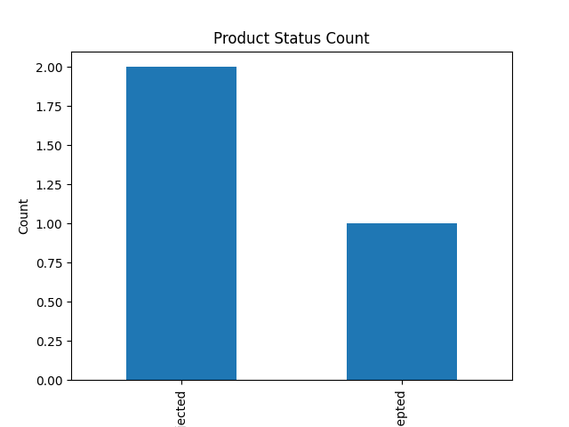
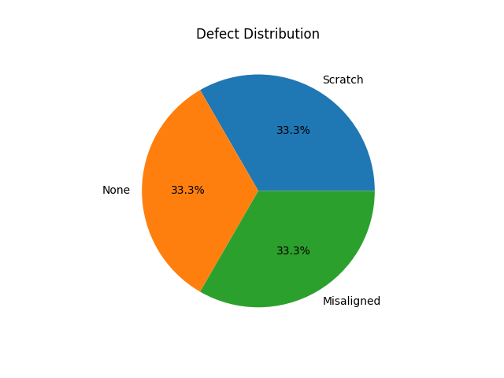
Visualization of Results

Slide 11
Deployment of the System
Deployment Components:
MongoDB database deployed using Docker container
Python analytics module for processing inspection data
Data visualization module for generating charts
Local environment for running real-time analytics pipeline
Deployment Using Docker:
MongoDB pulled from Docker Hub as a container image
Container created and exposed on port 27017
Persistent database service running in isolated environment
Easy startup and shutdown using Docker commands

Slide 12
Results and Inference
Key Findings:
Successfully implemented a real-time defect detection system
Continuous processing of streaming image data achieved
Accurate classification of defect and non-defect products
Insights Obtained:
Identification of frequent defect types
Monitoring of defect rates in production
Early detection of quality issues
Performance:
Low latency real-time processing
Scalable and efficient pipeline
Reliable data storage and retrieval

Slide 13
Impact of the Project
Human Impact:
Reduces manual inspection effort
Minimizes human errors
Improves decision-making
Societal Impact:
Supports smart manufacturing systems
Enhances product quality and reliability
Promotes industrial automation
Ethical Considerations:
Ensures responsible use of data
Maintains data privacy
Reduces bias in defect detection
Sustainability Impact:
Reduces waste from defective products
Improves resource efficiency
Supports environmentally friendly production

Slide 14
Conclusion and Future Work
Conclusion:
Developed a real-time quality control system
Integrated Kafka, Spark, and MongoDB
Demonstrated effectiveness of big data technologies
Future Work:
Use larger and more diverse datasets
Integrate advanced machine learning models
Develop real-time dashboards
Implement predictive analytics
Deploy on cloud platform

Slide 15
Learning Outcomes
Built a complete big data processing pipeline
Implemented streaming analytics using Spark
Integrated Spark with MongoDB
Gained experience in real-time data processing
Learned visualization of analytical results
Understood deployment using container technologies

Slide 16
REFERENCES
Apache Spark Documentation. Available at: https://spark.apache.org/docs/latest/
Apache Kafka Documentation. Available at: https://kafka.apache.org/documentation/
MongoDB Documentation. Available at: https://www.mongodb.com/docs/
Kaggle Dataset Repository – Screw Defect Dataset. Available at: https://www.kaggle.com/
Dean, J. and Ghemawat, S. (2008). MapReduce: Simplified Data Processing on Large Clusters. Communications of the ACM.
Zaharia, M. et al. (2016). Apache Spark: A Unified Engine for Big Data Processing. Communications of the ACM.
White, T. (2015). Hadoop: The Definitive Guide. O’Reilly Media.
Karau, H., Konwinski, A., Wendell, P., and Zaharia, M. (2015). Learning Spark. O’Reilly Media.
Han, J., Kamber, M., and Pei, J. (2011). Data Mining: Concepts and Techniques. Morgan Kaufmann.
OpenCV Documentation. Available at: https://docs.opencv.org/
Matplotlib Documentation. Available at: https://matplotlib.org/stable/contents.html

