Slide 1
Data:
Distribution of depression labels among each patient/individual
Overlapping of sleep labels
Feature extraction:
Spectral envelope and optimal scaling (Li et al 2021)
Classifier:
Gaussian processes?

Slide 2
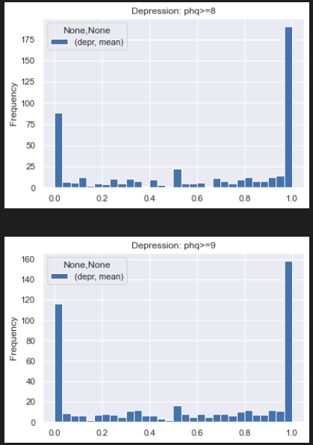
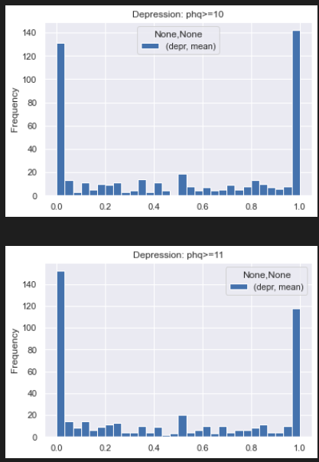
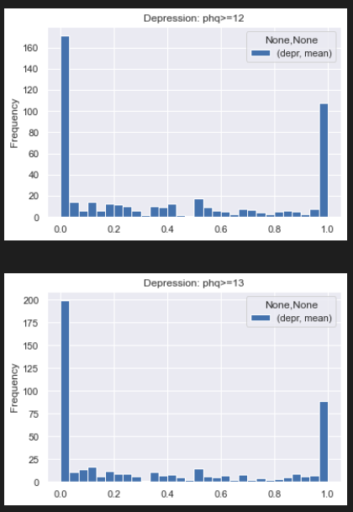

Slide 3
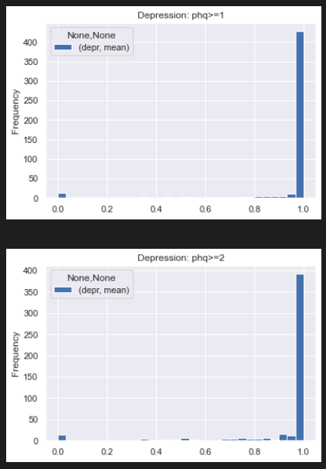
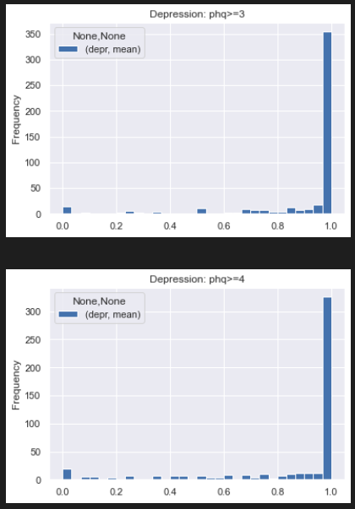
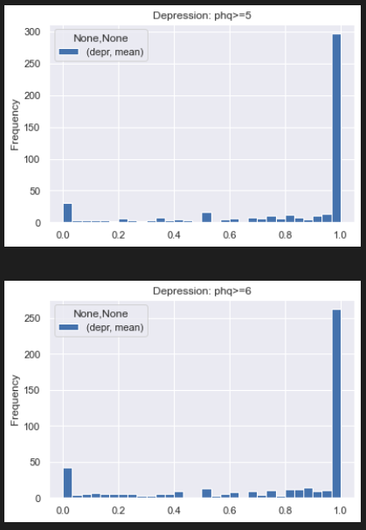
1-6

Slide 4
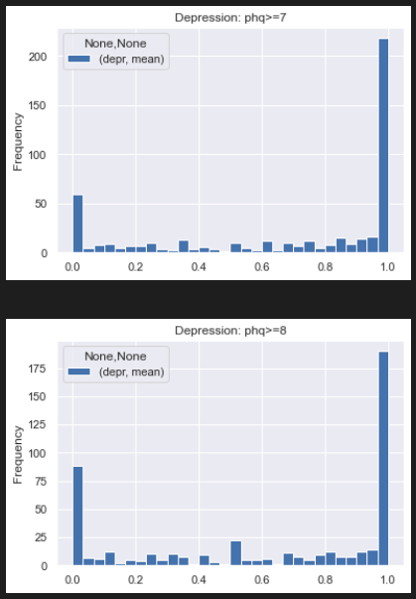
7-8

Slide 5
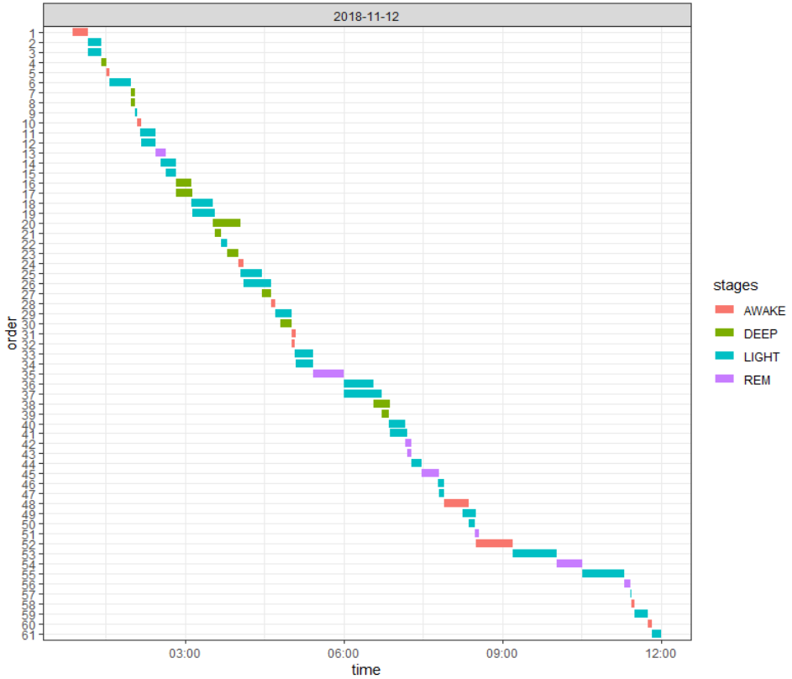
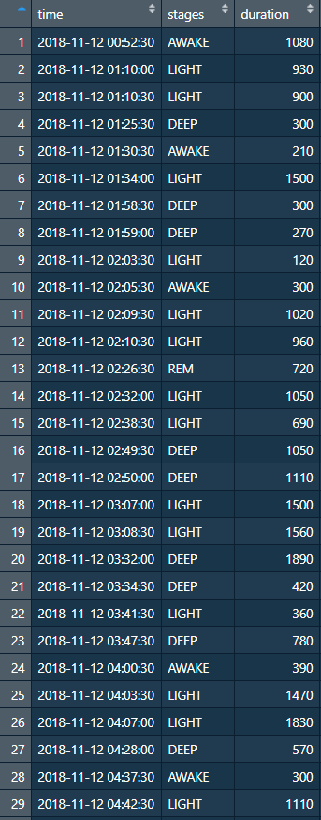
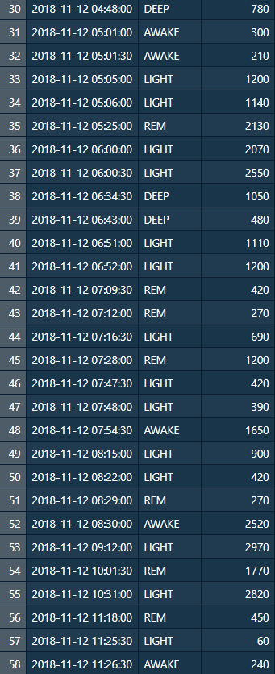
PID: 3c6671b8-45ae-4552-b92b-934ec6bbb89f

Slide 6
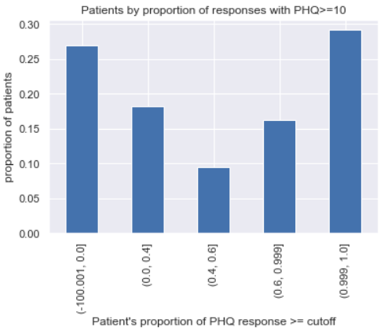
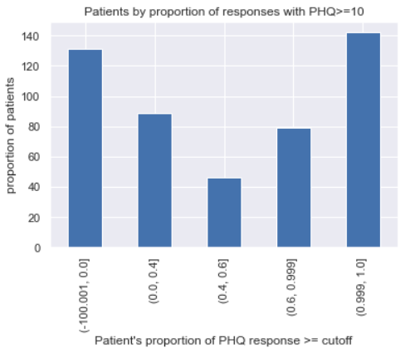

Slide 7
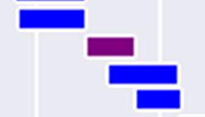
Less 0.5% of measured timestamps have >1 (duplicated) label
Only 122 out of 461 subjects have duplication issue
Depth =
1
2
2

Slide 8
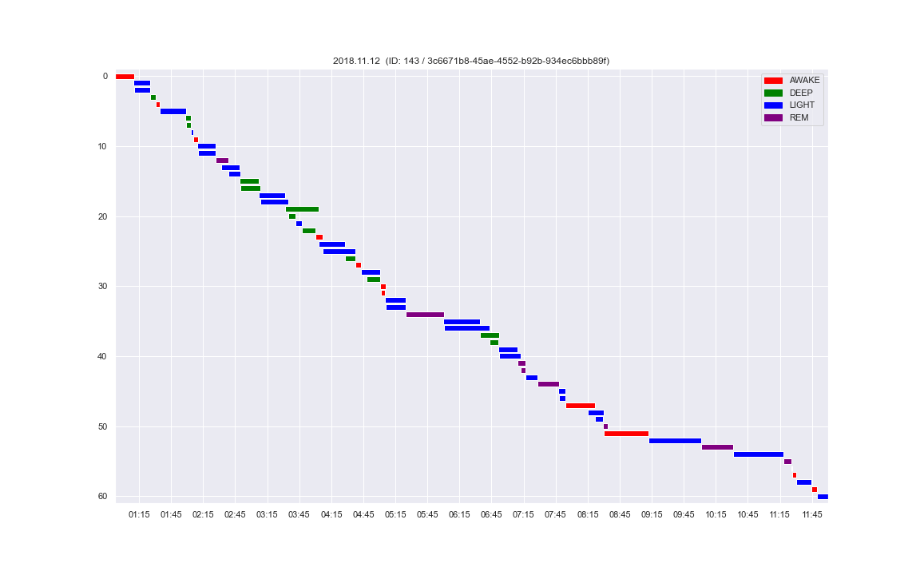
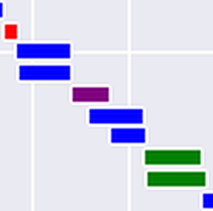
Before dedup

Slide 9
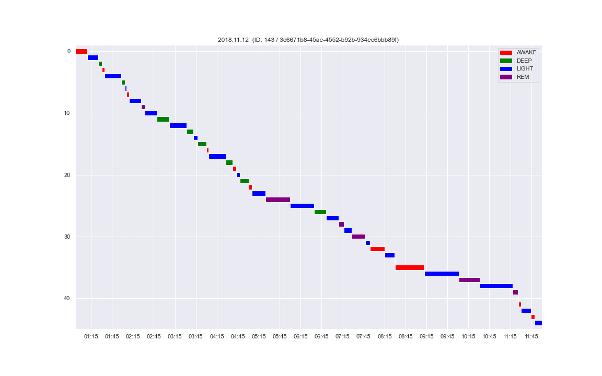
After dedup

Slide 10

Hard-to-resolve situations
→`
→
→
Before dedup
After dedup

Slide 11
Other issues
Patient IDs in PHQ and sleep stages – some are non-existent in meta-data file

Slide 12
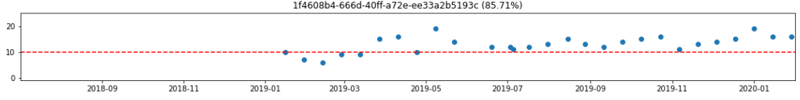
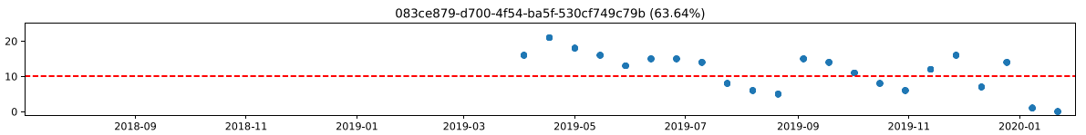
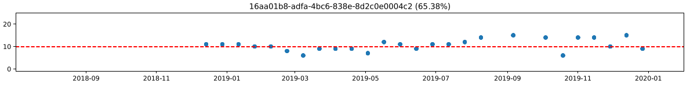
PHQ trajectories
Duplicate records
High/low variability in trajectories
MSc Project • 2022.02.10 updates

Slide 13
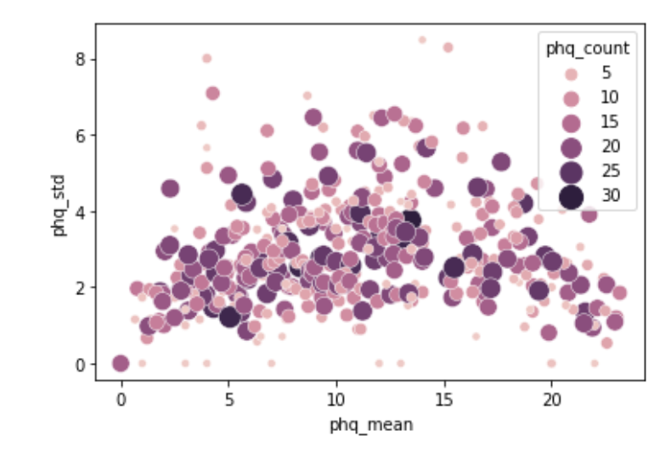
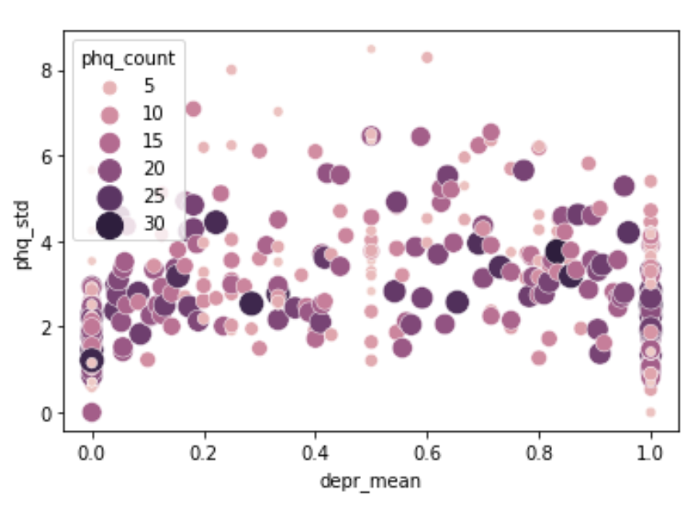

Slide 14
Outlook
Match by date
Run simple logistic model
Run empty mixed model vs non-mixed model
MSc Project • 2022.02.10 updates

Slide 15
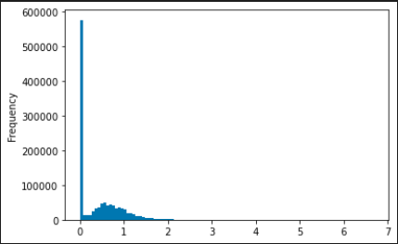
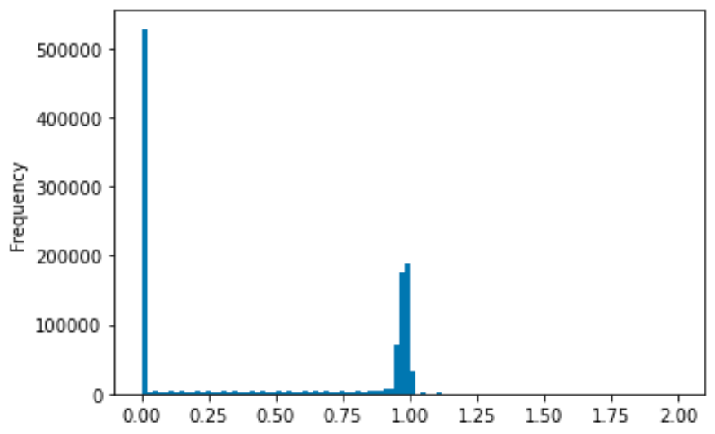
Preprocessing
Input dataframe: Each row = hour
Each column = proportion of sleep stage (awake/deep/light/rem)
Expected:
‘total’ sleep stage proportion per hour = 1
Accounting for missing values, 0 <= ‘total’ proportion <= 1
Problem: A significant number of hours (12.1%) show a ‘total’ proportion of >1
Many rows
Before: Distribution of hourly sleep stage proportions
After: Distribution of hourly sleep stage proportions
Total proportion=0 (entirely missing): 43.6%
MSc Project • 2022.03.02 updates

Slide 16
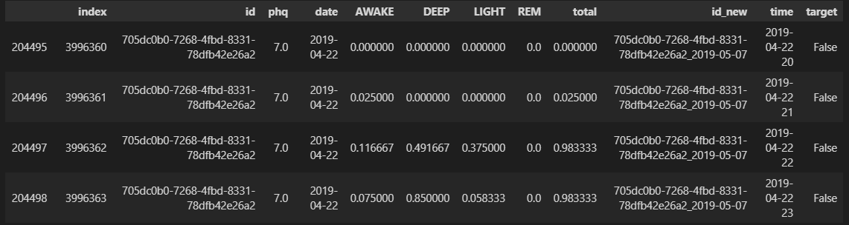
Preprocessing
Example input
MSc Project • 2022.03.02 updates

Slide 17
Preprocessing
Sleep stage intervals (n=1,855,957, 618,082 hours)
PHQ test records (n=5082)
Remove records from subjects unmatched in PHQ/metadata (n=57728, 3.11%)
Remove records from subjects unmatched in sleep data/metadata (n=233, 4.58%)
Sleep stage 30s timestamps (n=70,190,672)
PHQ test records (n=4849)
Remove timestamps outside 8pm-10am (n=2,932,777, 4.18%)
Deduplication (n=258,575, 0.38%)
Binning
Hourly-binned proportions (n=735555)
Merged
X (hourly proportions) Depressed: 414000 (56.28%) Non-depressed: 321555 (43.72%)
Target (PHQ test result covering 14-days) Depressed: 1725 (55.24%) Non-depressed: 2129 (44.76%)
MSc Project • 2022.03.02 updates

Slide 18
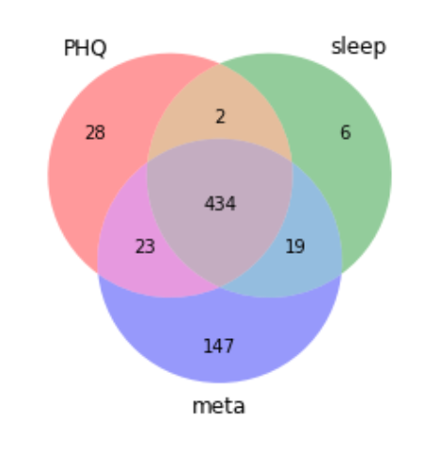
Preprocessing
Subject IDs in three data sources
MSc Project • 2022.03.02 updates

Slide 19
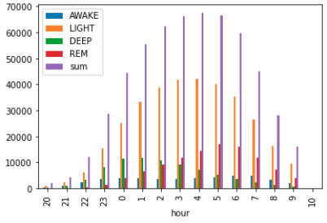
Preprocessing
Distribution of recorded sleep data by hour (8pm-10am)
MSc Project • 2022.03.02 updates

Slide 20
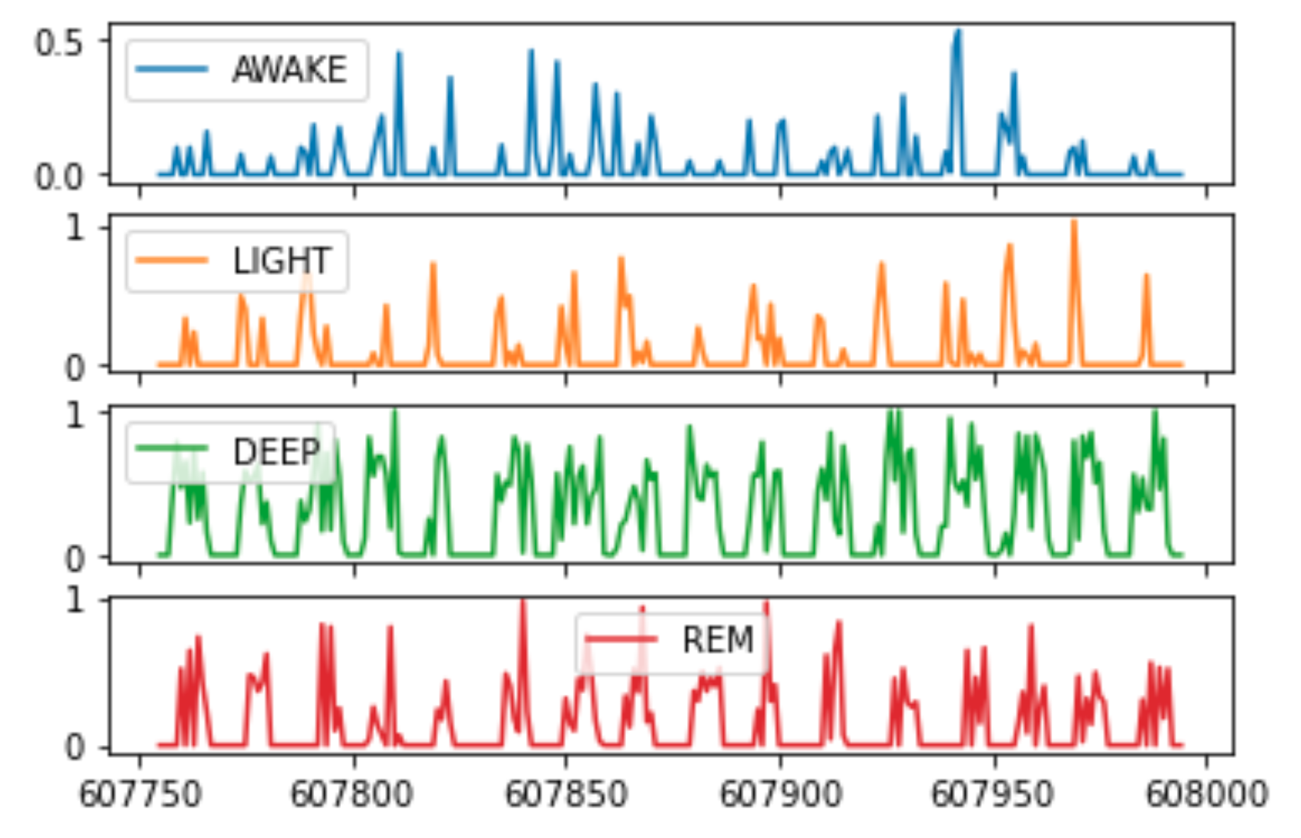
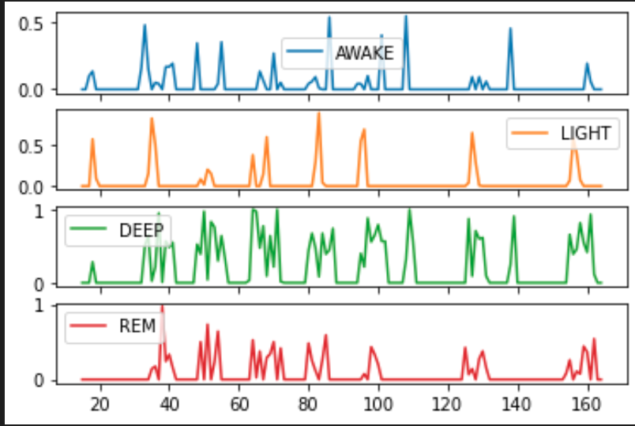
Feature extraction
Preview of input time series
Non-depressed
Depressed
show = df.loc[df['id_new']=='6fcdd023-6388-4650-a30d-8311015fc731_2019-05-08'] # non-depressed
show2 = df.loc[df['id_new']=='bf3defd7-2a52-4557-8202-9d887957e109_2019-02-04'] # depressed, same subject
MSc Project • 2022.03.02 updates

Slide 21
Title
Subtitle
- PCA and ICA taken jointly did not improve performance
- Feature transformation methods lower interpretability
- Different feature subsets give similar performance --> suggests the presence of different Markov Blankets
- i.e. "there may be different underlying combinations of features which essentially can jointly capture" the key characteristics for class separation”
Code
MSc Project • 2022.03.02 updates

Slide 22
Preprocessing
Current issues (fix later):
Probably dump 10am instead of keeping it
A few hours still have ‘total’ proportion > 1, reason unknown
RF classifier show terrible performance – need to double check preprocessing
Need to double check deduplication logic – is the code working as intended?
Code:
Routines
Bar plot with percentages
Anything else?
Understanding
pandas index
pandas datetime
MSc Project • 2022.03.02 updates

