Slide 1
Data:
Distribution of depression labels among each patient/individual
Overlapping of sleep labels
Feature extraction:
Spectral envelope and optimal scaling (Li et al 2021)
Classifier:
Gaussian processes?

Slide 2
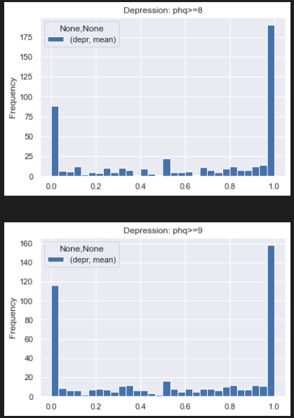
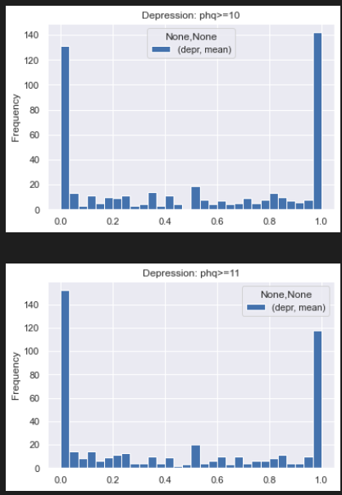
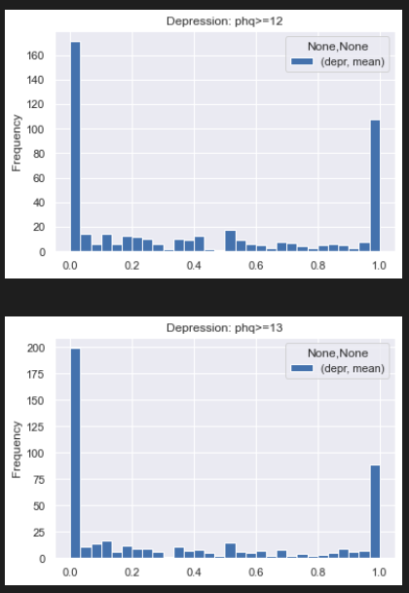

Slide 3
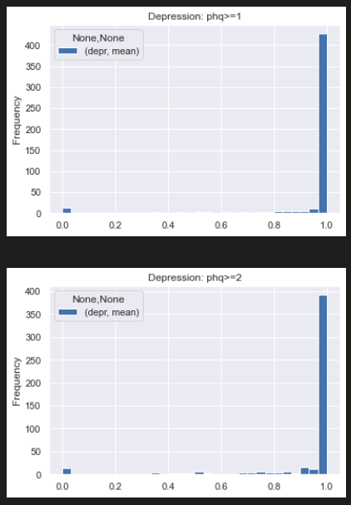
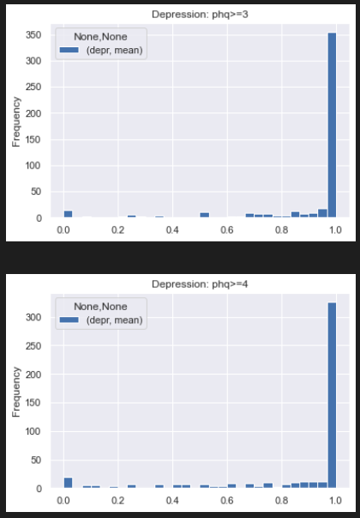
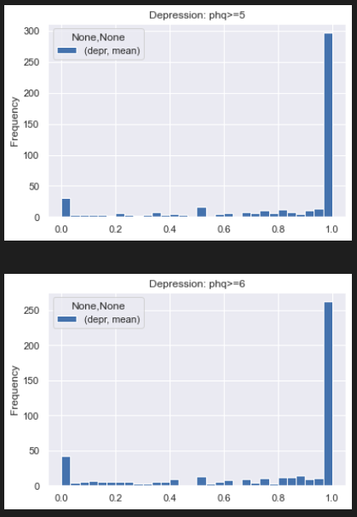
1-6

Slide 4
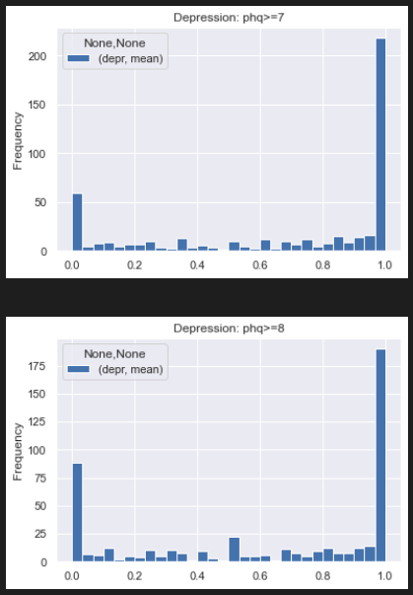
7-8

Slide 5
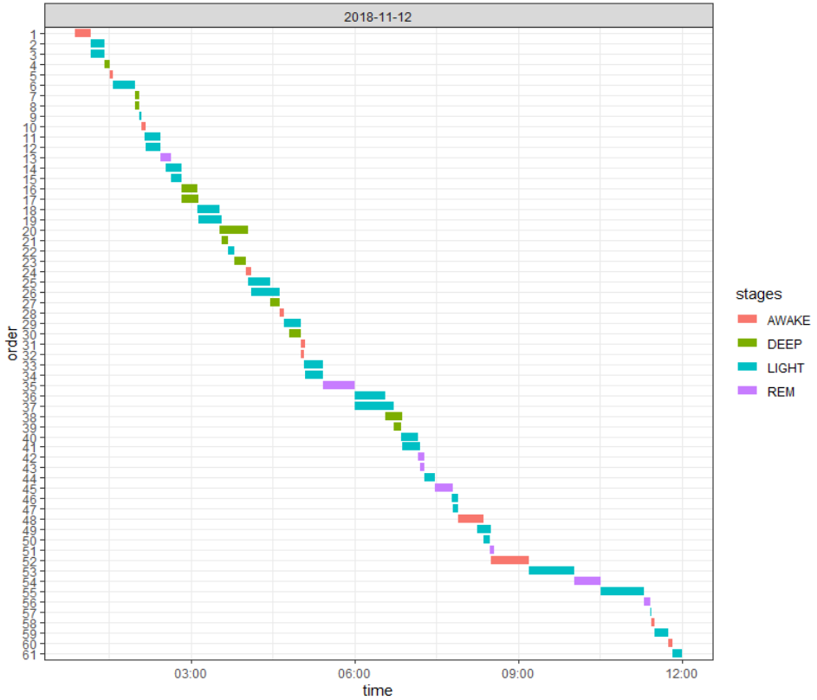
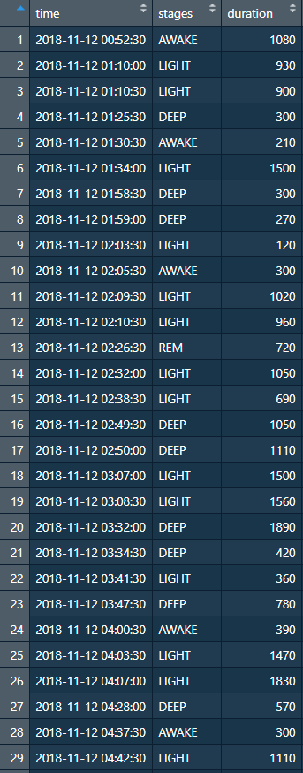
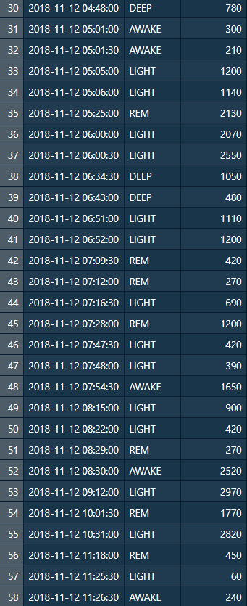
PID: 3c6671b8-45ae-4552-b92b-934ec6bbb89f

Slide 6
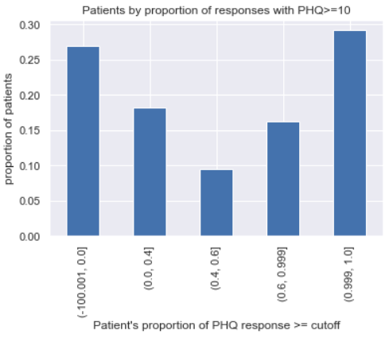
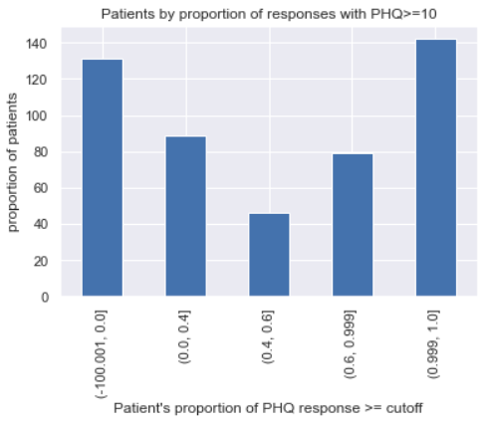

Slide 7
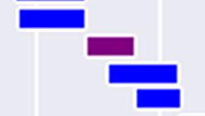
Less 0.5% of measured timestamps have >1 (duplicated) label
Only 122 out of 461 subjects have duplication issue
Depth =
1
2
2

Slide 8
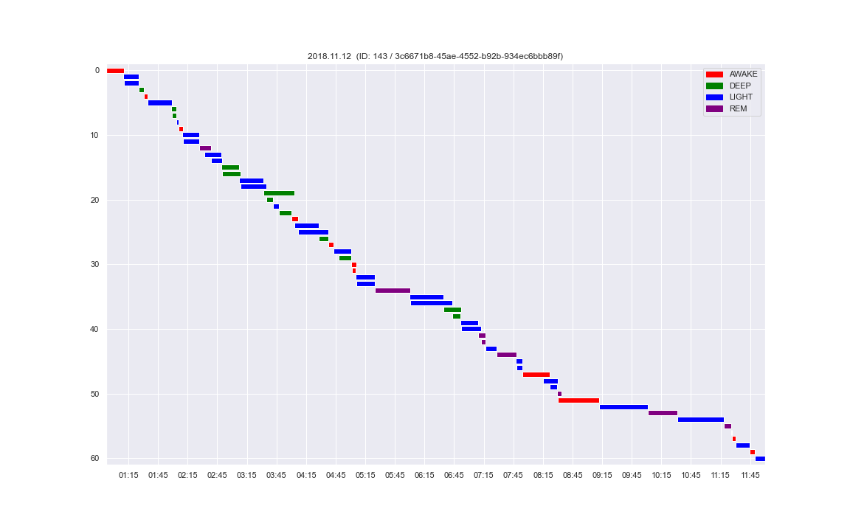
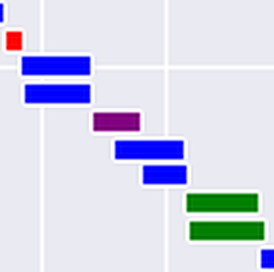
Before dedup

Slide 9
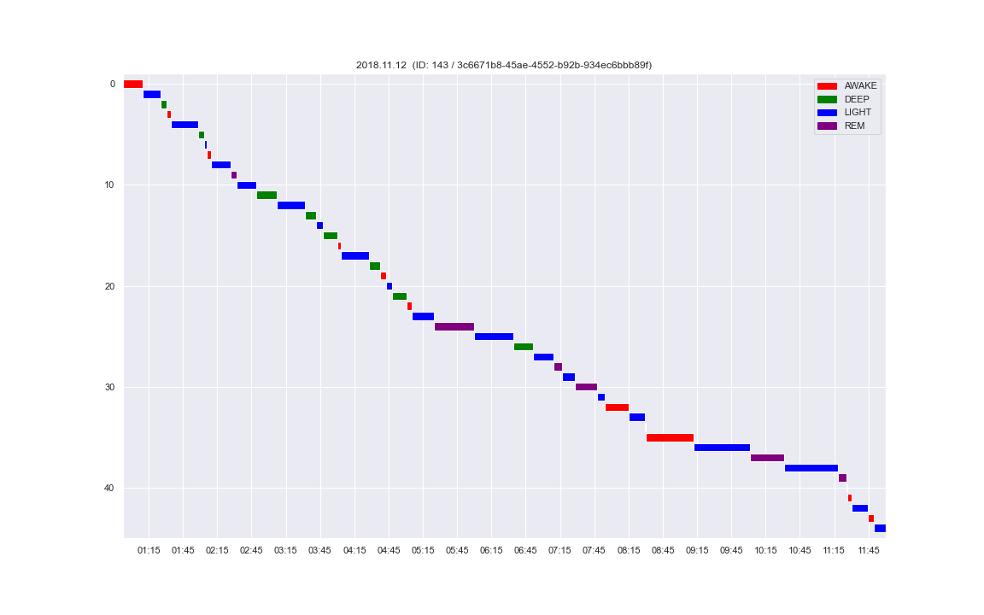
After dedup

Slide 10

Hard-to-resolve situations
→`
→
→
Before dedup
After dedup

Slide 11
Other issues
Patient IDs in PHQ and sleep stages – some are non-existent in meta-data file

Slide 12
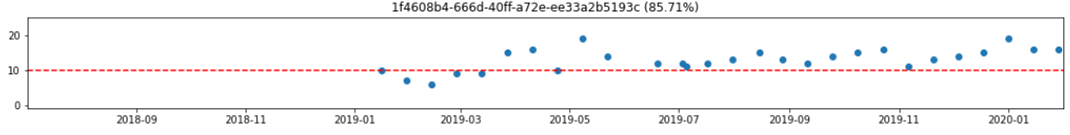
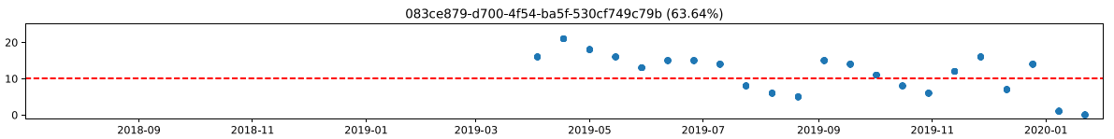
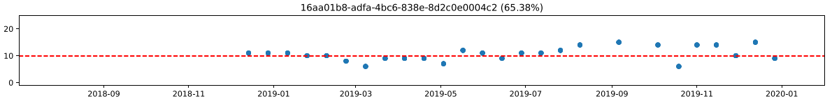
PHQ trajectories
Duplicate records
High/low variability in trajectories
MSc Project • 2022.02.10 updates

Slide 13
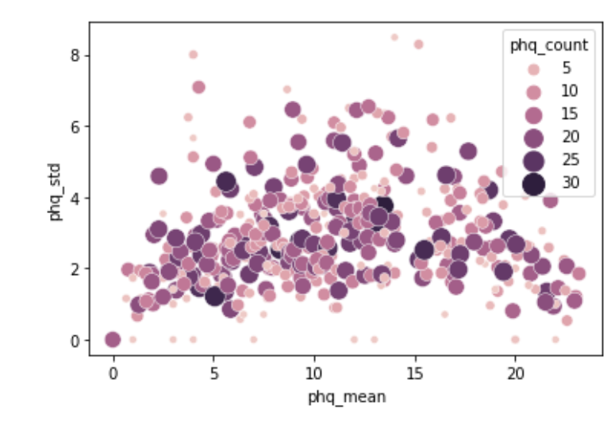
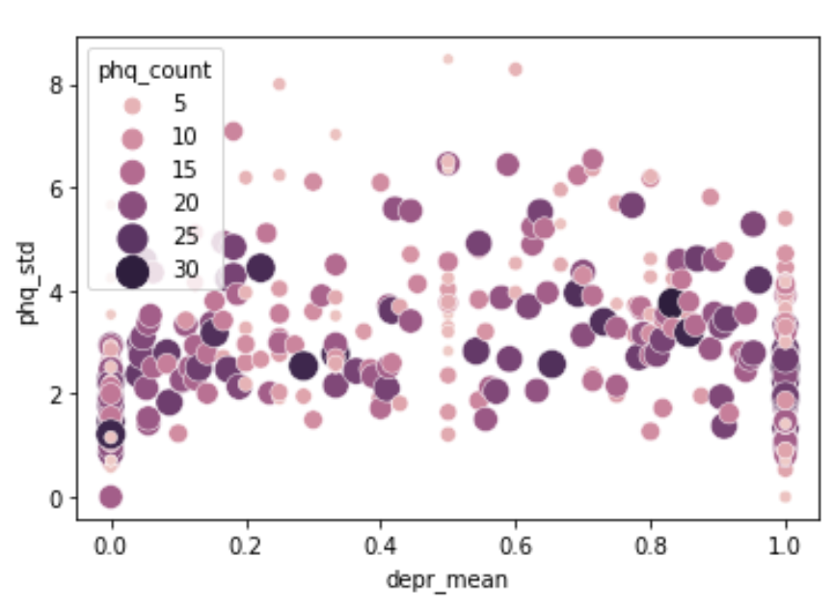

Slide 14
Outlook
Match by date
Run simple logistic model
Run empty mixed model vs non-mixed model
MSc Project • 2022.02.10 updates

Slide 15
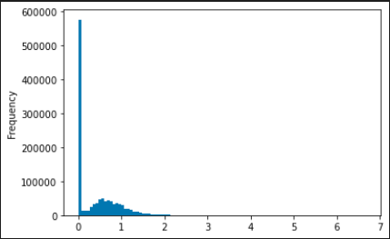
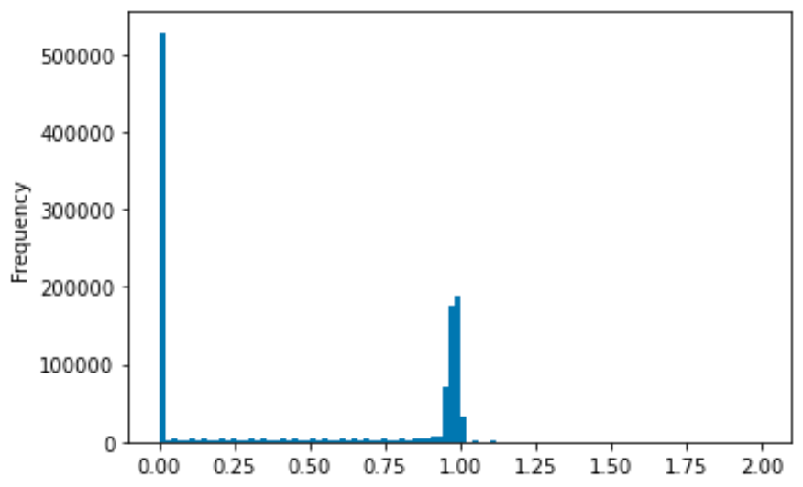
Preprocessing
Input dataframe: Each row = hour
Each column = proportion of sleep stage (awake/deep/light/rem)
Expected:
‘total’ sleep stage proportion per hour = 1
Accounting for missing values, 0 <= ‘total’ proportion <= 1
Problem: A significant number of hours (12.1%) show a ‘total’ proportion of >1
Many rows
Before: Distribution of hourly sleep stage proportions
After: Distribution of hourly sleep stage proportions
Total proportion=0 (entirely missing): 43.6%
MSc Project • 2022.03.02 updates

Slide 16
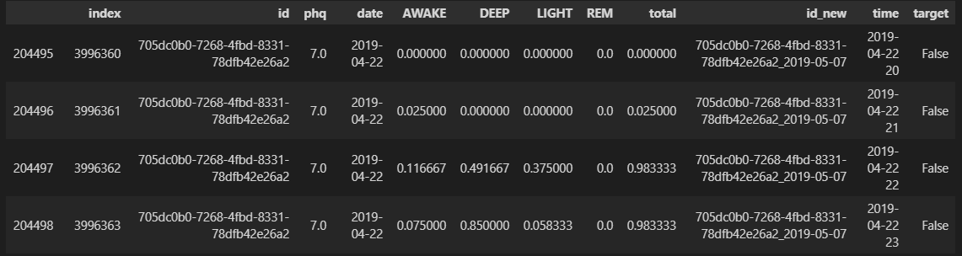
Preprocessing
Example input
MSc Project • 2022.03.02 updates

Slide 17
Preprocessing
Sleep stage intervals (n=1,855,957, 618,082 hours)
PHQ test records (n=5082)
Remove records from subjects unmatched in PHQ/metadata (n=57728, 3.11%)
Remove records from subjects unmatched in sleep data/metadata (n=233, 4.58%)
Sleep stage 30s timestamps (n=70,190,672)
PHQ test records (n=4849)
Remove timestamps outside 8pm-10am (n=2,932,777, 4.18%)
Deduplication (n=258,575, 0.38%)
Binning
Hourly-binned proportions (n=735555)
Merged
X (hourly proportions) Depressed: 414000 (56.28%) Non-depressed: 321555 (43.72%)
Target (PHQ test result covering 14-days) Depressed: 1725 (55.24%) Non-depressed: 2129 (44.76%)
MSc Project • 2022.03.02 updates

Slide 18
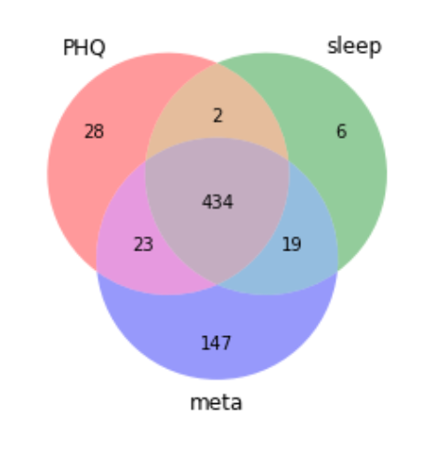
Preprocessing
Subject IDs in three data sources
MSc Project • 2022.03.02 updates

Slide 19
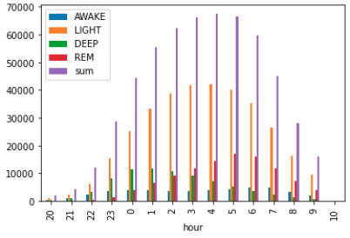
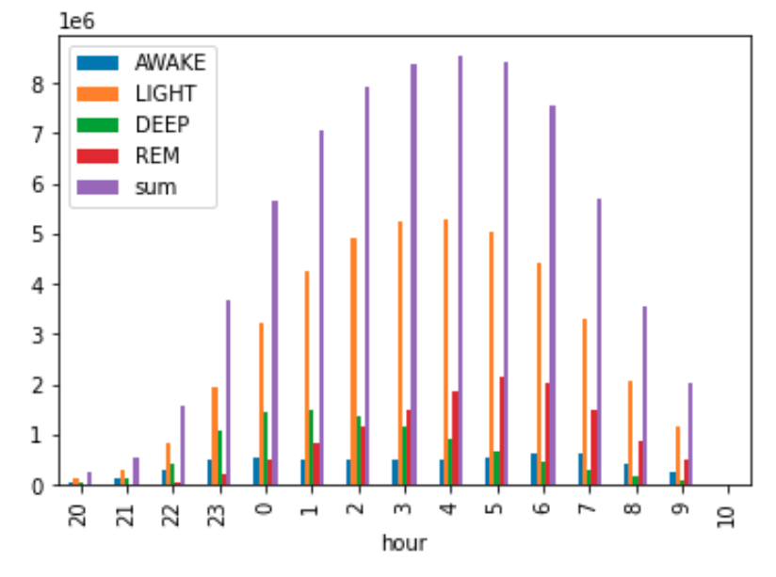
Preprocessing
Distribution of recorded sleep data by hour (8pm-10am)
MSc Project • 2022.03.02 updates

Slide 20
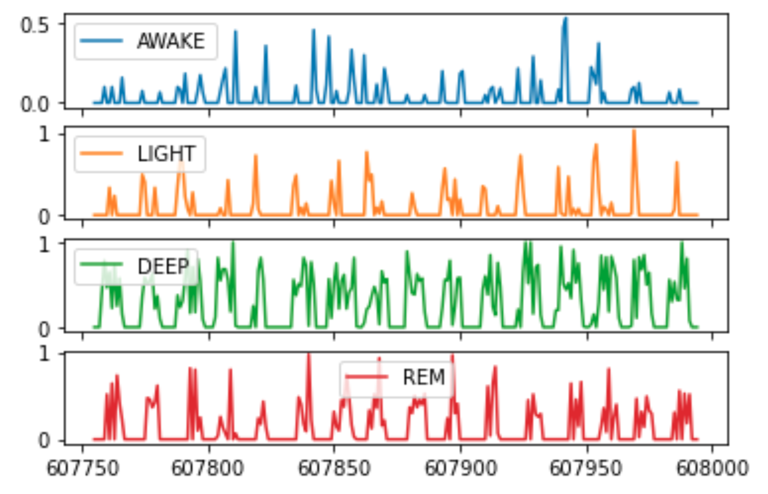
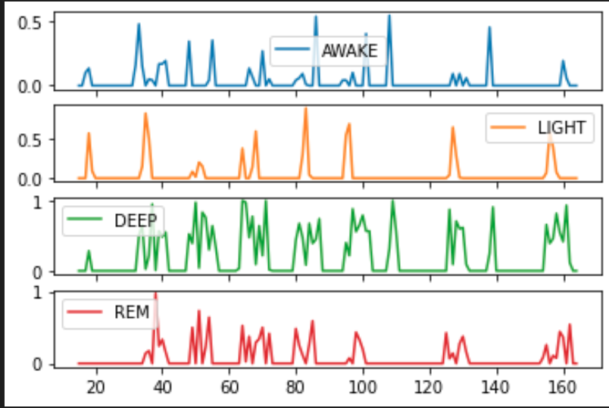
Feature extraction
Preview of input time series
Non-depressed
Depressed
show = df.loc[df['id_new']=='6fcdd023-6388-4650-a30d-8311015fc731_2019-05-08'] # non-depressed
show2 = df.loc[df['id_new']=='bf3defd7-2a52-4557-8202-9d887957e109_2019-02-04'] # depressed, same subject
MSc Project • 2022.03.02 updates

Slide 21
Title
Subtitle
- PCA and ICA taken jointly did not improve performance
- Feature transformation methods lower interpretability
- Different feature subsets give similar performance --> suggests the presence of different Markov Blankets
- i.e. "there may be different underlying combinations of features which essentially can jointly capture" the key characteristics for class separation”
Code
MSc Project • 2022.03.02 updates

Slide 22
Preprocessing
Current issues (fix later):
Probably dump 10am instead of keeping it
A few hours still have ‘total’ proportion > 1, reason unknown
RF classifier show terrible performance – need to double check preprocessing
Need to double check deduplication logic – is the code working as intended?
Code:
Routines
Bar plot with percentages
Anything else?
Understanding
pandas index
pandas datetime
MSc Project • 2022.03.02 updates

Slide 23
Pipeline
Baseline models
tsFresh
After filtering by non-missing days >= 12, number of deltaT = 2860
Feature Extraction: 3156 features
Feature Selection: 422 features
Train-test-split (not stratified by subject):
Training Features Shape: (858, 422)
Training Labels Shape: (858,)
Testing Features Shape: (2002, 422)
Testing Labels Shape: (2002,)
Testing proportion: 379 T – 479 F (44.1%)
Training proportion: 853 T – 1149 F (42.6%)
Preprocessing + Models + Tuning:
StandardScaling + KNN
StandardScaling + SVM classifier
No scaling + RandomForest
No scaling + LogisticRegression and regularized variants
MSc Project • 2022.03.24 updates

Slide 24
Tuning results on training set
Baseline models
### knn
Best score: 0.6361371153306452
Best params: {'knn__n_neighbors': 9}
### svc
Best score: 0.644029916331013
Best params: {'svc__C': 10, 'svc__gamma': 0.001, 'svc__kernel': 'rbf'}
### rf
Best score: 0.6363237836379443
Best params: {'rf__max_depth': 20, 'rf__max_features': 'auto', 'rf__min_samples_split': 2, 'rf__n_estimators': 200}
### logistic
Best score: 0.6189314284232641
Best params: {'logistic__C': 0.1, 'logistic__penalty': 'l1', 'logistic__solver': 'liblinear
MSc Project • 2022.03.24 updates

Slide 25
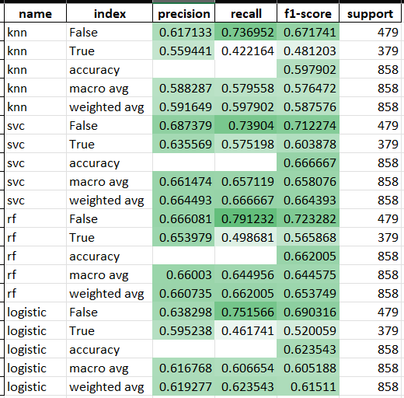
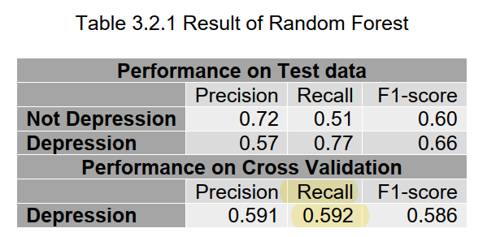
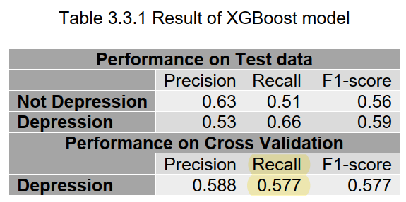
Performance on test set
Baseline models
MSc Project • 2022.03.24 updates

Slide 26
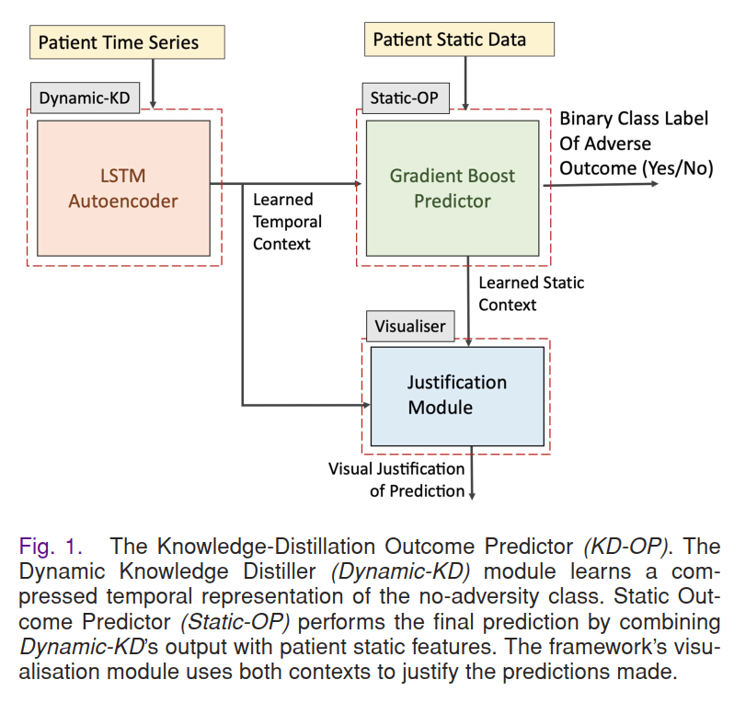
How to consider mixed effects?
Research idea
Time series
“Static” data
multiple levels to consider
Week level
Subject level
(3) ‘Stability’ of sleep? Standard deviations of some metrics?
MSc Project • 2022.03.24 updates

Slide 27
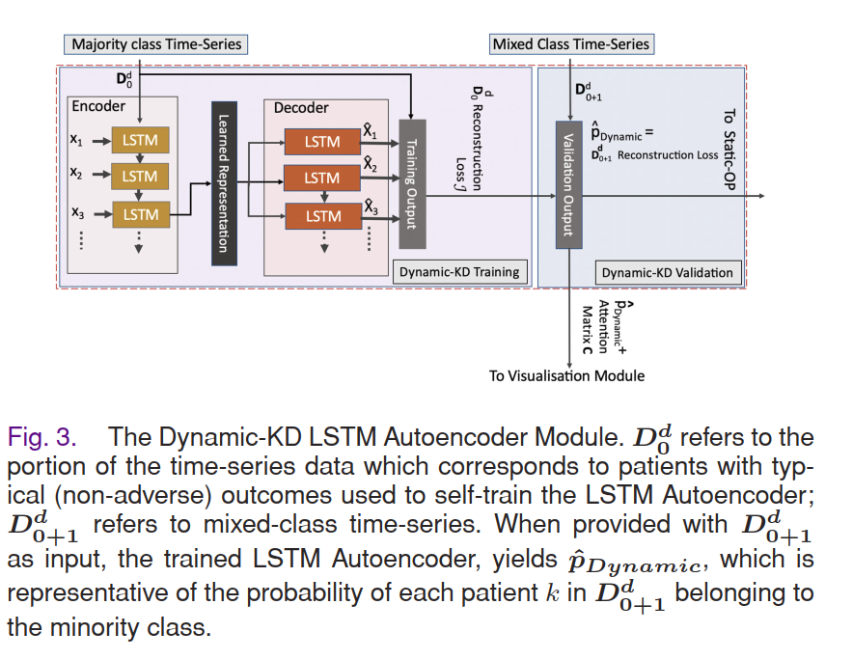

Slide 28
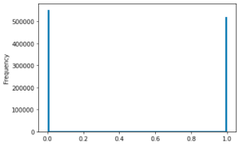
Sleep stage binning routine is fixed
Preprocessing
Total non-missing proportions (hourly) now <1 with no exceptions
No fix
Last meeting
Now
MSc Project • 2022.03.24 updates

Slide 29
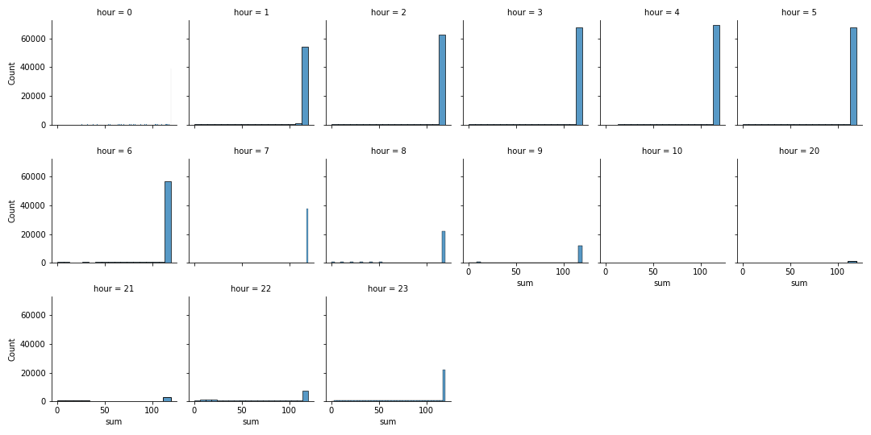
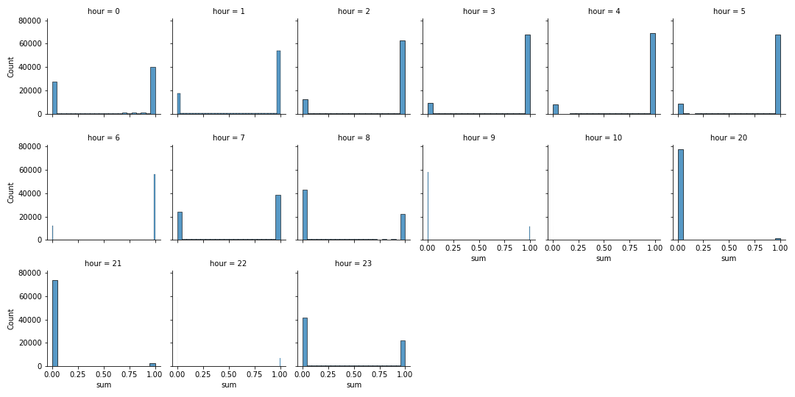
Binning routine is fixed
Preprocessing
As expected, completely empty hours are usually in midnight (total non-missing proportion = 0)
Before filling with zeros
Filling with zeros
MSc Project • 2022.03.24 updates

Slide 30
Binning routine is fixed
Preprocessing
Zeroes are mostly filled to
MSc Project • 2022.03.24 updates

Slide 31
Best hyperparameters
### knn
Best score: 0.6361371153306452
Best params: {'knn__n_neighbors': 9}
### svc
Best score: 0.644029916331013
Best params: {'svc__C': 10, 'svc__gamma': 0.001, 'svc__kernel': 'rbf'}
### rf
Best score: 0.6363237836379443
Best params: {'rf__max_depth': 20, 'rf__max_features': 'auto', 'rf__min_samples_split': 2, 'rf__n_estimators': 200}
### logistic
Best score: 0.6189314284232641
Best params: {'logistic__C': 0.1, 'logistic__penalty': 'l1', 'logistic__solver': 'liblinear'}

