Slide 1
Quantum Linear System Algorithms for Graph-Based Financial Risk Diffusion
Group 26A
Harris Ahmed M, Neha Girdhar, Snigdha Chandan,
Selvakumar Arumugam, Rishanthi Ramakrishnan

Slide 2
Problem Statement
Given:
A large but sparse financial network with N institutions (banks)
A few banks suddenly get high risk scores
How does the risk propagate across the network?
Which banks are affected?
What are the most affected banks?
Is my bank safe?

Slide 3
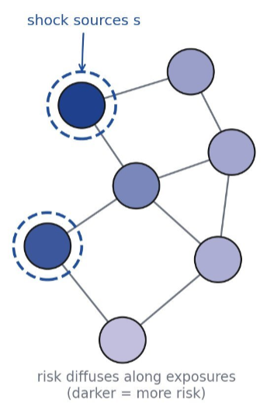
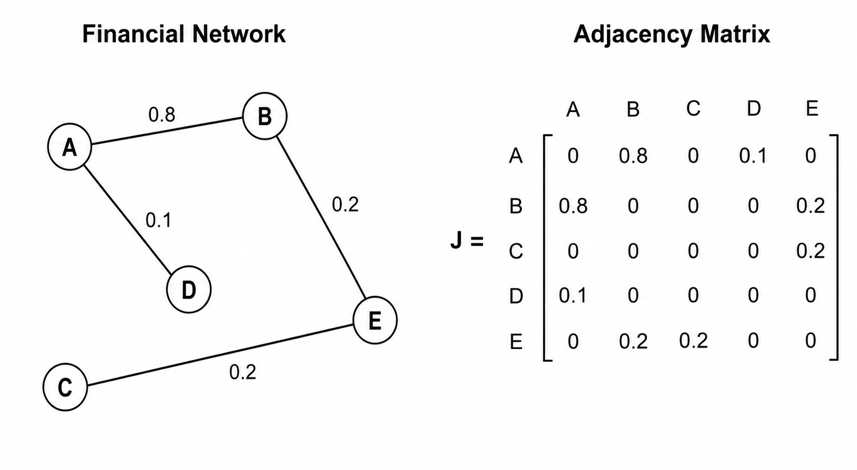
Problem Statement: Example

Slide 4

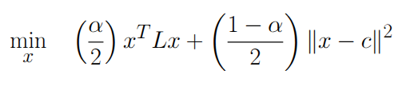
Problem Statement: Model
N nodes
Diffusion Parameter, α
Adjacency matrix, J
Degree matrix, D – diagonal :
Laplacian, L = D – J
Risk scores, x
Model:

Slide 5




Problem Statement – 3 Models
Model 1
Biased towards nodes with high degree. So, normalize Laplacian.
Model 3
Matrix not Hermitian, also poorly conditioned. So, symmetrically normalize Laplacian.
Model 2
Now, the matrix is nice!

Slide 6

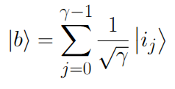

Quantum Formulation
Linear equation
The quantum solution state is proportional to the true solution
Realistic assumption on input shock vector
Sparsity, s
Condition Number,

Slide 7
Algorithmic Pipeline (Modular Components)
Financial Model
Represent A
Invert Eigenvalues
Readout (Measurement) 2 use cases
QPE-Based (Traditional HHL, Berry-Childs HHL – 2 variants) QSVT-Based
Prepare |b> (Sparse State Preparation) 2 methods
Adjacency matrix
Normalized Laplacian
Linear system
Hamiltonian Simulation (Trotterization)
Block Encoding (Berry-Childs, LCU)
Basis sampling (top k)
Observable estimation (single node risk)
Polynomial Approximation
Gleinig-Hoefler
Shukla-Vedula variant

Slide 8
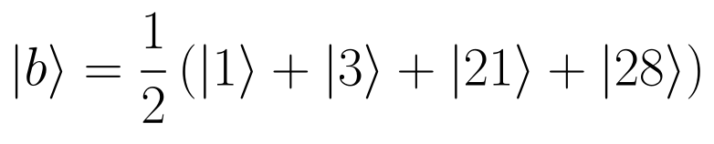
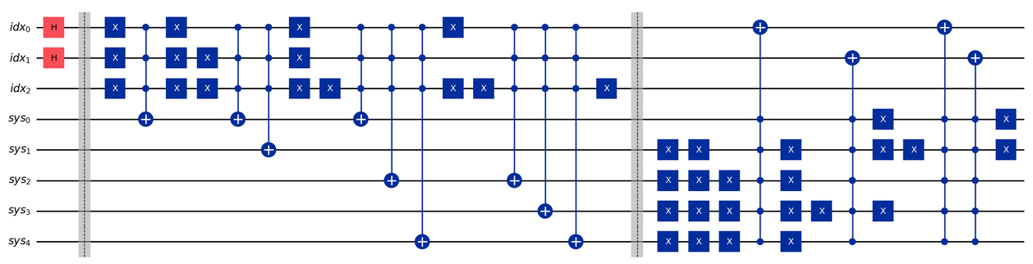
Shock State Preparation Circuit Example

Slide 9
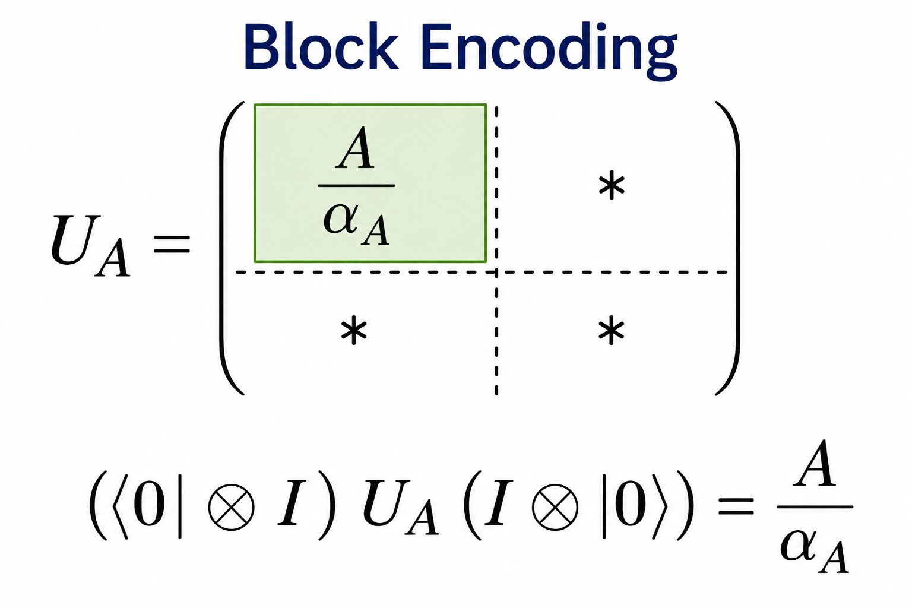
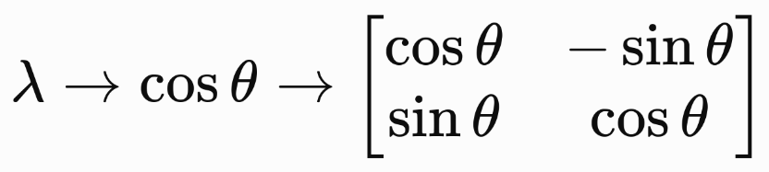
Block Encoding (Low and Chuang, 2016)
Encode A in a higher dim'l space
Eigenvalue/Eigenvector pairs become 2D-invariant subspaces
Each Eigenpair = A Qubit (Qubitization)

Slide 10
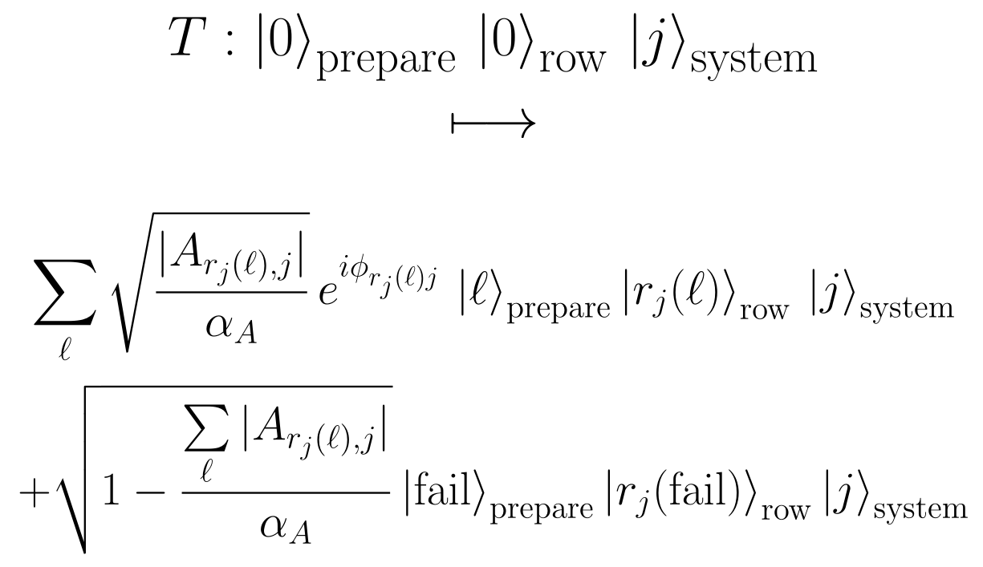
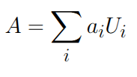
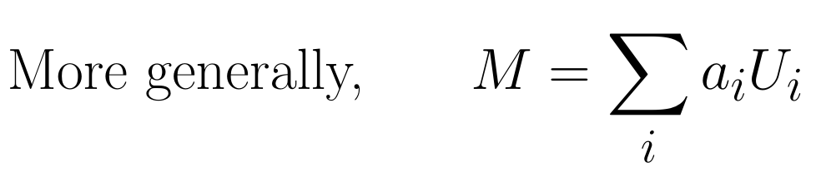
Block Encoding
Two kinds
Berry-Childs Block Encoding R = Reflection about Im(T) S = Swap row and system W = SR
Linear Combination of Unitaries

Slide 11
LCU Block Encoding
LCU sandwich
A/α_A
·
PREP
SELECT
PREP†
anc
|0⟩
U_A =
·
·
sys
(⟨0|⊗I)·U_A·(|0⟩⊗I) = A/α_A
⟨0|ₐ(PREP†·SELECT·PREP)|0⟩ₐ = Σⱼ(αⱼ/α_A)Uⱼ = A/α_A
Notes:
A block encoding hides A/α in the ancilla-|0⟩ corner of a larger unitary U_A. LCU is the constructive route: PREPARE loads amplitudes √(αⱼ/α), SELECT applies each Uⱼ, PREPARE† interferes the branches — post-selecting the ancilla on |0⟩ enacts A/α

Slide 12
The Implemented LCU Block Encoding
PREPARE = H → SELECT = controlled ±e^{itA} → UNPREPARE = H; ancilla-|0⟩ block = cos(tA)
be
H
H
PREPARE
UNPREPARE
e^(+itA)
e^(−itA)
sys
SELECT (controlled ± evolution)
○ control on |0⟩ → e^(+itA) ● control on |1⟩ → e^(−itA)
Notes:
Two-term uniform LCU: ½(e^{+itA}+e^{−itA}) = cos(tA). SELECT is one controlled forward evolution (on |0⟩, open dot) and one controlled backward evolution (on |1⟩, filled dot) — exactly the resource HHL certifies. Verified each run: ‖⟨0|U_enc|0⟩ − cos(tA)‖ = 2.2·10⁻¹⁶.

Slide 13
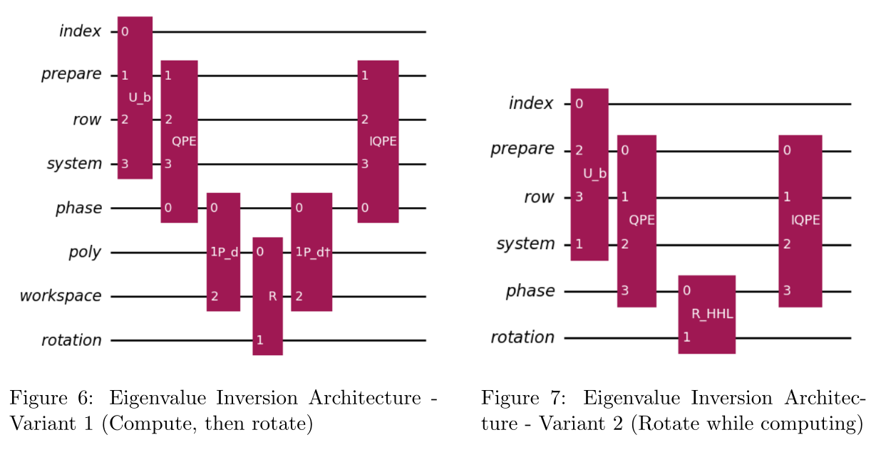
Eigenvalue Inversion Architecture (QPE)

Slide 14
QSVT Consumption & the Real-Part LCU
Phased iterates Rz(−2φₖ) alternate with U_enc; an outer LCU keeps the real part p(cos(tA))
QSVT layer structure
Rz(−2φ₀)
U_enc
Rz(−2φ₁)
U_enc
Rz(−2φ_{d})
be
⋯
sys
Real-part LCU wrapper
lc
H
H
|0⟩
QSVT(Φ)
QSVT(Φ)†
be,sys
Notes:
d = 40 → 80 U_enc queries (the outer LCU doubles), 82 Rz rotations, logical depth ≈ 177, 7 qubits total

Slide 15
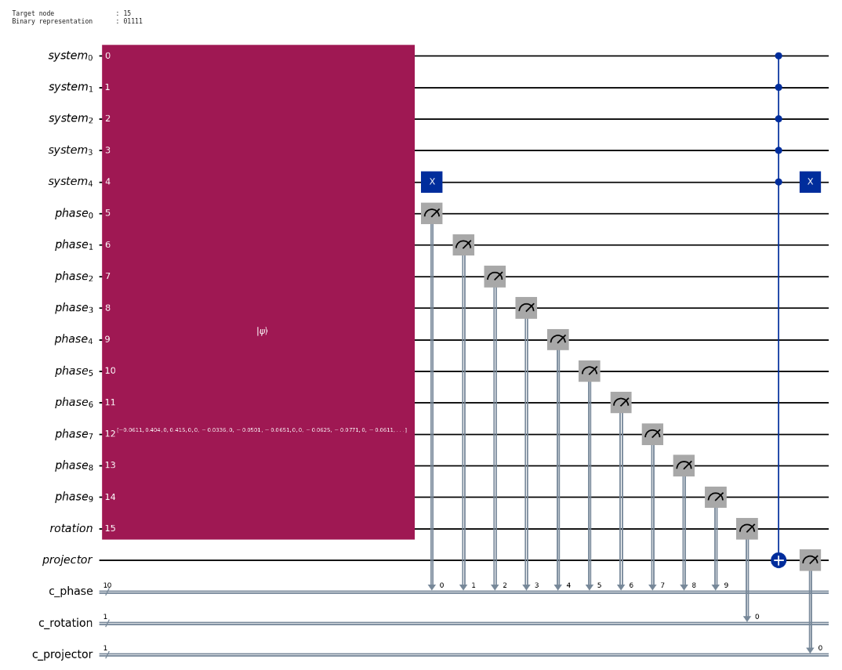
Measurement

Slide 16
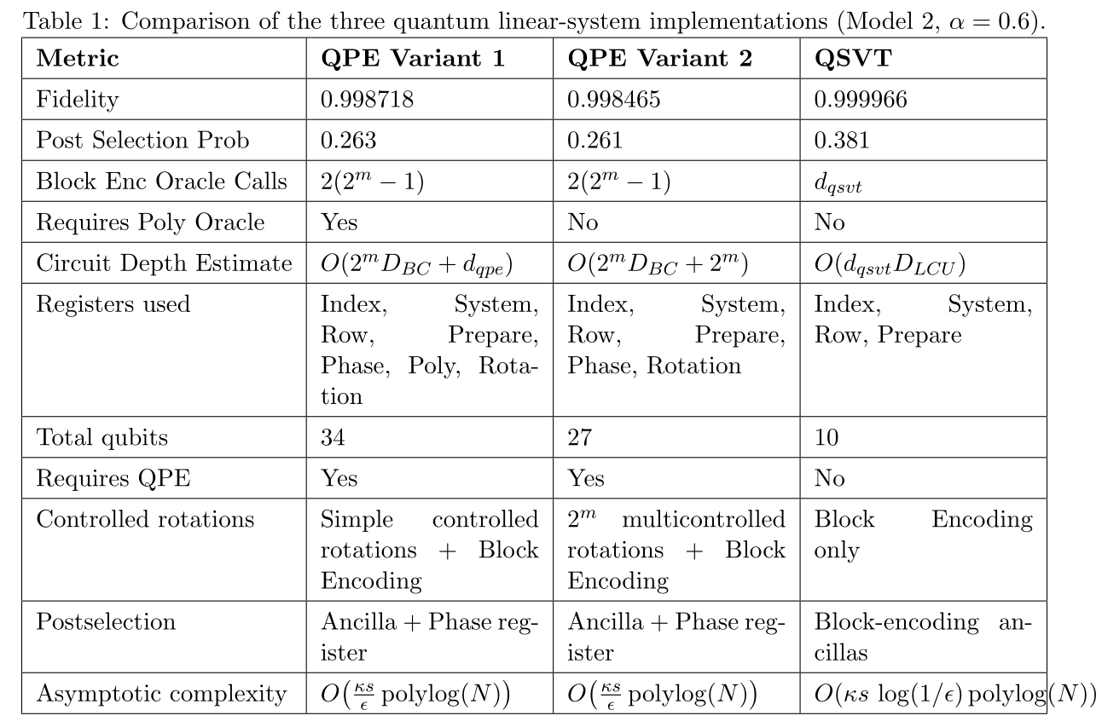
Results – Comparison and Discussion

Slide 17
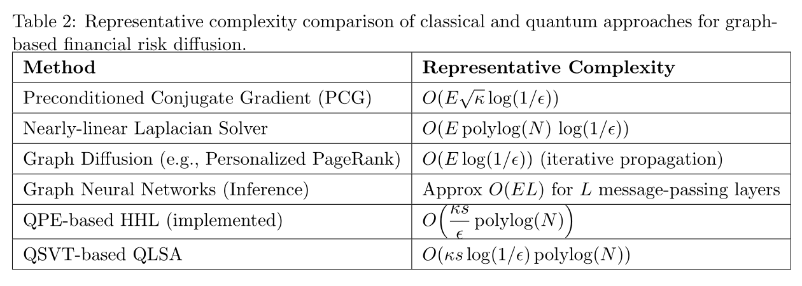
Complexity Comparison with Classical Methods

Slide 18
References (key)
[1] Harrow, Hassidim, Lloyd — Quantum algorithm for linear systems of equations, PRL 103, 150502 (2009).
[2] Childs, Wiebe — Hamiltonian simulation using linear combinations of unitary operations, QIC 12, 901 (2012).
[3] Low, Chuang — Hamiltonian simulation by qubitization, Quantum 3, 163 (2019).
[4] Gilyén, Su, Low, Wiebe — Quantum singular value transformation and beyond, STOC 2019.
[5] Xiaojin Zhu, Zoubin Ghahramani, and John D. Lafferty, Semi-supervised learning using gaussian fields and harmonic functions, (20th ICML), 2003, pp. 912–919.
[6] Berry, Childs, Cleve, Kothari, Somma — Truncated Taylor series simulation, PRL 114, 090502 (2015).
[7] Gleinig, Hoefler — An efficient algorithm for sparse quantum state preparation, DAC 2021.
[8] Berry, Childs — Black-box Hamiltonian simulation and unitary implementation, QIC 12, 29 (2012).
[9] Chakraborty, Gilyén, Jeffery — The power of block-encoded matrix powers, ICALP 2019.
[10] Camps, Van Beeumen — FABLE: fast approximate block-encodings, IEEE QCE 2022.
[11] Spielman, Teng — Nearly-linear time Laplacian solvers, STOC 2004.
[12] Sachdeva, Zhao — A simple and efficient parallel Laplacian solver, SPAA 2023.
[13] Alok Shukla and Prakash Vedula, An efficient quantum algorithm for preparation of uniform quantum superposition states, arXiv preprint arXiv:2306.11747 (2024).
[14] Dengyong Zhou, Olivier Bousquet, Thomas N. Lal, Jason Weston, and Bernhard Schölkopf, Learning with local and global consistency, Advances in Neural Information Processing Systems, vol. 16, 2004.
17

Slide 19
Questions?
18

Slide 20
Thank you!
19

Slide 21
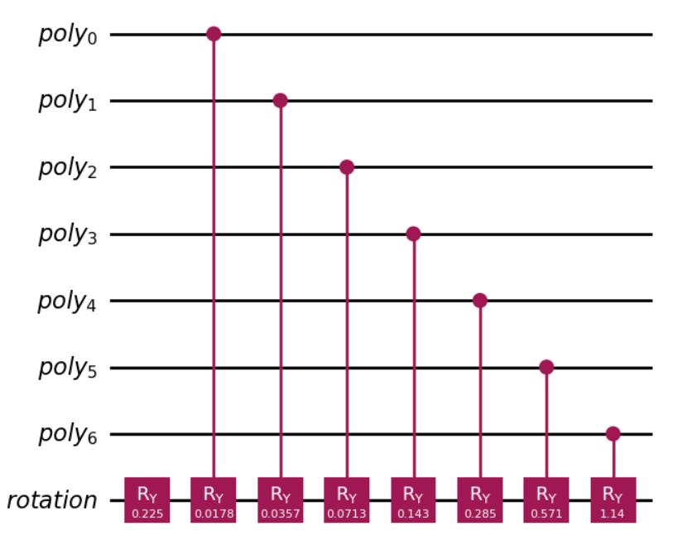

Slide 22
