Slide 1
The Influential Behavior of Social Media and AI
Presented by:
Cyarah Harris
CSIT 100 - Course Project

Slide 2
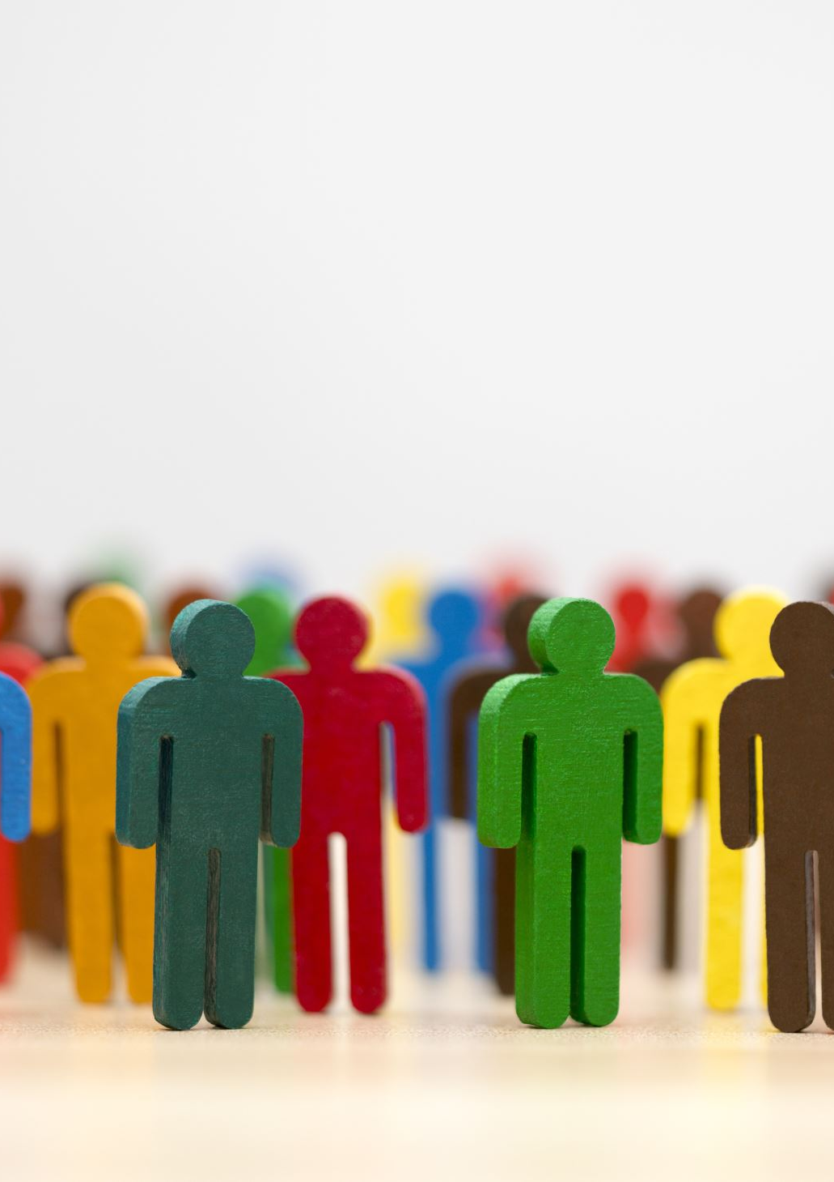
Purpose Introduction
Social media and AI have become central to communication and decision-making.
They shape opinions, buying habits, emotions, and even identity.
This presentation explores how and why they influence human behavior.

Slide 3
Growth of Social Media
Over 5 billion users worldwide
Platforms: Instagram, TikTok, YouTube, X, Facebook
Instant access to information (and misinformation)
Creates new social norms

Slide 4
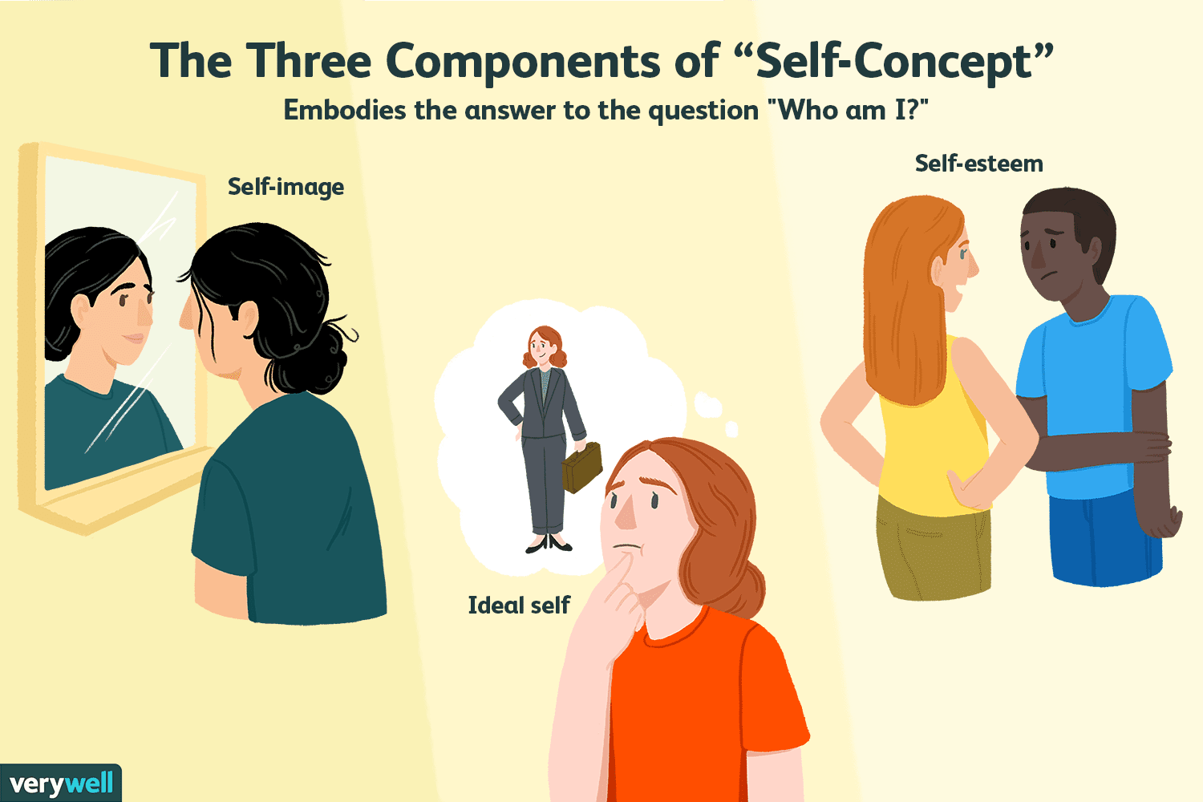
How Social Media Influences Behavior
Likes & comments create reward cycles
Social comparison affects self-image
Trends spread rapidly
Peer influence is magnified online
Self-concept is your overall view of yourself and who you are, including your beliefs, identity, and abilities.
It develops over time and can be influenced by experiences, relationships, culture, and feedback from others.
While self-concept tends to be fairly stable, you can improve yours through reflection, self-awareness, and effort.
Credits: Kendra Cherry
Self-Concept in Psychology: Definition, Development, Theories

Slide 5
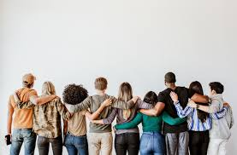
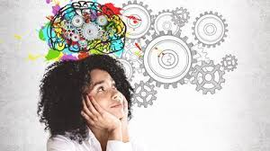

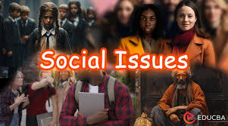
Positive Influences
Community building
Educational content
Awareness of social issues
Creative expression
https://www.lawgazette.co.uk/wellbeing/being-creative/5105745.article

Slide 6
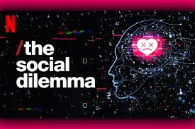
Netflix Documentary

Slide 7

What is Artificial Intelligence?
AI: systems that learn, predict, enhance, or automate tasks
Used in social media algorithms, recommendation systems, filters, and ads
Examples: ChatGPT, TikTok For You Page, Instagram Reels

Slide 8
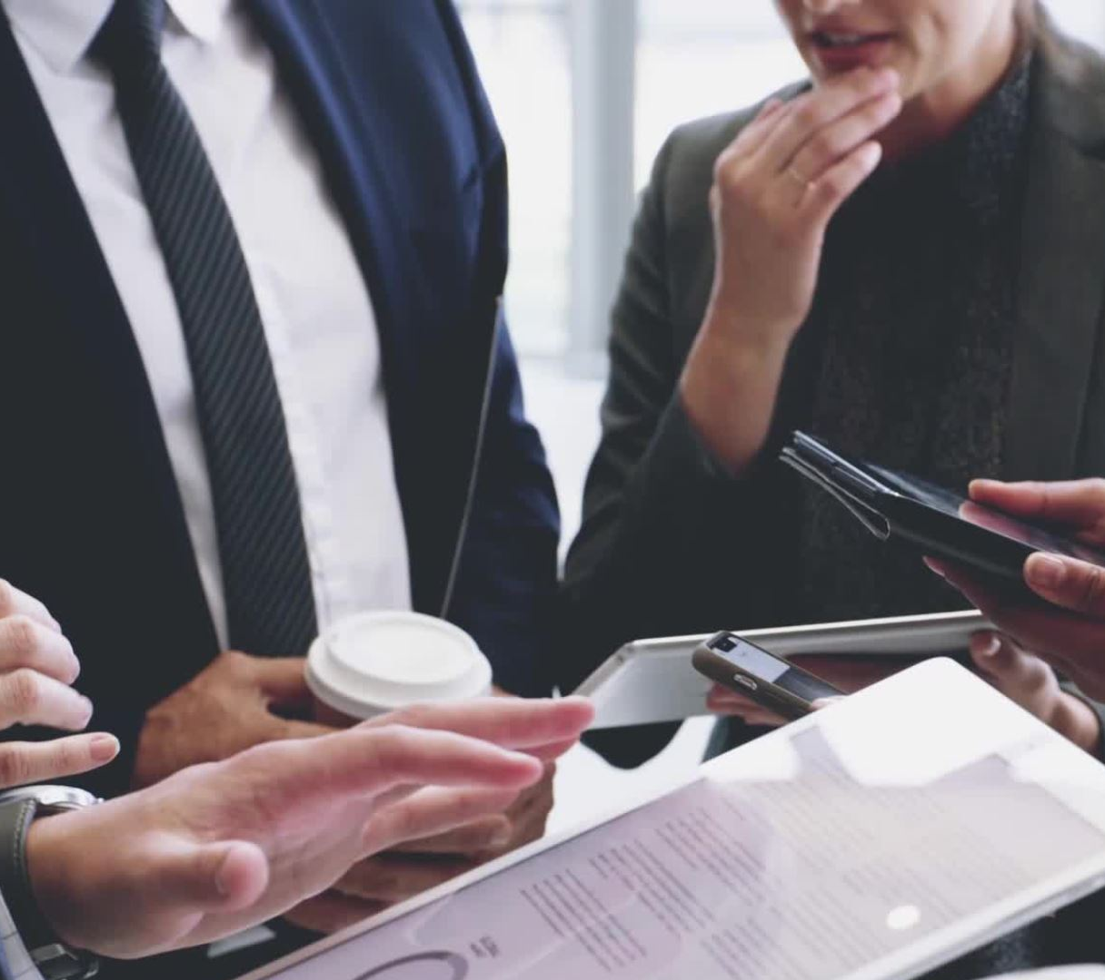
AI Influence on Behavior
AI predicts what users want to see
Personalized feeds shape opinions & interests
Influences consumer behavior (targeted ads)
Reinforces existing beliefs (echo chambers)

Slide 9
AI & Social Media Algorithms
Algorithms decide what appears in your feed
Content optimized for engagement
Leads to:
Addiction
Radicalization
Information bubbles
Behavior manipulation

Slide 10
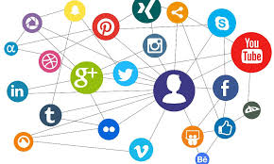
Real-World Examples
TikTok trends shaping fashion & music
Instagram filters influencing beauty standards
YouTube recommendations guiding political opinions
AI-generated influencers (“virtual influencers”)

Slide 11
How to Use Social Media & AI Responsibly
Check information sources
1
Limit screen time
2
Understand algorithm influence
3
Protect personal data
4
Follow diverse accounts to reduce bias
5

Slide 12
Conclusion
Social media + AI significantly influence human thoughts and actions
Effects can be positive or negative
Awareness leads to better, healthier digital habits
AI will continue shaping future behavior

