Slide 1

Aarakshan
Railway Reservation System
Leader Sowmiya N | Designer Giridhararajan | Tester Harrish M | Documentation Revathy N
Team Heisenberg
Notes:
Revathy || Aarakshan - Hindi for Reservation

Slide 2
Abstract
1
What the system aims to do?
Notes:
Revathy

Slide 3
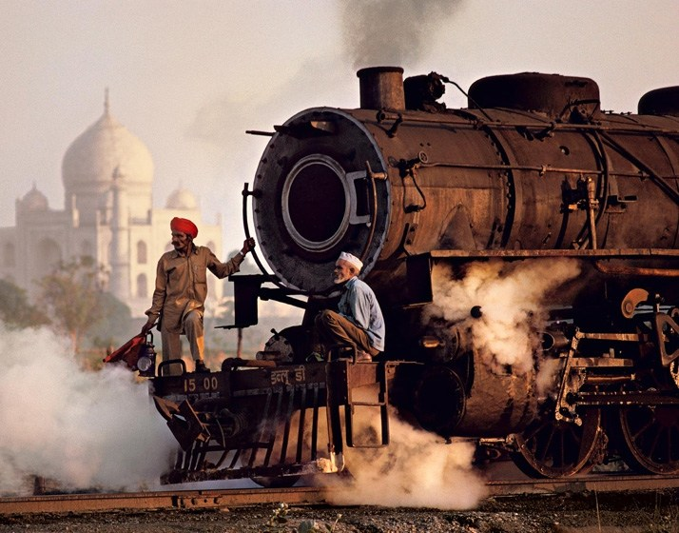
INDIA - 4th Largest Railway Network in the world
Notes:
Revathy

Slide 4
22 million passengers
3,32,619 trains
1.331 million employees
Everyday!
70,241 passenger coaches
World’s 8th largest employer
Notes:
Revathy

Slide 5
Abstract
Computerization reduces complexity of handling huge data
Users - Passengers
Enquire
Reserve
Tatkal
Cancel
Admin - Railway
Update
Retrieve
Moderate
Notes:
Revathy

Slide 6
GOALS
For Development
Notes:
Giri

Slide 7
On the go!
MOBILE APP
- Android
- Java + XML

Slide 8
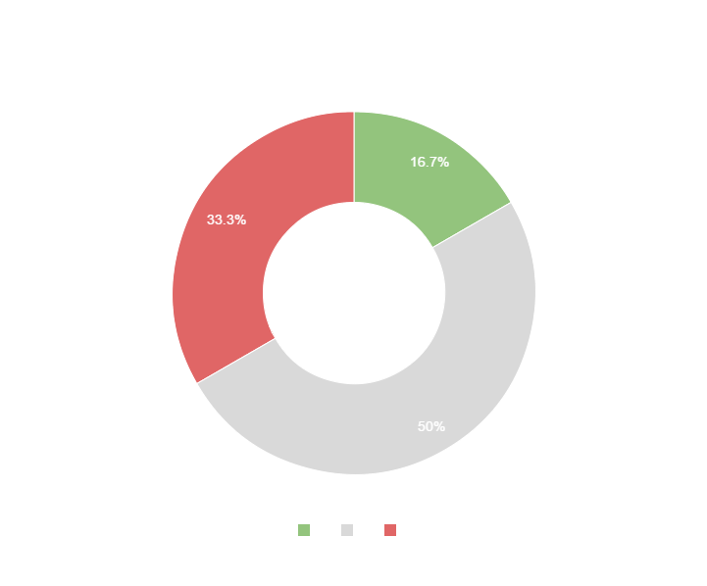
PC SOFTWARE
- windows
- Front-end:Python GUI
- Back-end:DBMS
Notes:
Harrish

Slide 9
Just a URL away!
WEB-APP
- HTML/CSS/JS
- Node.js/Express
Notes:
Sowmiya

Slide 10
PostgreSQL
Supported by a PaaS provider Hasura/Heroku
- APIs and deployment
Notes:
Sowmiya

Slide 11
Modules
3
Notes:
Giri

Slide 12
POSSIBLE MODULES
Users
Admin
UI
Trains, Stations and Route Details
Manage Functionality
Reservation Details
Data
Logic
User and Admin Details
Retrieve necessary normal/derived data
Notes:
UI - Giri || Data - Harrish || Logic - Revathy

Slide 13
ER Diagram
3
Notes:
Sowmiya

Slide 14
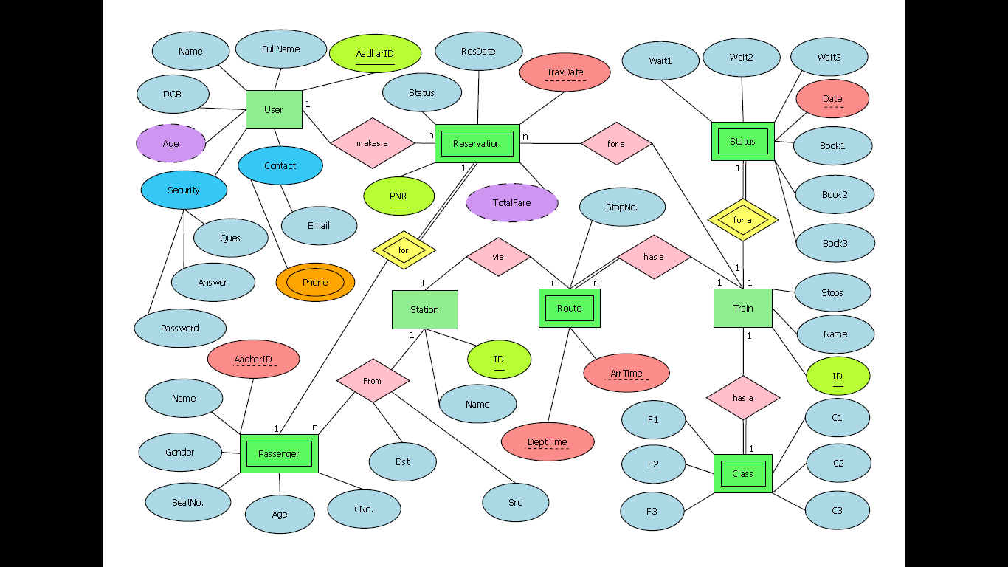
YOU CAN ALSO SPLIT YOUR CONTENT
Notes:
Sowmiya

Slide 15
Schema Diagram
3
Notes:
Harrish

Slide 16
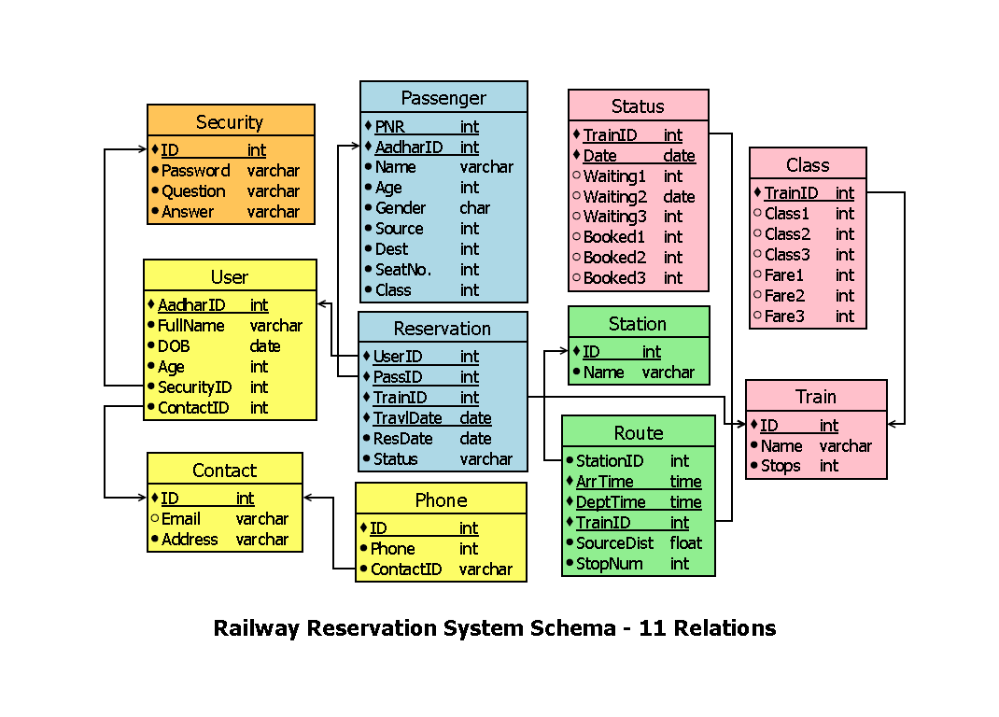
Notes:
Harrish

Slide 17
Relations - 11 tables
Security(ID, Password, Question, Answer);
Passenger(AadharID,Name,Age,Gender);
Status(TrainID,Date,Waiting1,Waiting2,Waiting3,Booked1,Booked2,Booked3);
Class(Train ID,Class1,Class2,Class3,Fare1,Fare2,Fare3);
User(AadharID,Fullname,DOB,Age,SecurityID,ContactID);
Reservation(UserID,PassID,TravlDate,ResDate,Status);
Station(ID,Name);
Train(ID,Name,Stops);
Contact(ID,Email,Address);
Phone(ID,Phone,ContactID);
Route(StationID,ArrTime,DeptTime,TrainID,StopNum);
Notes:
Giri

Slide 18
Admin permissions

Slide 19
Permission classes
Master Admin
CRUD - Including user moderation
Route Admin
RU - Train, Routes and Station
Accounts Admin
RU - Reservation, Passenger, User, Class

Slide 20
Updated Schema

Slide 21
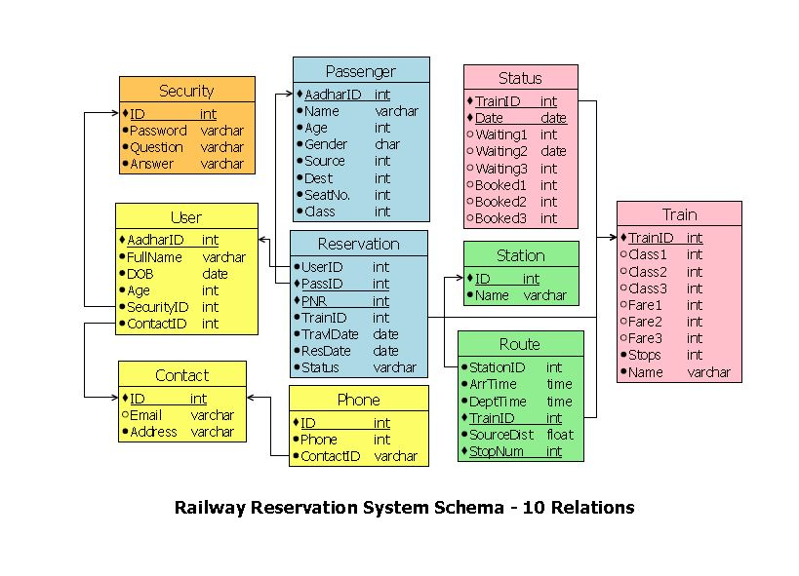

Slide 22
Canonical Cover
SID → (Password, Question, Answer)
AadharID → (FullName, DOB, Age, SID, CID)
CID → (Email, Address)
AadharID → (Name, Age, Gender, Source, Dest, SeatNo, Class)
PassID, PNR → (UserID, TID, TravlDate, ResDate, Status)
PID → (Phone, CID)
TID, Date → (Waiting1, Waiting2, Waiting3, Booked1, Booked2, Booked3)
StID → Name
TID, StopNum → (StationID, ArrTime, DeptTime, TID, SourceDist)
TID → (Class1, Class2, Class3, Fare1, Fare2, Fare3, Name, Stops)

Slide 23
Thanks!

