Slide 1

Mepco Schlenk Engineering College (Autonomous)
ONLINE EYEWEAR STORE
Gowtham Babu E (Reg. No. : 22004039)
Harrish Ragavendar S (Reg. No. : 202004044)
Department of Computer Science and Engineering
1

Slide 2
Mepco Schlenk Engineering College (Autonomous)
1. Problem Description
The need for an online eyewear store has increased over the years due to several factors.
Firstly, people have become more tech-savvy and prefer to shop online, as it offers convenience and saves time.
Secondly, the eyewear industry is growing rapidly, and customers are looking for a wider range of products, styles, and designs to choose from. An online eyewear store can offer a more extensive range of products as compared to a physical store.
The online eyewear store project aims to provide a convenient and hassle-free way for customers to purchase high-quality eyewear products from the comfort of their own homes.
The website will offer a wide range of eyewear products, including prescription glasses, sunglasses, contact lenses, and other accessories.
Department of Computer Science and Engineering
2

Slide 3
Mepco Schlenk Engineering College (Autonomous)
2. Objective
To create an user-friendly and convenient platform for customers to purchase high-quality eyewear products online.
To offer a wide range of eyewear products, including prescription glasses, sunglasses, contact lenses, and other accessories.
To ensure a safe shopping experience, the project aims to offer secure payment gateways and provide excellent customer service, including prompt responses to customer queries and timely resolution of issues.
Department of Computer Science and Engineering
3

Slide 4
Mepco Schlenk Engineering College (Autonomous)
To offer high-quality products, personalized recommendations, and excellent customer service, the project aims to increase brand awareness and loyalty while generating revenue for the business.
Ultimately, the objective of the online eyewear store project is to provide customers with a seamless and hassle-free shopping experience, increasing customer satisfaction and loyalty.
Department of Computer Science and Engineering
4

Slide 5
Mepco Schlenk Engineering College (Autonomous)
3. Outcome
Building an online eyewear store website in Angular can bring numerous benefits to your business. Angular is a popular JavaScript framework that is used to build scalable and robust web applications. Some of the benefits of building an online eyewear store website in Angular include:
1. Increased Revenue: An online store can help increase revenue by providing a more extensive reach to potential customers beyond your physical location. Customers can purchase products anytime and anywhere, which can result in more sales.
2. Improved Customer Experience: An online eyewear store can offer an improved customer experience, such as personalized product recommendations, easy browsing and selection of products, and quick and convenient checkout. These can help to create a loyal customer base and increase repeat purchases.
Department of Computer Science and Engineering
5

Slide 6
Mepco Schlenk Engineering College (Autonomous)
3. Better Inventory Management: An online store can help with better inventory management, as the real-time tracking of inventory can help to minimize stockouts and reduce overstocking.
4. Easier Management of Customer Data: Online stores can provide insights into customer behaviour and preferences, which can be used to improve the marketing and sales strategies. This data can help businesses to tailor their products and services to customer needs and preferences, leading to higher customer satisfaction and sales.
5. Increased Brand Awareness: An online store can help increase brand awareness, as it allows businesses to reach a wider audience and attract new customers. This can help to establish the business as a reputable brand in the eyewear industry and create a loyal customer base.
Department of Computer Science and Engineering
6

Slide 7
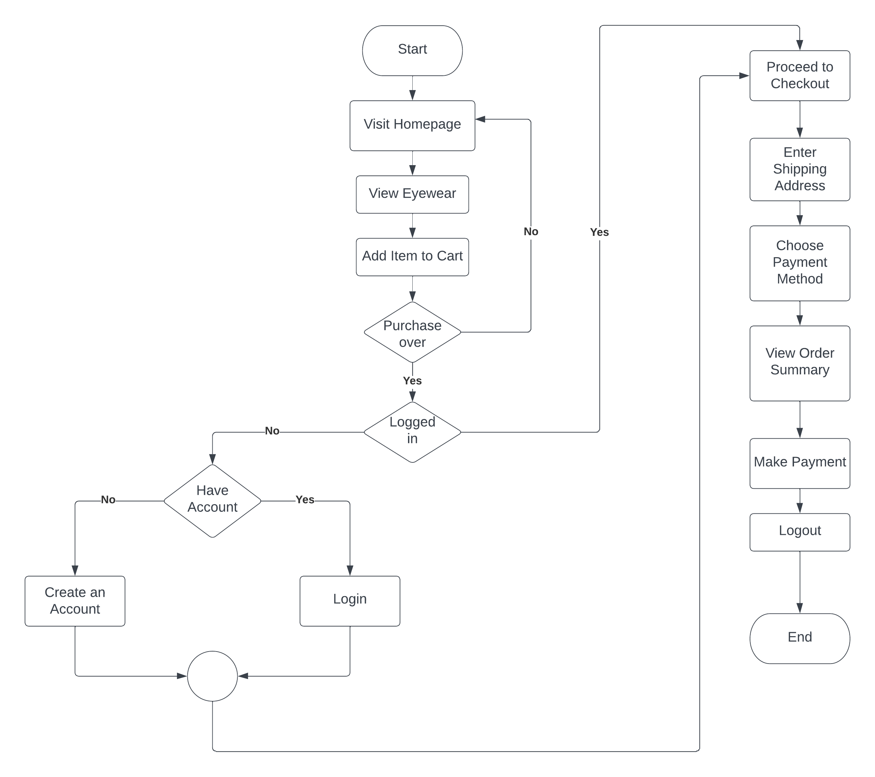
Mepco Schlenk Engineering College (Autonomous)
4. Flow Diagram
Figure 4.1: Flow Diagram of Online Eyewear Store Website
Department of Computer Science and Engineering
7

Slide 8
Mepco Schlenk Engineering College (Autonomous)
Architectural flow diagram implies the flow of the system. Figure 4.1 depicts the architectural flow diagram for the Online Eyewear Store website.
The detailed explanation of the flow diagram is as follows:
The flow starts with the user visiting the homepage of the website.
The user can view the various kind of eyewear that are available.
The user can also view the detailed description of each eyewear.
The user can add the eyewear to the cart that he/she wishes to buy.
Once the eyewear is added to the cart, the user can also change the quantity of the eyewear that he/she wishes to buy, that is it can be incremented or decremented.
The user can then return to the home page and buy furthermore eyewear.
Department of Computer Science and Engineering
8

Slide 9
Mepco Schlenk Engineering College (Autonomous)
Once the user has added all the desired eyewear to the cart with the desired quantity, the system checks whether the user is logged in or not.
If the user is already logged in, the user proceeds to checkout page.
Else, the user is taken to the login page to login to the lensmakers website.
If the user is a new user, then the user is taken to the registration page for creating a new account.
Then, the user proceeds to check out and enters the shipping address of the products.
Then the user chooses the desired payment method, and the order summary is shown to the user.
Then the user makes payment online if he has chosen the PayPal option, else the user confirms the order in case of COD option.
Department of Computer Science and Engineering
9

Slide 10
Mepco Schlenk Engineering College (Autonomous)
5. Modules
Listed below gives a description of database document schemas used for Online Eyewear Store.
Table 5.1: User Description
Attribute Name | Type | Constraint(s) | Description
User ID | String | UNIQUE | Autogenerated for each user, when a new user registers in the website
Name | String | NOT NULL | Name of the user
Email-ID | String | Must be of the form <username>@<mailserver>.<domain> UNIQUE, NOT NULL | E-Mail ID of the User
Password | String | NOT NULL | Password which the user uses to login to the website
IsAdmin | Boolean | NOT NULL | Indicates whether the user has admin privileges
Department of Computer Science and Engineering
10

Slide 11
Mepco Schlenk Engineering College (Autonomous)
Table 5.2: Product Description
Attribute Name | Type | Constraint(s) | Description
Product ID | String | UNIQUE | Autogenerated for each product, when it is added to the database
Name | String | NOT NULL | Name of the product
Slug | String | UNIQUE | Used to navigate to the product description page of that product
Image | String | NOT NULL | Path to the image of the eyewear
Brand | String | NOT NULL | Brand of the eyewear
Category | String | NOT NULL | Type of eyewear
Description | String | NOT NULL | Detailed description about the eyewear
Price | Number | NOT NULL | Price of the eyewear
Count in stock | Number | NOT NULL | Number of that particular eyewear currently in stock
Rating | Number | NOT NULL | Star rating out of 5
Number of reviews | Number | NOT NULL | Total number of reviews for that eyewear
Reviews | Array | NOT NULL | Collection of usernames, with their corresponding rating and comments
Department of Computer Science and Engineering
11

Slide 12
Mepco Schlenk Engineering College (Autonomous)
Table 5.3: Review Description
Attribute Name | Type | Constraint(s) | Description
Name | String | NOT NULL | Name of the user
Rating | Number | NOT NULL | Star rating out of 5
Comment | String | NOT NULL | Comment provided by the user
Department of Computer Science and Engineering
12

Slide 13
Mepco Schlenk Engineering College (Autonomous)
Table 5.4: Order Description
Attribute Name | Type | Constraint(s) | Description
Order ID | String | UNIQUE | Autogenerated for each order, when it is added to the database
Products | Array | NOT NULL | Name of the user
Shipping Address | Object | NOT NULL | Delivery address for the order
User ID | String | NOT NULL | Comment provided by the user
Payment Method | String | NOT NULL | Way by which customer makes payment for the purchase
Items Price | Number | NOT NULL | Price of all the items the customer has purchased
Shipping Price | Number | NOT NULL | Shipping charges for the purchase
Tax Price | Number | NOT NULL | Tax for the purchase
Total Price | Number | NOT NULL | Total price including the items price, shipping charges and the tax price
IsPaid | Boolean | NOT NULL | Indicates whether the payment has been made or not
Payment Result | Object |  | Status of the payment
paidAt | Timestamp |  | Exact time at which payment is made
IsDelivered | Boolean |  | Indicates whether the product has been delivered or not
deliveredAt | Timestamp |  | Exact time at which order is delivered
Department of Computer Science and Engineering
13

Slide 14
Mepco Schlenk Engineering College (Autonomous)
Table 5.5: Shipping Address Description
Attribute Name | Type | Constraint(s) | Description
Full Name | String | NOT NULL | Full name of the customer
Address | String | NOT NULL | Street address and area
City | String | NOT NULL | Delivery City
State | String | NOT NULL | Delivery State
Postal Code | String | NOT NULL | PIN code of delivery address
Country | String | NOT NULL | Delivery country
Department of Computer Science and Engineering
14

Slide 15
Mepco Schlenk Engineering College (Autonomous)
Table 5.6: Payment Description
Attribute Name | Type | Constraint(s) | Description
Payment ID | String | UNIQUE | ID generated for each payment
Status | String | NOT NULL | Current state of the payment
Department of Computer Science and Engineering
15

Slide 16
Mepco Schlenk Engineering College (Autonomous)
The various modules available in the Online Eyewear Store are as follows:
Login Module
Register Module
Search Eyewear Module
Search by Category Module
Add Eyewear Module
Edit Eyewear Module
Delete Eyewear Module
Add to Cart Module
Place Order Module
Make Payment Module
Edit User Module
Delete User Module
Department of Computer Science and Engineering
16

Slide 17
Mepco Schlenk Engineering College (Autonomous)
5.1. Login Module
Table 5.7 Login Module Description
Files used | login.component.html, login.component.ts, auth.service.ts, user.routes.ts
Short Description | Allows the user to login to the online eyewear store website
Arguments | E-Mail ID, Password
Return | Success/Failure in login
Pre-Condition | The user must have an account in the website
Post-Condition | The home page of the online eyewear store will be displayed
Exception | Invalid E-Mail ID or password
Actors | Admin, User
Collections used | Users collection
Department of Computer Science and Engineering
17

Slide 18
Mepco Schlenk Engineering College (Autonomous)
5.2. Register Module
Table 5.8 Register Module Description
Files used | register.component.html, register.component.ts, user.service.ts, user.routes.ts
Short Description | Allows the user to create a new account in the online eyewear store website
Arguments | Name, E-Mail ID, Password, Confirm Password
Return | Success/Failure in registration
Pre-Condition | The user must not have an account with the e-mail id
Post-Condition | The home page of the online eyewear store will be displayed
Exception | Invalid e-mail or Weak password
Actors | User
Collections used | Users collection
Department of Computer Science and Engineering
18

Slide 19
Mepco Schlenk Engineering College (Autonomous)
5.3. Search Eyewear Module
Table 5.9 Search Eyewear Module Description
Files used | search.component.html, search.component.ts, product.routes.ts, product.service.ts
Short Description | Allows the user to search an eyewear based on the name of the eyewear
Arguments | Eyewear Name
Return | Eyewear Details/Eyewear Not Found
Pre-Condition | The user must know the correct name of the eyewear that he is going to search for
Post-Condition | All the eyewear that contains the search term in its name is displayed to the user
Exception | No matching eyewear
Actors | User
Collections used | Products collection
Department of Computer Science and Engineering
19

Slide 20
Mepco Schlenk Engineering College (Autonomous)
5.4. Search by Category Module
Table 5.10 Search by Category Module Description
Files used | search.component.html, search.component.ts, product.routes.ts, product.service.ts
Short Description | Allows the user to search an eyewear based on the category of the eyewear
Arguments | Eyewear Category
Return | List of Eyewear Details/Eyewear Not Found
Pre-Condition | The user must know the category or the class of the eyewear that he wishes to buy
Post-Condition | All the eyewear that belongs to the selected category is displayed to the user.
Exception | No matching eyewear in the selected category
Actors | User
Collections used | Products collection
Department of Computer Science and Engineering
20

Slide 21
Mepco Schlenk Engineering College (Autonomous)
5.5. Add Eyewear Module
Table 5.11 Add Eyewear Module Description
Files used | admin-product-edit.component.html, admin-product-edit.component.ts, product.service.ts, product.routes.ts, admin.guard.ts
Short Description | Allows the admin to add new eyewear to the online eyewear store website
Arguments | Name, Slug, Price, Path to Image, Brand, Category, Count in stock, Description
Return | Success/Failure in adding new eyewear
Pre-Condition | The admin must be logged in to the website
Post-Condition | The eyewear inventory page of the online eyewear store will be displayed
Exception | Duplicate slug or Invalid path to image
Actors | Admin
Collections used | Products collection, User Collection
Department of Computer Science and Engineering
21

Slide 22
Mepco Schlenk Engineering College (Autonomous)
5.6. Add to Cart Module
Table 5.12 Add to Cart Module Description
Files used | cart.component.html, cart.component.ts, cart.service.ts, product.routes.ts
Short Description | Allows the user add eyewear to the cart in the online eyewear store website
Arguments | Eyewear name, quantity
Return | Success/Failure adding eyewear to cart
Pre-Condition | The user must be logged in to the website
Post-Condition | The cart page of the online eyewear store will be displayed
Exception | Product out of stock
Actors | User
Collections used | Products collection, Users Collection
Department of Computer Science and Engineering
22

Slide 23
Mepco Schlenk Engineering College (Autonomous)
5.7. Place Order Module
Table 5.13 Place Order Module Description
Files used | place-order.component.html, place-order.component.ts, order.routes.ts, cart.service.ts, order.service.ts
Short Description | Allows the user to login to the online eyewear store website
Arguments | Eyewear name, Quantity, Shipping Address, Payment Method
Return | Success/Failure in placing order
Pre-Condition | The user must be logged in to the website
Post-Condition | The order summary page of the online eyewear store will be displayed
Exception | Invalid shipping address or Product out of stock
Actors | User
Collections used | Orders collection, Users Collection
Department of Computer Science and Engineering
23

Slide 24
Mepco Schlenk Engineering College (Autonomous)
5.8. Make Payment Module
Table 5.14 Make Payment Module Description
Files used | payment-method.component.html, payment-method.component.ts, order.routes.ts, auth.guard.ts, auth.service.ts
Short Description | Allows the user to make payment for an order placed in the online eyewear store website
Arguments | Order ID, Amount, PayPal E-Mail, PayPal Password
Return | Success/Failure in payment
Pre-Condition | The user must be logged in to the website
Post-Condition | The payment status for the order will be displayed to the user
Exception | Invalid PayPal E-Mail or Password
Actors | User
Collections used | Orders collection, Payment Collection
Department of Computer Science and Engineering
24

Slide 25
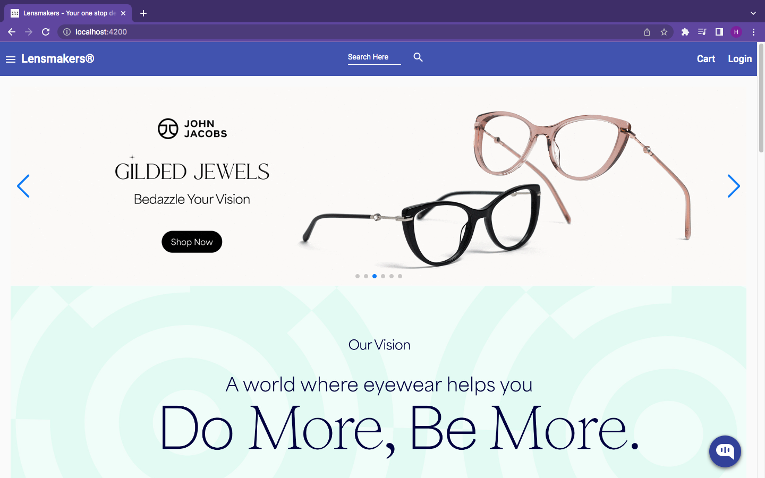
Mepco Schlenk Engineering College (Autonomous)
6. Results
Figure 6.1: Home Page of Online Eyewear Store
Department of Computer Science and Engineering
25

Slide 26
Mepco Schlenk Engineering College (Autonomous)
Figure 6.1 provides the interface for home page of the website. The user can select form a wide range of eyewear available in the homepage. There is also a search feature to search for a particular eyewear from the website. Also, a filter by category option is available in the side menu, to filter out eyewear based on specific category, for example sunglasses or power glasses.
Department of Computer Science and Engineering
26

Slide 27
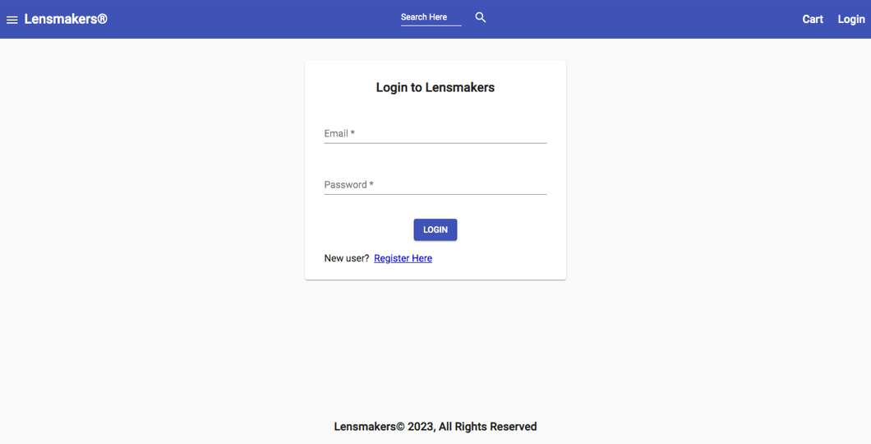
Mepco Schlenk Engineering College (Autonomous)
Figure 6.2: Login Page of Online Eyewear Store
Department of Computer Science and Engineering
27

Slide 28
Mepco Schlenk Engineering College (Autonomous)
Figure 6.2 provides the interface for login page of the website. If the login e-mail and password are valid, the user is allowed to login to the website. If the user is a new user there is also a register link embedded in the page which takes the user to the registration page.
Department of Computer Science and Engineering
28

Slide 29
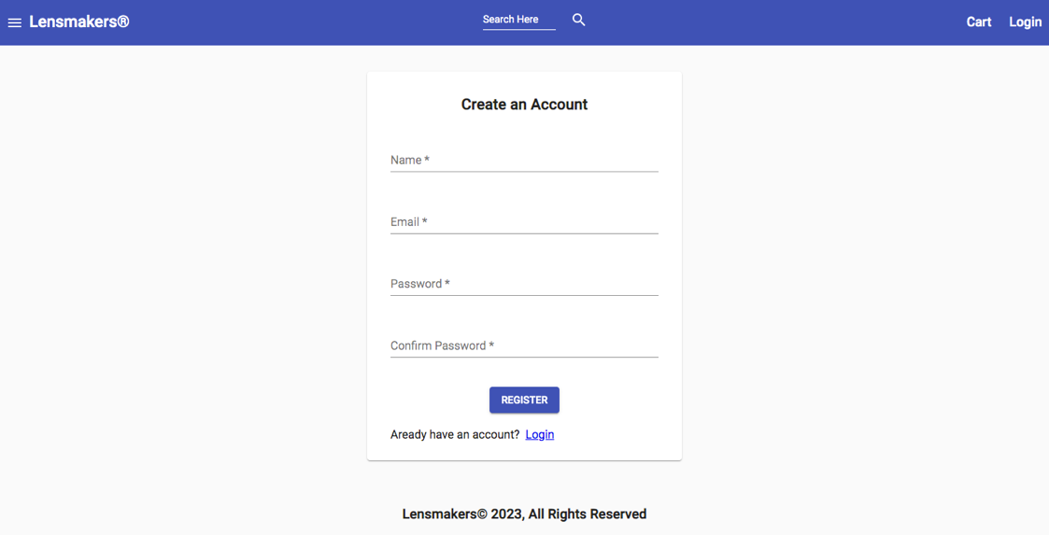
Mepco Schlenk Engineering College (Autonomous)
Figure 6.3: Register Page of Online Eyewear Store
Department of Computer Science and Engineering
29

Slide 30
Mepco Schlenk Engineering College (Autonomous)
Figure 6.3 provides the interface for new user registration page of the website. The user can create a new account in the website by using his/her e-mail address, provided the e-mail doesn’t already exist on the database. If the user already has an account, then the user is taken to the login page where the user can login with his/her existing e-mail and password.
Department of Computer Science and Engineering
30

Slide 31
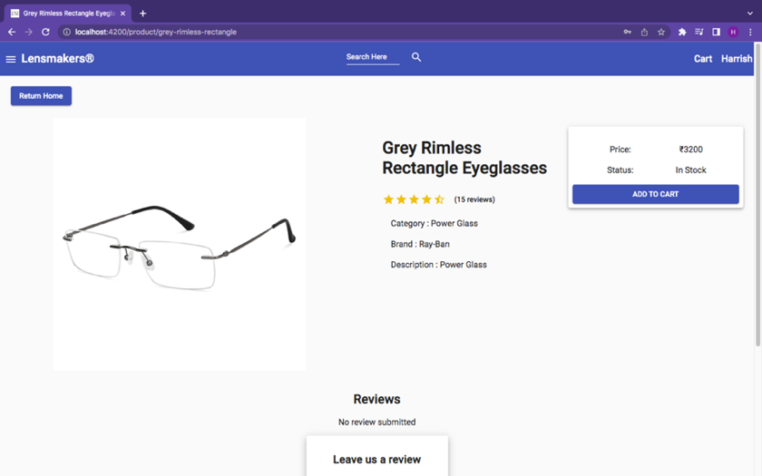
Mepco Schlenk Engineering College (Autonomous)
Figure 6.4: Product Details Page of Online Eyewear Store
Department of Computer Science and Engineering
31

Slide 32
Mepco Schlenk Engineering College (Autonomous)
Figure 6.4 provides the detailed information about an eyewear. It contains the name of the eyewear, category of the eyewear, brand of the eyewear, price of the eyewear, short description about the eyewear, stock status of the eyewear, star rating out of 5, number of reviews. The user can also submit a star rating and review for the eyewear. Add to cart button is provided in the website, which the user can use to add the product to his/her cart, provided the item is in stock, for purchase.
Department of Computer Science and Engineering
32

Slide 33
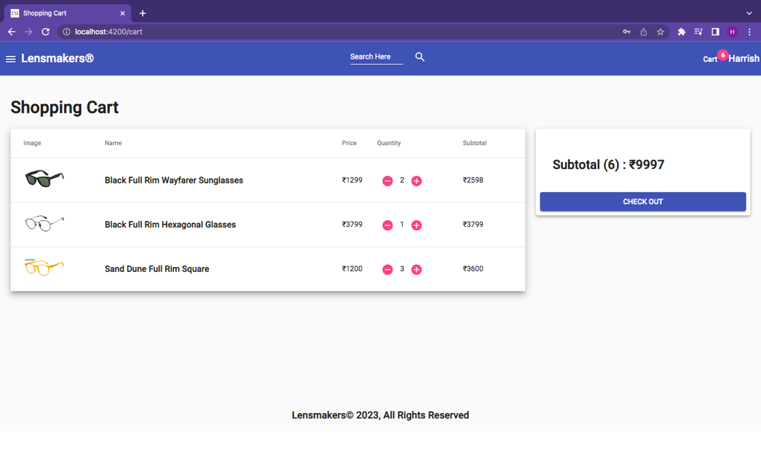
Mepco Schlenk Engineering College (Autonomous)
Figure 6.5: Cart Page of Online Eyewear Store
Department of Computer Science and Engineering
33

Slide 34
Mepco Schlenk Engineering College (Autonomous)
Figure 6.5 provides the cart page of the website. This page displays all the eyewear that the user has added to his/her cart with the eyewear name, preview image and its price. The user can also increment or decrement the quantity of the eyewear in the cart page. After completing the process, the user can proceed to checkout.
Department of Computer Science and Engineering
34

Slide 35
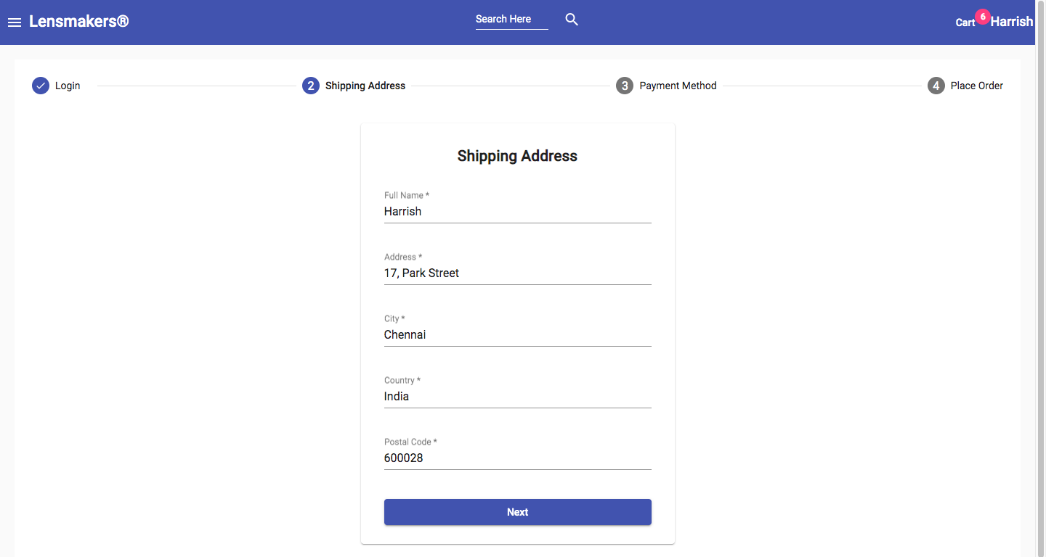
Mepco Schlenk Engineering College (Autonomous)
Figure 6.6: Shipping Address Page of Online Eyewear Store
Department of Computer Science and Engineering
35

Slide 36
Mepco Schlenk Engineering College (Autonomous)
Figure 6.6 provides the shipping address page of the website. The user must fill the billing name along with the complete address with postal code for the successful delivery of the package.
Department of Computer Science and Engineering
36

Slide 37
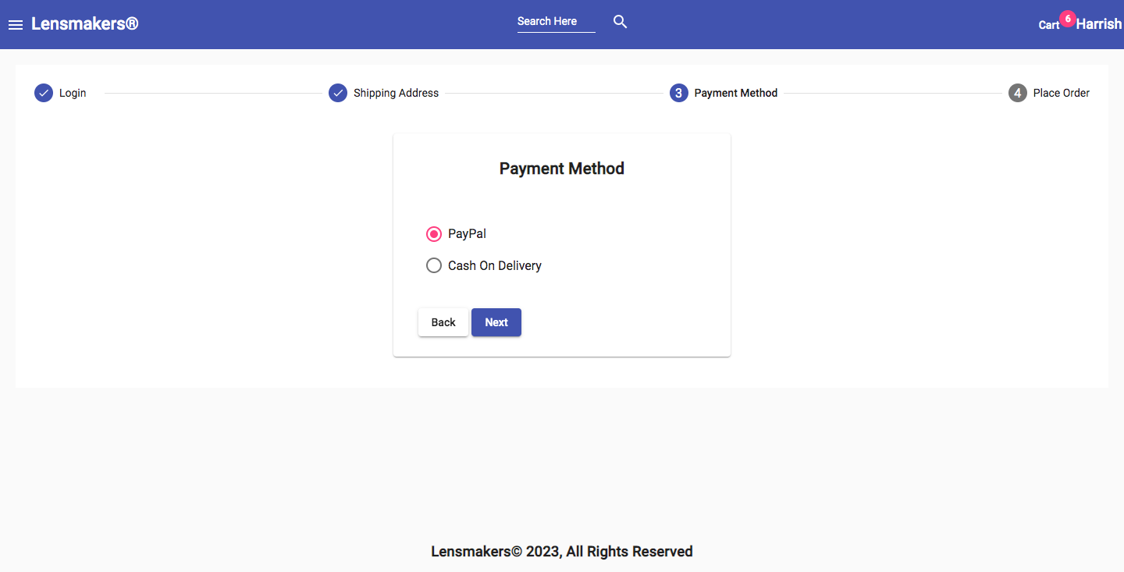
Mepco Schlenk Engineering College (Autonomous)
Figure 6.7: Payment Method Page of Online Eyewear Store
Department of Computer Science and Engineering
37

Slide 38
Mepco Schlenk Engineering College (Autonomous)
Figure 6.7 provides the payment method page of the website. The user can choose to pay through the PayPal payment gateway or the Cash on Delivery option.
Department of Computer Science and Engineering
38

Slide 39
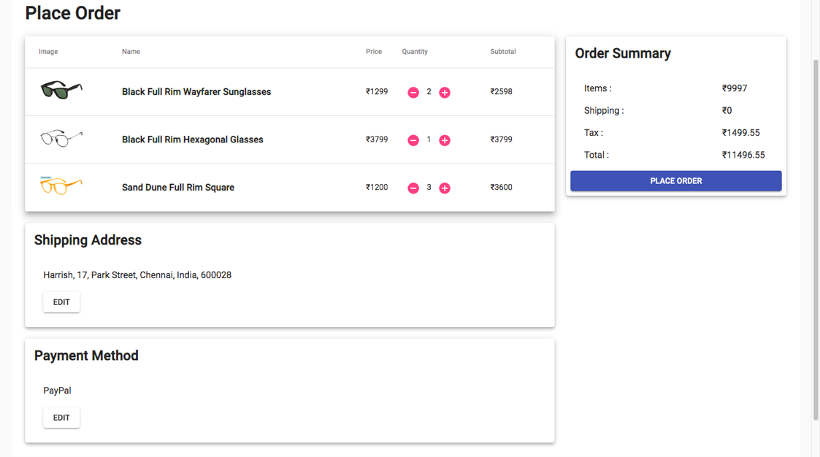
Mepco Schlenk Engineering College (Autonomous)
Figure 6.8: Place Order Page of Online Eyewear Store
Department of Computer Science and Engineering
39

Slide 40
Mepco Schlenk Engineering College (Autonomous)
Figure 6.8 provides the place order page of the website. The user can still increment or decrement the quantity of eyewear that he/she has finally checked out. The user can also edit the shipping address or the mode of payment. Once the user has confirmed all the details, he/she can click the place order button to confirm the order.
Department of Computer Science and Engineering
40

Slide 41
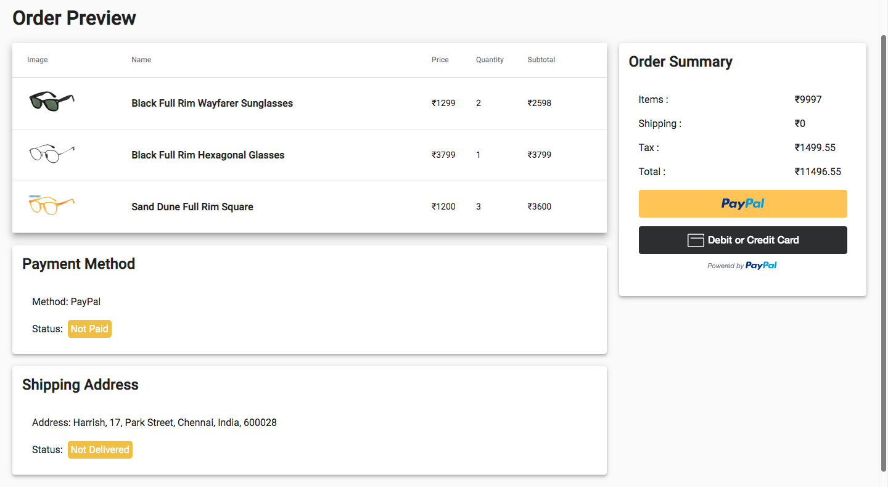
Mepco Schlenk Engineering College (Autonomous)
Figure 6.9: Order Summary Page of Online Eyewear Store
Department of Computer Science and Engineering
41

Slide 42
Mepco Schlenk Engineering College (Autonomous)
Figure 6.9 provides the order summary page of the website. This page displays all the eyewear purchased by the user, with the preview image, eyewear name, price and quantity. It also displays the item price, tax and total amount of the purchase. The user can make payment through the PayPal Payment gateway or using his/her debit/credit card.
Department of Computer Science and Engineering
42

Slide 43
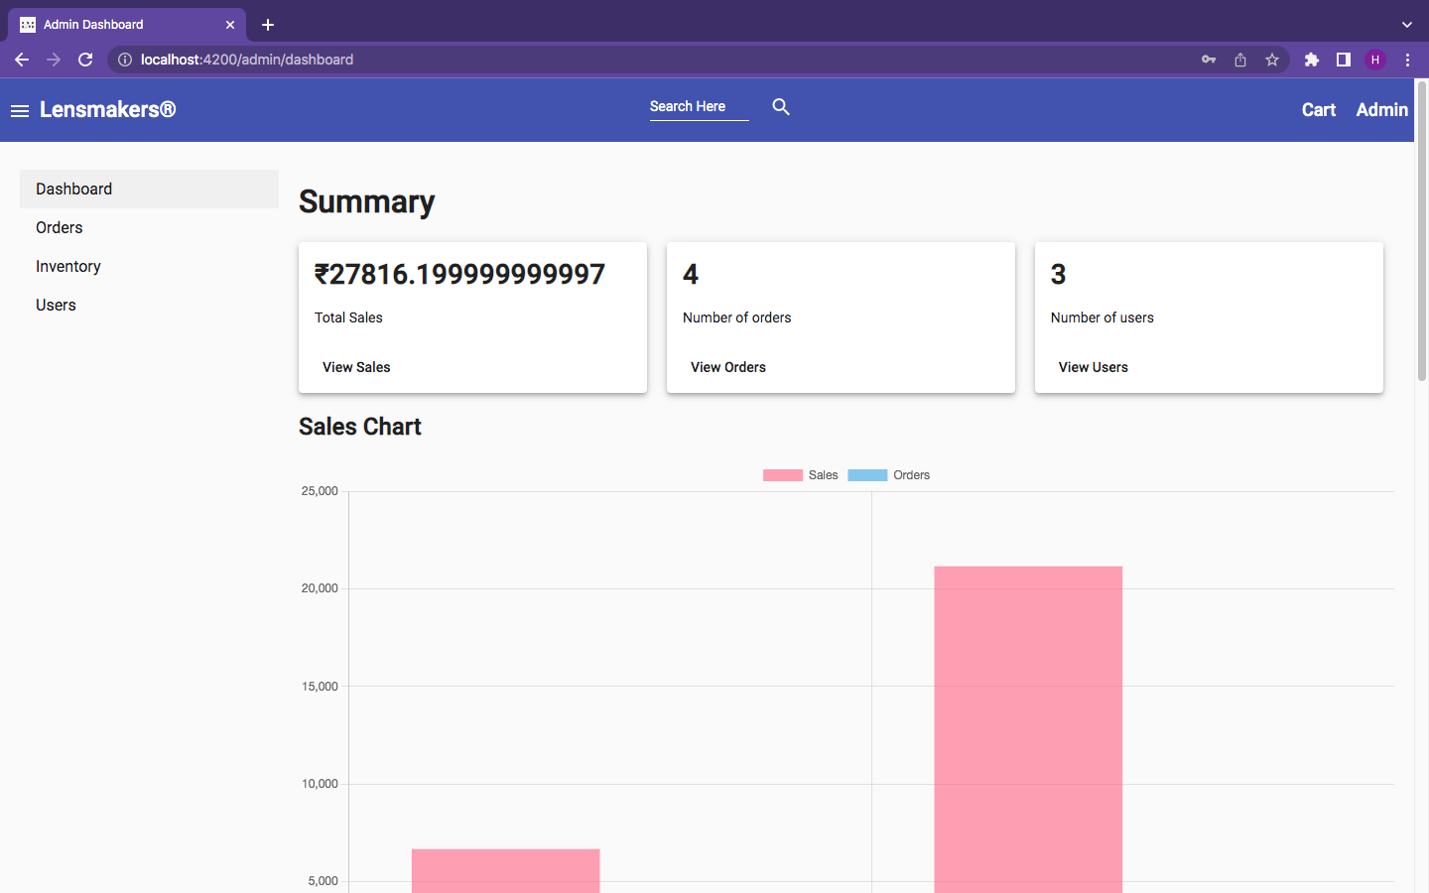
Mepco Schlenk Engineering College (Autonomous)
Figure 6.10: Admin Dashboard Page of Online Eyewear Store
Department of Computer Science and Engineering
43

Slide 44
Mepco Schlenk Engineering College (Autonomous)
Figure 6.10 provides the admin dashboard page of the website. This page helps the admin to track the sales, orders and users. The sales is tracked and visually plotted using a histogram and the count of each eyewear category in the inventory is visualized using a pie chart.
Department of Computer Science and Engineering
44

Slide 45
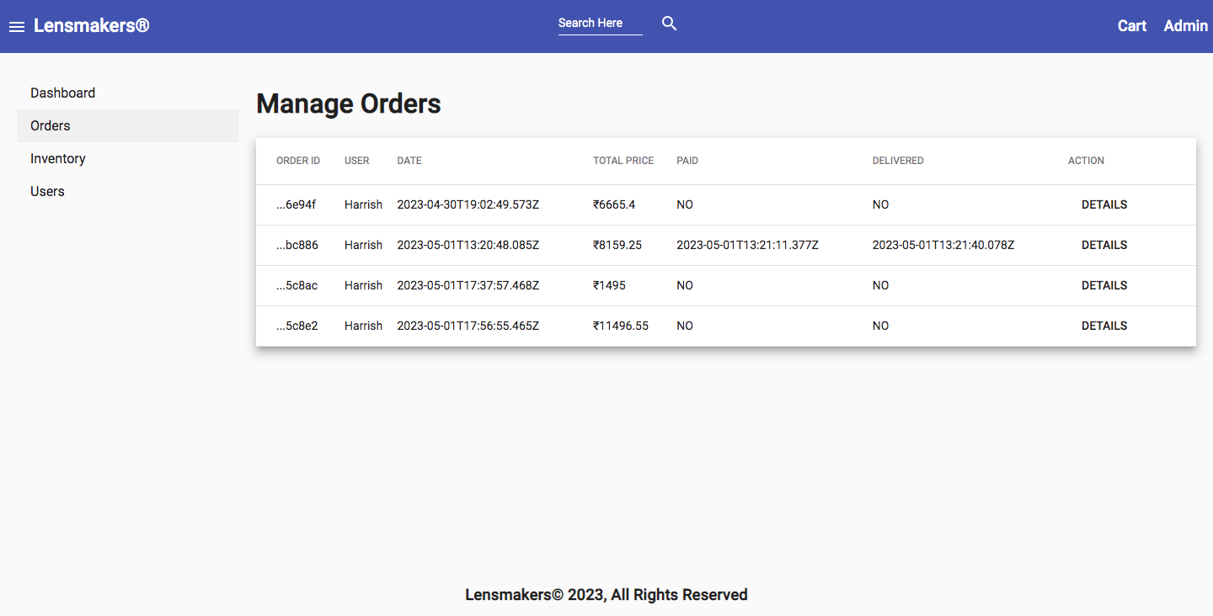
Mepco Schlenk Engineering College (Autonomous)
Figure 6.11: Manage Orders Page of Online Eyewear Store
Department of Computer Science and Engineering
45

Slide 46
Mepco Schlenk Engineering College (Autonomous)
Figure 6.11 provides the order management page of the website. The admin can see and manage all the order details through this page. The admin can also mark a parcel as delivered by clicking the details button which takes the admin to the order details page.
Department of Computer Science and Engineering
46

Slide 47
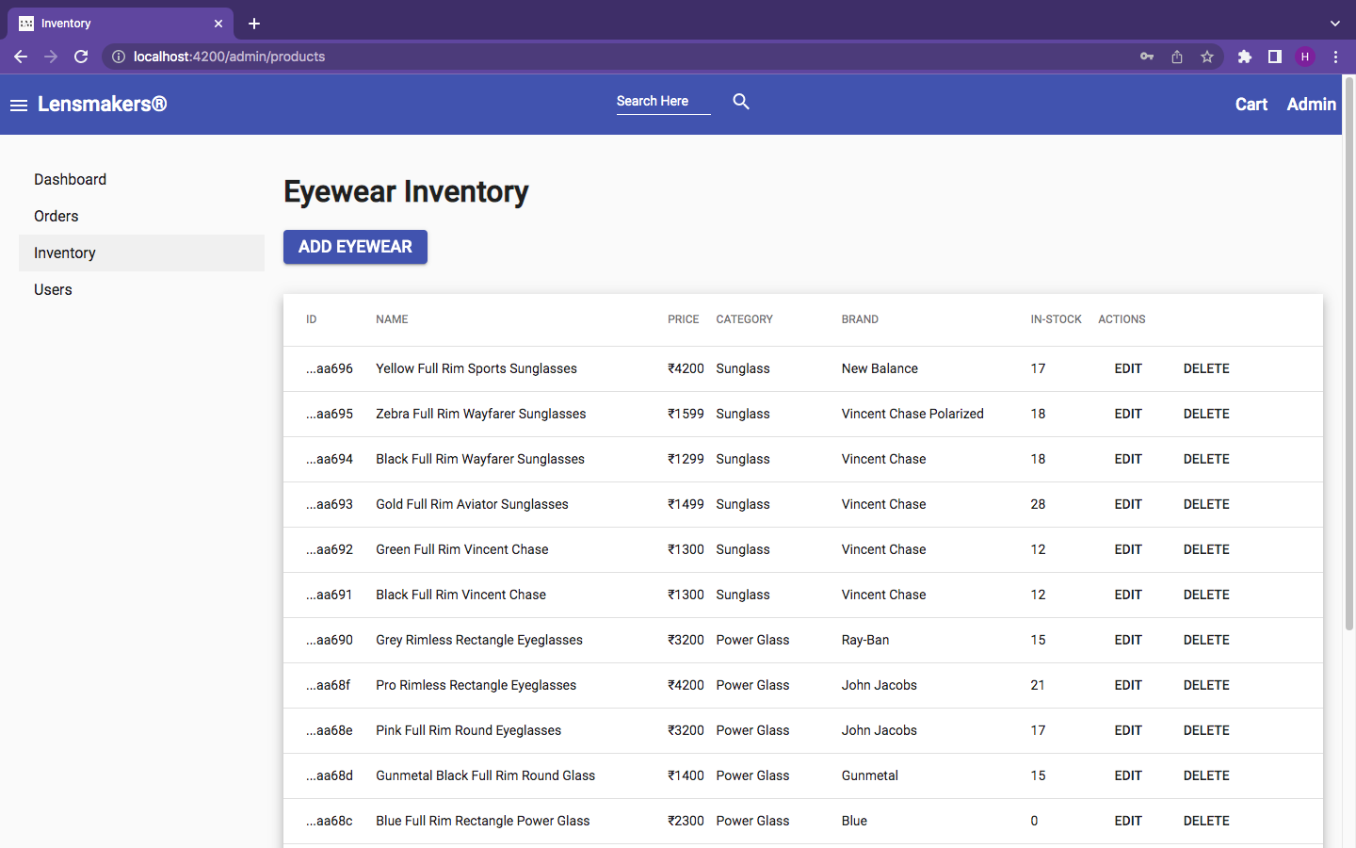
Mepco Schlenk Engineering College (Autonomous)
Figure 6.12: Eyewear Inventory Page of Online Eyewear Store
Department of Computer Science and Engineering
47

Slide 48
Mepco Schlenk Engineering College (Autonomous)
Figure 6.12 provides the eyewear inventory page of the website. It displays all the eyewear that are currently in the inventory of the eyewear store. The admin can add a new eyewear or modify or delete the existing eyewear details.
Department of Computer Science and Engineering
48

Slide 49
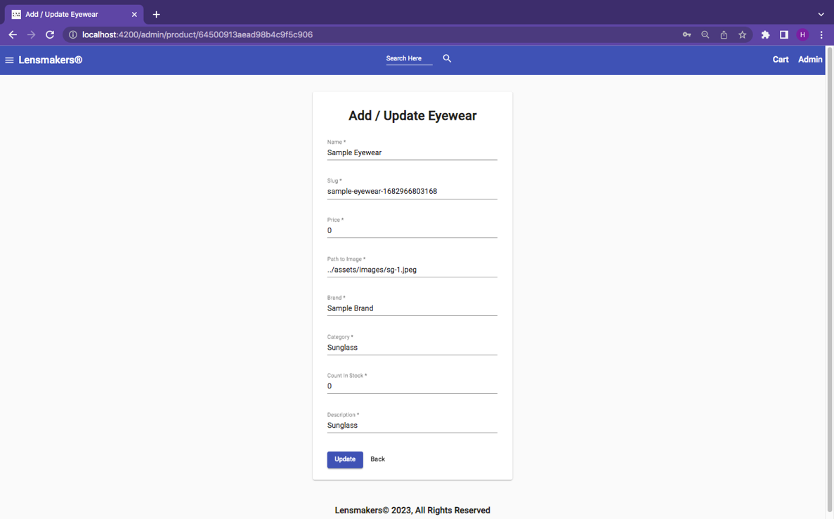
Mepco Schlenk Engineering College (Autonomous)
Figure 6.13: Add Eyewear Page of Online Eyewear Store
Department of Computer Science and Engineering
49

Slide 50
Mepco Schlenk Engineering College (Autonomous)
Figure 6.13 provides the add eyewear page of the website. The Admin can add a new eyewear to the inventory or update the details of an existing eyewear. Once a new eyewear is added or updated, the change is reflected immediately in the home page of the website.
Department of Computer Science and Engineering
50

Slide 51
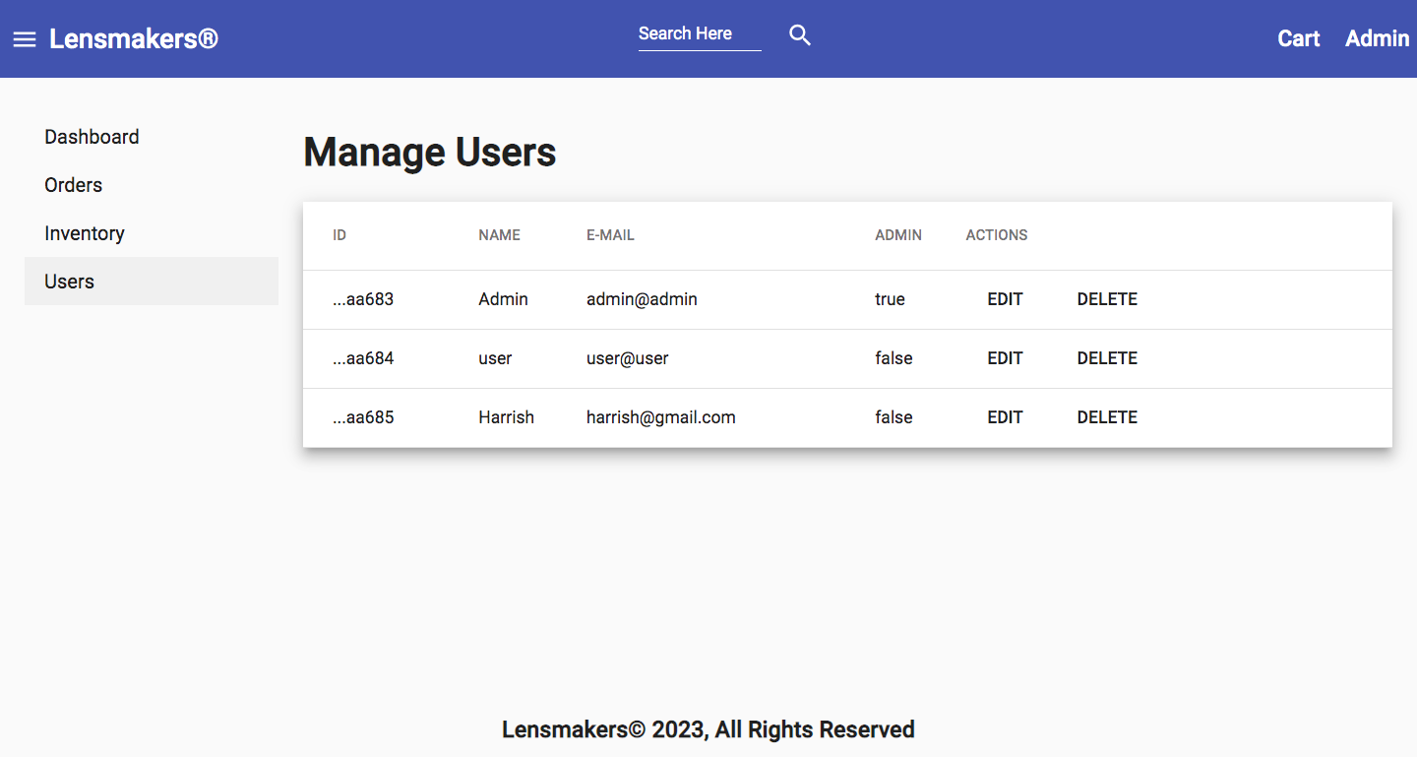
Mepco Schlenk Engineering College (Autonomous)
Figure 6.14: Manage Users Page of Online Eyewear Store
Department of Computer Science and Engineering
51

Slide 52
Mepco Schlenk Engineering College (Autonomous)
Figure 6.14 provides the manage users page of the website. The Admin can edit user details or delete user from the website. The admin can also make another user an Admin. That is, the admin can provide admin privileges to other users also.
Department of Computer Science and Engineering
52

Slide 53
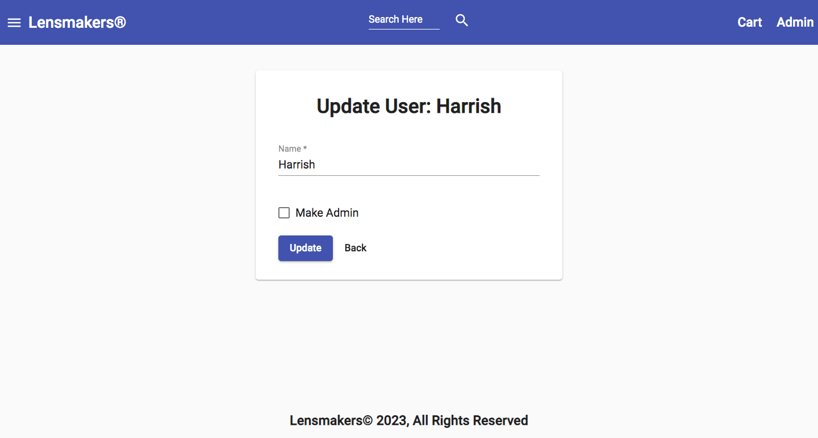
Mepco Schlenk Engineering College (Autonomous)
Figure 6.15: Update User Page of Online Eyewear Store
Department of Computer Science and Engineering
53

Slide 54
Mepco Schlenk Engineering College (Autonomous)
Figure 6.15 provides the update user page of the website. The admin can change the name of the user and can provide a user with Admin privileges.
Department of Computer Science and Engineering
54

Slide 55
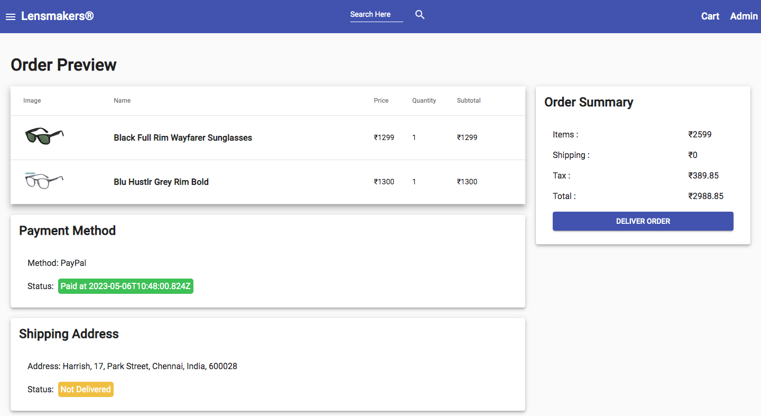
Mepco Schlenk Engineering College (Autonomous)
Figure 6.16: Deliver Order Page of Online Eyewear Store
Department of Computer Science and Engineering
55

Slide 56
Mepco Schlenk Engineering College (Autonomous)
Figure 6.16 provides the deliver order page of the website. Once the payment has been made successfully by the user, and the order has been delivered, the admin can mark the order as delivered in the website.
Department of Computer Science and Engineering
56

Slide 57
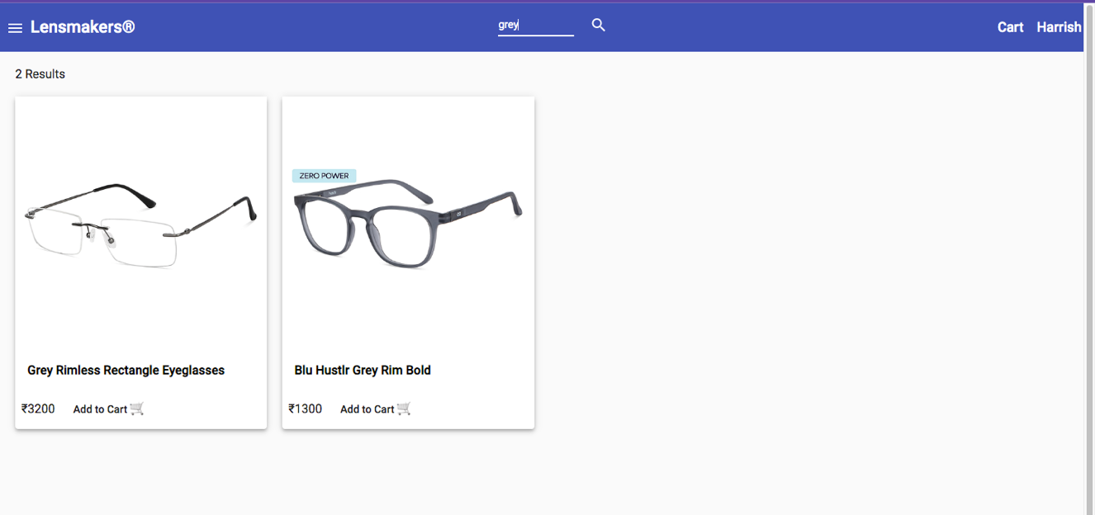
Mepco Schlenk Engineering College (Autonomous)
Figure 6.17: Search Page of Online Eyewear Store
Department of Computer Science and Engineering
57

Slide 58
Mepco Schlenk Engineering College (Autonomous)
Figure 6.17 provides the search eyewear page of the website. It enables the user to search for any particular eyewear based on the given eyewear name or a substring of the eyewear name.
Department of Computer Science and Engineering
58

Slide 59
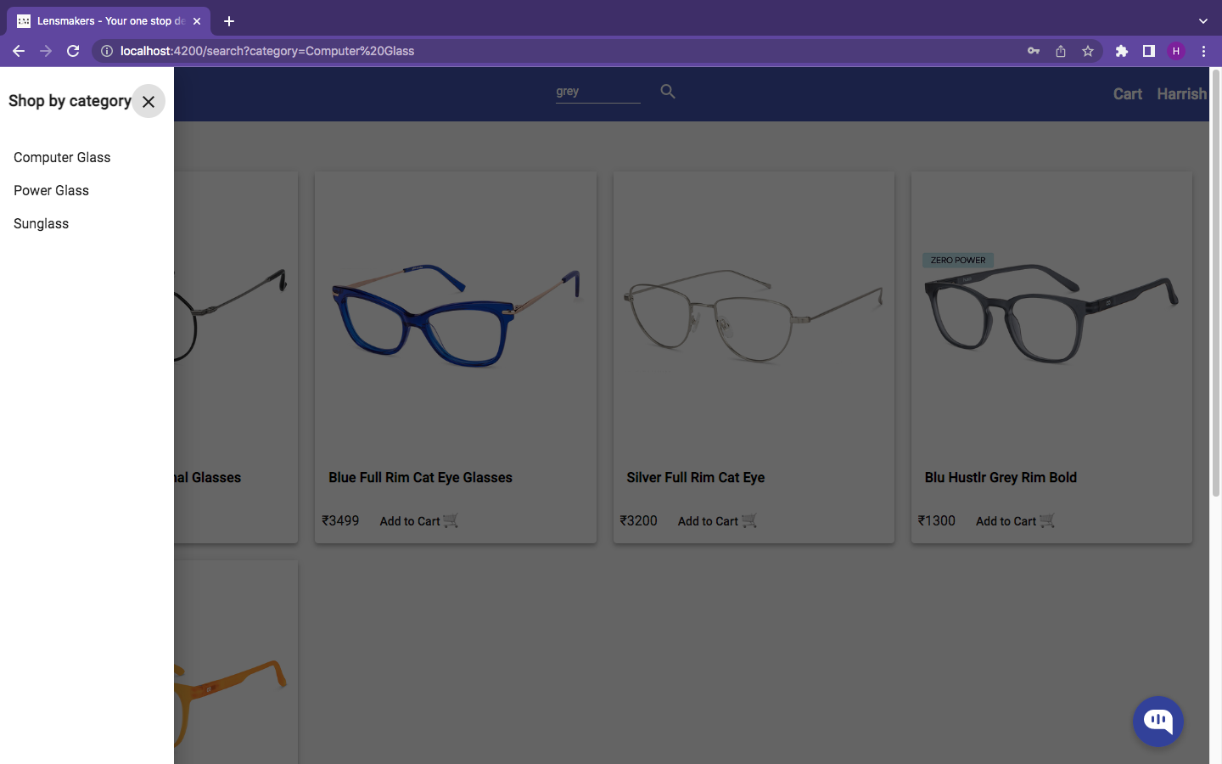
Mepco Schlenk Engineering College (Autonomous)
Figure 6.18: Search by Category Page of Online Eyewear Store
Department of Computer Science and Engineering
59

Slide 60
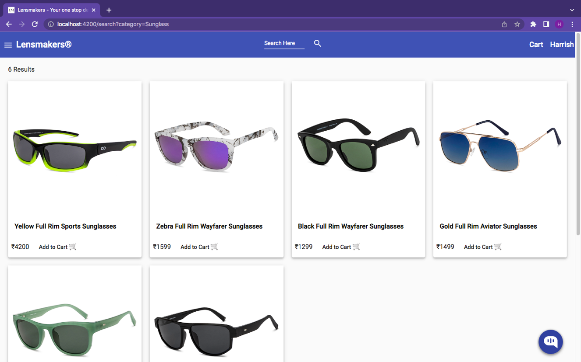
Mepco Schlenk Engineering College (Autonomous)
Figure 6.19: Category Filter Page of Online Eyewear Store
Department of Computer Science and Engineering
60

Slide 61
Mepco Schlenk Engineering College (Autonomous)
Figure 6.18 and Figure 6.19 provides the search by category page and category-based filter results of the website. It enables the user to filter eyewear based on a selected category such as Sunglasses or Computer Glasses.
Department of Computer Science and Engineering
61

Slide 62
Mepco Schlenk Engineering College (Autonomous)
Conclusion:
Based on the user interface screenshots presented, it can be concluded that the design of the online eyewear store's interface is visually appealing and user-friendly. The use of high-quality product images, clear typography, and a consistent color scheme creates a cohesive and professional look. The layout of the homepage effectively showcases the store's featured products, while the top navigation bar and search bar make it easy for users to find what they are looking for. The product category pages are well-organized and provide useful filtering options, allowing users to quickly narrow down their search.
The product pages themselves are well-designed, with detailed product descriptions and clear pricing information. The "Add to Cart" and "Check Out" buttons are prominently displayed, making it easy for users to complete their purchase. The shopping cart and checkout pages are also well-designed, with clear instructions and easy-to-fill forms. The use of a progress bar during checkout provides users with a clear understanding of the steps required to complete their purchase. Overall, the user interface screenshots demonstrate that the online eyewear store's interface is well-designed and user-friendly, creating a positive user experience.
Department of Computer Science and Engineering
62

Slide 63
Mepco Schlenk Engineering College (Autonomous)
THANK YOU!
Department of Computer Science and Engineering
63

